Slide 1
WUPR
SP₀
Pointer Update Logic
N₀
Request
R
Segment Pointer 3
Used Space
SP₁
r
Unused Space
Row Tracker
N₁
refresh
ToRefresh
SP₂
r
Select & Compare
SP₀
N₂
SP₁
SP₃
Dummy_refresh
dref
SP₂
SP₃
N₃
DRAM Row Space

Slide 2
3D DRAM Die
Mode Register
DRAM Bank
Memory Controller
WUPR
Command Bus
Dummy Refresh/AR
Refresh or not
Refresh
Management
Refresh
Counter
Update

Slide 3
ODT CTR
3D DRAM Die
ZQ CAL
Control Logic
Refresh Counter
Bank row-address Latch
DRAM Bank
Memory Array
Mode Register
Row Decoder
Read Driver
Row buffer
IO gating DM mask logic
Write driver
A[19:0]
Address Register
Column Address Latch
Column Decoder

Slide 4
ODT CTR
3D DRAM Die
ZQ CAL
Control Logic
Refresh Counter
Bank row-address Latch
DRAM Bank
Memory Array
CK,CK#
Mode Register
Row Decoder
1024
Read Driver
DQ[1023:0]
Row buffer
16
IO gating DM mask logic
1024
DQS,DQS#
1024
Write driver
A[19:0]
Address Register
4
Column Address Latch
4
Column Decoder

Slide 5
ODT CTR
3D DRAM Die
ZQ CAL
Control Logic
Refresh Counter
16
Row Address Mux
DRAM Bank
Memory Array
(65536x16x1024)
CK,CK#
Mode Register
65536
Read Driver
Row Decoder
1024
DQ[1023:0]
16
Row buffer
16
Bank Control Logic
65536
IO gating DM mask logic
1024
DQS,DQS#
16x1024
Write driver
Address Register
1024
A[19:0]
4
Column Address Latch
Column Decoder
4

Slide 6
ODT
ODT CTR
3D DRAM Die
ZQ
ZQ CAL
CKE
Control Logic
ZQCL,
ZQCS
RESET#
CK,CK#
CS#
Refresh Counter
Row Address Mux
DRAM Bank
Memory Array
(65536x16x1024)
CK,CK#
RAS#
16
CAS#
WE#
Read Driver
Mode Register
65536
Row Decoder
1024
DQ[1023:0]
16
Row buffer
16
Bank Control Logic
65536
IO gating DM mask logic
1024
DQS,DQS#
16x1024
Write driver
Address Register
1024
A[19:0]
4
Column Address Latch
Column Decoder
4

Slide 7
ODT
ODT CTR
3D DRAM Die
ZQ
ZQ CAL
CKE
Control Logic
ZQCL,ZQCS
RESET#
CK,CK#
OTF
CS#
Refresh Counter
Row Address Mux
DRAM Bank
Memory Array
(65536x16x1024)
CK,CK#
RAS#
16
CAS#
WE#
Row Decoder
Read Driver
Mode Register
65536
1024
DQ[1023:0]
16
Row buffer
16
Bank Control Logic
65536
IO gating DM mask logic
1024
DQS,DQS#
16x1024
Write Driver
Address Register
1024
A[19:0]
4
Column Address Latch
Column Decoder
4

Slide 8
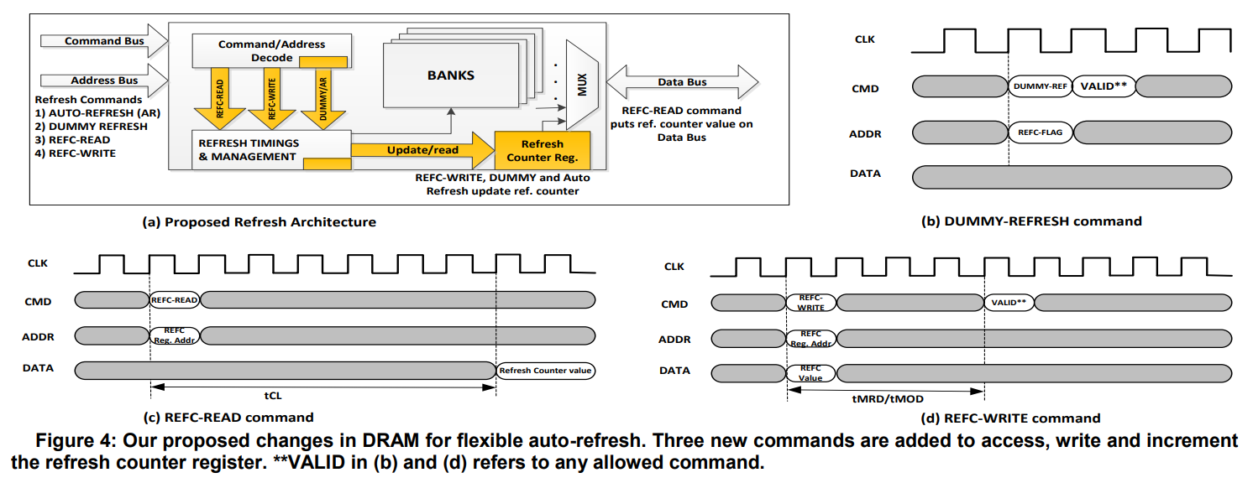

Slide 9
ODT
ODT CTR
3D DRAM Die
ZQ
ZQ CAL
CKE
Control Logic
ZQCL,ZQCS
RESET#
CK,CK#
OTF
CS#
Refresh Counter
Row Address Mux
DRAM Bank
Memory Array
(65536x16x1024)
CK,CK#
RAS#
16
CAS#
1
Add New Commands
WE#
Row Decoder
Read Driver
Mode Register
Update
Address
65536
1024
DQ[1023:0]
3
16
Row buffer
Allows Skipping Refresh
16
2
Bank Control Logic
65536
IO gating DM mask logic
1024
DQS,DQS#
16x1024
Write Driver
Address Register
1024
A[19:0]
4
Column Address Latch
Column Decoder
4

Slide 10
Function | Symbol | CKE |  | CS# | RAS# | CAS# | WE# | BA[2:0] | An | A12 | A10 | A[11:0]
 |  | Prev. Cycle | Next Cycle
Auto REFRESH | AREF | H | H | L | L | L | H | V | V | L | L | V
Dummy REFRESH | DREF | H | H | L | L | L | H | V | V | H | L | V
REFC WRITE | REFWR | H | H | L | L | L | H | V | V | H | H | V

Slide 11
WUPR
SP₀
Pointer Update Logic
N₀
Request
R
Ra
Segment Pointers
Used Space
SP₁
r
Unused Space
Row Tracker
N₁
refresh
ToRefresh
SP₂
r
Select & Compare
SP₀
N₂
SP₁
SP₃
dref
dref
SP₂
SP₃
N₃
DRAM Row Space

Slide 12
3D DRAM Bank
Mode Register
DRAM rows
Memory Controller
WUPR
Command Bus
Dummy Refresh/AR
Refresh or not
Refresh
Management
Refresh
Counter
Update

