Slide 1
Tree diagrams, absolute frequencies, and diagnostic testing
Corinne Riddell
September 30, 2019

Slide 2
Today’s agenda
Use absolute frequencies to calculate probabilities
Use tree diagrams to calculate probabilities
Apply these skills to diagnostic testing
Sensitivity, specificity, positive predictive value, negative predictive value, true positives, false positives, true negatives, and false negatives
Learn Bayes’ theorem

Slide 3
Unintended pregnancies
Approximately 9% of all births in the US are to teen mothers (aged 15-19), 24% to young-adult mothers (ages 20-24) and the remaining 67% to adult mothers (aged 25-44).
A survey found that only 23% of births to teen mothers are intended. Among births to young adult women, 50% are intended, and among women aged 25-44 75% are intended

Slide 4
Define events using probability notation
Express all the percents on the previous slide using probability notation.
Let M denote the age of the mother and B denote whether the birth was intended. Then we can define the events on the previous slides as:
P(M = teen) = 0.09
P(M = young adult) = 0.24
P(M = older adult) = 0.67
P(B = intended|M = teen) = 0.23
P(B = intended|M = young adult) = 0.5
P(B = intended|M = older adult) = 0.75

Slide 5
Question to answer
What is the probability that any given live birth in the U.S. is unintended?
Rewrite this question as a probability statement
We will cover two ways to answer this question:
Using absolute frequencies (not covered in the book)
Using tree diagrams

Slide 6
Method a: Absolute Frequencies
Pretend there are 1000 women. Given that 9%, 24%, and 67% of the mothers are teens, younger, and older mothers (respectively) this means that out of the 1000:
90 are teens
240 are younger mothers
670 are older mothers

Slide 7
Method a: Absolute Frequencies
Now, conditional on being a teen, 23% of the pregnancies are intended.
This means that 90x23% = 20.7 teen mothers had intended pregnancies.
We can calculate these joint probabilities for each age group:
90 are teens, 90x23% = 20.7 teens with intended pregnancies (and 69.3 teens with unintended pregnancies).
240 are younger mothers, 240 x50% = 120 younger mothers with intended pregnancies (and 120 younger mothers with intended pregnancies).
670 are older mothers, 670x75% = 502.5 older mothers with intended pregnancies (and 167.5 with unintended pregnancies).

Slide 8
Method a: Absolute Frequencies
Then, we can add on the number of unintended pregnancies across all the mothers:
69.3 + 120 + 167.5 = 356.8
The last step is to convert this back to a probability.
To do that, remember that there were 1000 women in the population. So 356.8/1000 = 35.7%
Conclusion: The chance that a live birth in the US is unintended is 35.7%.

Slide 9
Method b: Tree diagram
Rather than using absolute frequencies, you might prefer to draw this information using a tree diagram
These diagrams are helpful when you know information about conditional probabilities and when the events of interest have more than two states (which is when Venn diagrams are used)

Slide 10
Method b: Tree diagram
Event B
P(M and B)
P(B|M)
Event M
0.0207
0.23
intended
P(M)
teen
0.77
unintended
0.0693
0.09
0.50
intended
0.12
0.24
younger
adult
0.50
unintended
0.12
0.67
0.75
intended
0.5025
older
adult
0.25
unintended
0.1675

Slide 11
Method b: Tree diagram
Event B
P(M and B)
P(B|M)
Event M
0.0207
0.23
intended
P(M)
teen
0.77
unintended
0.0693
0.09
0.50
intended
0.12
0.24
younger
adult
0.50
unintended
0.12
0.67
0.75
intended
0.5025
older
adult
0.25
unintended
0.1675
P(B=unintended) = 0.0693 + 0.12 + 0.1675 = 35.7%

Slide 12
Diagnostic Testing

Slide 13
Recall the question I asked a few days ago…
Suppose that there is test for a specific type of cancer that has a 90% chance of testing positive for cancer if the individual truly has cancer and a 90% chance of testing negative for cancer when the individual does not have it.
1% of patients in the population have the cancer being tested for.
What is the chance that a patient has cancer given that they test positive?
a) Between 0% - 24.9%
b) Between 25.0% - 49.9%
c) Between 50.0% - 74.9%
d) Between 75.0% - 100%

Slide 14
Rewrite this information using prob. notation
Let C be the true cancer status. C = cancer for individuals who truly have cancer and C = no cancer for individuals who truly do not have cancer.
Let T be the test result. T = + for individuals who test positively for cancer and T = - for individuals who test negative for cancer. Then:
P(C=cancer)=0.01
P(Test = positive|C=cancer) = 0.90
P(Test = negative|C=no cancer) = 0.90
The question is “What is the chance that a patient has cancer given that they test positive”. Rewrite the question using this probability notation.
Notes:
Answer: P(C = cancer| Test = positive) = ?

Slide 15
Diagnostic testing definitions
Sensitivity: The test’s ability to appropriately give a positive result when a person tested has the disease, or P(T = +|C=cancer)
Specificity: The test’s ability to appropriately give a negative result when a person tested does not have the disease, or P(test = -|C= no cancer)

Slide 16
Diagnostic testing definitions
Positive predictive value: The chance that a person truly has cancer, given that the test is positive, or P(C=cancer|T=+)
Negative predictive value: The chance that a person truly does not have cancer, given that the test is negative, or P(C=no cancer|T=-)

Slide 17
Back to the question
Going back to the question… The question provided us information on the test’s sensitivity and specificity as well as the prevalence of cancer in the underlying population
The question asks us for the test’s positive predictive value.
We can use absolute frequencies or a tree diagram to answer the question.

Slide 18
Absolute frequency approach
Suppose that there are 1000 women in the population
Translate the probabilities provided into absolute frequencies:
1% truly have cancer → 10 women truly have cancer, 990 women do not.
90% sensitivity → Among the 10 who truly have cancer, 9 women will test positive and 1 will test negative.
90% specificity → Among the 990 who do not have cancer, 891 will test negative, and 99 will test positive.
So, we have 9 + 99 = 108 women detected with cancer
Of these 108 women, only 9 truly have cancer. Thus, 9/108 = 8.3% of those detected for cancer actually have it.

Slide 19
Method b: Tree diagram
Event B
P(C and T)
P(T|C)
Event C
0.009
0.90
positive
P(C)
cancer
0.10
negative
0.001
0.01
0.99
0.10
positive
0.099
no cancer
0.90
negative
0.891

Slide 20
Method b: Tree diagram
Event B
P(C and T)
P(T|C)
Event C
True Positive (TP)
positive
0.009
0.90
P(C)
cancer
negative
False negative (FN)
0.10
0.001
0.01
False positive (FP)
positive
0.099
0.10
no
cancer
0.99
negative
0.891
True negative (TN)
0.90
P(C=cancer|T=+) = P(cancer & test positive)/P(test positive)
= P(cancer & test positive)/[P(test positive & cancer) + P(test positive & no cancer)]
= P(true positive)/[P(true positive) + P(false positive)]
= 0.009/(0.009 + 0.099) = 8.3%

Slide 21
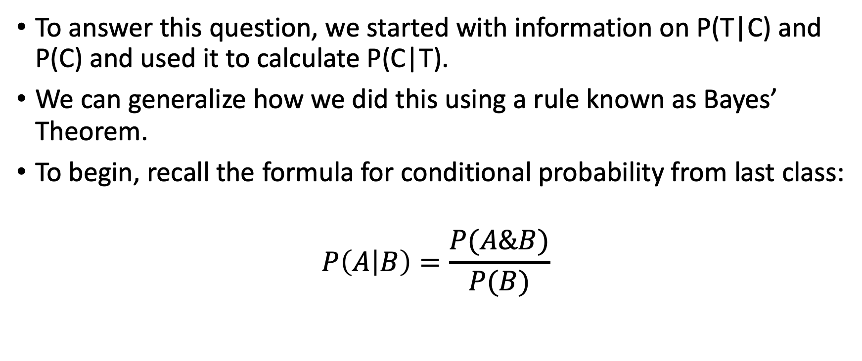
Bayes’ Theorem
To answer this question, we started with information on P(T|C) and P(C) and used it to calculate P(C|T).
We can generalize how we did this using a rule known as Bayes’ Theorem.
To begin, recall the formula for conditional probability from last class:
$$P\left(A | B\right)=\frac{P(A\&B)}{P(B)}$$

Slide 22
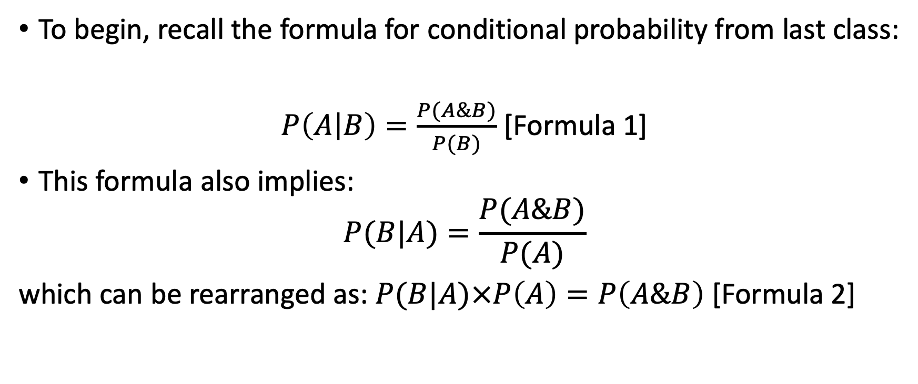
Bayes’ Theorem
To begin, recall the formula for conditional probability from last class:
$P\left(A | B\right)=\frac{P(A\&B)}{P(B)}$ [Formula 1]
This formula also implies:
$$P(B|A)=\frac{P(A\&B)}{P(A)}$$
which can be rearranged as: $P(B|A)×P\left(A\right)=P\left(A\&B\right)$ [Formula 2]

Slide 23
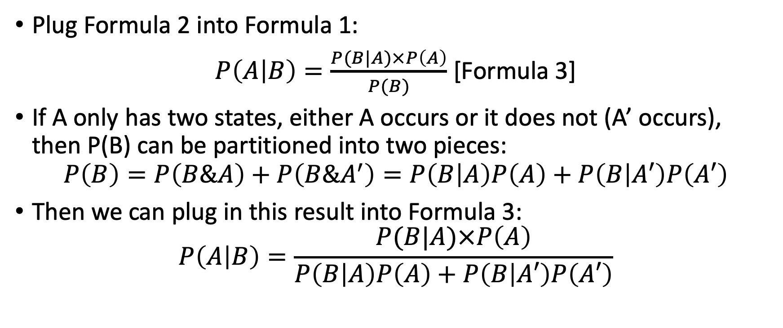
Bayes’ Theorem
Plug Formula 2 into Formula 1:
$P\left(A | B\right)=\frac{P(B|A)×P\left(A\right)}{P(B)}$ [Formula 3]
If A only has two states, either A occurs or it does not (A’ occurs), then P(B) can be partitioned into two pieces:
$$P\left(B\right)=P\left(B\&A\right)+P\left(B\&A^{′}\right)=P\left(B | A\right)P\left(A\right)+P\left(B | A′\right)P\left(A′\right)$$
Then we can plug in this result into Formula 3:
$$P\left(A | B\right)=\frac{P(B|A)×P\left(A\right)}{P\left(B | A\right)P\left(A\right)+P\left(B | A′\right)P\left(A′\right)}$$

Slide 24
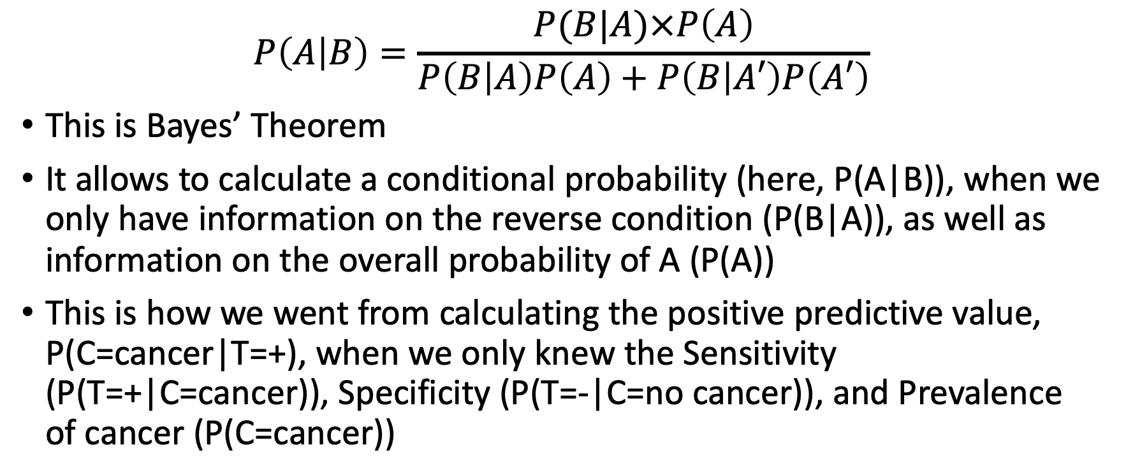
Bayes’ Theorem
$$P\left(A | B\right)=\frac{P(B|A)×P\left(A\right)}{P\left(B | A\right)P\left(A\right)+P\left(B | A′\right)P\left(A′\right)}$$
This is Bayes’ Theorem
It allows to calculate a conditional probability (here, P(A|B)), when we only have information on the reverse condition (P(B|A)), as well as information on the overall probability of A (P(A))
This is how we went from calculating the positive predictive value, P(C=cancer|T=+), when we only knew the Sensitivity (P(T=+|C=cancer)), Specificity (P(T=-|C=no cancer)), and Prevalence of cancer (P(C=cancer))

Slide 25
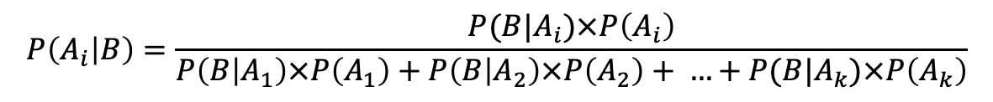
Bayes’ Theorem, Generalized
Rather than only having A and A', suppose that A could take the values 1, 2, 3, and so on through A=k, where each of these states are disjoint and there probabilities are non-zero and add to 1.
Then for B whose probability is not 0 or 1,
Don’t worry too much about understanding this formula
Rather, focus on practicing the calculations for diagnostic testing like the one shown on the previous slide.
You can watch this video (6 mins) to see how Bayes’ Theorem is using in AI today.
$$P\left(A_{i} | B\right)=\frac{P(B|A_{i})×P\left(A_{i}\right)}{P\left(B | A_{1}\right)×P\left(A_{1}\right)+P\left(B | A_{2}\right)×P\left(A_{2}\right)+ …+P(B|A_{k})×P\left(A_{k}\right)}$$

Slide 26
Recap
Absolute frequencies or tree diagrams
Use the method you like best to solve for probabilities
Or, use a Venn diagram. Apply the method that makes the most sense to you and suits the question.
Diagnostic testing
Key lesson: Just because Sensitivity and Specificity are high, this does not imply that the Positive predictive value is also high. In lab, you will explore why this is the case
Bayes’ Theorem
We used it without event knowing it!
Don’t worry about the formula, just know how to solve for probabilities using the method that you understand best.

