Slide 1
Using Venn diagrams to calculate probability of joint events
Corinne Riddell
September 25, 2020

Slide 2
Learning objectives for today
How to make a Venn diagram
How to use a Venn diagram to compute probabilities
Determine whether two events are independent or dependent
Conditional probability
General addition rule for probability
General multiplication rule for probability

Slide 3
A basic Venn diagram
Entire sample space S
Event B
Event A

Slide 4
A basic Venn diagram
Entire sample space S
Suppose you had access to survey data about vaping and JUUL-related advertisements.
You could define the following random variables:
J is the event “seen ad for JUUL”
V is the event “vaped in the last 30 days”
V
J

Slide 5
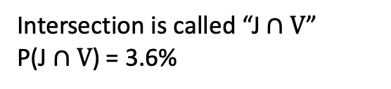

A basic Venn diagram
Entire sample space S
You could also add the percentages you know from the survey data onto the Venn diagram.
Event B. P(V) = 11%
Event A. P(J) = 18%
Intersection is called “J$∩V$”
P(J$∩V$) = 3.6%
Think: $∩$ stands for Intersection

Slide 6
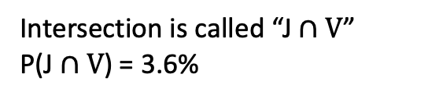
Using a Venn diagram to calculate a probability
What percent of individuals saw an ad for JUUL and do not vape?
Event B. P(V) = 11%
Event A. P(J) = 18%
Intersection is called “J$∩V$”
P(J$∩V$) = 3.6%

Slide 7
Using a Venn diagram to calculate a probability
What percent of individuals saw an ad for JUUL and do not vape?
This percent is represented by this area:
Event B. P(V) = 11%
Event A. P(J) = 18%
Intersection is called “J$∩V$”
P(J$∩V$) = 3.6%

Slide 8
Using a Venn diagram to calculate a probability
What percent of individuals saw an ad for JUUL and do not vape?
Write this question as a probability statement
Calculate the percentage
Event B. P(V) = 11%
Event A. P(J) = 18%
Intersection is called “J$∩V$”
P(J$∩V$) = 3.6%

Slide 9
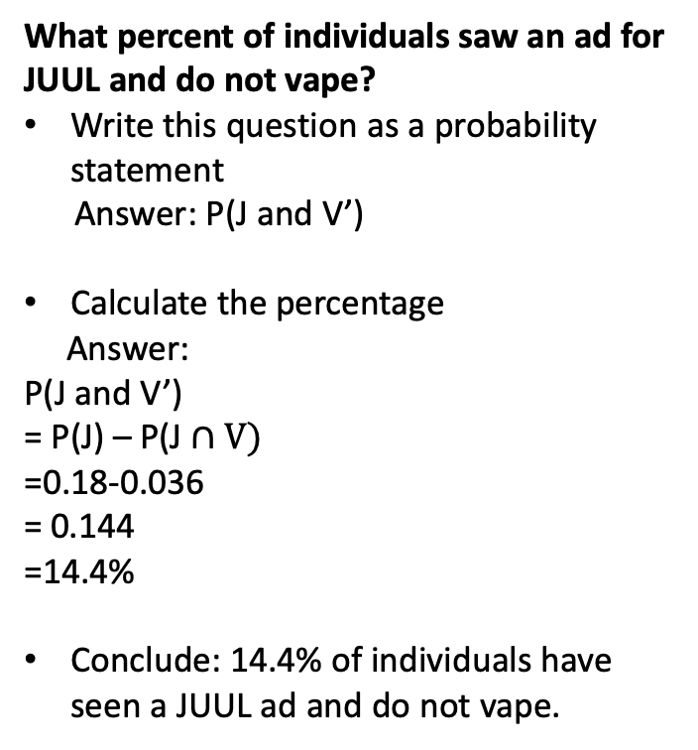
Using a Venn diagram to calculate a probability
What percent of individuals saw an ad for JUUL and do not vape?
Write this question as a probability statement
Answer: P(J and V’)
Calculate the percentage
Answer:
P(J and V’)
= P(J) – P(J$∩V)$
=0.18-0.036
= 0.144
=14.4%
Conclude: 14.4% of individuals have seen a JUUL ad and do not vape.
Event B. P(V) = 11%
Event A. P(J) = 18%
Intersection is called “J$∩V$”
P(J$∩V$) = 3.6%

Slide 10
Using a Venn diagram to calculate a probability
Your turn: What percent of individuals vape but have not seen an ad for JUUL?
Event B. P(V) = 11%
Event A. P(J) = 18%
Intersection is called “J$∩V$”
P(J$∩V$) = 3.6%

Slide 11
Using a Venn diagram to calculate a probability
Your turn: What percent of individuals vape but have not seen an ad for JUUL?
Event B. P(V) = 11%
Event A. P(J) = 18%
Intersection is called “J$∩V$”
P(J$∩V$) = 3.6%

Slide 12
Using a Venn diagram to calculate a probability
Your turn: What percent of individuals vape but have not seen an ad for JUUL?
Write this question as a probability statement
Calculate the percentage
Your answer:
Event B. P(V) = 11%
Event A. P(J) = 18%
Intersection is called “J$∩V$”
P(J$∩V$) = 3.6%

Slide 13

Generalized rule of addition
What percent of individuals have seen an ad for JUUL and vape?
The “and” represents the intersection, the area where both events have occurred:
P(J$∩V$) = 3.6%
3.6% of individuals have seen an ad for JUUL and have vaped in past 30 days
Event B. P(V) = 11%
Event A. P(J) = 18%
Intersection is called “J$∩V$”
P(J$∩V$) = 3.6%

Slide 14

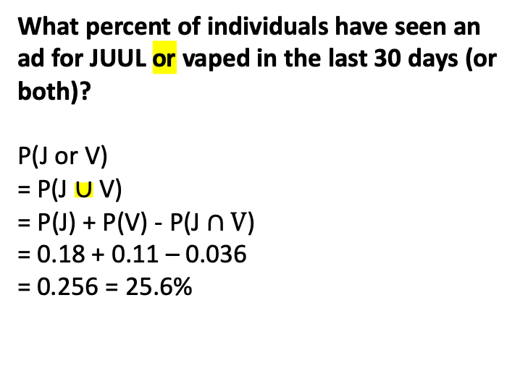
Generalized rule of addition
What percent of individuals have seen an ad for JUUL or vaped in the last 30 days (or both)?
P(J or V)
= P(J $∪$ V)
= P(J) + P(V) - P(J$∩V$)
= 0.18 + 0.11 – 0.036
= 0.256 = 25.6%
Event B. P(V) = 11%
Event A. P(J) = 18%
Think:$∪$ stands for Union
This is the generalized rule for addition. You need to subtract off the probability of the intersection so you do not double count the probability when two events are not disjoint!
Intersection is called “J$∩V$”
P(J$∩V$) = 3.6%

Slide 15
Conditional Probability
Among individuals who have seen an ad for JUUL, what percent vaped in the past month?
This is a conditional probability question
You can tell because of the way the question is phrased: “Among individuals..”, that is, this probability is conditional on the event “seeing an ad for JUUL”
We write conditional probabilities like this: P(V|J) and read this “Probability of V (occurring) given J (has occurred)"
Event B. P(V) = 11%
Event A. P(J) = 18%
Intersection is called “J$∩V$”
P(J$∩V$) = 3.6%

Slide 16
Conditional Probability
Among individuals who have seen an ad for JUUL, what percent vaped in the past month?
P(V|J) = P(V and J)/P(J)
= 0.036/0.18
= 0.2
= 20%
20% of individuals who have seen an ad for JUUL vaped in the last 30 days.
How does this 20% compare with the percent of individuals who vape among those who have not seen an ad for JUUL?
Event B. P(V) = 11%
Event A. P(J) = 18%
Intersection is called “J$∩V$”
P(J$∩V$) = 3.6%

Slide 17
Conditional Probability
Among individuals who have not seen an ad for JUUL, what percent vaped in the past month?
P(V|J’)
= P(V and J’)/P(J’)
What is P(J’)?
= 1 – 0.18 = 0.82
What is P(V and J’)?
= 0.11 – 0.036
= 0.074
So:
P(V|J’)
= P(V and J’)/P(J’)
= 0.074/0.82
= 0.0902439 … = 9.02%
Event B. P(V) = 11%
Event A. P(J) = 18%
Intersection is called “J$∩V$”
P(J$∩V$) = 3.6%

Slide 18
Conditional Probability
Among individuals who have not seen an ad for JUUL, what percent vaped in the past month?
P(V|J’)
= P(V and J’)/P(J’)
What is P(J’)?
= 1 – 0.18 = 0.82
What is P(V and J’)?
= 0.11 – 0.036
= 0.074
So:
P(V|J’)
= P(V and J’)/P(J’)
= 0.074/0.82
= 0.0902439 … = 9.02%
Event B. P(V) = 11%
Event A. P(J) = 18%
From the last two slides: 9% of individuals who did not see an ad for JUUL vaped in the last month vs. 20% among those who did see an ad.
This could be the beginning of providing evidence that JUUL marketing affects the chance that an individual will vape.
Intersection is called “J$∩V$”
P(J$∩V$) = 3.6%

Slide 19
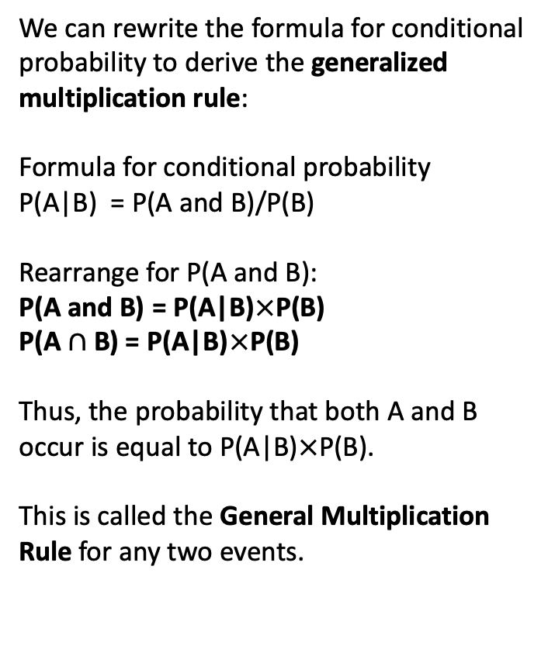
Conditional Probability and the Generalized Multiplication Rule
We can rewrite the formula for conditional probability to derive the generalized multiplication rule:
Formula for conditional probability
P(A|B) = P(A and B)/P(B)
Rearrange for P(A and B):
P(A and B) = P(A|B)$×$P(B)
P(A $∩$ B) = P(A|B)$×$P(B)
Thus, the probability that both A and B occur is equal to P(A|B)$×$P(B).
This is called the General Multiplication Rule for any two events.
Event B. P(V) = 11%
Event A. P(J) = 18%
Intersection is called “J$∩V$”
P(J$∩V$) = 3.6%

Slide 20
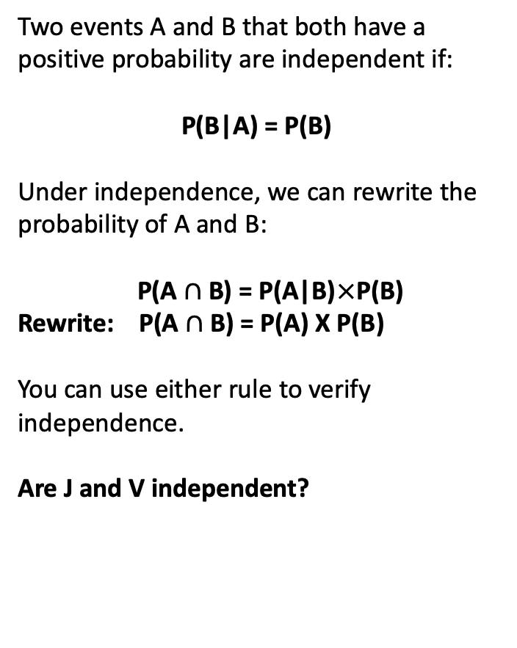
Independence
Two events A and B that both have a positive probability are independent if:
P(B|A) = P(B)
Under independence, we can rewrite the probability of A and B:
P(A $∩$ B) = P(A|B)$×$P(B)
Rewrite: P(A $∩$ B) = P(A) X P(B)
You can use either rule to verify independence.
Are J and V independent?
Event B. P(V) = 11%
Event A. P(J) = 18%
Intersection is called “J$∩V$”
P(J$∩V$) = 3.6%

Slide 21
Examine independence using rule #1
If two events are independent then the following statement is true:
P(B|A) = P(B)
Are J and V independent?
We know that P(V) = 11%
From earlier questions, we also know that P(V|J) = 20%
Thus, P(V|J) does not equal P(V), so these events are not independent.
Event B. P(V) = 11%
Event A. P(J) = 18%
Intersection is called “J$∩V$”
P(J$∩V$) = 3.6%

Slide 22
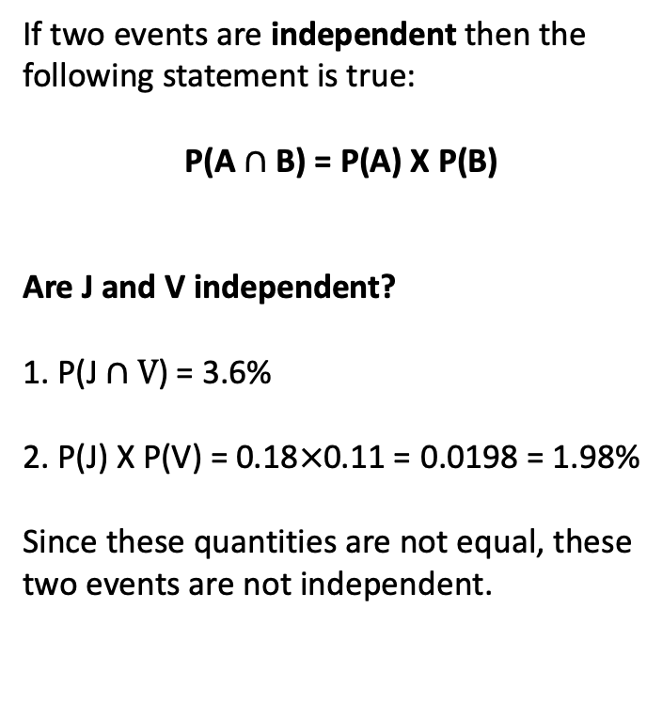
Examine independence using rule #2
If two events are independent then the following statement is true:
P(A $∩$ B) = P(A) X P(B)
Are J and V independent?
1. P(J$∩V$) = 3.6%
2. P(J) X P(V) = 0.18$×$0.11 = 0.0198 = 1.98%
Since these quantities are not equal, these two events are not independent.
Event B. P(V) = 11%
Event A. P(J) = 18%
Intersection is called “J$∩V$”
P(J$∩V$) = 3.6%

Slide 23
Additional slides on independence

Slide 24
Independence
What sorts of events are independent? Two events are independent if knowing that one event occurred does not change the probability that the other occurred

Slide 25
Example 1a
Down syndrome is a genetic disorder caused when abnormal cell division results in an extra full or partial copy of chromosome 21.¹
The largest risk factor for having a child with Down syndrome is advanced maternal age.¹
Suppose that Martha is 40 and her baby has been diagnosed with Down syndrome. Martha’s best friend Jane, also 40, is hoping to conceive. Is her baby’s risk of Down syndrome independent of Martha’s baby’s risk?
Reference: https://www.mayoclinic.org/diseases-conditions/down-syndrome/symptoms-causes/syc-20355977

Slide 26
Example 1b
The risk of having a baby with Down syndrome is 1/100 among 40 year olds. Suppose that Jenny and Samantha are two 40-year old women. What is the probability that they both have babies with Down syndrome?

Slide 27
Example 2a
Breast Cancer is the most common cancer diagnosed in women in the US.
If a woman’s mother, sister, or daughter was diagnosed with breast cancer, her estimated risk of breast cancer is doubled (compared to a woman whose mother/sister/daughter has not been diagnosed).¹
Jacqueline was diagnosed with breast cancer. Is her daughter’s chance of developing breast cancer independent or dependent on Jacqueline’s diagnosis?
Reference. https://www.mayoclinic.org/diseases-conditions/breast-cancer/symptoms-causes/syc-20352470

Slide 28
Example 2b
A white woman aged 40 who had her first period at age 12 and first child at age 27. Her mother had Breast Cancer. Given this information, she has an estimated 5-year risk of breast cancer of 1.1% and lifetime risk of breast cancer of 18.8%.
Had the woman’s mother not had breast cancer, here 1-year risk would have been 0.6% and lifetime risk 11.1%. Based on these risk estimates, are the events “mother has breast cancer” and “daughter has breast cancer” independent? Why?
(See here to calculate breast cancer risk under a variety of settings. For the above risk estimates I set the variables as specified and selected “Unknown” for having the BRCA1/2 gene, and ever having a breast biopsy. I selected “No” for every having a medical history of any breast cancer.)

