Slide 1
PH 142: Review of Part III
December 3rd, 2023
Instructor: Tomer Altman

Slide 2
Course Evaluation Assignment!
Screenshot and submitted to Gradescope
Due Dec 5th at 11:59 PM
This assignment contributes 5% to your participation grade
This is NOT extra credit. You will lower your grade if you skip this!
See pinned message on Ed for more details

Slide 3
Part III of the course
Heavily focused on conducting hypothesis tests and calculating confidence intervals
We covered many tests one by one. Your task is to be able to know which test applies when you read a question.

Slide 4
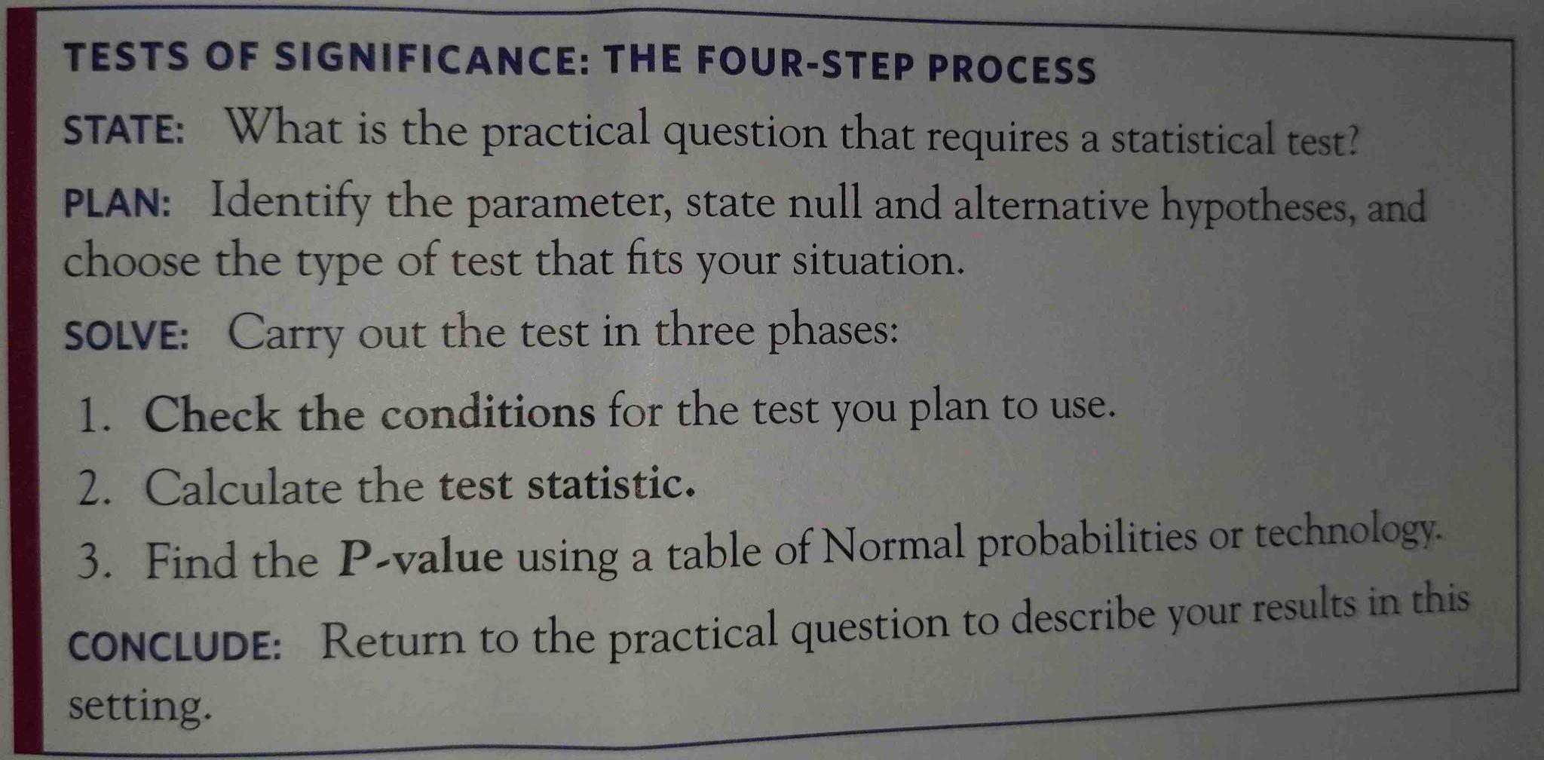
Hypothesis testing: four steps
Baldi & Moore

Slide 5
Parts of a hypothesis test
What are the assumptions?
State the null and alternative hypotheses. Are they one or two-sided?
Calculate the test statistic
Calculate the p-value (or write/identify the code to do so)
Interpret the p-value with respect to consistency with the null hypothesis

Slide 6
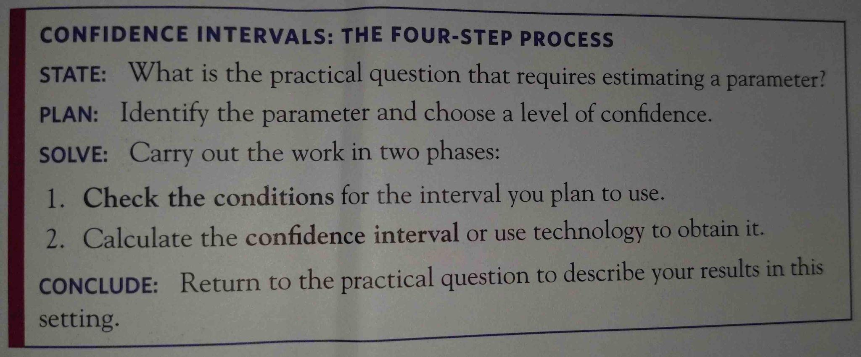
Confidence Intervals: Four Steps
Baldi & Moore

Slide 7
Confidence interval analysis
Form: estimate +/- (critical value x standard error)
Estimate is what you calculate from your data
  The sample mean
  The sample proportion
  The difference in means (or proportions)
The critical value is found using one of the R `q` functions like `qnorm()` or `qt()`. You are asking R for the value such that 95% (or 99%, say) of the area of the distribution is between +/- that value.
The standard error is calculated using a formula, such as s/sqrt(n). The standard error decreases as the sample size n increases
No parametric formula for the sampling distribution of an estimator? No problem, just use the Bootstrap!

Slide 8
Meta Questions:
What to ask yourself when you read a question
What type of data is represented?
  Quantitative
    Discrete
    Continuous
  Categorical
    Binary
    Categorical with >2 levels
      Ordinal
      Nominal
How many samples are there?
  One sample
  Two samples
  > Two samples
How many relevant variables are there in the data to test?
What is the problem really asking for?

Slide 9
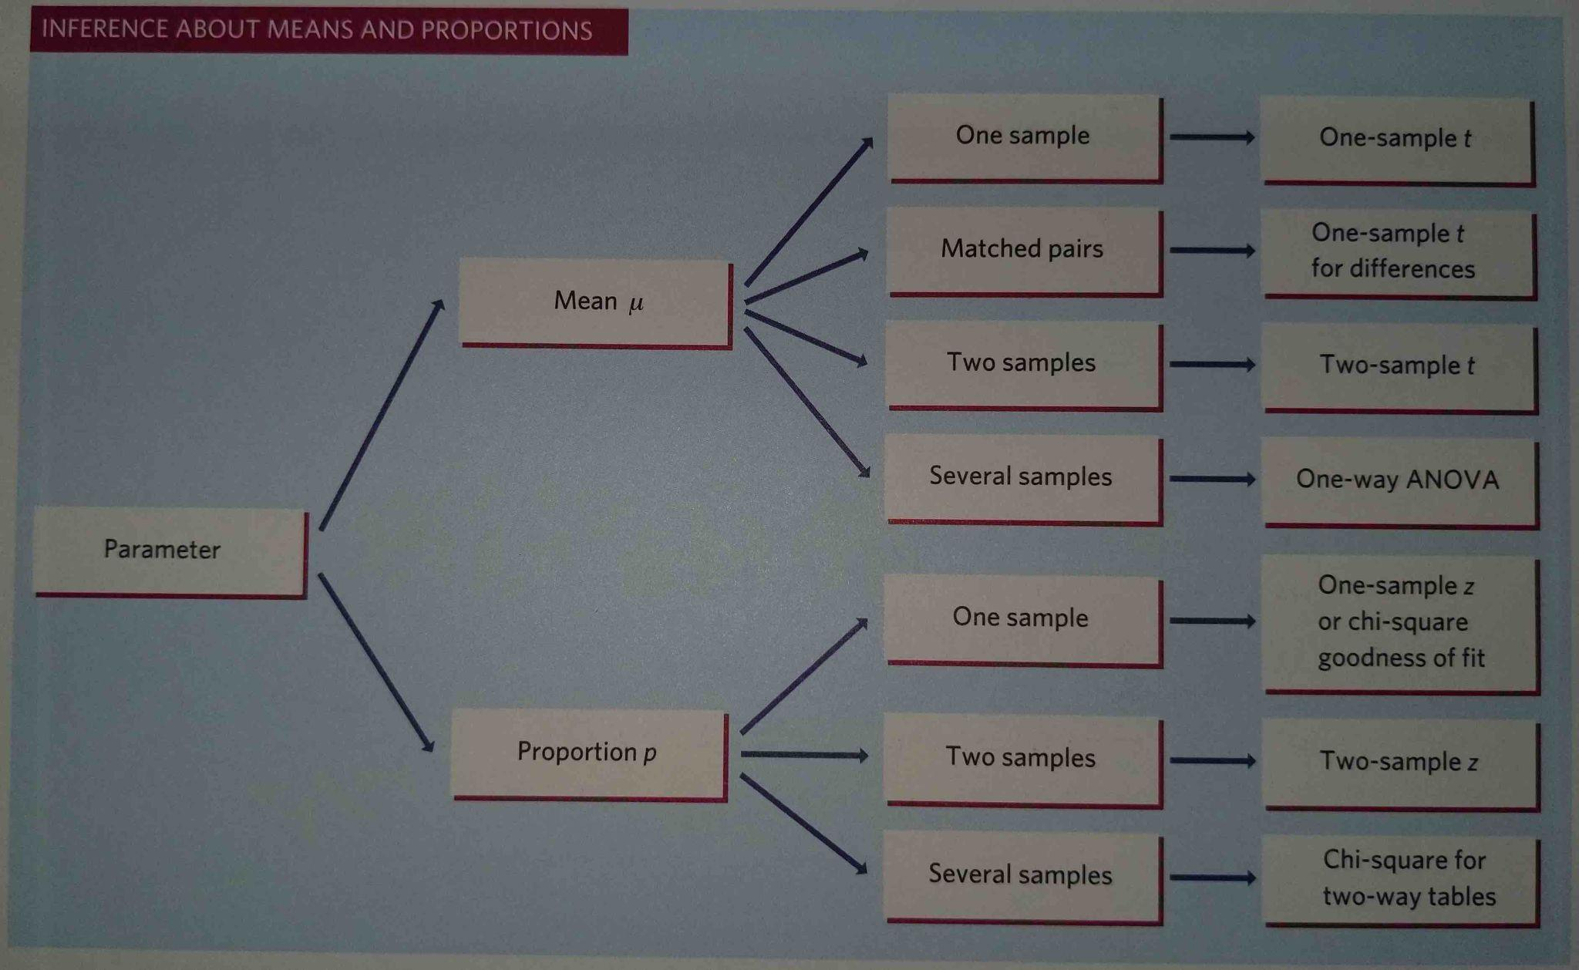
Single Variable Methods
Baldi & Moore

Slide 10
If you have continuous data, single variable:
How many samples?
One sample
Two samples
>2 samples
Known population SD
Unknown population SD
Paired data
Unpaired data/independent samples
One sample z-test for a population mean (Ch 17)
One sample t-test for a population mean (Ch 17)
Matched pairs t-test (Ch 17)
Independent two-sample t-test (Ch 18)
ANOVA (Ch 24)
Non-parametric alternative
Wilcoxon sign-rank test
Non-parametric alternative
Kruskal Wallis test
Permutation (not covered)
Non-parametric alternative
Wilcoxon Rank-Sum test
Permutation tests

Slide 11
If you have binary data, single variable:
How many samples?
One sample
Two samples
>2 samples
equivalent
One sample z-test for a proportion (Ch 19)
Chi-square test for independence(Ch 22)
Two sample z-test for proportions (Ch 20)
Chi-square test for independence (Ch 22)
Four CI methods:
Large sample
Plus four
Clopper Pearson/Exact
Wilson Score
Two CI methods:
Large sample
Plus four

Slide 12
If you have categorical data (>2 levels), single variable:
Counts/percentages for one categorical variable
Chi-square test for goodness of fit (Ch 21)

Slide 13
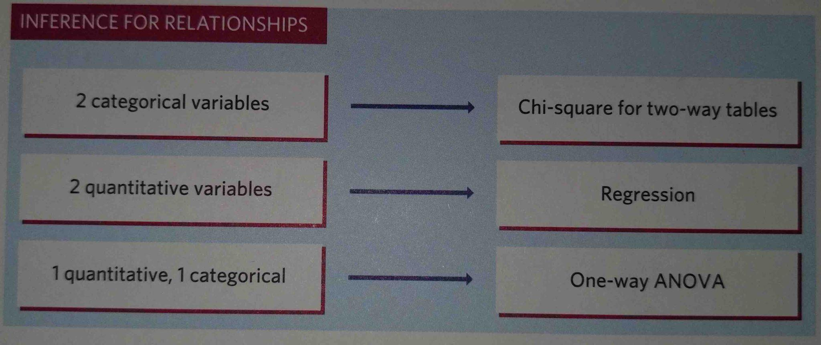
Two Variable Methods
Baldi & Moore

Slide 14
What if you have two variables?
Two continuous variables
Counts/percentages for contingency table of two categorical variables
One categorical variable and one continuous variable
Inference for Regression
(Ch 23)
Chi-square test for independence (Ch 22)
ANOVA
(Ch 24)
Regression with categorical x variable
(no Chapter)
Non-parametric alternative
Permutation test

Slide 15
Two variable analysis table
 |  | Explanatory Variable
 |  | Quantitative | Categorical
Response Variable | Quantitative | Regression | One-Way ANOVA Regression with Categorical Explanatory Variable
 | Categorical | (not covered) | Two-Way Chi Square Test of Independence

Slide 16
More about inference for regression
Continuous data
One sample
Two continuous variables: an explanatory variable x and a response variable y
t-test for the regression slope (Ch 23)
t-test for correlation (Ch 23)
We didn’t cover this because it is redundant to the test for slope

Slide 17
Example 1: Which test to perform?
The amygdala is a brain structure involved in the processing of memory of emotional reactions. Ten subjects were shown emotional video clips. They had their brains scanned and their memory of the clips assessed. The first three rows of the data frame looks like this:
What type of data do you have?
How many samples?
How many variables?
Relative activity | Memory score
-0.417 | 31
-0.258 | 29
-0.234 | 29

Slide 18
Example 1: Which test to perform? (From Ch 23)
t-test for the regression slope (Ch 23)
Continuous data
One sample (on ten participants)
Two variables
While it isn’t yet apparent (because a question wasn’t asked), this should signal linear regression because that is what we try when we have two continuous variables on one sample
Questions that could be asked (if you had all the data):
Make a scatter plot. Does it appear linear?
Interpret the provided r or r² values.
Write code to test the slope coefficient. Write the null and alternative hypotheses for the corresponding test. Interpret the output from the test (including the p-value).
Assess the provided diagnostic plots. Does the data meet the assumptions?

Slide 19
Example 2: Which test to perform?
A study investigated ways to prevent staph infections in surgery patients. In a first step, the researchers examined the nasal secretions of a random sample of 6771 patients admitted to various hospitals for surgery. They found that 1251 tested positive for Staphylococcus aureus, the bacterium responsible for most staph infections.
  What type of data do you have?
  How many samples?
  How many variables?

Slide 20
Example 2: Which test to perform? (Ch 19)
Binary data (staph or not)
One sample
One variable
Questions that could be asked:
Perform the test (write your hypotheses, evaluate the assumptions, calculate the test statistic, write code to find the p-value, interpret the p-value
Calculate the confidence interval by hand using large sample or plus four method (when to use plus four method?). Write code for the other two methods
Evaluate the assumptions for using the method
One sample z-test for a proportion (Ch 19)
Four CI methods:
Large sample
Plus four
Clopper Pearson/Exact
Wilson Score

Slide 21
Example 3: Which test to perform
A study on the effects of vaping classifies people as “never vapers”, “occasional vapers”, “frequent vapers”. You interview a sample of 150 people in each group and ask a questionnaire to derive a quantitative score (between 0 and 100) on stress levels.
  What type of data do you have?
  How many samples?
  How many variables?

Slide 22
Example 3: Which test to perform (Ch 24)
You have one categorical variable (level of vaping), and one continuous variable (stress level)
The categorical variable corresponds to three samples – one for each level of the category
Two variables: one categorical and one continuous
Either is appropriate:
ANOVA (Ch 24)
Regression with categorical x variable (no Chapter)

Slide 23
Example 3: Which test to perform (Ch 24)
Questions that could be asked:
State the null and alternative hypotheses for an ANOVA test
With more information, you could perform the ANOVA calculation, write code to perform the calculation or interpret the ANOVA R output
Write a model to perform regression with x as a categorical variable.
Interpret the output from a regression model performed on these data

Slide 24
Example 4: Which test to perform?
Essential tremor is a neurological movement disorder characterized by involuntary rhythmic movement that typically interferes with the full use of the arms and hands. A pilot experiment examining the effectiveness of a noninvasive handheld device using active cancellation of tremor technology to stabilize tremor-induced motion in patients diagnosed with essential tremor. Tremor amplitude was measured (in centimeters) for each of 11 subjects when performing a spoon-use tasks with the ACT device turned, in random order, once on and once off.
  What type of data do you have?
  How many samples?
  How many variables?

Slide 25
Example 4: Which test to perform? (Ch 17)
Tremor amplitude is a continuous variable
One sample, but paired data (before and after)
If helpful, can think of “on” and “off” as a second, categorical variable.
Questions that could be asked:
(If you had the data or some statistics): Perform the appropriate test. Write code for the p-value.
What is the key feature of these data that determines which test is appropriate?
How could you plot the data before performing the test to visualize the statistic of interest?
Define wash out period, and carry over effects.
Matched pairs t-test (Ch 17)

Slide 26
Example 5: Which test to perform?
A random sample of 700 births from local records shows this distribution across the days of the week. Do these data give evidence that local births are not equally likely on all days of the week?
  What type of data do you have?
  How many samples?
  How many variables?
Day | Births
Monday | 110
Tuesday | 124
Wednesday | 104
Thursday | 94
Friday | 112
Saturday | 72
Sunday | 84

Slide 27
Example 5: Which test to perform? (Ch 21)
Categorical variable with > 2 levels: Day of the week
One sample
Note that you have a table of data where the numeric information is only one column and you’re asked if data is evenly distributed across the days
  This signals that the null is an “even distribution” across the days and should remind you to calculate observed counts (provided) and expected counts (under the null)
Questions that could be asked:
  Calculate the expected counts, calculate the test statistic, what are the degrees of freedom, write code to calculate the p-value. What day of the week contributes data that is furthest from the null hypothesis?

