Slide 1
Profiling “VIP Accounts” Access Patterns in User-Centric Data Streams
Rod Soto, PHACK.org (pacific hackers conference Joseph Zadeh, Xioadan Li

Slide 2
Whoami
Rod Soto has over 15 years of experience in information technology and security. He is founder and orgaznizer of the Pacific Hackers Conference, https://phack.org. He has spoken at ISSA, ISC2, OWASP, DEFCON, Hackmiami, Bsides and also been featured in Rolling Stone Magazine, Pentest Magazine, Univision, VICE and CNN. Rod Soto was the winner of the 2012 BlackHat Las Vegas CTF competition and is the founder and lead developer of the Kommand && Kontroll competitive hacking tournament series.
Joseph Zadeh has a background in mathematics and statistics and received a PhD from Purdue University. While in college, he worked in a Network Operation Center focused on security and network performance. Most recently he joined Corelights Research team and previously he was at Splunk UBA, Caspida and the data science consulting team at Greenplum/Pivotal. Joseph has presented at various research and security conferences including Defcon, Blackhat, RSA and Derbycon.

Slide 3
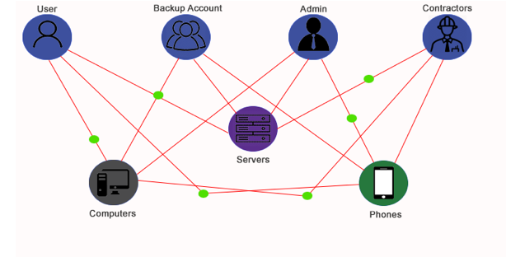
What is a VIP account?
A VIP account is the most privileged account on a system or application. This account gives the ability to carry out all facets of system administration, including adding accounts, changing user passwords, examining log files, installing software, etc.

Slide 4
Why are VIP accounts needed?
VIP accounts are powerful accounts within an organization and are needed for administration, configuration and general upkeep of organizational resources through the use of systems, applications, devices, etc…
VIP accounts are analog to system administrator or root accounts in many environments. In others there might be layers and sublayers of account with VIP properties, however they may be limited to specific systems, network segments, organizational units, devices, etc...

Slide 5
What defines a VIP account?
VIP accounts are defined mainly by their access to privileged actions (execute, write, read). The rights associated to these accounts usually give total access and control of every resource.
Accounts that usually have access rights of this form are administrator or system in MS and root accounts in *nix systems.
This gets a little murky as we escalate in size and extension of users, systems and applications...

Slide 6
Context and Schemas of VIP accounts
The interconnectivity of multiple systems/applications and access by multiple users requires a context or schema where the level of privileges are assigned according to each user and each system role in an organization.
The most common approach in large organizations is RBAC. Role Based Access Control. In this approach privileges are assigned depending on roles within the organization. This basically defines levels of access of users, systems and applications.

Slide 7
Context and Schemas of VIP accounts (cont…)
Once we have and schema definition of access and access control per roles. We need a technology to apply such schema. The most popular application of such concept is LDAP.
With LDAP with can operationalize and enforce user’s, application and system access levels depending on defined roles. The most prevalent application of LDAP in enterprise environments is Microsoft Active Directory. A directory service that can be configured to apply RBAC.

Slide 8
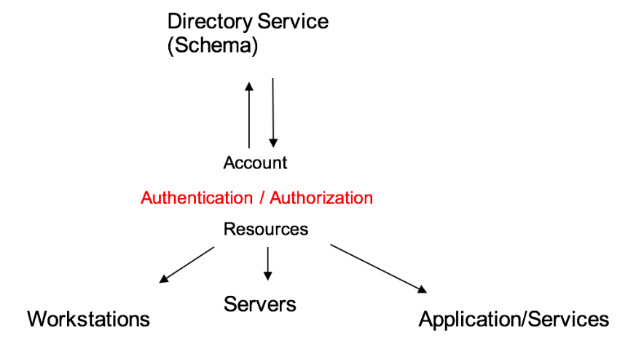
Context and schemas of VIP accounts (cont…)

Slide 9
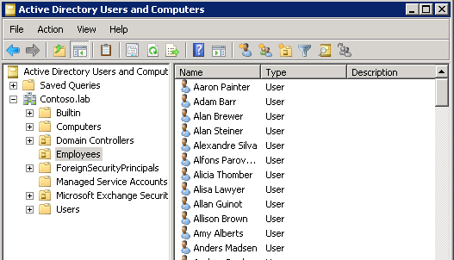
Context and schemas of VIP accounts (cont…)

Slide 10
Context and schemas of VIP accounts (cont…)
It can get even more complicated...
Super admins
OU admins
Hidden OUs
Service Accounts
Interdomain Admins/Cross domain trusts
Forest/Domain Trusts

Slide 11
Context of VIP accounts...
With the understanding of schema definitions of users access levels, we can profile accounts by their related activities. VIP accounts can be profiled as they use their privileges for distinct tasks in an organization (backups, password resets, creation of accounts, software installs).
On the same token, observing a standard user perform such tasks may indicate possible account compromise.

Slide 12
Why profile these accounts?
VIP accounts are constantly targeted as they provide a faster path to resources, data and control of a victim organization.
As such these accounts are subject to spear phishing campaigns, brute force or account takeovers by different means. Malicious actors must either target the account holders directly or use methods that provides the path of the compromised account to the higher privileges

Slide 13
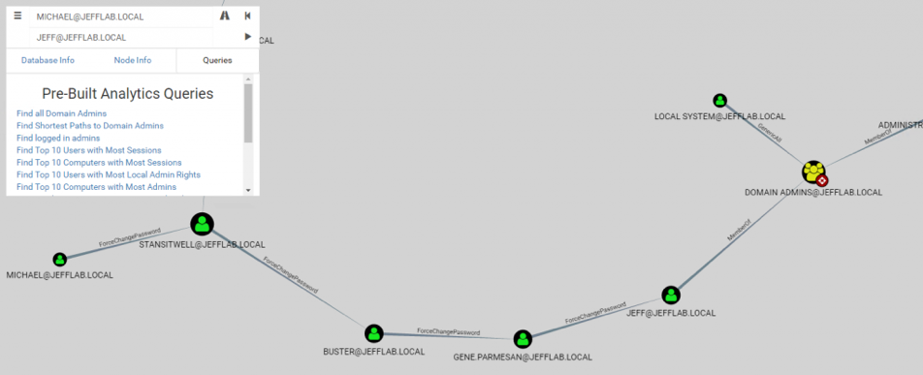
Targeting VIP Accounts...
Bloodhound find your way to domain admin tool

Slide 14
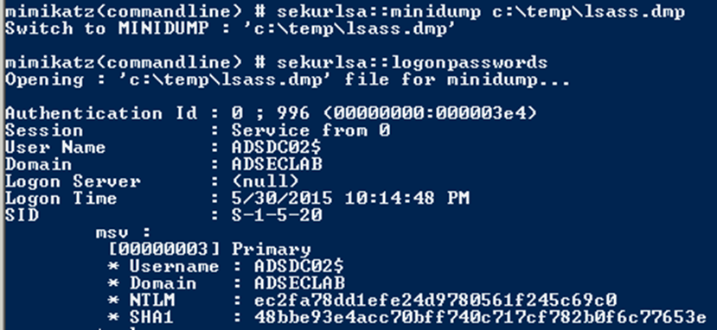
Targeting VIP Accounts...
Of course … Mimikatz

Slide 15
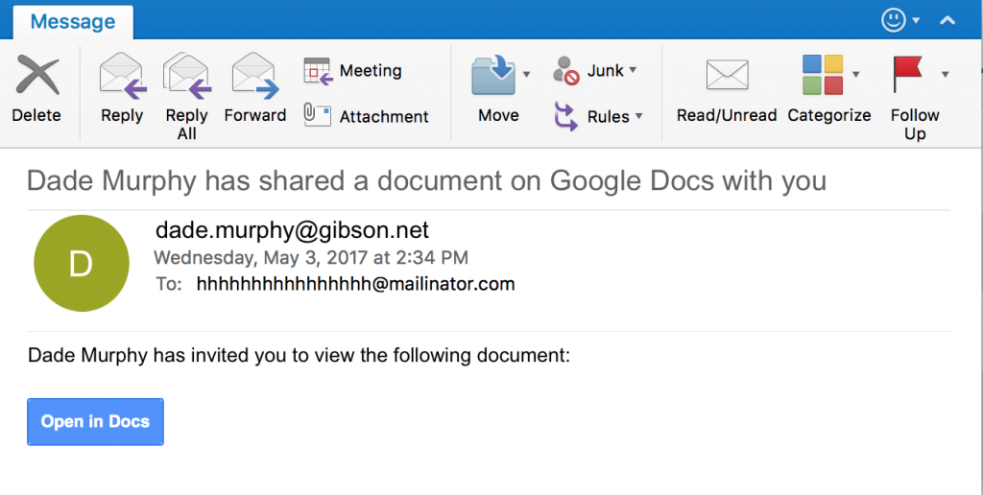
Targeting VIP accounts
Phishing or even insider take over...

Slide 16
The problem
How can we tell if a VIP account has been compromised?

Slide 17
Our approach
Mine user-centric data streams for valuable historical contextual patterns (Kafka Streams + behavioral patterns of access)
Use statistical (machine) learning and graph algorithms to monitor and process large amounts of data close to real time (page rank, tensorflow)
Use a model to validate if current behavior deviates from past and attempt to detect account compromise based on VIP access patterns
Notes:
Once we have identified VIP accounts programmatically we can group there behaviors and use data driven methods to operationalize the use case.

Slide 18
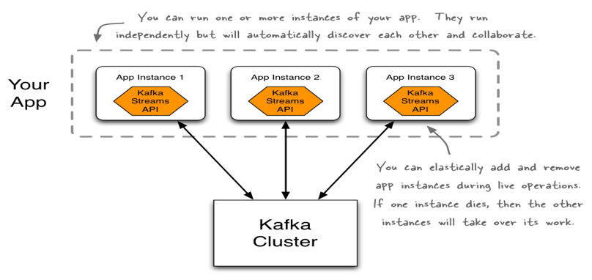
What is Kafka the Kafka Streams API
Example Kafka Streams App (https://kafka.apache.org/intro)

Slide 19
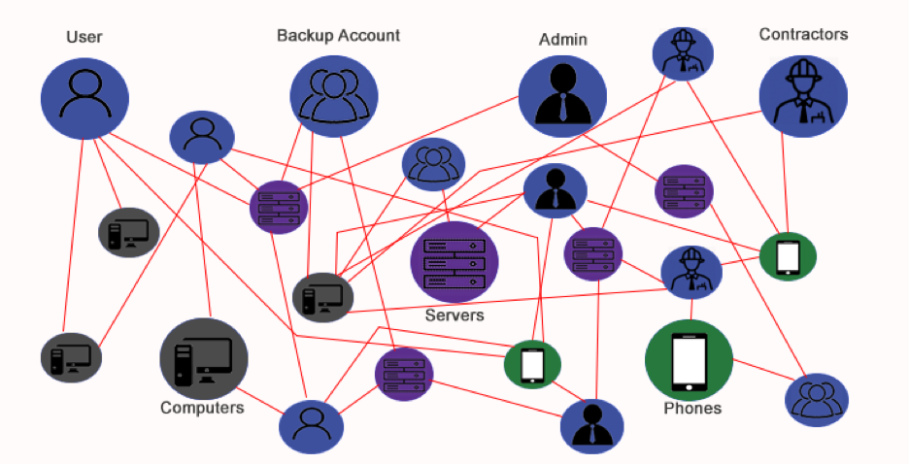
Profiling Individual risk in real time

Slide 20
Algorithm
Step 1: Build the graph of account-to device access. Each (directed) edge is an account-device interaction pair. In the record stream, if one account accesses a device, the edge between device and account is drawn.
Step 2: Compute a graph metric. This graph metric will be used in the next section as a threshold-based method that ranks accounts based on weekly and monthly “popularity scores”. In this particular example, higher page rank = higher likelihood that the account is associated with an admin or key systems ID that is a VIP in the context of modeling risk and computing baselines.
Step 3: Identify VIP’s (important accounts).Use a threshold to score all the PageRank scores of the accounts we computed in the previous step. The distribution of scores is important in this case for identifying key accounts to assign “higher-risk’ accounts in the top percentile of overall PageRank rankings. These higher risk accounts are considered VIPs or accounts of importance.
Step 4: Compute blended risk score.Update the risk score for each account once a new day of activity is added to the heatmap (matrix computation takes place) or the graph of the weekly/monthly account rank changes.

Slide 21
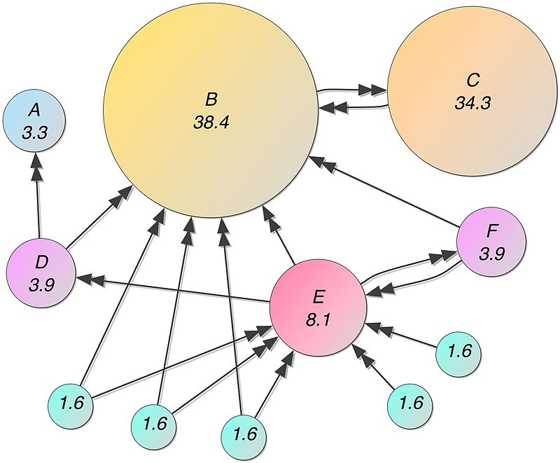
Introduction to PageRank
PageRank was named after Larry Page, one of the founders of Google. PageRank is a way of measuring the importance of website pages. According to Google: PageRank works by counting the number and quality of links to a page to determine a rough estimate of how important the website is.
Notes:
Summary of PageRank: PageRank is a type of graph algorithm that relates to the general problem of how to rank the relative importance of a node in a graph. This algorithm was created by Larry Page and Sergey Brin and is first mentioned in their paper that formed the original foundation for Google’s search engine: “PageRank: Bringing Order to the Web.” Wikipedia describes the original inception for the algorithm in terms of ranking world wide web pages, stating “PageRank works by counting the number and quality of links to a page to determine a rough estimate of how important the website is. The underlying assumption is that more important websites are likely to receive more links from other websites.” For this project, we borrowed this type of metric and applied it to a graph we modeled on user and system account access information. We used a variety of data sets to build various types of graphs and applied different types of metrics to model a data-driven method for deriving context about how important a specific account is relative to an entire enterprise of interactions across systems and humans.
Summary of SVD: Singular Value Decomposition(SVD) is a classic matrix factorization method in machine learning, used often for data pre-processing. In our project, SVD takes a rectangular matrix of row-oriented activity for each account (defined as P, P is a k⨉ dmatrix) where k is number of devices the account accesses and d represents time. The singular value decomposition is shown as follows:
Where U contains the left singular vectors,contains right singular vectors and S is diagonal and has singular values. All of the singular values are arranged in descending order. The effect of SVD is to reduce the input activity matrix P to a reduced set of constituent parts in order of importance indicated by the magnitude of the singular values. Unlike other factorization methods, SVD has minimal requirements for pre-processing and regularity of the data. For instance, it does not need to be pre-normalized or de-trended prior to factorization, in most cases.

Slide 22
Graph modeling with user data
In this algorithm, a graph of accounts and corresponding edges representing access to particular systems is built. The graph is then compared to a matrix extracted from a window of streaming tuples in Kafka. . Typically, the access information for past seven days is collected to get a score by SVD. Then the access information for the past eight days, including the current day, is used to get second score. The difference between these two scores is used to detect an anomaly.
For each day, the account access pattern is grouped by servers for each account.
Matrix of counts representing access patterns of the account for typical weekly access to windows resources are built. The heat map matrix for one account is shown below. Each row represents different servers. Each column stands for different dates.
Notes:
The streaming tuples we used in this example are account, system, date type fields extracted from a stream of user centric logs, such as OS Query, McAfee EPO, Cylance and Active Directory.. The time window is generally a week

Slide 23
Detecting malicious graph patterns
Detect High-Risk Changes in VIP Account Behavior. For each VIP account, we compute an access pattern matrix and assign it an individual risk score. The risk posed by the matrix of account history is computed using another algorithm called SVD via the following steps:
● For each day, the account access pattern is grouped by servers for each account.
● Matrix of counts representing access patterns of the account for typical weekly access to Windows resources is built. The heat map matrix for one account is shown below. Each row represents different servers. Each column stands for different dates.

Slide 24
Enterprise Account Modeling
The use case for targeting VIPs is only one of many that focus on fingerprinting and tagging users related to certain roles

Slide 25
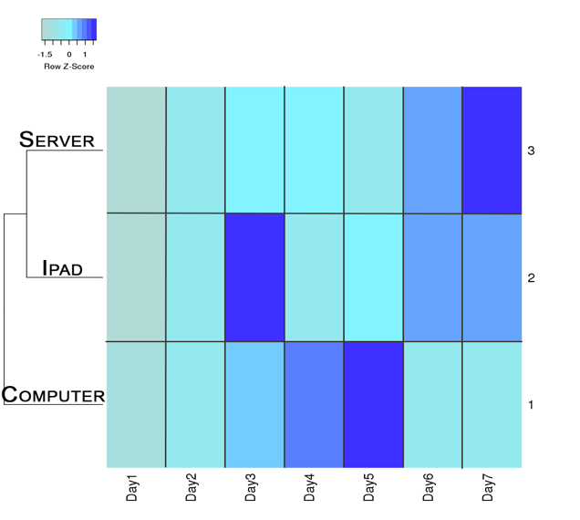
Proof of Concept
Figure 2 shows access patterns for the past eight days. From the heat map, we discover that the access pattern for account 2’s eighth day is significantly different from the past seven days. This becomes easy to detect with an algorithm by comparing each day’s “SVD score”. Essentially the idea is to use the score for each matrix and compare the score to the previous matrix.

Slide 26
Conclusion
Real time user profiling can be achieved by combining tools from graph theory and machine learning
VIP account fingerprinting can apply to many use cases: database admins, active directory admins, etc...
Models of VIPs have led to prosecutable cases and the detection of insider activity involving theft of IP

Slide 27
Interested in working with the founders of Bro/Zeek?
https://www.corelight.com/company/careers
Corelight Labs: Security Researcher
Work with Vern Paxson (creator of Zeek, UC Berkeley Professor and world renowned network security researcher) and with mentorship from Richard Bejtlich (famed threat defense thought leader)

