Slide 1
Using Deep Learning to Uncover Dark web Malicious Actors and Their Close Circle
By Joseph Zadeh & Rod Soto

Slide 2
$Whoami
Rod Soto
Co-Founder of Hackmiami/PHACK>ORG.President Pacific Hackers Conference
Joseph Zadeh
Security Researcher at Corelight. Co-Founder of Hack The Valley %27

Slide 3
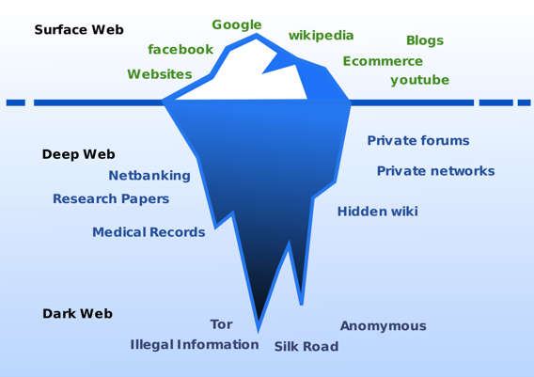
The Dark Web

Slide 4
Dark Web vs Deep Web
Deep Web
Business intranets, web archives, password-protected websites. Many times larger than surface web.
Dark Web
Websites are not indexed by normal search engines. Accessible mainly via TOR .
*darknets: The darknets which constitute the dark web include small, friend-to-friend peer-to-peer networks, as well as large, popular networks like Tor, Freenet, I2P and Riffle operated by public organizations and individuals. *

Slide 5
Dark web facts
Part of Deep Web NOT all of it.
Accessible mainly via TOR (Onionland)
Not indexed by standard search engines
Provides a level of anonymity acceptable for criminal operators
Heavily monitored, regulated by LE actions
Low latency
Driven by cryptocurrencies (BTC,XMR, ETH, LTC, etc.)

Slide 6
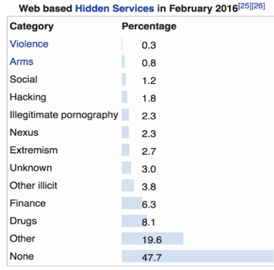
Dark web noticeable items
Buy guns
Buy stolen or fake identities (Including citizenships)
Drugs like nowhere
Piracy (All kinds of legal and illegal content)
Assassination/Terrorism
Sex offenders haven (trafficking, CP, etc.)

Slide 7
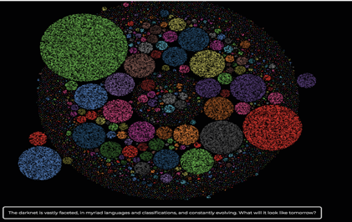
Dark Web Facts
Darkowl has an index of over 500,000,000 sites across the entire Dark Web.
One of the key partners we owe a big thanks to contributing time and access to data is DarkOwl!! Viz from here: https://mapthedark.com/

Slide 8


Looks a lot like the 90s internet

Slide 9
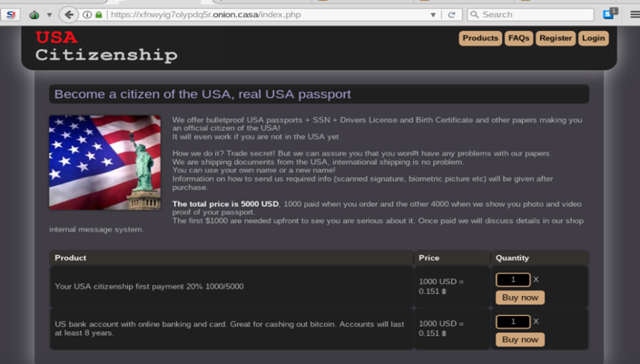
You can buy anything...

Slide 10
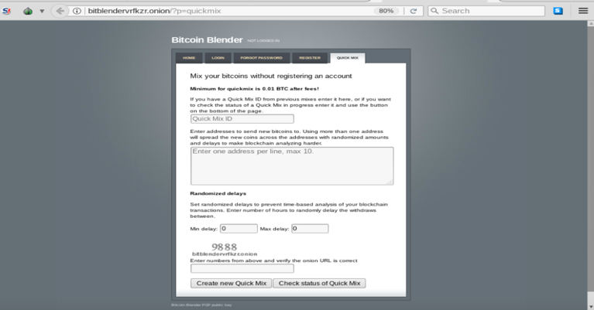
Cryptocurrency the big enabler

Slide 11
Human Trafficking Facts
Estimated of 150 BILLION market per year *
At any given time in 2016, an estimated 40.3 million people are in modern slavery, including 24.9 million in forced labor and 15.4 million in forced marriage.*
Commercial sexual exploitation accounting for $99 billion of that total.*
Traffickers are driven by the level of anonymity provided by dark web/darknets and cryptocurrency.
What you see in Clearnet (Internet as we all know it) is tip of the iceberg, transactions and logistics mainly performed using dark web/crypto
Human Trafficking Facts

Slide 12
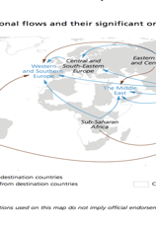
Tracking cybercrime groups
As dark web provides an effective mean of coverage, the use of new techniques applied to research can provide advantages:
Automated scraping, monitoring, indexing, & labeling of targeted data (Details next)
Cryptocurrency tracking (I.E chain analysis, anchain.ai)
Use of machine learning and data driven methods to uncover patterns, establish entities and identify specific types of anonymized behavior

Slide 13
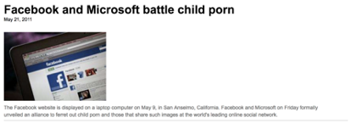


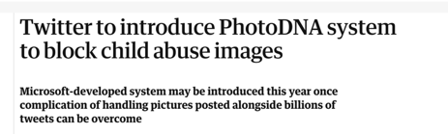

Data Driven Security Analytics on the Dark web: Hackers Helping save lives

Slide 14







How did we get involved in this type of research?
Private/public sector collaboration at grass roots level
Silicon valley partnerships and “data science for good” programs
Child safety hackathons at Facebook every year and similar volunteer type engineering/research opportunities

Slide 15
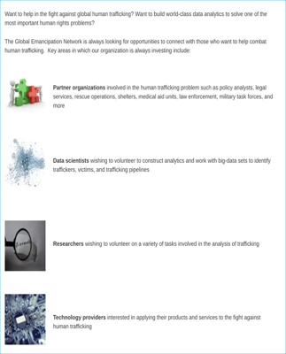

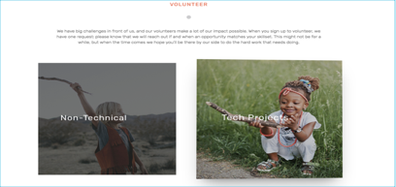
We Need Infosec Professionals Like You: THORN and Global Emancipation examples
https://www.wearethorn.org/join-us/
https://www.globalemancipation.ngo/engage-with-us/

Slide 16
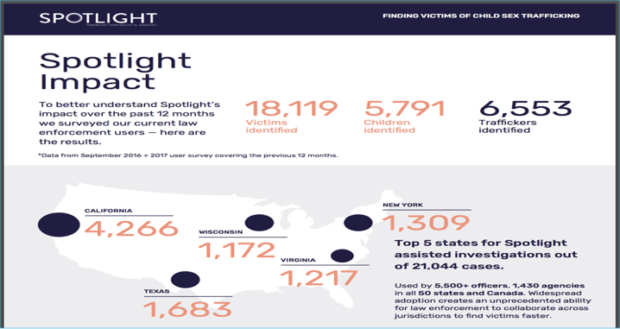
Impact: Thorn and Global Emancipation Network have been involved in helping rescue multiple children In slave labor

Slide 17
Challenging Research Problems
There are so many open problems and ways hackers can help drive research some great examples are:
Global Emancipation Research: http://www.kdd.org/kdd2017/papers/view/backpage-and-bitcoin-uncovering-human-traffickers
https://github.com/EricSchles/traffickingGrab: A tool used to scrape popular websites for instances of human trafficking. Presently looks for sex trafficking.
https://code.google.com/archive/p/nudetech/: this tool can be integrated with various file and media sharing sites such as YouTube, Flickr, Rapidshare, Megaupload etc. to prevent images/videos containing nudity or pornography from being uploaded to their system.
https://traffickcam.com/: Help fight trafficking by uploading photos of your hotel room. These photos will be used to determine where perpetrators of sex trafficking are committing their crimes.
Other examples of a couple models we will talk about in next couple slides
Modeling populations of content producers vs content consumers in CP forums
Image correlation and similarity matching

Slide 18
Deep Neural Nets (DNN): Elevator Pitch
Deep learning in some sense is synonymous with the state of the art in techniques for a variety of statistical learning problems (both supervised and unsupervised)
One of the biggest ways deep learning has impacted my work in last couple years is DNN can be applied to raw data and the model itself will learn which features(stats/columns) are most important (Feature Learning)
Downside: Building DNN models are computationally expensive. Breakthroughs in training algorithms and the commoditization of compute has helped accelerate the ability to make the time to learn feasible for practical applications
Interpreting the model is also challenging with neural nets

Slide 19
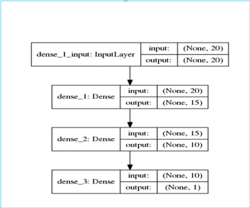
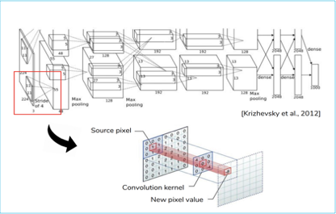
Modeling in the era of deep learning: the magic is in the architecture and the algorithms that update the weights in each part of the network

Slide 20
Modeling Dark Web Interactions
Data set: DarkOwl for querying Darknet scrapes (500,000,000 darkweb pages indexed) and Thorn collaboration with law enforcement Key statistical assumption: Forum interactions /child abuse are tightly linked to specific subgroups of the population. There is a very small number of active users who are creating/posting the majority of the content
Modeling method core concept: Latent Dirichlet Allocation (NLP) + PageRank (Graph Algorithms) + Object Detection (DNN)Graph of the population is made based on @mentions and similar type tweets on darknet sites suspect of sharing CP and correlated with metadata and telemetry (e.g. darkowl data set)

Slide 21
Modeling Dark Web Interactions
Algorithm:
Step 1: Build the graph. Process all data into sets of users (nodes) and forum posts. If another user is mentioned in a post draw an edge between those two users.
Step 2: NLP Tools. Topic model. Aggregate all posts for a single user and call this a “document.” (lots of preprocessing tricks to reduce the cardinality of the vocabulary here as well as build NLP features computed for upstream correlations). For each document we run LDA to cluster users into similar groups (“Topics”)

Slide 22
Modeling Dark Web Interactions
Algorithm:
Step 3: Use PageRank to assign popularity scores to more influential users and correlate the
Step 4: Data reduction and correlation. Assign labels /rank to clusters of users that upload most content and are highly active/interconnected
Step 5: Time to hunt for OpSec fails in coms (NLP) and image object recognition ( DNN) to help triangulate with local law possible human trafficking victims in posted content

Slide 23
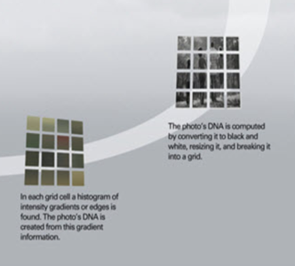
Correlating Images to missing persons
Of the nearly 25,000 runaways reported to the National Center for Missing and Exploited Children (NCMEC) in 2017, one in seven were likely victims of child sex trafficking. And that’s just in the US. Around the world, even with under reporting, the numbers are equally staggering.
POC originally built by the MS team at Facebook hackathon tested the idea on 5000 missing persons photos in California law unsolved cases: The pictures were correlated to scrapes of escort sites (huge asymptotic complexity here)
During the 24 hour hackathon a missing woman was identified as correlating to an escort post despite photos being taken a few years apart and the proper evidence was given to law enforcement for cross border collaboration

Slide 24










Photo DNA PhotoDNA provides a way to create a unique signature - similar to a fingerprint - from a photo that will remain consistent even after it is edited or manipulated.

Slide 25
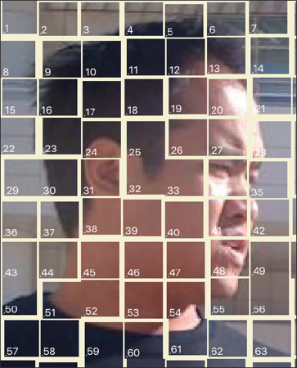
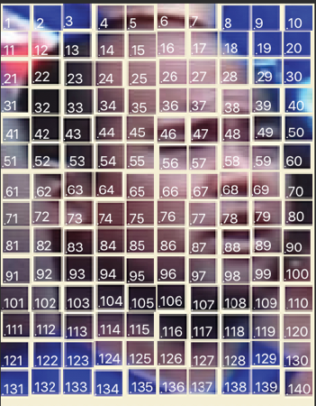
PhotoDNA match

Slide 26
Conclusions
The Darkweb is one place where statistical techniques help de-obfuscate and model targets of interests behavioral profile. The darkweb is but a small part of the bigger picture though (plenty of use cases exists just scrapping the regular internet for instance)
There are fascinating intersections of research that touch security, algorithms, geo politics and forensics (some of the problems are very hard)
ML/AI are buzzwords that are useful sometimes in tactical applications when we know the right tool for the job. DNN represents (often times) the state of the art in terms of prediction power

