Slide 1
Git
Atul Phad

Slide 2
Introduction
Git is a distributed revision control and source code management system with an emphasis on speed.
Git was initially designed and developed by Linus Torvalds for Linux kernel development.
Git is a free software distributed under the terms of the GNU General Public License version

Slide 3
Contd..
Git is foundation of many services like GitHub and GitLab, but we can use Git without using any other Git services. Git can be used privately and publicly.
Git was created by Linus Torvalds in 2005 to develop Linux Kernel. It is also used as an important distributed version-control tool for the DevOps.
Git is easy to learn, and has fast performance. It is superior to other SCM tools like Subversion, CVS, Perforce, and ClearCase.

Slide 4
Version Control
Version Control System (VCS) is a software that helps software developers to work together and maintain a complete history of their work/ code.

Slide 5
Why VCS
Allows developers to work simultaneously.
Does not allow overwriting each other’s changes.
Maintains a history of every version.

Slide 6
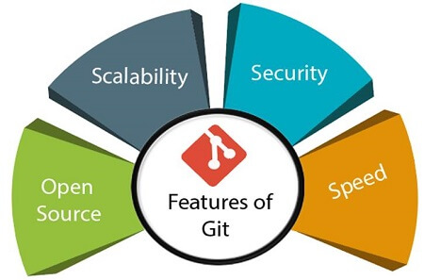
Git advantages

Slide 7
Contd..
Open Source
Git is an open-source tool. It is released under the GPL (General Public License) license.
Scalable
Git is scalable, which means when the number of users increases, the Git can easily handle such situations.
Distributed
One of Git's great features is that it is distributed. Distributed means that instead of switching the project to another machine, we can create a "clone" of the entire repository. Also, instead of just having one central repository that you send changes to, every user has their own repository that contains the entire commit history of the project.

Slide 8
Contd.
Security
Git is secure. It uses the SHA1 (Secure Hash Function) to name and identify objects within its repository. Files and commits are checked and retrieved by its checksum at the time of checkout. It stores its history in such a way that the ID of particular commits depends upon the complete development history leading up to that commit. Once it is published, one cannot make changes to its old version.
Speed
Git is very fast, so it can complete all the tasks in a while. Most of the git operations are done on the local repository, so it provides a huge speed. Also, a centralized version control system continually communicates with a server somewhere.

Slide 9
Contd..
Easier branching
CVCS uses cheap copy mechanism, If we create a new branch, it will copy all the codes to the new branch, so it is time-consuming and not efficient. Also, deletion and merging of branches in CVCS is complicated and time-consuming. But branch management with Git is very simple. It takes only a few seconds to create, delete, and merge branches.

Slide 10
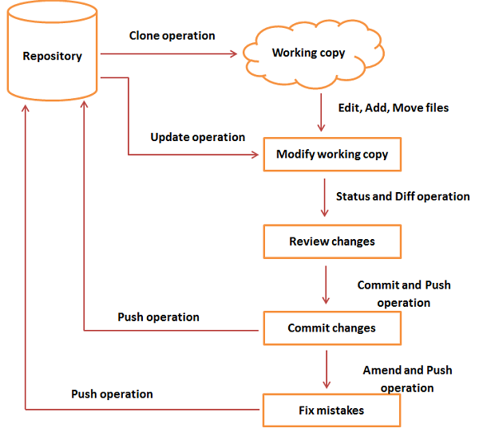

Slide 11
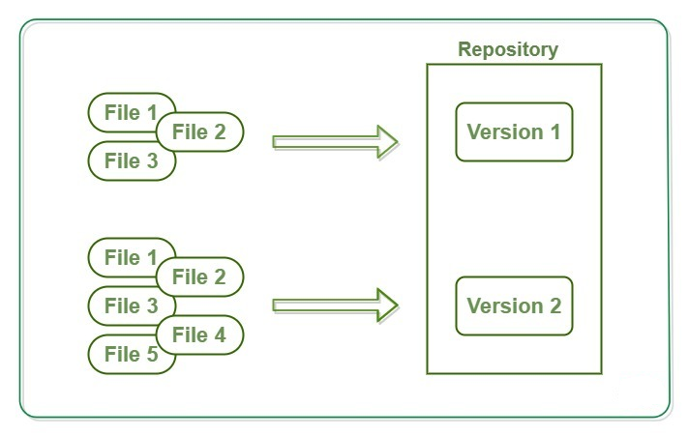

Slide 12
Terminology
Repository:
Repositories in GIT contain a collection of files of various different versions of a Project.
Local Repository
Every VCS tool provides a private workplace as a working copy. Developers make changes in their private workplace
Working Directory and Staging Area or Index
The working directory is the place where files are checked out. In other CVCS, developers generally make modifications and commit their changes directly to the repository. But Git uses a different strategy. Git doesn’t track each and every modified file. Whenever you do commit an operation, Git looks for the files present in the staging area. Only those files present in the staging area are considered for commit and not all the modified files.

Slide 13
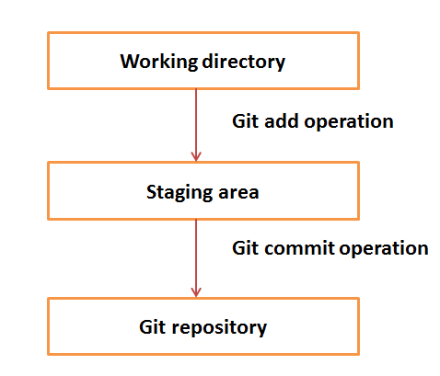

Slide 14
Contd..
Remote
In Git, the term remote is concerned with the remote repository. It is a shared repository that all team members use to exchange their changes. A remote repository is stored on a code hosting service like an internal server, GitHub, Subversion and more.
Branch
A branch is a version of the repository that diverges from the main working project. It is an essential feature available in most modern version control systems. A Git project can have more than one branch. We can perform many operations on Git branch-like rename, list, delete, etc.
Checkout
In Git, the term checkout is used for the act of switching between different versions of a target entity. The git checkout command is used to switch between branches in a repository.

Slide 15
Contd..
Clone
The git clone is a Git command-line utility. It is used to make a copy of the target repository or clone it. If I want a local copy of my repository from GitHub, this tool allows creating a local copy of that repository on your local directory from the repository URL.
Fetch
It is used to fetch branches and tags from one or more other repositories, along with the objects necessary to complete their histories. It updates the remote-tracking branches.
HEAD
HEAD is the representation of the last commit in the current checkout branch. We can think of the head like a current branch. When you switch branches with git checkout, the HEAD revision changes, and points the new branch.

Slide 16
Contd..
Master
Master is a naming convention for Git branch. It's a default branch of Git. After cloning a project from a remote server, the resulting local repository contains only a single local branch. This branch is called a "master" branch. It means that "master" is a repository's "default" branch.
Merge
Merging is a process to put a forked history back together. The git merge command facilitates you to take the data created by git branch and integrate them into a single branch.
Origin
In Git, "origin" is a reference to the remote repository from a project was initially cloned. More precisely, it is used instead of that original repository URL to make referencing much easier.

Slide 17
Contd..
Pull/Pull Request
The term Pull is used to receive data from GitHub. It fetches and merges changes on the remote server to your working directory. The git pull command is used to make a Git pull.
Pull requests are a process for a developer to notify team members that they have completed a feature. Once their feature branch is ready, the developer files a pull request via their remote server account. Pull request announces all the team members that they need to review the code and merge it into the master branch.

Slide 18
Contd..
Push
The push term refers to upload local repository content to a remote repository. Pushing is an act of transfer commits from your local repository to a remote repository. Pushing is capable of overwriting changes; caution should be taken when pushing.
Rebase
In Git, the term rebase is referred to as the process of moving or combining a sequence of commits to a new base commit. Rebasing is very beneficial and visualized the process in the environment of a feature branching workflow.
Stashing
Sometimes you want to switch the branches, but you are working on an incomplete part of your current project. You don't want to make a commit of half-done work. Git stashing allows you to do so.

Slide 19
Git commands (CLI)
Git config command
This command configures the user. The Git config command is the first and necessary command used on the Git command line. This command sets the author name and email address to be used with your commits.
$ git config --global user.name “atulphad"
$ git config --global user.email “phadatul@gmail.com"

Slide 20
Contd..
Git Init command
This command is used to create a local repository.
Syntax
$ git init Demo

Slide 21
Contd..
Git clone command
This command is used to make a copy of a repository from an existing URL. If I want a local copy of my repository from GitHub, this command allows creating a local copy of that repository on your local directory from the repository URL.
Syntax
$ git clone URL

Slide 22
Contd..
Git add command
This command is used to add one or more files to staging (Index) area.
$ git add HelloWorld.java
$ git add *

Slide 23
Contd..
Git commit
Since we have finished our work, we are ready move from stage to commit for our repo.
Adding commits keep track of our progress and changes as we work. Git considers each commit change point or "save point". It is a point in the project you can go back to if you find a bug, or want to make a change.
When we commit, we should always include a message.
$git commit -m "First release of Hello World!"

Slide 24
Contd..
Git Commit without Stage
Sometimes, when you make small changes, using the staging environment seems like a waste of time. It is possible to commit changes directly, skipping the staging environment. The -a option will automatically stage every changed, already tracked file.
$git commit –a -m “Second release of Hello World!"

Slide 25
Contd..
Git Status
The git status command is used to display the state of the repository and staging area. It allows us to see the tracked, untracked files and changes. This command will not show any commit records or information.
git status
git status –short
Note: Short status flags are:
?? - Untracked files
A - Files added to stage
M - Modified files
D - Deleted files

Slide 26
Contd..
Git push Command
It is used to upload local repository content to a remote repository. Pushing is an act of transfer commits from your local repository to a remote repo.
$ git push origin master
$ git push --all

Slide 27
Contd..
Git pull command
Pull command is used to receive data from GitHub. It fetches and merges changes on the remote server to your working directory.
$ git pull URL

Slide 28
Contd..
Git Branch Command
This command lists all the branches available in the repository.
Syntax
$ git branch

Slide 29
Contd..
Git Merge Command
This command is used to merge the specified branch’s history into the current branch.
Syntax
$ git merge BranchName

Slide 30
Contd..
Git log Command
This command is used to check the commit history.
Syntax
$ git log

