Slide 1

Accessing AWS Cloud9 from VSCode
Ankita Phadke
04/06/23

Slide 2
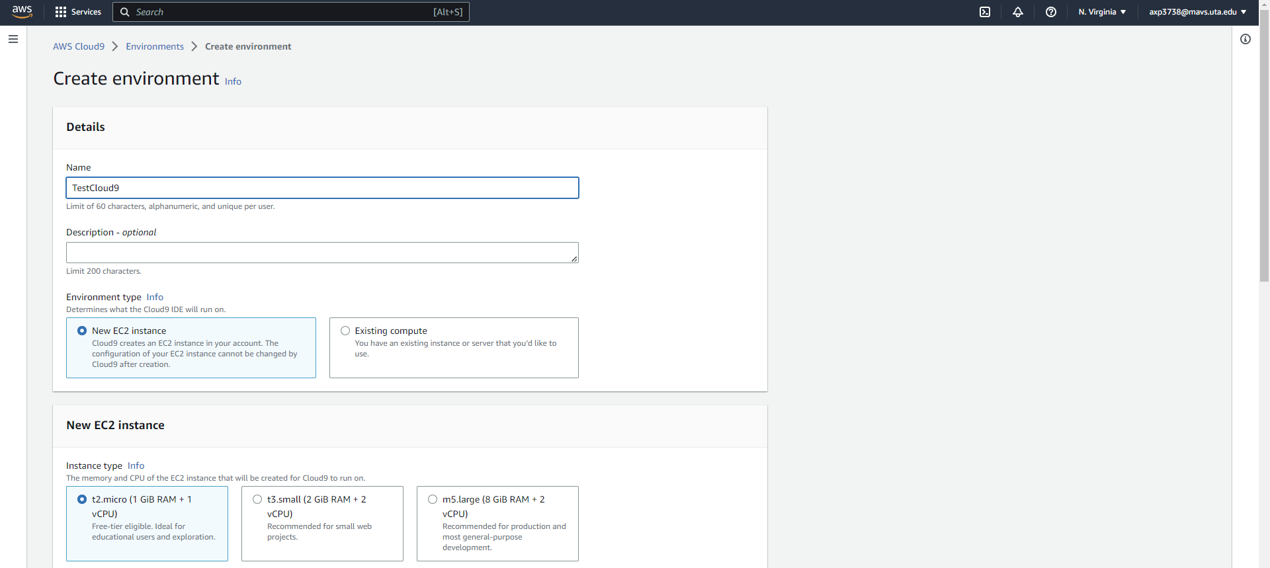
Connecting and accessing Cloud9 from VSCode
Login to AWS, on browser window, Create new Cloud9 environment.
Enter the name, select new EC2 environment, and t2.micro instance.
Inside AWS

Slide 3
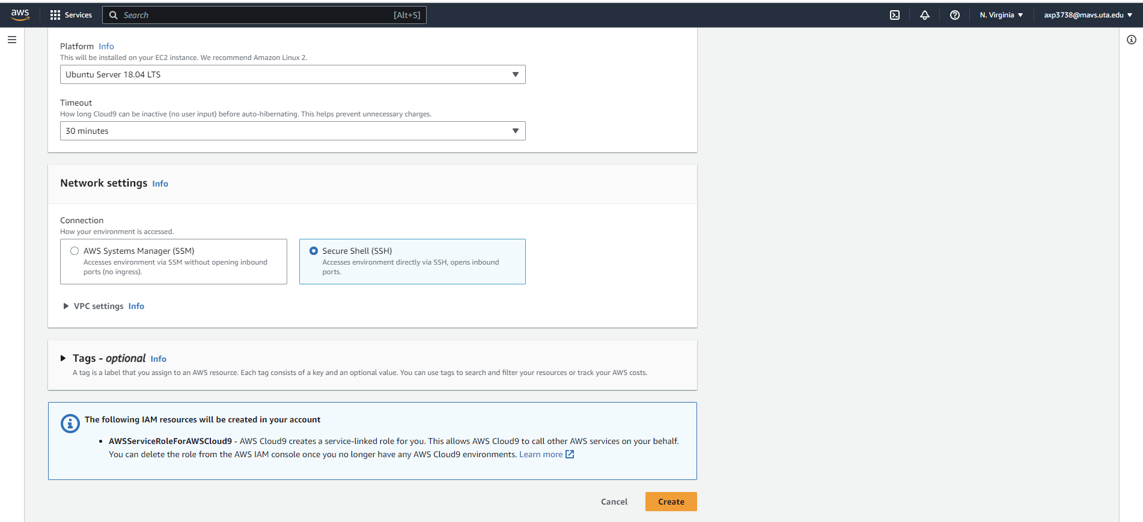
Connecting and accessing Cloud9 from VSCode
Select Ubuntu, and SSH options and click on Create.

Slide 4
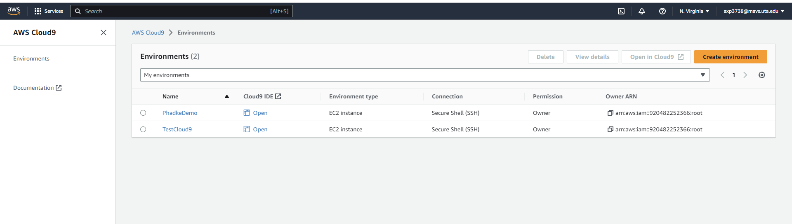
Connecting and accessing Cloud9 from VSCode
Open the created Cloud9 environment.
Click on Open: will open the created Cloud9 IDE in new window.
Also, click on TestCloud9 name: to see the details of the Cloud9 Environment

Slide 5
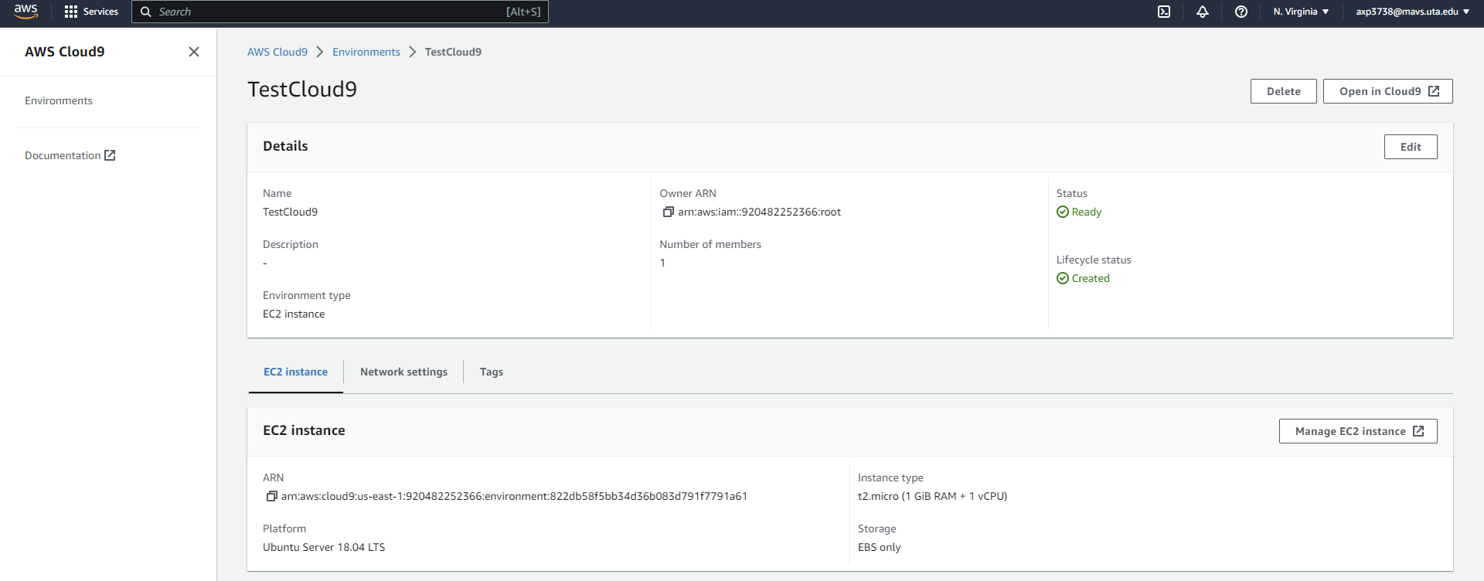
Connecting and accessing Cloud9 from VSCode
Open the associated EC2 environment using Manage EC2 instance option (after clicking on TesCloud9)

Slide 6
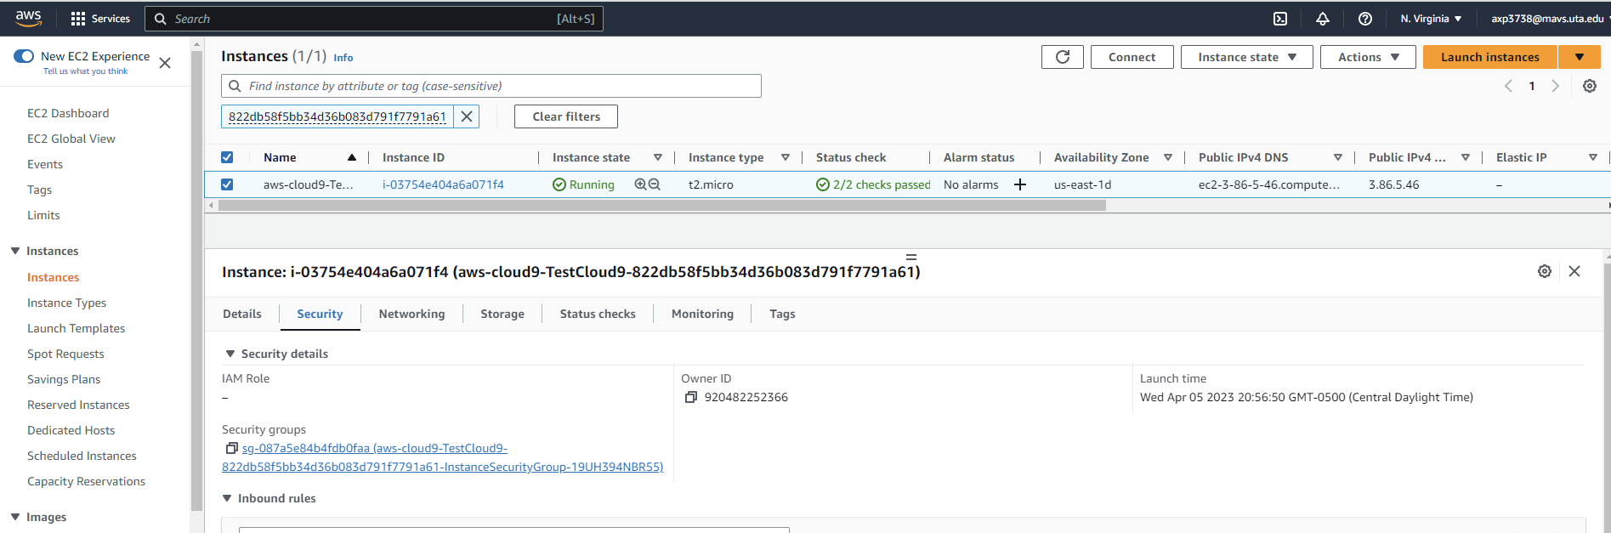
Connecting and accessing Cloud9 from VSCode
Open the security details associated EC2 environment, go to security group

Slide 7
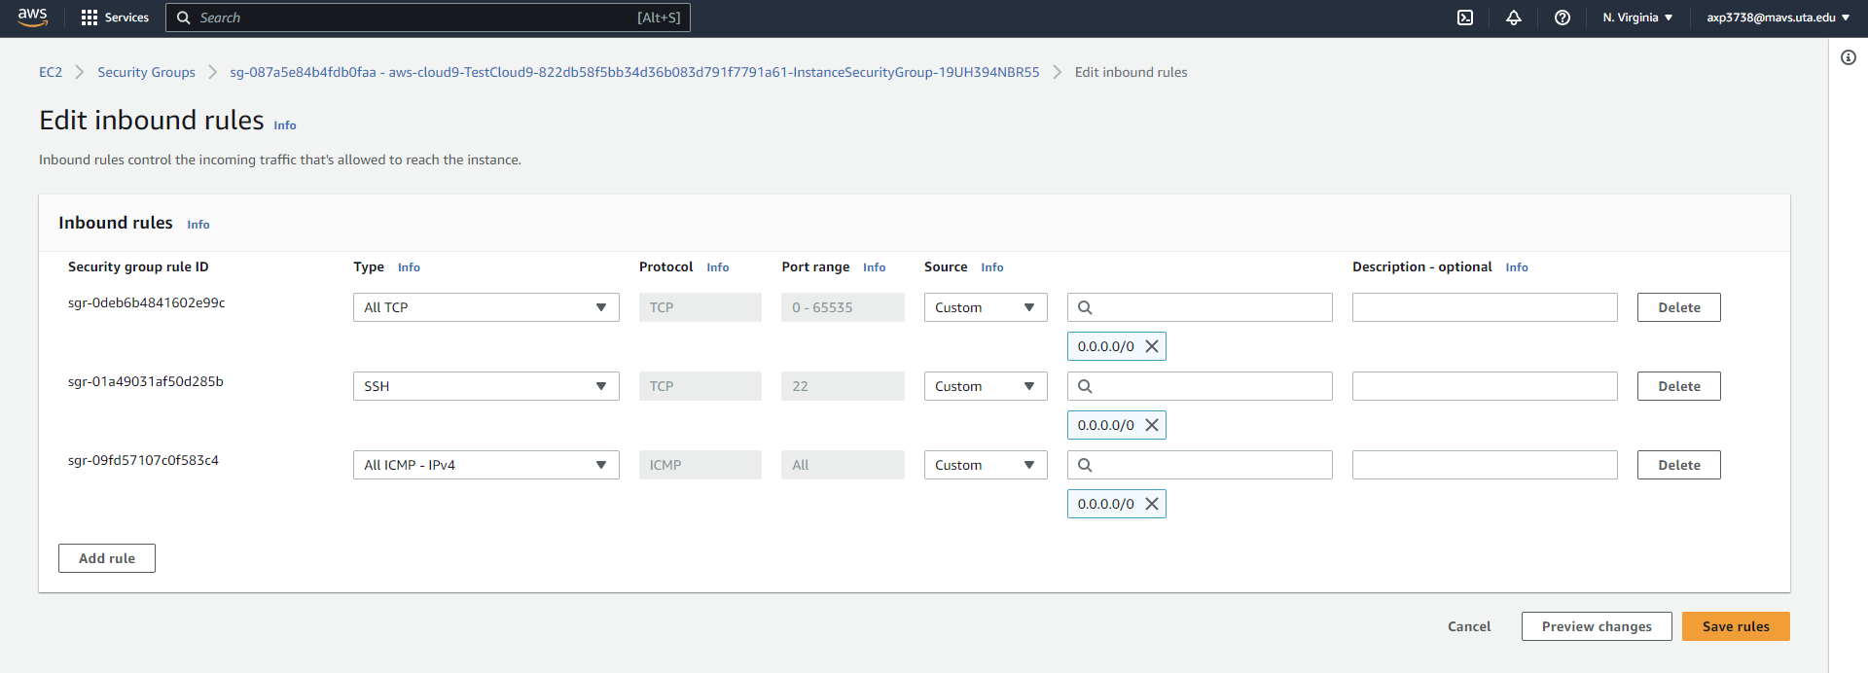
Connecting and accessing Cloud9 from VSCode
Edit inbound rules to allow traffic from everywhere (SSH is important here)

Slide 8
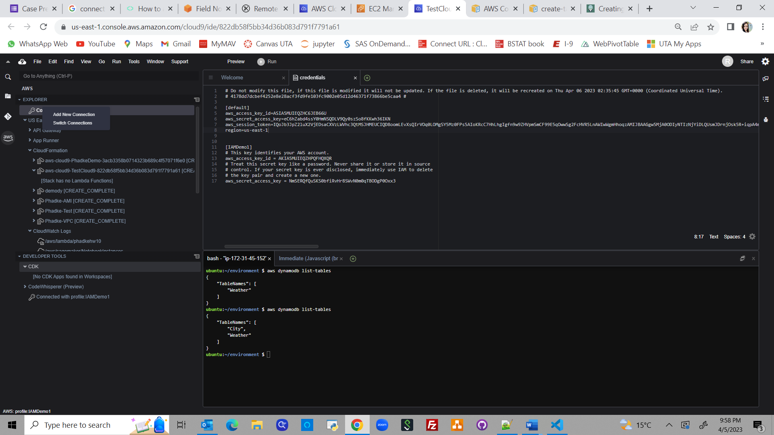
Connecting and accessing Cloud9 from VSCode
Inside Cloud9 on browser
After opening Cloud9, add associated IAM profile to it (same as the one present in VS Code)

Slide 9
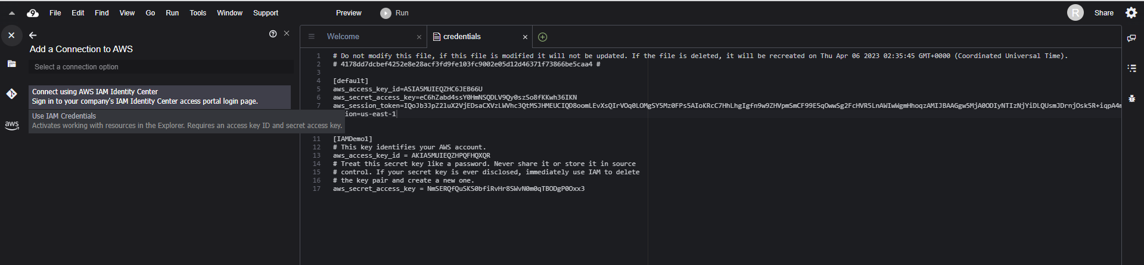
Connecting and accessing Cloud9 from VSCode
After opening Cloud9, add associated IAM profile to it (same as the one present in VS Code):
Select option ‘Use IAM Credentials’

Slide 10
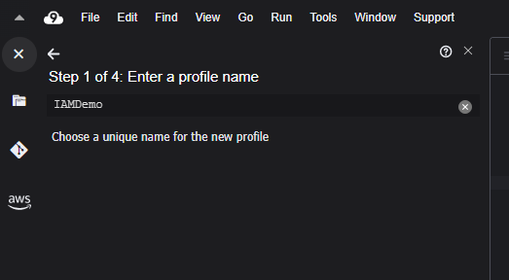
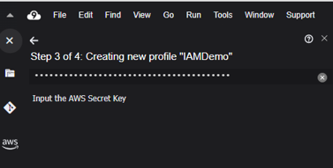
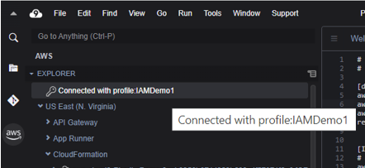
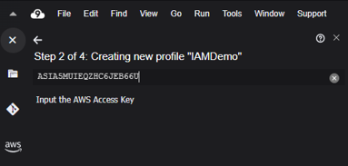
Connecting and accessing Cloud9 from VSCode
Setup the associated IAM profile

Slide 11
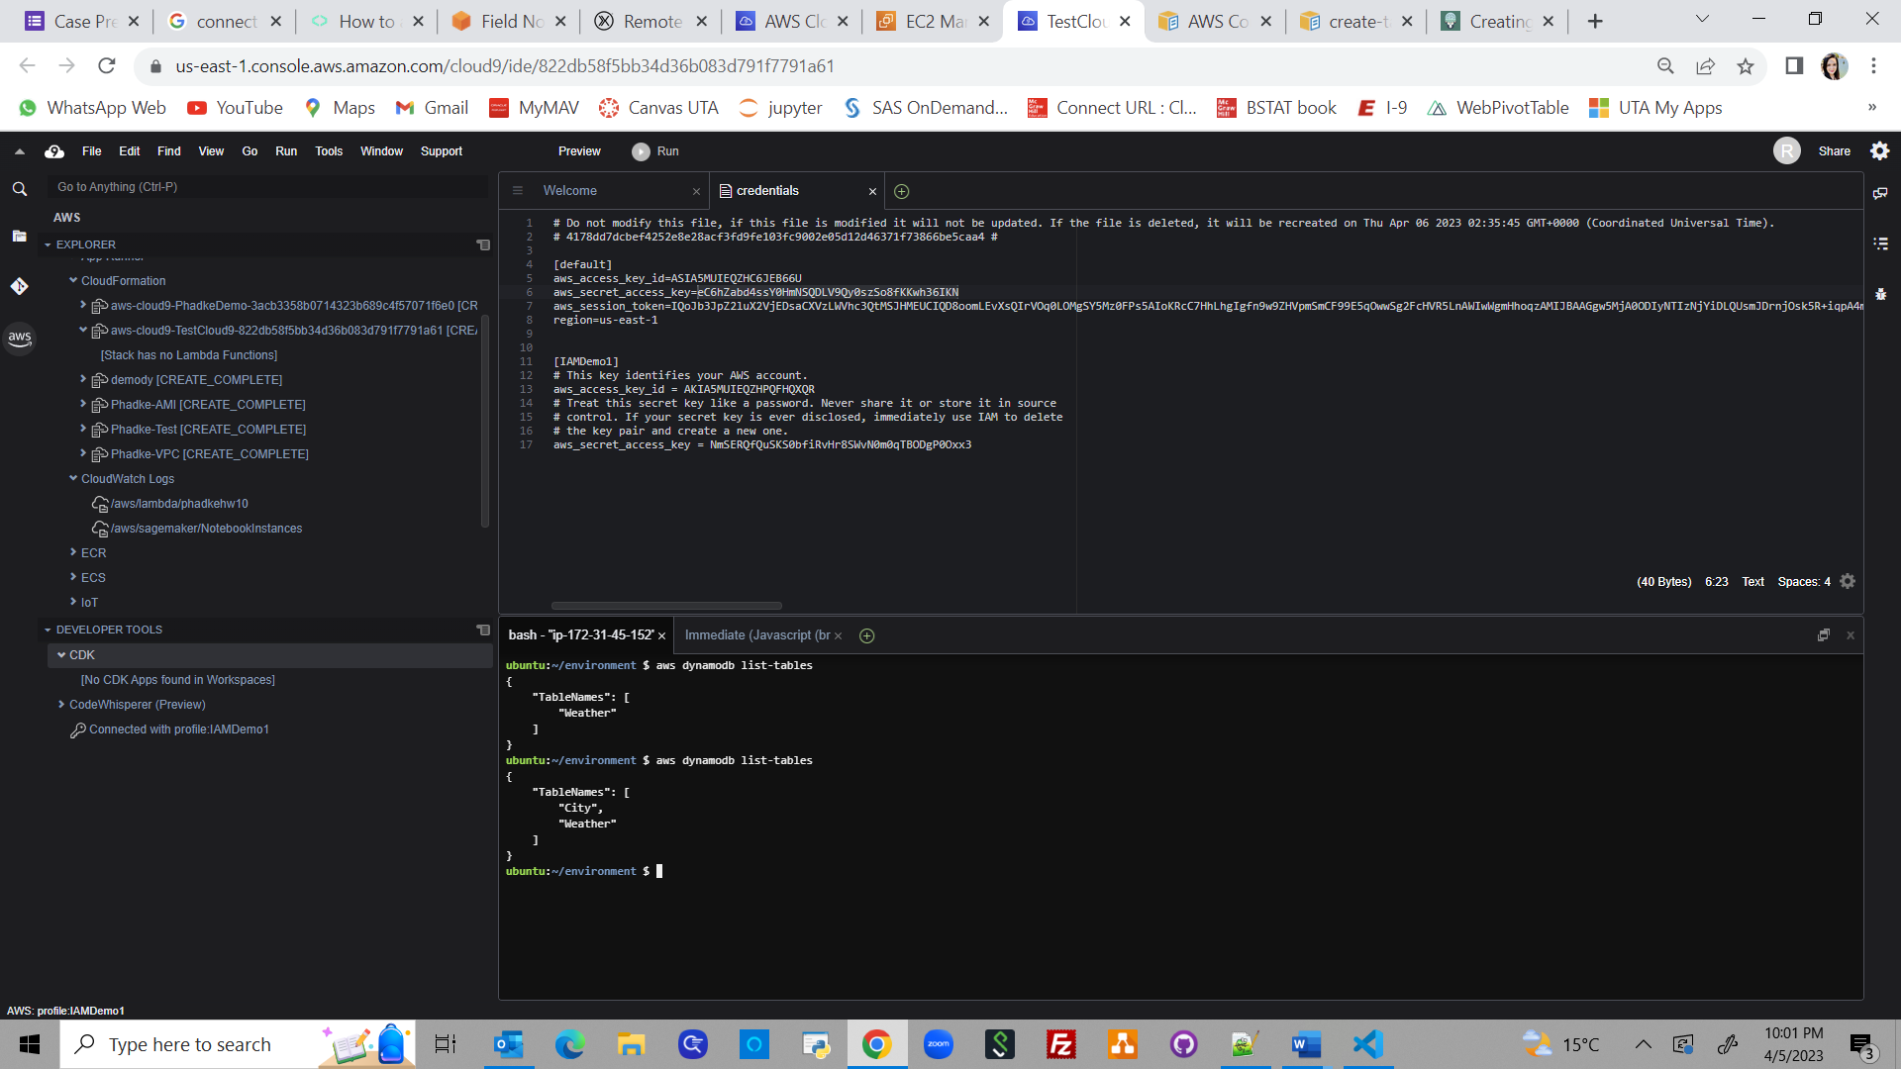
Connecting and accessing Cloud9 from VSCode
Created a test table, Weather from Cloud9
Inside Cloud9 on browser
Before connecting from VSCode

Slide 12
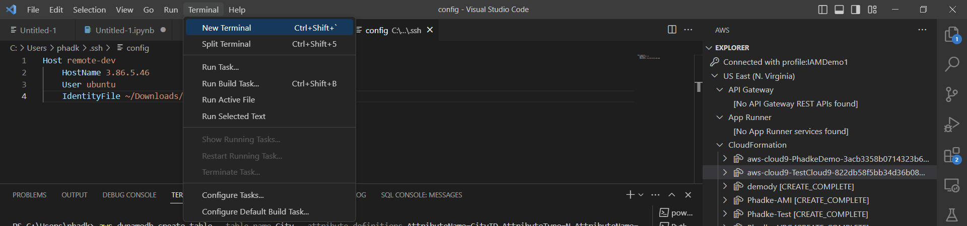
Connecting and accessing Cloud9 from VSCode
Inside VSCode
Open new terminal

Slide 13
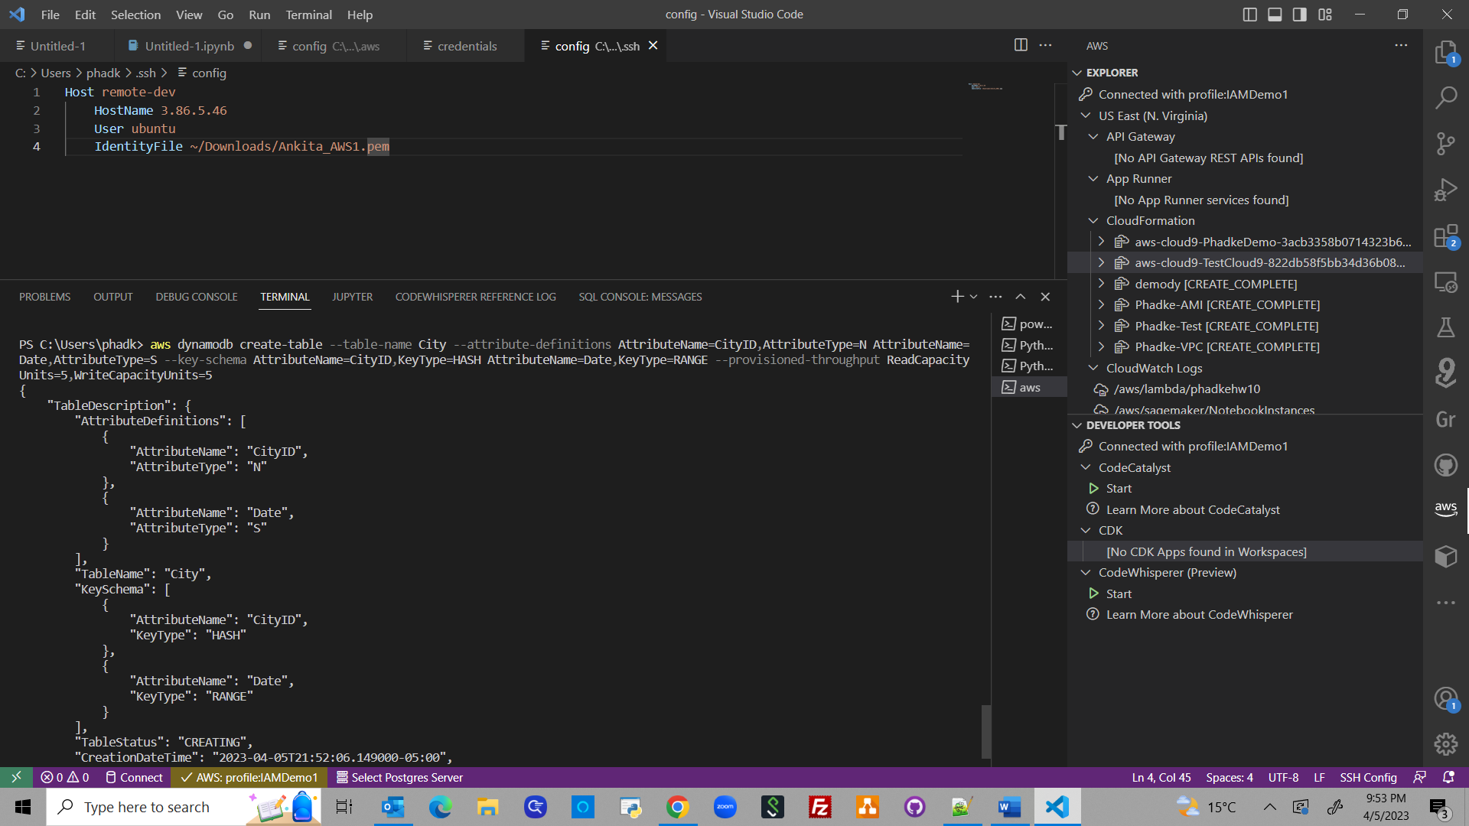
Connecting and accessing Cloud9 from VSCode
Enter the CLI Commands to create a new table named City

Slide 14
Connecting and accessing Cloud9 from VSCode
Recheck if City table is created in Cloud 9
Inside Cloud9 on browser
Before connecting from VSCode
After connecting from VSCode

Slide 15
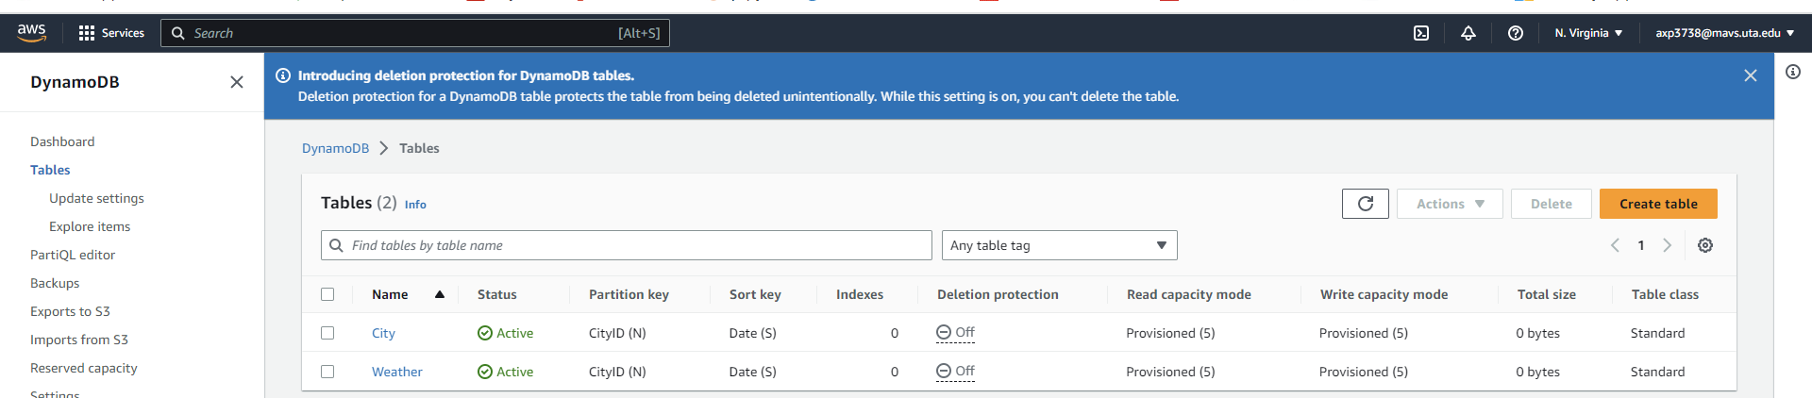
Connecting and accessing Cloud9 from VSCode
Inside AWS
Recheck if the table is created in dynamodb

Slide 16
References:
https://aws.amazon.com/blogs/architecture/field-notes-use-aws-cloud9-to-power-your-visual-studio-code-ide/
https://globaldatanet.com/tech-blog/how-to-access-aws-cloud9-ide-from-vscode

