Slide 1

Accessing AWS EC2 from VSCode
Ankita Phadke
04/06/23

Slide 2
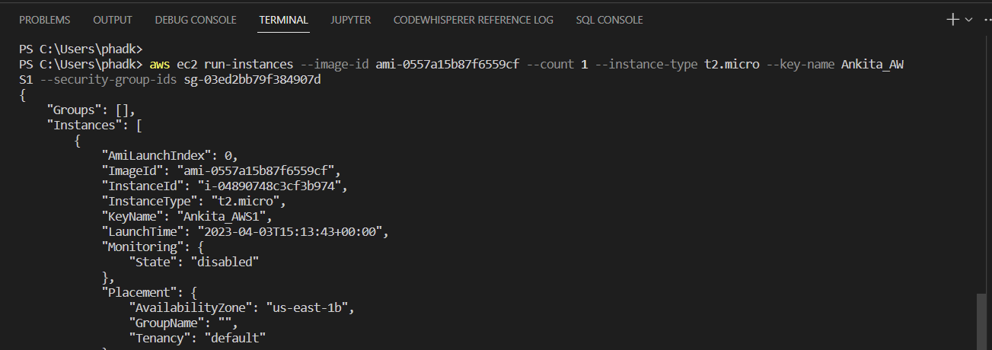
Connecting and accessing EC2 from VSCode
Login to IAM user using access key & secret access key from VS Code
Create new EC2 using AWS CLI from VS code. Choose a security group with public SSH access.
Inside VSCode

Slide 3
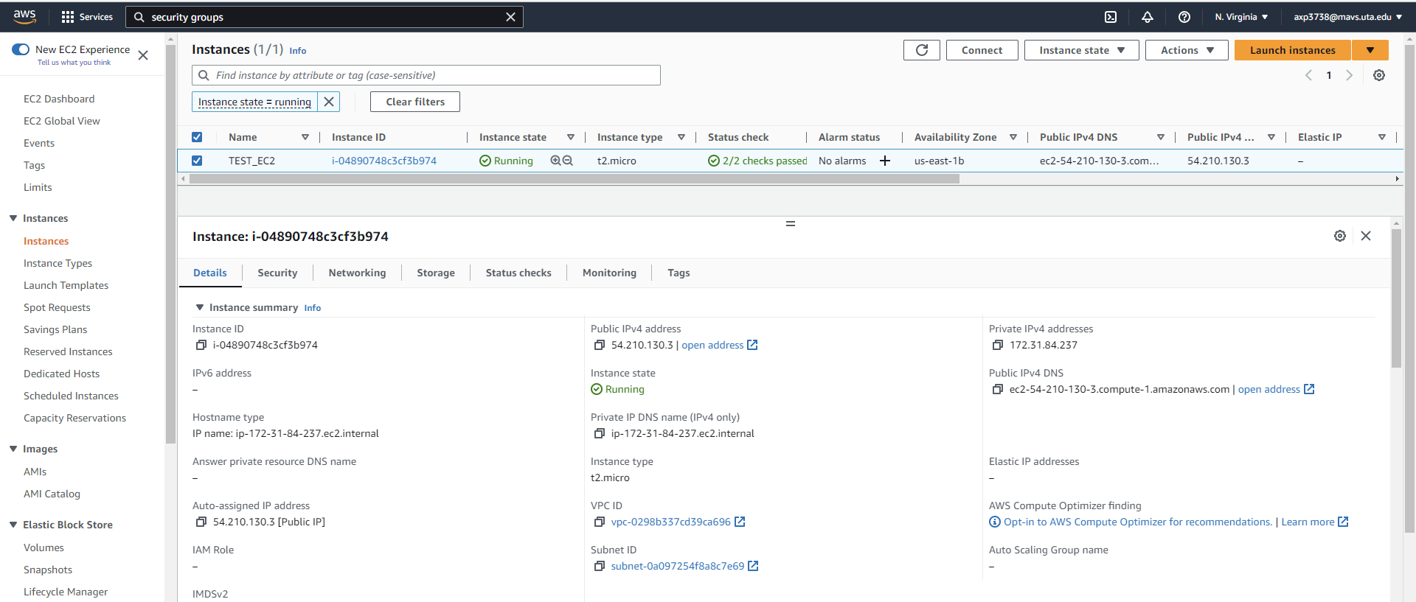
Connecting and accessing EC2 from VSCode
New EC2 is created and is running
Inside AWS

Slide 4
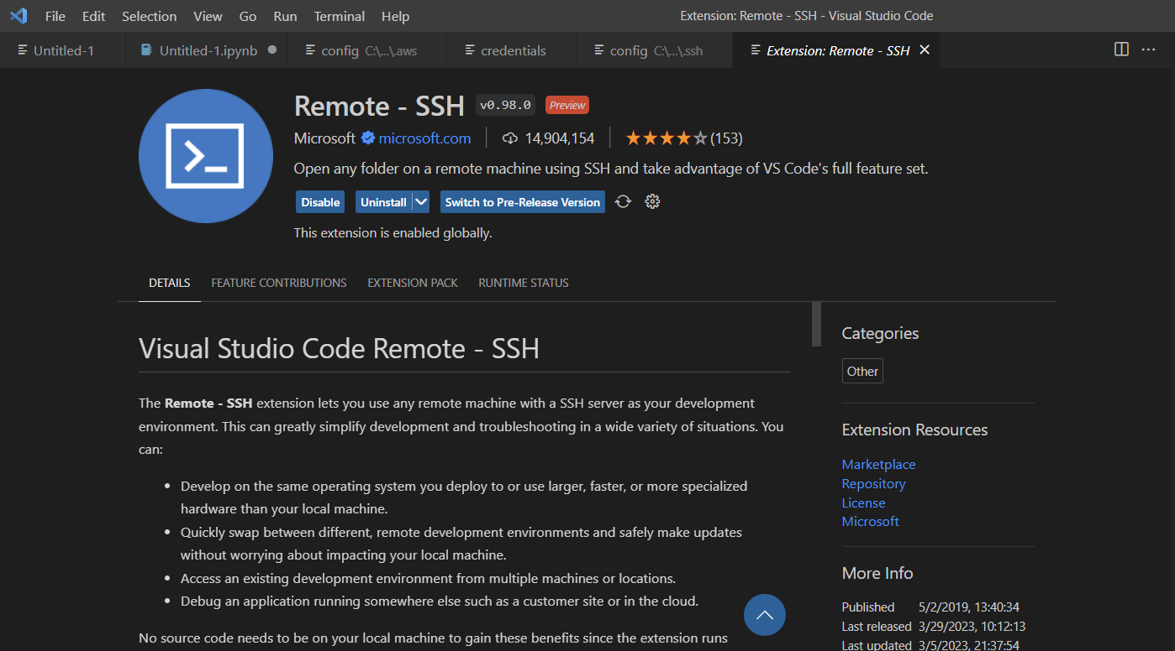
Connecting and accessing EC2 from VSCode
Download and install below extension in VS Code from marketplace
Inside VSCode

Slide 5
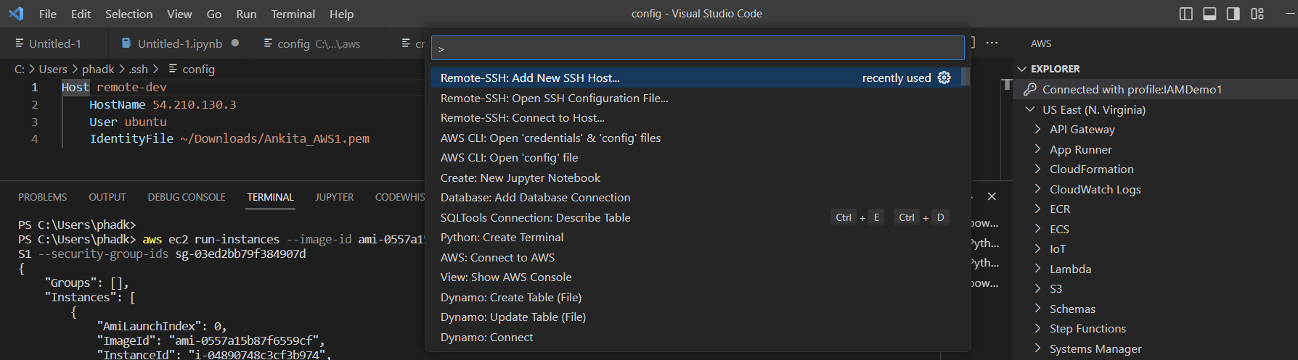
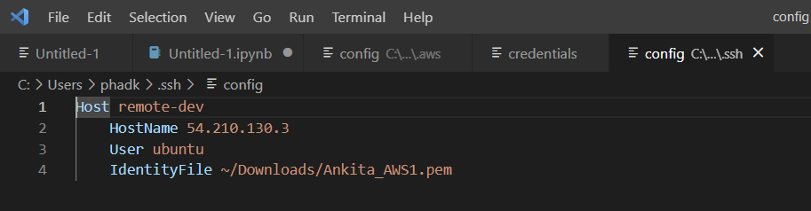
Connecting and accessing EC2 from VSCode
Add new SSH Host details and enter EC2 public IP address in the config file
(View > Command Palette), this file already exists at given path.
Inside VSCode

Slide 6
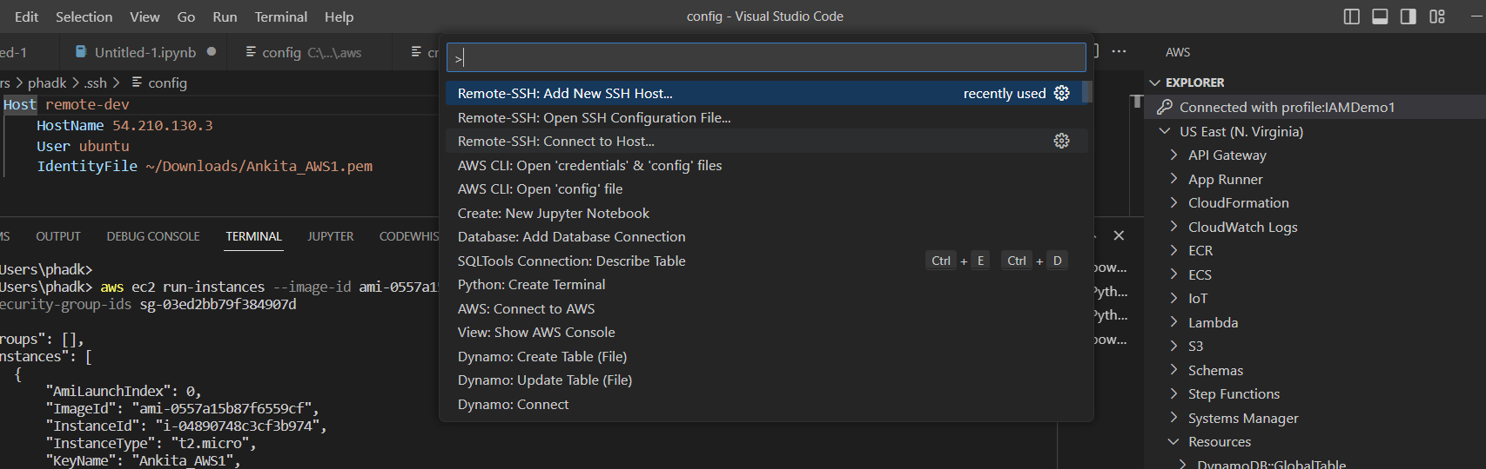
Connecting and accessing EC2 from VSCode
Once the details of connection are saved, select “SSH: Connect to Host”
(View > Command Palette)

Slide 7
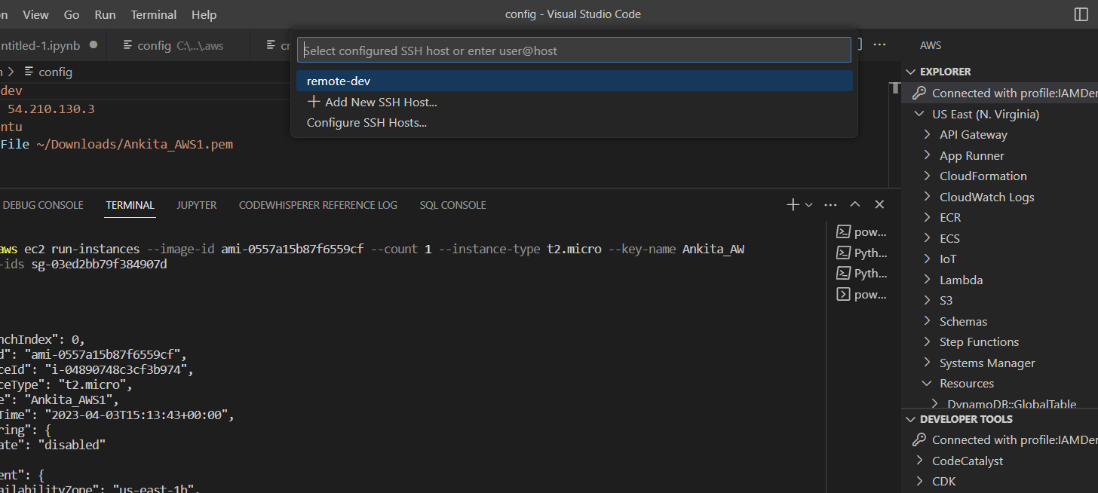
Connecting and accessing EC2 from VSCode
Select the connection created with the name ‘remote-dev’

Slide 8
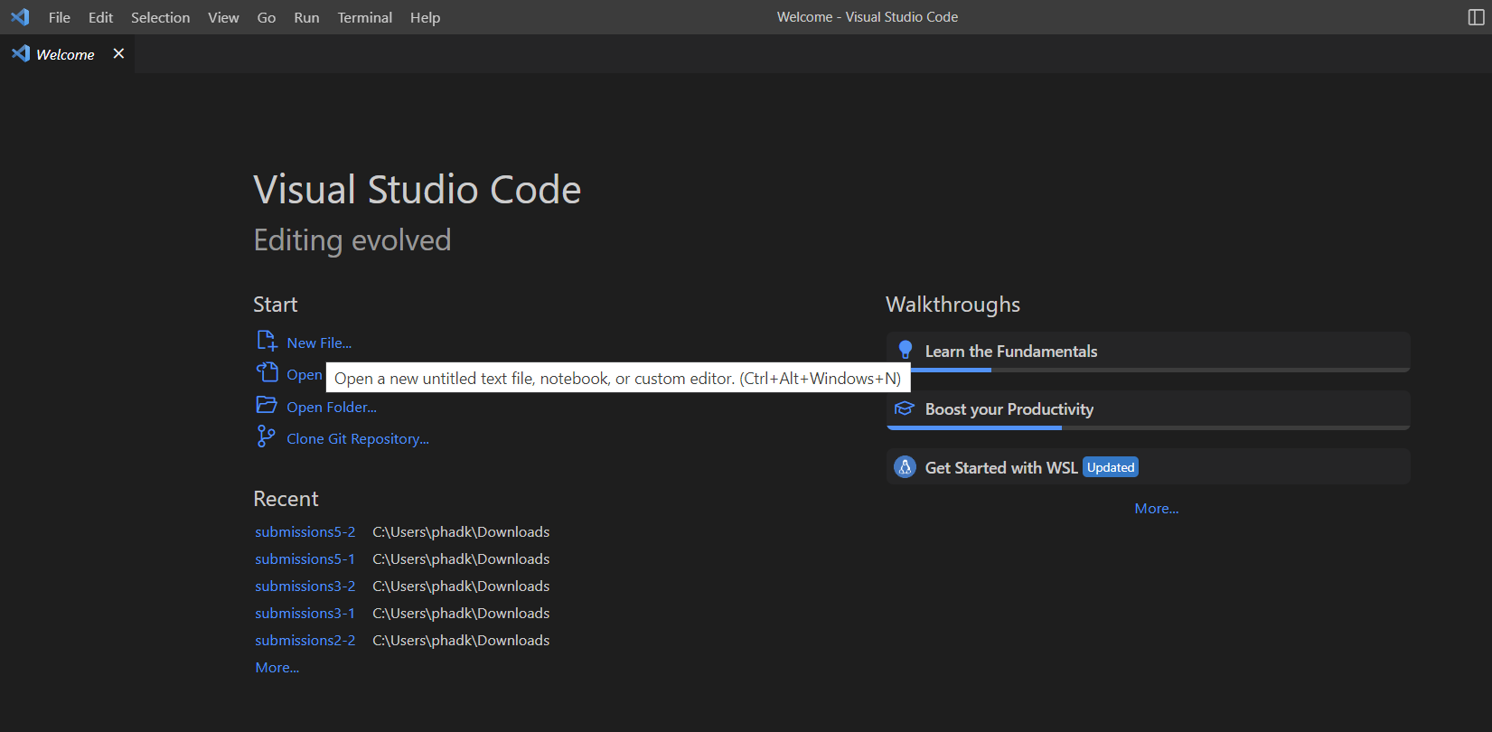
Connecting and accessing EC2 from VSCode
A new window opens up and EC2 server can be accessed. Click on New File to create a new text file

Slide 9
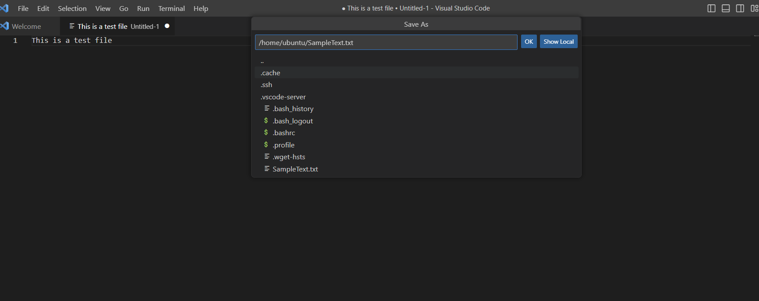
Connecting to existing AWS RDS from VSCode
Save a test text and save the file with the name SampleText.txt

Slide 10
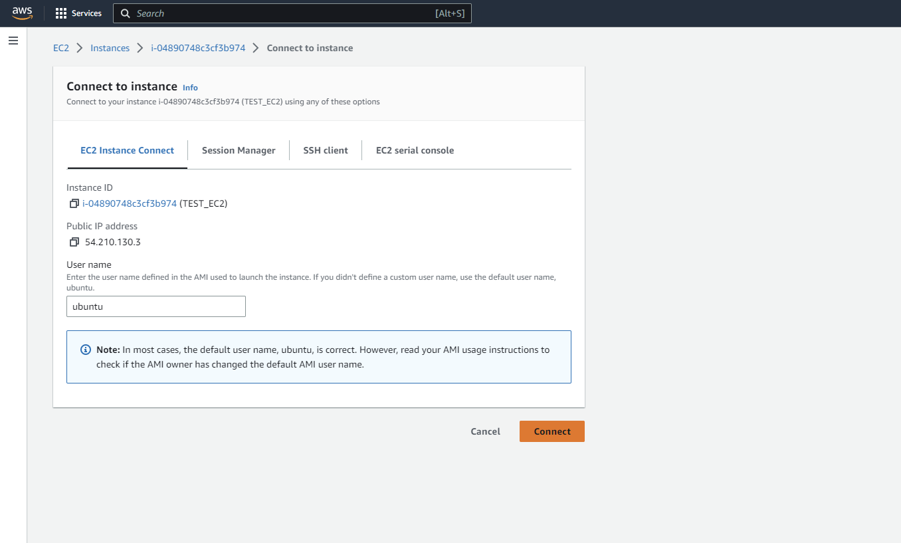
Connecting to existing AWS RDS from VSCode
Inside AWS
Connect to EC2 from AWS and verify the file is created

Slide 11
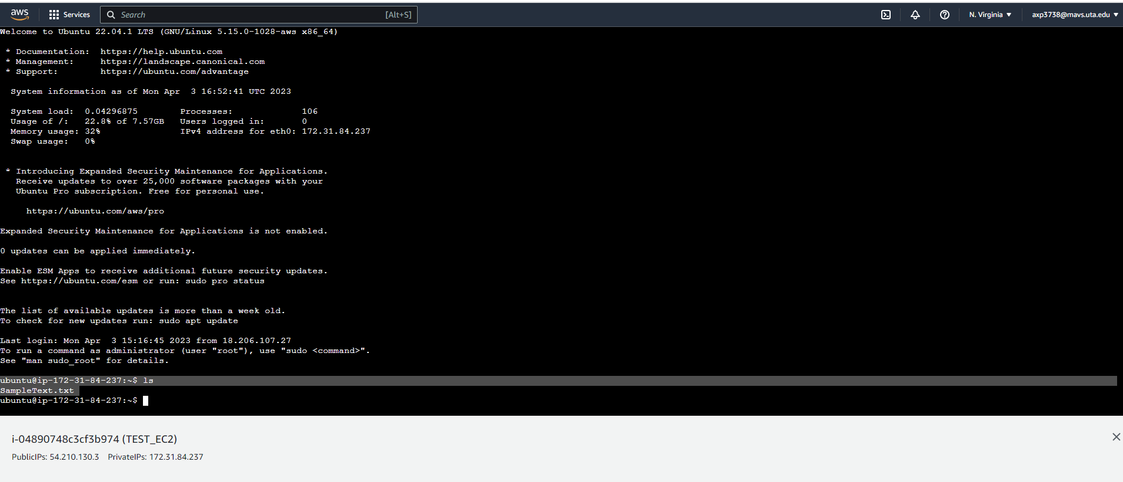
Connecting to AWS RDS from VSCode using Python
‘ls’ command lists the text file here
Inside AWS

Slide 12
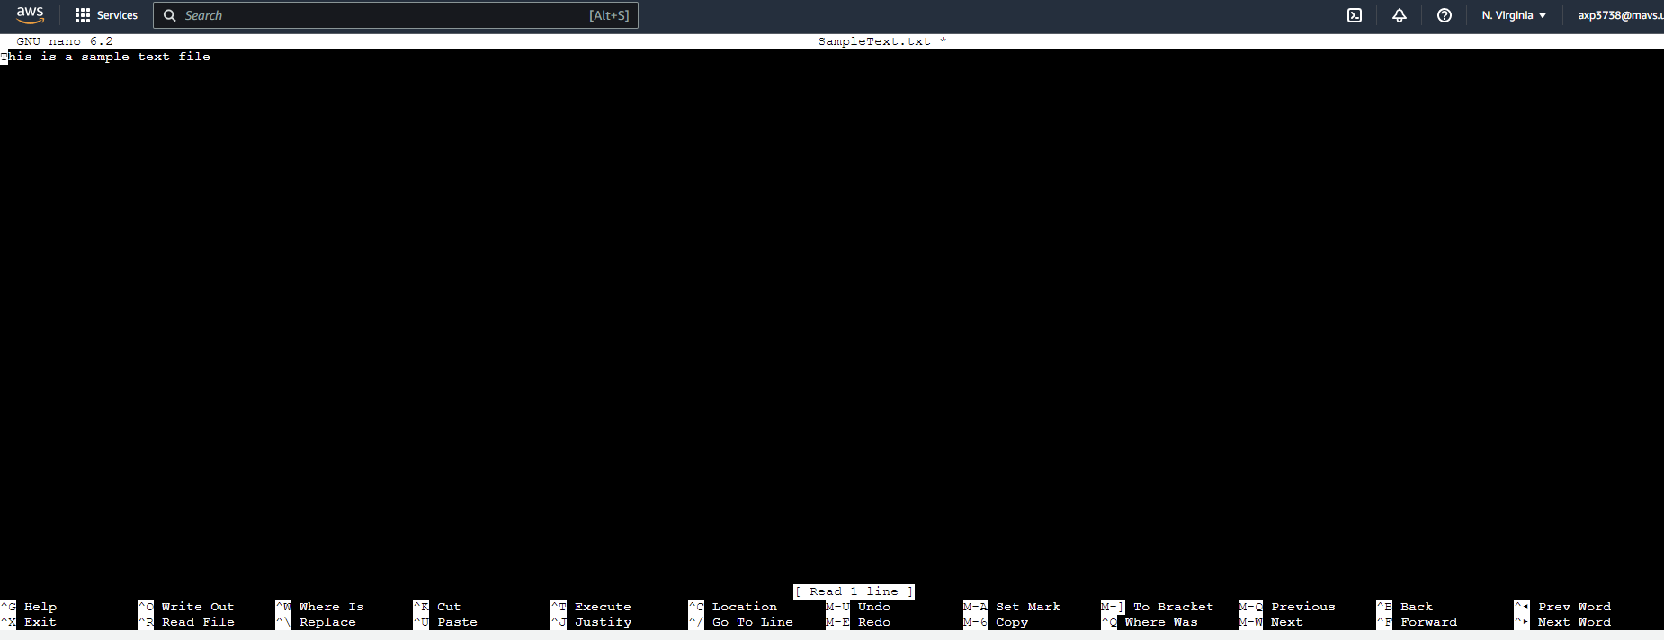
Connecting to AWS RDS from VSCode using Python
‘nano’ command shows the file contents
Inside AWS

Slide 13
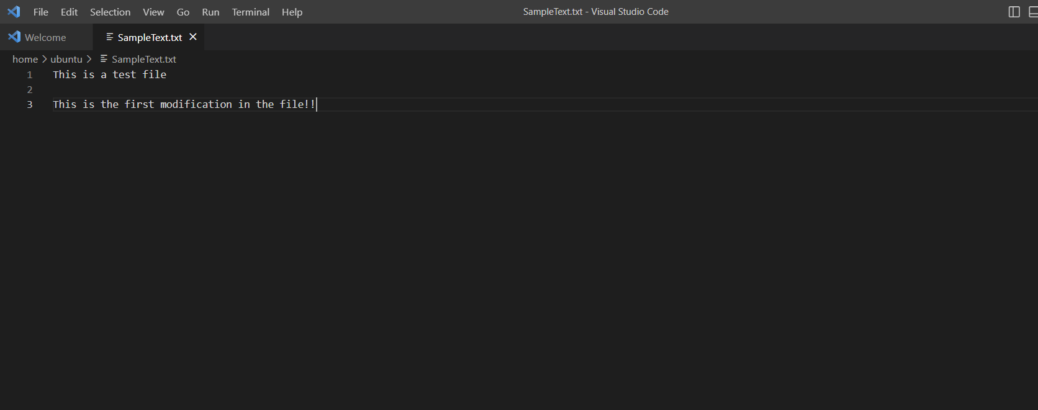
Connecting to AWS RDS from VSCode using Python
Edit the text file from VSCode and confirm if the changes can be seen in AWS
Inside VSCode

Slide 14

Connecting to AWS RDS from VSCode using Python
Inside AWS
Modifications can be seen in the file, opened from AWS

Slide 15
References:
https://docs.aws.amazon.com/toolkit-for-vscode/latest/userguide/connect.html
https://medium.com/@christyjacob4/using-vscode-remotely-on-an-ec2-instance-7822c4032cff

