Slide 1
START
7th International Conference on Bacteriophage Research and Antimicrobial Resistance
Lytic Legends Edition — 13 rounds of plaques, probes and punchlines

Slide 2
Teams
Lytic Legends
Biofilm Breakers
Phage Pharmers
Virion Architects
Dr. Ruma
Ms. Priya
Mr. Karan
Dr. Rupali
Dr. Prachi
Mr. Prajasattak
Team member 1
Team member 2
Team member 3
Team member 1
Team member 2
Team member 3

Slide 3
Rounds
1. GENERAL QUESTIONS
2. HISTORY OF BACTERIOPHAGES
3. PHAGE RELATED PROTOCOLS
4. PHAGE INFORMATICS
5. PHAGE IDENTIFICATION
6. IDENTIFY THE FIGURE
7. PHAGE THERAPY & CLINICAL FRONTIERS NEW TOPIC
8. PHAGE ACRONYMS
9. PHAGE ECOLOGY & ONE HEALTH NEW TOPIC
10. BACTERIAL DEFENSES & PHAGE COUNTER-DEFENSE NEW TOPIC
BREAK (5 min)
11. RAPID FIRE
12. TIE-BREAKER ROUND
13. EMOJI REBUS & PHAGE PERSONALS FUN ROUND
14. LYTIC LAUGHS

Slide 4
Markings
Rounds 1-5 +10 / 0 30 sec
Rounds 6-10 +10 / -5 30 sec
Rapid Fire +5 / 0, no passing 60 sec / team
Tie-Breaker +20 / -10, passed +5 60 sec
Emoji Rebus & Lytic Laughs +10 / 0 30 sec
Each MCQ round: 8 team questions + 2 audience questions

Slide 5
1
GENERAL QUESTIONS
Correct +10
Wrong 0
30 sec

Slide 6
ROUND 1
Phage genomes are unusually compact, with overlapping genes and non-canonical start codons. The best explanation is
A Selection for genome compaction under capsid packaging constraints
B A high mutation rate that erases intergenic regions
C Limitation of host ribosomes during infection
D An artifact of automated annotation pipelines
Notes:
ANSWER: A — Selection for genome compaction under capsid packaging constraints

Slide 7
ROUND 1
Phage genomes are unusually compact, with overlapping genes and non-canonical start codons. The best explanation is
A Selection for genome compaction under capsid packaging constraints
B A high mutation rate that erases intergenic regions
C Limitation of host ribosomes during infection
D An artifact of automated annotation pipelines

Slide 8
ROUND 1
The ~50–60 atm internal pressure that drives genome ejection from tailed phage capsids is generated mainly by
A The host proton-motive force pulling DNA inward
B Dense inverse-spool DNA packing with electrostatic self-repulsion
C ATP hydrolysis by the portal motor during ejection
D Osmotic water influx upon receptor binding
Notes:
ANSWER: B — Dense inverse-spool DNA packing with electrostatic self-repulsion

Slide 9
ROUND 1
The ~50–60 atm internal pressure that drives genome ejection from tailed phage capsids is generated mainly by
A The host proton-motive force pulling DNA inward
B Dense inverse-spool DNA packing with electrostatic self-repulsion
C ATP hydrolysis by the portal motor during ejection
D Osmotic water influx upon receptor binding

Slide 10
ROUND 1
At an MOI of exactly 1, the fraction of host cells receiving at least one phage (Poisson distribution) is approximately
A 37%
B 50%
C 63%
D 90%
Notes:
ANSWER: C — 63%

Slide 11
ROUND 1
At an MOI of exactly 1, the fraction of host cells receiving at least one phage (Poisson distribution) is approximately
A 37%
B 50%
C 63%
D 90%

Slide 12
ROUND 1
In the lambda lysis cassette (S, R, Rz, Rz1), the spanins Rz/Rz1 act by
A Degrading peptidoglycan from the periplasm
B Timing holin insertion into the inner membrane
C Recycling murein for the next infection cycle
D Fusing inner and outer membranes after endolysin action
Notes:
ANSWER: D — Fusing inner and outer membranes after endolysin action

Slide 13
ROUND 1
In the lambda lysis cassette (S, R, Rz, Rz1), the spanins Rz/Rz1 act by
A Degrading peptidoglycan from the periplasm
B Timing holin insertion into the inner membrane
C Recycling murein for the next infection cycle
D Fusing inner and outer membranes after endolysin action

Slide 14
ROUND 1
Optimality models of lysis timing predict that the evolutionarily stable latent period balances
A Burst size against the number of lysis cycles completed per unit time
B Adsorption rate against the eclipse period
C Genome size against capsid interior volume
D Latent period against the multiplicity of infection
Notes:
ANSWER: A — Burst size against the number of lysis cycles completed per unit time

Slide 15
ROUND 1
Optimality models of lysis timing predict that the evolutionarily stable latent period balances
A Burst size against the number of lysis cycles completed per unit time
B Adsorption rate against the eclipse period
C Genome size against capsid interior volume
D Latent period against the multiplicity of infection

Slide 16
ROUND 1
Botstein's “modular theory” of phage evolution proposes that
A Phage genes evolve strictly vertically with their hosts
B Functional modules (head, tail, lysis, lysogeny) recombine across phage lineages
C All tailed phages preserve a single ancestral gene order
D Phage genomes change only by point mutation
Notes:
ANSWER: B — Functional modules (head, tail, lysis, lysogeny) recombine across phage lineages

Slide 17
ROUND 1
Botstein's “modular theory” of phage evolution proposes that
A Phage genes evolve strictly vertically with their hosts
B Functional modules (head, tail, lysis, lysogeny) recombine across phage lineages
C All tailed phages preserve a single ancestral gene order
D Phage genomes change only by point mutation

Slide 18
ROUND 1
Jumbo phages such as ΦKZ protect their replicating DNA inside a compartment whose shell is built from
A Host-derived lipid bilayer
B Condensed RNA and polyamines
C The protein chimallin (a proteinaceous phage nucleus)
D Crystallized terminase
Notes:
ANSWER: C — The protein chimallin (a proteinaceous phage nucleus)

Slide 19
ROUND 1
Jumbo phages such as ΦKZ protect their replicating DNA inside a compartment whose shell is built from
A Host-derived lipid bilayer
B Condensed RNA and polyamines
C The protein chimallin (a proteinaceous phage nucleus)
D Crystallized terminase

Slide 20
ROUND 1
The kinetics of phage adsorption to susceptible hosts are best described as
A Zero-order until receptors saturate
B First-order in phage only, independent of host density
C Logistic, limited by burst size
D Second-order overall: first-order in both phage and host concentration
Notes:
ANSWER: D — Second-order overall: first-order in both phage and host concentration

Slide 21
ROUND 1
The kinetics of phage adsorption to susceptible hosts are best described as
A Zero-order until receptors saturate
B First-order in phage only, independent of host density
C Logistic, limited by burst size
D Second-order overall: first-order in both phage and host concentration

Slide 22
AUDIENCE
ROUND 1
Which is generally SMALLER?
A A bacteriophage
B A bacterium
C A yeast cell
D A red blood cell
Notes:
ANSWER: A — A bacteriophage

Slide 23
AUDIENCE
ROUND 1
Which is generally SMALLER?
A A bacteriophage
B A bacterium
C A yeast cell
D A red blood cell

Slide 24
AUDIENCE
ROUND 1
Phage contamination of starter cultures is a classic industrial problem in which fermentation?
A Bread baking
B Cheese and yogurt making
C Beer brewing
D Wine making
Notes:
ANSWER: B — Cheese and yogurt making

Slide 25
AUDIENCE
ROUND 1
Phage contamination of starter cultures is a classic industrial problem in which fermentation?
A Bread baking
B Cheese and yogurt making
C Beer brewing
D Wine making

Slide 26
2
HISTORY OF BACTERIOPHAGES
Correct +10
Wrong 0
30 sec

Slide 27
ROUND 2
In the Hershey–Chase experiment, what physically separated “phage ghosts” from infected bacteria?
A Shearing in a Waring blendor
B Differential centrifugation of isotopes
C Freeze–thaw lysis of the cells
D Ethanol precipitation of free phage
Notes:
ANSWER: A — Shearing in a Waring blendor

Slide 28
ROUND 2
In the Hershey–Chase experiment, what physically separated “phage ghosts” from infected bacteria?
A Shearing in a Waring blendor
B Differential centrifugation of isotopes
C Freeze–thaw lysis of the cells
D Ethanol precipitation of free phage

Slide 29
ROUND 2
Benzer's rII recombination mapping was only possible because rII mutants fail to plaque on
A Escherichia coli B
B Salmonella Typhimurium LT2
C Escherichia coli K12(λ)
D Pseudomonas aeruginosa PAO1
Notes:
ANSWER: C — Escherichia coli K12(λ)

Slide 30
ROUND 2
Benzer's rII recombination mapping was only possible because rII mutants fail to plaque on
A Escherichia coli B
B Salmonella Typhimurium LT2
C Escherichia coli K12(λ)
D Pseudomonas aeruginosa PAO1

Slide 31
ROUND 2
Crick, Brenner and colleagues (1961) proved the triplet nature of the code using proflavin-induced frameshifts in
A The T4 rII gene
B Lambda cI
C MS2 coat protein
D T7 gene 10
Notes:
ANSWER: A — The T4 rII gene

Slide 32
ROUND 2
Crick, Brenner and colleagues (1961) proved the triplet nature of the code using proflavin-induced frameshifts in
A The T4 rII gene
B Lambda cI
C MS2 coat protein
D T7 gene 10

Slide 33
ROUND 2
Weigle reactivation (1960) showed that UV-damaged lambda is rescued by
A Recombination with co-infecting intact phage
B SOS-induced host repair functions
C Photoreactivation of phage RNA
D Mitomycin C induction of the prophage
Notes:
ANSWER: B — SOS-induced host repair functions

Slide 34
ROUND 2
Weigle reactivation (1960) showed that UV-damaged lambda is rescued by
A Recombination with co-infecting intact phage
B SOS-induced host repair functions
C Photoreactivation of phage RNA
D Mitomycin C induction of the prophage

Slide 35
ROUND 2
“Host-controlled variation” of lambda grown on E. coli K-12 versus B directly led to the discovery of
A CRISPR-Cas immunity
B Abortive infection systems
C Restriction–modification systems
D Superinfection exclusion
Notes:
ANSWER: C — Restriction–modification systems

Slide 36
ROUND 2
“Host-controlled variation” of lambda grown on E. coli K-12 versus B directly led to the discovery of
A CRISPR-Cas immunity
B Abortive infection systems
C Restriction–modification systems
D Superinfection exclusion

Slide 37
ROUND 2
The Luria–Delbrück fluctuation test established that phage-resistance mutations
A Are instructed by phage exposure
B Spread by transduction
C Require SOS induction
D Arise spontaneously before phage exposure
Notes:
ANSWER: D — Arise spontaneously before phage exposure

Slide 38
ROUND 2
The Luria–Delbrück fluctuation test established that phage-resistance mutations
A Are instructed by phage exposure
B Spread by transduction
C Require SOS induction
D Arise spontaneously before phage exposure

Slide 39
ROUND 2
Frederick Twort's 1915 filterable agent was first observed lysing cultures of
A Shigella dysenteriae
B Vibrio cholerae
C Bacillus anthracis
D Staphylococcus
Notes:
ANSWER: D — Staphylococcus

Slide 40
ROUND 2
Frederick Twort's 1915 filterable agent was first observed lysing cultures of
A Shigella dysenteriae
B Vibrio cholerae
C Bacillus anthracis
D Staphylococcus

Slide 41
ROUND 2
Which 1930s assessment most accelerated the decline of commercial phage therapy in the United States?
A The Flexner Report
B The Eaton & Bayne-Jones review of phage preparations
C The Nuremberg Code
D A Lister Institute ban
Notes:
ANSWER: B — The Eaton & Bayne-Jones review of phage preparations

Slide 42
ROUND 2
Which 1930s assessment most accelerated the decline of commercial phage therapy in the United States?
A The Flexner Report
B The Eaton & Bayne-Jones review of phage preparations
C The Nuremberg Code
D A Lister Institute ban

Slide 43
AUDIENCE
ROUND 2
The 2017 compassionate-use case that brought phage therapy to global headlines treated a patient with
A Disseminated Acinetobacter baumannii infection
B MRSA endocarditis
C XDR tuberculosis
D Candida auris sepsis
Notes:
ANSWER: A — Disseminated Acinetobacter baumannii infection

Slide 44
AUDIENCE
ROUND 2
The 2017 compassionate-use case that brought phage therapy to global headlines treated a patient with
A Disseminated Acinetobacter baumannii infection
B MRSA endocarditis
C XDR tuberculosis
D Candida auris sepsis

Slide 45
AUDIENCE
ROUND 2
The 1969 Nobel Prize (Delbrück, Hershey, Luria) honoured work on the replication and genetic structure of
A Influenza virus
B Bacteriophages
C Poliovirus
D Retroviruses
Notes:
ANSWER: B — Bacteriophages

Slide 46
AUDIENCE
ROUND 2
The 1969 Nobel Prize (Delbrück, Hershey, Luria) honoured work on the replication and genetic structure of
A Influenza virus
B Bacteriophages
C Poliovirus
D Retroviruses

Slide 47
3
PHAGE RELATED PROTOCOLS
Correct +10
Wrong 0
30 sec

Slide 48
ROUND 3
Top-agar concentrations above ~0.7% shrink plaque sizes mainly because they
A Melt at lower temperatures
B Select for resistant mutants
C Chelate Ca2+ and Mg2+
D Restrict phage diffusion through the matrix
Notes:
ANSWER: D — Restrict phage diffusion through the matrix

Slide 49
ROUND 3
Top-agar concentrations above ~0.7% shrink plaque sizes mainly because they
A Melt at lower temperatures
B Select for resistant mutants
C Chelate Ca2+ and Mg2+
D Restrict phage diffusion through the matrix

Slide 50
ROUND 3
The particle-to-PFU ratio of a lysate is obtained by combining
A qPCR with PFGE
B CsCl gradients with SYBR Gold
C Flow cytometry (particle counts) with plaque assay
D LAL with TEM
Notes:
ANSWER: C — Flow cytometry (particle counts) with plaque assay

Slide 51
ROUND 3
The particle-to-PFU ratio of a lysate is obtained by combining
A qPCR with PFGE
B CsCl gradients with SYBR Gold
C Flow cytometry (particle counts) with plaque assay
D LAL with TEM

Slide 52
ROUND 3
During phage DNA extraction, contaminating free bacterial DNA is removed selectively by
A DNase I treatment before capsid lysis (capsid DNA is protected)
B Proteinase K before lysis
C Ethanol precipitation alone
D RNase A after lysis
Notes:
ANSWER: A — DNase I treatment before capsid lysis (capsid DNA is protected)

Slide 53
ROUND 3
During phage DNA extraction, contaminating free bacterial DNA is removed selectively by
A DNase I treatment before capsid lysis (capsid DNA is protected)
B Proteinase K before lysis
C Ethanol precipitation alone
D RNase A after lysis

Slide 54
ROUND 3
In a CsCl isopycnic gradient, phage bands at ~1.5 g/cm³. A lighter band at ~1.3 g/cm³ is most likely
A Protein and membrane vesicles
B Host chromosomal DNA
C Intact ribosomes
D Free exopolysaccharide
Notes:
ANSWER: A — Protein and membrane vesicles

Slide 55
ROUND 3
In a CsCl isopycnic gradient, phage bands at ~1.5 g/cm³. A lighter band at ~1.3 g/cm³ is most likely
A Protein and membrane vesicles
B Host chromosomal DNA
C Intact ribosomes
D Free exopolysaccharide

Slide 56
ROUND 3
Chloroform clarification of a lysate must NOT be used for
A Microviruses
B Enveloped phages such as Φ6
C Filamentous inoviruses
D Tailed dsDNA phages
Notes:
ANSWER: B — Enveloped phages such as Φ6

Slide 57
ROUND 3
Chloroform clarification of a lysate must NOT be used for
A Microviruses
B Enveloped phages such as Φ6
C Filamentous inoviruses
D Tailed dsDNA phages

Slide 58
ROUND 3
In the Ellis–Delbrück one-step growth experiment, unadsorbed phage is neutralized by
A Using stationary-phase hosts
B Anti-phage serum (or extreme dilution)
C Chilling to 4 °C
D Adding chloroform at time zero
Notes:
ANSWER: B — Anti-phage serum (or extreme dilution)

Slide 59
ROUND 3
In the Ellis–Delbrück one-step growth experiment, unadsorbed phage is neutralized by
A Using stationary-phase hosts
B Anti-phage serum (or extreme dilution)
C Chilling to 4 °C
D Adding chloroform at time zero

Slide 60
ROUND 3
A spot test giving confluent lysis that disappears on dilution, without plaques, indicates
A Lysis from without at high phage input
B A fully permissive host
C Lysogenic conversion
D Capsular blocking of adsorption
Notes:
ANSWER: A — Lysis from without at high phage input

Slide 61
ROUND 3
A spot test giving confluent lysis that disappears on dilution, without plaques, indicates
A Lysis from without at high phage input
B A fully permissive host
C Lysogenic conversion
D Capsular blocking of adsorption

Slide 62
ROUND 3
For phage stocks kept at 4 °C, which additive limits titer loss by adsorption to tube walls?
A 100 mM EDTA
B 50% glycerol
C Sodium azide
D Gelatin (or BSA)
Notes:
ANSWER: D — Gelatin (or BSA)

Slide 63
ROUND 3
For phage stocks kept at 4 °C, which additive limits titer loss by adsorption to tube walls?
A 100 mM EDTA
B 50% glycerol
C Sodium azide
D Gelatin (or BSA)

Slide 64
AUDIENCE
ROUND 3
In a spot test, a clear zone where phage suspension was dropped on a bacterial lawn indicates
A Medium contamination
B The strain is sensitive (lysis)
C The strain is resistant
D A mutation arose
Notes:
ANSWER: B — The strain is sensitive (lysis)

Slide 65
AUDIENCE
ROUND 3
In a spot test, a clear zone where phage suspension was dropped on a bacterial lawn indicates
A Medium contamination
B The strain is sensitive (lysis)
C The strain is resistant
D A mutation arose

Slide 66
AUDIENCE
ROUND 3
In a plaque assay, each plaque originates from
A A free DNA fragment
B An antibiotic disc
C A single infectious phage particle
D A single bacterial cell
Notes:
ANSWER: C — A single infectious phage particle

Slide 67
AUDIENCE
ROUND 3
In a plaque assay, each plaque originates from
A A free DNA fragment
B An antibiotic disc
C A single infectious phage particle
D A single bacterial cell

Slide 68
4
PHAGE INFORMATICS
Correct +10
Wrong 0
30 sec

Slide 69
ROUND 4
Under MIMAG standards, a high-quality draft viral genome requires
A ≥90% completeness, <5% contamination, plus tRNAs and identified termini
B Any contig >10 kb carrying a capsid gene
C 100× coverage regardless of completeness
D Presence of an integrase gene
Notes:
ANSWER: A — ≥90% completeness, <5% contamination, plus tRNAs and identified termini

Slide 70
ROUND 4
Under MIMAG standards, a high-quality draft viral genome requires
A ≥90% completeness, <5% contamination, plus tRNAs and identified termini
B Any contig >10 kb carrying a capsid gene
C 100× coverage regardless of completeness
D Presence of an integrase gene

Slide 71
ROUND 4
In read-mapping to a phage reference, terminal redundancy of the genome appears as
A A coverage gap at the cos site
B Elevated coverage across both genome ends
C Uniform coverage with spikes at tRNA genes
D Coverage falling to zero at the ends
Notes:
ANSWER: B — Elevated coverage across both genome ends

Slide 72
ROUND 4
In read-mapping to a phage reference, terminal redundancy of the genome appears as
A A coverage gap at the cos site
B Elevated coverage across both genome ends
C Uniform coverage with spikes at tRNA genes
D Coverage falling to zero at the ends

Slide 73
ROUND 4
Anti-CRISPR (acr) genes in prophages are typically found next to
A Host CRISPR arrays
B tRNA clusters
C aca genes encoding HTH-type transcriptional regulators
D Direct terminal repeats
Notes:
ANSWER: C — aca genes encoding HTH-type transcriptional regulators

Slide 74
ROUND 4
Anti-CRISPR (acr) genes in prophages are typically found next to
A Host CRISPR arrays
B tRNA clusters
C aca genes encoding HTH-type transcriptional regulators
D Direct terminal repeats

Slide 75
ROUND 4
“Viral tagging” (fluorescently labelled phage + flow sorting of single cells) is used to
A Measure buoyant density
B Cluster genomes by tetranucleotide frequency
C Sequence CRISPR spacers
D Link phages to their hosts at single-cell resolution
Notes:
ANSWER: D — Link phages to their hosts at single-cell resolution

Slide 76
ROUND 4
“Viral tagging” (fluorescently labelled phage + flow sorting of single cells) is used to
A Measure buoyant density
B Cluster genomes by tetranucleotide frequency
C Sequence CRISPR spacers
D Link phages to their hosts at single-cell resolution

Slide 77
ROUND 4
VIRIDIC demarcates viral species and genera using
A Intergenomic nucleotide similarity
B Shared tRNA counts
C Codon-usage distance
D Capsid morphology vectors
Notes:
ANSWER: A — Intergenomic nucleotide similarity

Slide 78
ROUND 4
VIRIDIC demarcates viral species and genera using
A Intergenomic nucleotide similarity
B Shared tRNA counts
C Codon-usage distance
D Capsid morphology vectors

Slide 79
ROUND 4
CheckV evaluates viral metagenome-assembled genomes for
A Host range prediction
B Completeness, contamination and provirus boundaries
C Plaque morphology class
D AMR gene content
Notes:
ANSWER: B — Completeness, contamination and provirus boundaries

Slide 80
ROUND 4
CheckV evaluates viral metagenome-assembled genomes for
A Host range prediction
B Completeness, contamination and provirus boundaries
C Plaque morphology class
D AMR gene content

Slide 81
ROUND 4
PhageTerm determines
A Lysis timing from growth curves
B Taxonomic family from marker genes
C Genome termini and the packaging mechanism (cos, pac, headful)
D Optimal cocktail composition
Notes:
ANSWER: C — Genome termini and the packaging mechanism (cos, pac, headful)

Slide 82
ROUND 4
PhageTerm determines
A Lysis timing from growth curves
B Taxonomic family from marker genes
C Genome termini and the packaging mechanism (cos, pac, headful)
D Optimal cocktail composition

Slide 83
ROUND 4
Comparing phage codon adaptation to candidate hosts helps predict
A Burst size
B Capsid diameter
C Genome termini type
D The likely host / recent host adaptation
Notes:
ANSWER: D — The likely host / recent host adaptation

Slide 84
ROUND 4
Comparing phage codon adaptation to candidate hosts helps predict
A Burst size
B Capsid diameter
C Genome termini type
D The likely host / recent host adaptation

Slide 85
AUDIENCE
ROUND 4
The complete collection of viruses in a sample is called the
A Microbiome
B Virome
C Proteome
D Plasmidome
Notes:
ANSWER: B — Virome

Slide 86
AUDIENCE
ROUND 4
The complete collection of viruses in a sample is called the
A Microbiome
B Virome
C Proteome
D Plasmidome

Slide 87
AUDIENCE
ROUND 4
A prophage region whose GC content differs strongly from the rest of the bacterial chromosome suggests
A Recently acquired foreign DNA
B A better plaque morphology
C A smaller capsid
D An RNA genome
Notes:
ANSWER: A — Recently acquired foreign DNA

Slide 88
AUDIENCE
ROUND 4
A prophage region whose GC content differs strongly from the rest of the bacterial chromosome suggests
A Recently acquired foreign DNA
B A better plaque morphology
C A smaller capsid
D An RNA genome

Slide 89
5
PHAGE IDENTIFICATION
Correct +10
Wrong 0
30 sec

Slide 90
ROUND 5
Under current ICTV taxonomy, phage T7 (formerly Podoviridae) is placed in the family
A Autographiviridae
B Ackermannviridae
C Drexlerviridae
D Herelleviridae
Notes:
ANSWER: A — Autographiviridae

Slide 91
ROUND 5
Under current ICTV taxonomy, phage T7 (formerly Podoviridae) is placed in the family
A Autographiviridae
B Ackermannviridae
C Drexlerviridae
D Herelleviridae

Slide 92
ROUND 5
The lipid envelope of cystovirus Φ6 is
A Assembled from host-derived membrane lipids
B Acquired from outer-membrane vesicles of other species
C A protein-only pseudo-envelope
D Synthesized de novo with phage-made sterols
Notes:
ANSWER: A — Assembled from host-derived membrane lipids

Slide 93
ROUND 5
The lipid envelope of cystovirus Φ6 is
A Assembled from host-derived membrane lipids
B Acquired from outer-membrane vesicles of other species
C A protein-only pseudo-envelope
D Synthesized de novo with phage-made sterols

Slide 94
ROUND 5
In levivirus MS2, the single-copy maturation (A) protein
A Triggers lysis
B Forms the icosahedral capsid
C Binds the F-pilus and escorts the RNA into the cell
D Acts as the replicase subunit
Notes:
ANSWER: C — Binds the F-pilus and escorts the RNA into the cell

Slide 95
ROUND 5
In levivirus MS2, the single-copy maturation (A) protein
A Triggers lysis
B Forms the icosahedral capsid
C Binds the F-pilus and escorts the RNA into the cell
D Acts as the replicase subunit

Slide 96
ROUND 5
The portal vertex of tailed phages is typically a ring of
A 5 subunits
B ~12–13 portal subunits
C 60 subunits matching T=1 symmetry
D 1 subunit
Notes:
ANSWER: B — ~12–13 portal subunits

Slide 97
ROUND 5
The portal vertex of tailed phages is typically a ring of
A 5 subunits
B ~12–13 portal subunits
C 60 subunits matching T=1 symmetry
D 1 subunit

Slide 98
ROUND 5
Transcription of jumbo phage ΦKZ is independent of the host RNA polymerase because the phage
A Transcribes via a ribozyme
B Hijacks host Pol II
C Uses a phage-encoded sigma factor with host RNAP
D Encodes its own multisubunit RNA polymerase
Notes:
ANSWER: D — Encodes its own multisubunit RNA polymerase

Slide 99
ROUND 5
Transcription of jumbo phage ΦKZ is independent of the host RNA polymerase because the phage
A Transcribes via a ribozyme
B Hijacks host Pol II
C Uses a phage-encoded sigma factor with host RNAP
D Encodes its own multisubunit RNA polymerase

Slide 100
ROUND 5
Filamentous inoviruses leave the host without lysis by
A Low-frequency holin–endolysin lysis
B Spanin-mediated membrane fusion
C Budding with a lipid envelope
D Extrusion through the envelope (e.g., via the pIV secretin)
Notes:
ANSWER: D — Extrusion through the envelope (e.g., via the pIV secretin)

Slide 101
ROUND 5
Filamentous inoviruses leave the host without lysis by
A Low-frequency holin–endolysin lysis
B Spanin-mediated membrane fusion
C Budding with a lipid envelope
D Extrusion through the envelope (e.g., via the pIV secretin)

Slide 102
ROUND 5
T4 whiskers (wac/fib3) function to
A Anchor the baseplate to the capsid
B Hold long tail fibers folded against the tail before adsorption
C Contract and pierce the outer membrane
D Package DNA into the procapsid
Notes:
ANSWER: B — Hold long tail fibers folded against the tail before adsorption

Slide 103
ROUND 5
T4 whiskers (wac/fib3) function to
A Anchor the baseplate to the capsid
B Hold long tail fibers folded against the tail before adsorption
C Contract and pierce the outer membrane
D Package DNA into the procapsid

Slide 104
ROUND 5
The collar of phage T4 forms
A The portal–terminase bridge
B The head–tail junction
C The sheath–tube interface
D The fiber–baseplate contact
Notes:
ANSWER: B — The head–tail junction

Slide 105
ROUND 5
The collar of phage T4 forms
A The portal–terminase bridge
B The head–tail junction
C The sheath–tube interface
D The fiber–baseplate contact

Slide 106
AUDIENCE
ROUND 5
Under TEM, a tailed phage with a small head and a very SHORT non-contractile tail is a
A Siphovirus
B Filamentous phage
C Podovirus
D Myovirus
Notes:
ANSWER: C — Podovirus

Slide 107
AUDIENCE
ROUND 5
Under TEM, a tailed phage with a small head and a very SHORT non-contractile tail is a
A Siphovirus
B Filamentous phage
C Podovirus
D Myovirus

Slide 108
AUDIENCE
ROUND 5
Turbid (cloudy) plaques usually suggest
A A temperate phage forming lysogens
B A strictly lytic phage
C An RNA phage
D Medium contamination
Notes:
ANSWER: A — A temperate phage forming lysogens

Slide 109
AUDIENCE
ROUND 5
Turbid (cloudy) plaques usually suggest
A A temperate phage forming lysogens
B A strictly lytic phage
C An RNA phage
D Medium contamination

Slide 110
6
IDENTIFY THE FIGURE
Correct +10
Wrong -5
30 sec

Slide 111
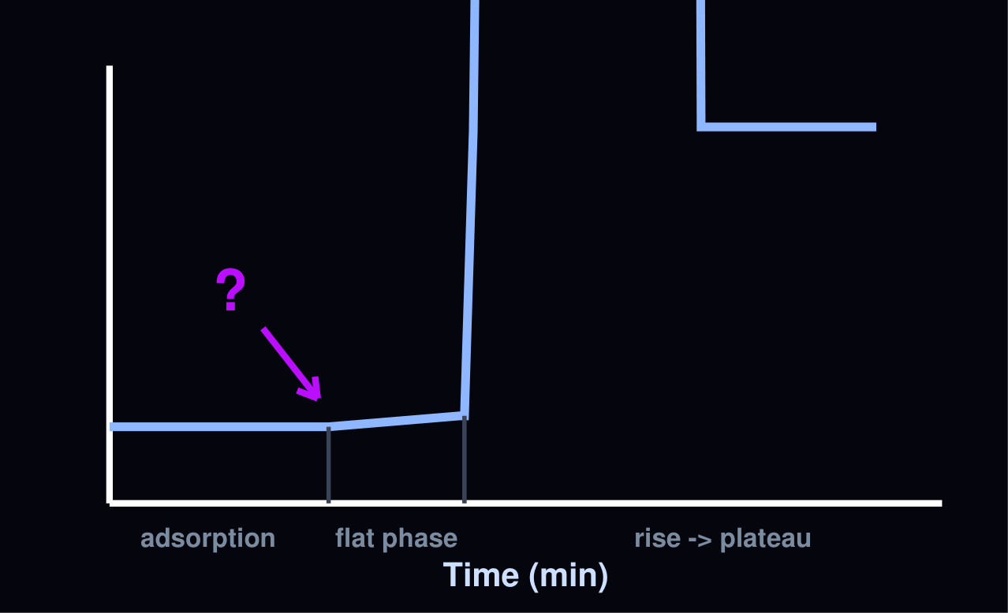
ROUND 6
In the arrowed interval of this one-step growth curve, no intracellular infectious virions can be recovered. This portion is the
A Eclipse period
B Rise period
C Burst phase
D Adsorption plateau
Notes:
ANSWER: A — Eclipse period

Slide 112
ROUND 6
In the arrowed interval of this one-step growth curve, no intracellular infectious virions can be recovered. This portion is the
A Eclipse period
B Rise period
C Burst phase
D Adsorption plateau

Slide 113
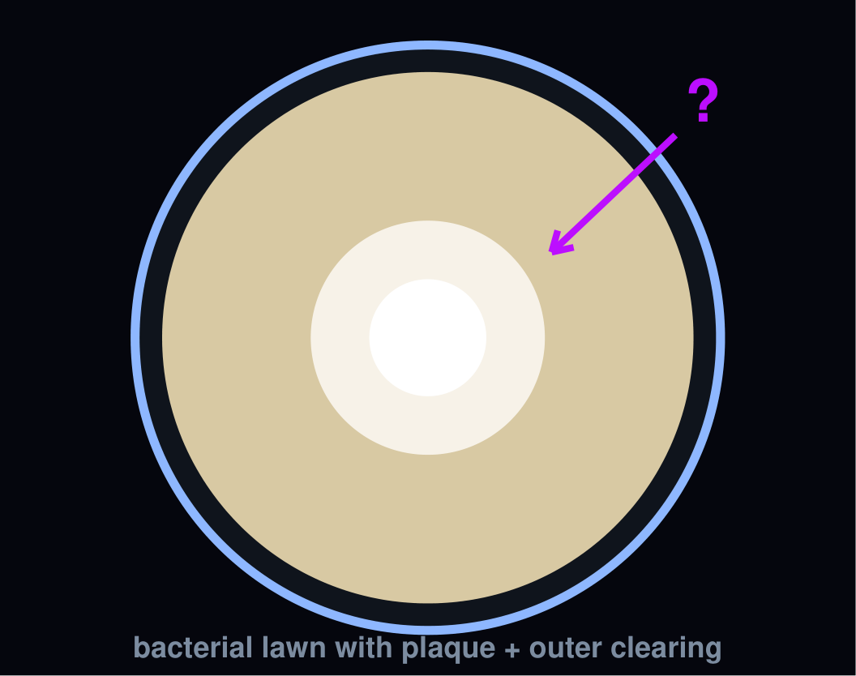
ROUND 6
The clear HALO extending beyond the plaque edge in this plate is most likely due to
A An antibiotic in the medium
B Extracellular depolymerase degrading the capsule/EPS
C Lysis from without
D Phage-resistant mutants
Notes:
ANSWER: B — Extracellular depolymerase degrading the capsule/EPS

Slide 114
ROUND 6
The clear HALO extending beyond the plaque edge in this plate is most likely due to
A An antibiotic in the medium
B Extracellular depolymerase degrading the capsule/EPS
C Lysis from without
D Phage-resistant mutants

Slide 115
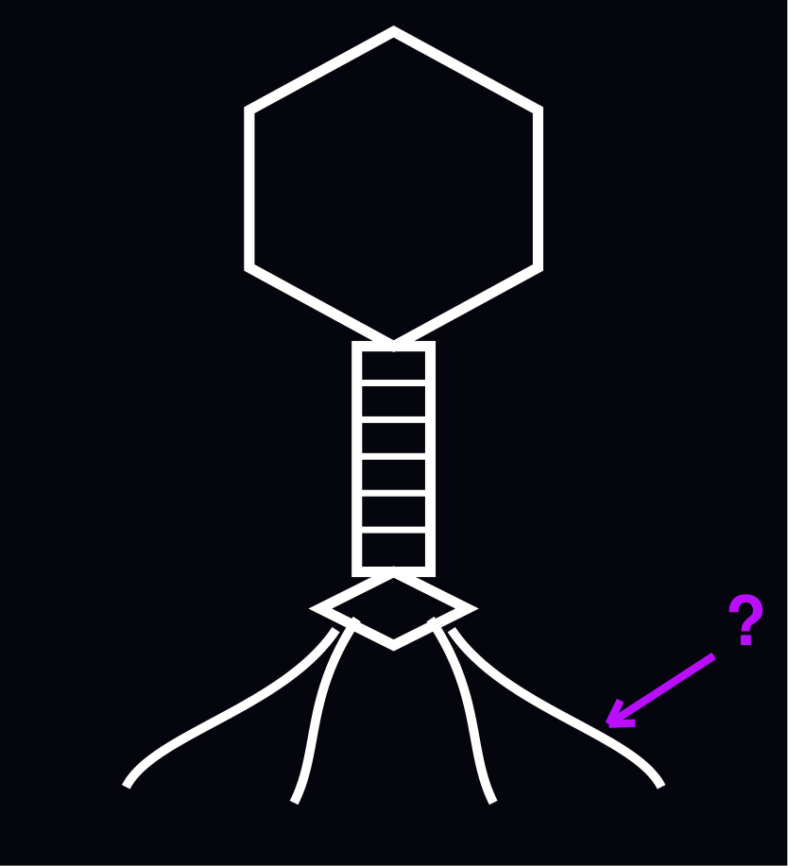
ROUND 6
The arrowed long tail fibers bind reversibly. Irreversible adsorption of T4 is then mediated by
A Short tail fibers engaging the inner LPS core after baseplate triggering
B A second long-fiber receptor
C Teichoic acid bridging
D Pilus retraction
Notes:
ANSWER: A — Short tail fibers engaging the inner LPS core after baseplate triggering

Slide 116
ROUND 6
The arrowed long tail fibers bind reversibly. Irreversible adsorption of T4 is then mediated by
A Short tail fibers engaging the inner LPS core after baseplate triggering
B A second long-fiber receptor
C Teichoic acid bridging
D Pilus retraction

Slide 117
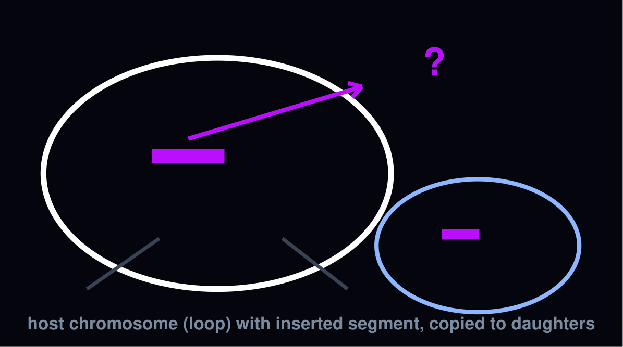
ROUND 6
The integrated state depicted here is maintained by
A Cro
B The cI repressor
C CII
D N antitermination
Notes:
ANSWER: B — The cI repressor

Slide 118
ROUND 6
The integrated state depicted here is maintained by
A Cro
B The cI repressor
C CII
D N antitermination

Slide 119
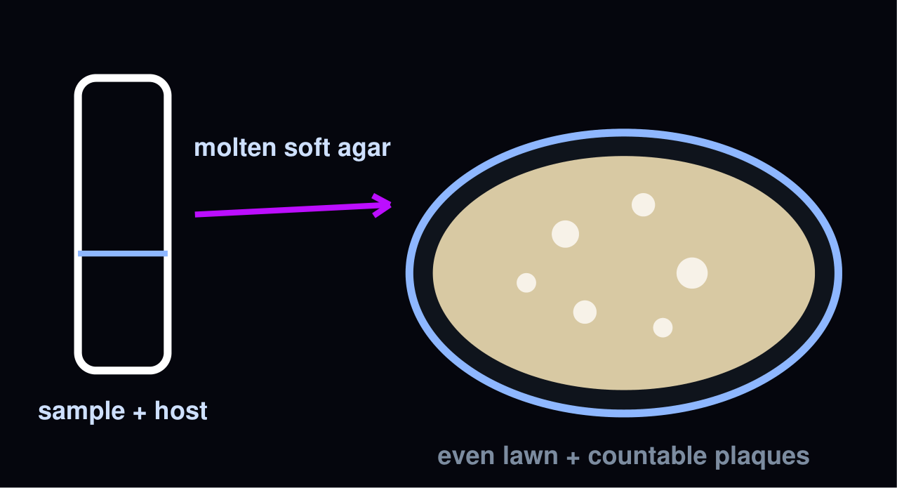
ROUND 6
Top agar is cooled to ~45 °C before mixing because this
A Increases plaque turbidity
B Speeds up lawn growth
C Prevents Ca2+ precipitation
D Keeps agar liquid while sparing phage and host from heat
Notes:
ANSWER: D — Keeps agar liquid while sparing phage and host from heat

Slide 120
ROUND 6
Top agar is cooled to ~45 °C before mixing because this
A Increases plaque turbidity
B Speeds up lawn growth
C Prevents Ca2+ precipitation
D Keeps agar liquid while sparing phage and host from heat

Slide 121

ROUND 6
The arrowed band at ~1.5 g/cm³ holds phage. A fainter band at ~1.3 g/cm³ in the same tube would be
A Protein and membrane vesicles
B Host rRNA
C Intact progeny virions
D DNA–protein concatemers
Notes:
ANSWER: A — Protein and membrane vesicles

Slide 122
ROUND 6
The arrowed band at ~1.5 g/cm³ holds phage. A fainter band at ~1.3 g/cm³ in the same tube would be
A Protein and membrane vesicles
B Host rRNA
C Intact progeny virions
D DNA–protein concatemers

Slide 123
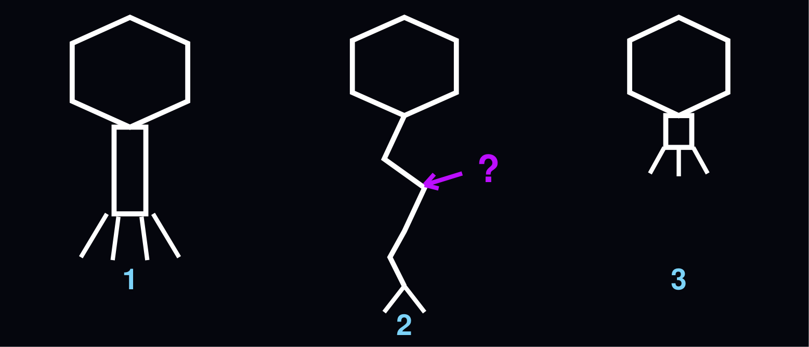
ROUND 6
Unlike virion 1, the MIDDLE virion injects its DNA by
A Contracting its tail more slowly
B Injecting RNA instead of DNA
C Receptor-triggered conformational change without sheath contraction
D Consuming host ATP for contraction
Notes:
ANSWER: C — Receptor-triggered conformational change without sheath contraction

Slide 124
ROUND 6
Unlike virion 1, the MIDDLE virion injects its DNA by
A Contracting its tail more slowly
B Injecting RNA instead of DNA
C Receptor-triggered conformational change without sheath contraction
D Consuming host ATP for contraction

Slide 125
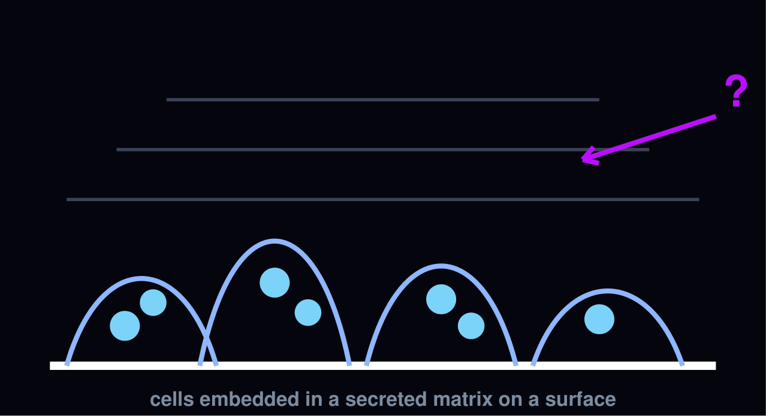
ROUND 6
To penetrate the matrix shown in this biofilm diagram, the most useful phage-encoded enzymes are
A DNA ligases
B Integrases
C RNA polymerases
D Depolymerases
Notes:
ANSWER: D — Depolymerases

Slide 126
ROUND 6
To penetrate the matrix shown in this biofilm diagram, the most useful phage-encoded enzymes are
A DNA ligases
B Integrases
C RNA polymerases
D Depolymerases

Slide 127
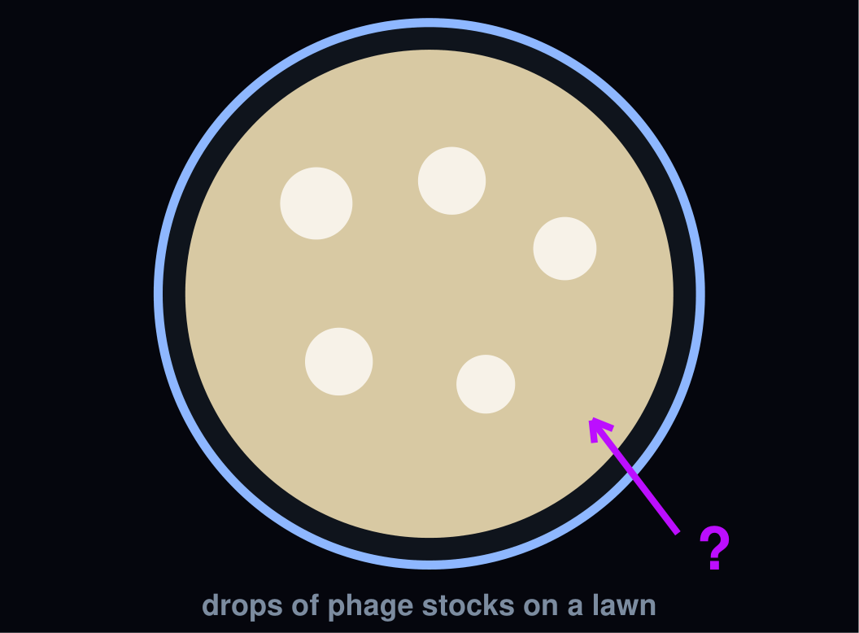
ROUND 6
On this spot-assay plate, a drop giving confluent clearing but no plaques on dilution indicates
A A fully permissive host
B Lysogenic conversion
C Lysis from without / killing without productive infection
D Depolymerase secretion
Notes:
ANSWER: C — Lysis from without / killing without productive infection

Slide 128
ROUND 6
On this spot-assay plate, a drop giving confluent clearing but no plaques on dilution indicates
A A fully permissive host
B Lysogenic conversion
C Lysis from without / killing without productive infection
D Depolymerase secretion

Slide 129
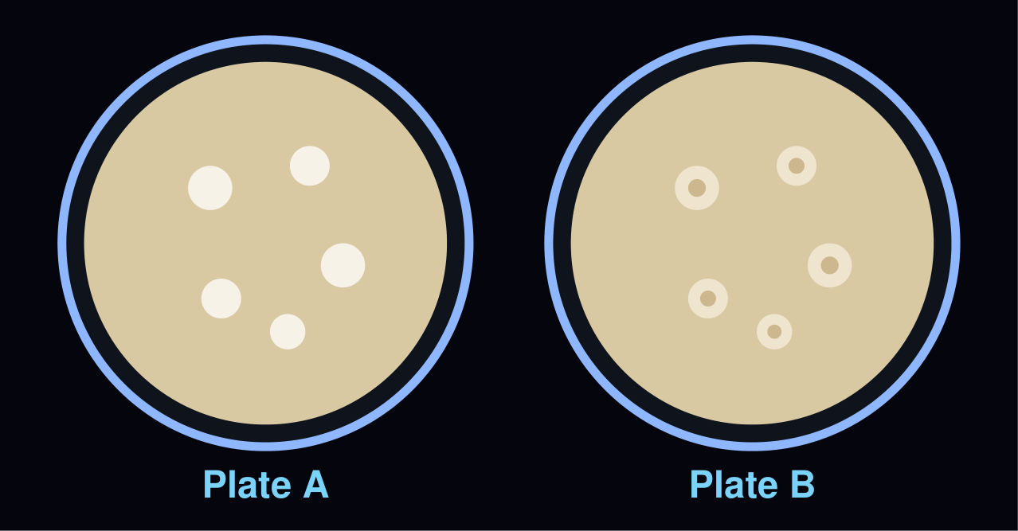
ROUND 6
Plate A shows clear plaques, plate B turbid plaques. The turbidity in plate B is caused by
A Incomplete top-agar setting
B Growth of immune lysogens within the plaque
C Contaminating fungi
D A very small burst size
Notes:
ANSWER: B — Growth of immune lysogens within the plaque

Slide 130
ROUND 6
Plate A shows clear plaques, plate B turbid plaques. The turbidity in plate B is caused by
A Incomplete top-agar setting
B Growth of immune lysogens within the plaque
C Contaminating fungi
D A very small burst size

Slide 131
7
PHAGE THERAPY & CLINICAL FRONTIERS
✦ NEW TOPIC ✦
Correct +10
Wrong -5
30 sec

Slide 132
NEW TOPIC
ROUND 7
The 2019 Nature Medicine report of an engineered three-phage cocktail successfully treated which infection in a cystic fibrosis patient?
A Staphylococcus aureus osteomyelitis
B Disseminated Mycobacterium abscessus infection
C Pseudomonas aeruginosa pneumonia
D Acinetobacter baumannii sepsis
Notes:
ANSWER: B — Disseminated Mycobacterium abscessus infection

Slide 133
NEW TOPIC
ROUND 7
The 2019 Nature Medicine report of an engineered three-phage cocktail successfully treated which infection in a cystic fibrosis patient?
A Staphylococcus aureus osteomyelitis
B Disseminated Mycobacterium abscessus infection
C Pseudomonas aeruginosa pneumonia
D Acinetobacter baumannii sepsis

Slide 134
NEW TOPIC
ROUND 7
Since 2018, Belgium delivers therapeutic phages to patients as
A Over-the-counter medicines
B Vaccines
C Medical devices
D Active pharmaceutical ingredients within magistral preparations
Notes:
ANSWER: D — Active pharmaceutical ingredients within magistral preparations

Slide 135
NEW TOPIC
ROUND 7
Since 2018, Belgium delivers therapeutic phages to patients as
A Over-the-counter medicines
B Vaccines
C Medical devices
D Active pharmaceutical ingredients within magistral preparations

Slide 136
NEW TOPIC
ROUND 7
The PhagoBurn trial (Lancet ID, 2018) evaluated phage therapy against which pathogen in burn wounds?
A Escherichia coli
B Staphylococcus aureus
C Pseudomonas aeruginosa
D Klebsiella pneumoniae
Notes:
ANSWER: C — Pseudomonas aeruginosa

Slide 137
NEW TOPIC
ROUND 7
The PhagoBurn trial (Lancet ID, 2018) evaluated phage therapy against which pathogen in burn wounds?
A Escherichia coli
B Staphylococcus aureus
C Pseudomonas aeruginosa
D Klebsiella pneumoniae

Slide 138
NEW TOPIC
ROUND 7
LBP-EC01, the first engineered (CRISPR-Cas3-enhanced) phage tested in a randomized placebo-controlled trial, targets
A Escherichia coli in urinary tract infection
B Clostridioides difficile colitis
C Pseudomonas aeruginosa in CF
D Staphylococcus aureus bacteremia
Notes:
ANSWER: A — Escherichia coli in urinary tract infection

Slide 139
NEW TOPIC
ROUND 7
LBP-EC01, the first engineered (CRISPR-Cas3-enhanced) phage tested in a randomized placebo-controlled trial, targets
A Escherichia coli in urinary tract infection
B Clostridioides difficile colitis
C Pseudomonas aeruginosa in CF
D Staphylococcus aureus bacteremia

Slide 140
NEW TOPIC
ROUND 7
“Phage steering” mitigates AMR by
A Increasing the MOI until resistance collapses
B Selecting phage-resistant mutants whose fitness cost re-sensitizes them to antibiotics
C Blocking phage receptors with antibodies
D Using phages to inactivate antibiotics
Notes:
ANSWER: B — Selecting phage-resistant mutants whose fitness cost re-sensitizes them to antibiotics

Slide 141
NEW TOPIC
ROUND 7
“Phage steering” mitigates AMR by
A Increasing the MOI until resistance collapses
B Selecting phage-resistant mutants whose fitness cost re-sensitizes them to antibiotics
C Blocking phage receptors with antibodies
D Using phages to inactivate antibiotics

Slide 142
NEW TOPIC
ROUND 7
A key immunological limitation of repeated intravenous phage dosing is
A Permanent T-cell exhaustion
B Neutralizing antibodies that accelerate phage clearance
C Phages cannot enter the bloodstream
D Immediate IgE anaphylaxis in every patient
Notes:
ANSWER: B — Neutralizing antibodies that accelerate phage clearance

Slide 143
NEW TOPIC
ROUND 7
A key immunological limitation of repeated intravenous phage dosing is
A Permanent T-cell exhaustion
B Neutralizing antibodies that accelerate phage clearance
C Phages cannot enter the bloodstream
D Immediate IgE anaphylaxis in every patient

Slide 144
NEW TOPIC
ROUND 7
In the United States, compassionate-use phage therapy is typically authorized through
A An FDA emergency/expanded-access IND (eIND)
B EPA registration
C An OTC monograph
D A USDA rule
Notes:
ANSWER: A — An FDA emergency/expanded-access IND (eIND)

Slide 145
NEW TOPIC
ROUND 7
In the United States, compassionate-use phage therapy is typically authorized through
A An FDA emergency/expanded-access IND (eIND)
B EPA registration
C An OTC monograph
D A USDA rule

Slide 146
NEW TOPIC
ROUND 7
Before clinical use, a therapeutic phage genome must be screened to confirm
A Absence of toxin, AMR and virulence genes
B GC content above 60%
C Uracil instead of thymine
D Presence of an integrase gene
Notes:
ANSWER: A — Absence of toxin, AMR and virulence genes

Slide 147
NEW TOPIC
ROUND 7
Before clinical use, a therapeutic phage genome must be screened to confirm
A Absence of toxin, AMR and virulence genes
B GC content above 60%
C Uracil instead of thymine
D Presence of an integrase gene

Slide 148
NEW TOPIC
AUDIENCE
ROUND 7
Commercial phage preparations sprayed on ready-to-eat food to control Listeria are an example of
A Pasteurization
B Vaccination
C Fermentation
D Biocontrol
Notes:
ANSWER: D — Biocontrol

Slide 149
NEW TOPIC
AUDIENCE
ROUND 7
Commercial phage preparations sprayed on ready-to-eat food to control Listeria are an example of
A Pasteurization
B Vaccination
C Fermentation
D Biocontrol

Slide 150
NEW TOPIC
AUDIENCE
ROUND 7
Compared with antibiotics, a distinctive advantage of phages is that they
A Kill human cells selectively
B Never encounter resistance
C Self-amplify at the site of infection
D Work without any bacteria present
Notes:
ANSWER: C — Self-amplify at the site of infection

Slide 151
NEW TOPIC
AUDIENCE
ROUND 7
Compared with antibiotics, a distinctive advantage of phages is that they
A Kill human cells selectively
B Never encounter resistance
C Self-amplify at the site of infection
D Work without any bacteria present

Slide 152
8
PHAGE ACRONYMS
Correct +10
Wrong -5
30 sec

Slide 153
ROUND 8
In phage anti-CRISPR biology, Aca proteins are
A Acr-associated HTH transcriptional regulators of acr operons
B Accessory capsid antigens
C Acid-stable coat adapters
D attC-associated recombinases
Notes:
ANSWER: A — Acr-associated HTH transcriptional regulators of acr operons

Slide 154
ROUND 8
In phage anti-CRISPR biology, Aca proteins are
A Acr-associated HTH transcriptional regulators of acr operons
B Accessory capsid antigens
C Acid-stable coat adapters
D attC-associated recombinases

Slide 155
ROUND 8
In phage genomics, DTRs and ITRs refer to
A Degenerate tandem recombinases
B Direct and inverted terminal repeats
C Density-transfer ratios
D Double-stranded transcriptional regions
Notes:
ANSWER: B — Direct and inverted terminal repeats

Slide 156
ROUND 8
In phage genomics, DTRs and ITRs refer to
A Degenerate tandem recombinases
B Direct and inverted terminal repeats
C Density-transfer ratios
D Double-stranded transcriptional regions

Slide 157
ROUND 8
In the name vB_EcoM-VPAE1, the “vB” prefix denotes
A Virus of Bacteria (followed by host genus and morphotype)
B Verified bacteriophage
C Viral barcode
D Vector backbone
Notes:
ANSWER: A — Virus of Bacteria (followed by host genus and morphotype)

Slide 158
ROUND 8
In the name vB_EcoM-VPAE1, the “vB” prefix denotes
A Virus of Bacteria (followed by host genus and morphotype)
B Verified bacteriophage
C Viral barcode
D Vector backbone

Slide 159
ROUND 8
MIMAG stands for
A Metagenome Integration Map
B Minimum Information about Microbial Archaeal Genomes
C Minimum Information about a Metagenome-Assembled Genome
D Microbial Image Magnification
Notes:
ANSWER: C — Minimum Information about a Metagenome-Assembled Genome

Slide 160
ROUND 8
MIMAG stands for
A Metagenome Integration Map
B Minimum Information about Microbial Archaeal Genomes
C Minimum Information about a Metagenome-Assembled Genome
D Microbial Image Magnification

Slide 161
ROUND 8
In phage genomics, AMGs are
A Auxiliary metabolic genes
B Amplified mobile genes
C Ancestral marker genes
D Adaptive mutation groups
Notes:
ANSWER: A — Auxiliary metabolic genes

Slide 162
ROUND 8
In phage genomics, AMGs are
A Auxiliary metabolic genes
B Amplified mobile genes
C Ancestral marker genes
D Adaptive mutation groups

Slide 163
ROUND 8
PHROGs are
A Prophage host-range groups
B Phage restriction operon groups
C Plaque heterogeneity ratings
D Phage orthologous groups for functional annotation
Notes:
ANSWER: D — Phage orthologous groups for functional annotation

Slide 164
ROUND 8
PHROGs are
A Prophage host-range groups
B Phage restriction operon groups
C Plaque heterogeneity ratings
D Phage orthologous groups for functional annotation

Slide 165
ROUND 8
In phage–mucus research, the BAM model stands for
A Bacterial adhesion matrix
B Bacteriophage adherence to mucus
C Biofilm-associated microcolony
D Buffered agar medium
Notes:
ANSWER: B — Bacteriophage adherence to mucus

Slide 166
ROUND 8
In phage–mucus research, the BAM model stands for
A Bacterial adhesion matrix
B Bacteriophage adherence to mucus
C Biofilm-associated microcolony
D Buffered agar medium

Slide 167
ROUND 8
The LAL assay reagent used in phage formulation is derived from
A Lactic acid bacteria
B Lysed adenovirus libraries
C Lipid antigen liposomes
D Limulus (horseshoe crab) amebocyte lysate
Notes:
ANSWER: D — Limulus (horseshoe crab) amebocyte lysate

Slide 168
ROUND 8
The LAL assay reagent used in phage formulation is derived from
A Lactic acid bacteria
B Lysed adenovirus libraries
C Lipid antigen liposomes
D Limulus (horseshoe crab) amebocyte lysate

Slide 169
AUDIENCE
ROUND 8
In One-Health discussions, AMR stands for
A Acquired mobile resistance
B Adaptive mutation rate
C Antimicrobial resistance
D Antibiotic modifier region
Notes:
ANSWER: C — Antimicrobial resistance

Slide 170
AUDIENCE
ROUND 8
In One-Health discussions, AMR stands for
A Acquired mobile resistance
B Adaptive mutation rate
C Antimicrobial resistance
D Antibiotic modifier region

Slide 171
AUDIENCE
ROUND 8
In the phage morphology lab, TEM stands for
A Thermal emission microscopy
B Transmission electron microscopy
C Total evanescent measurement
D Tunneling electron mapping
Notes:
ANSWER: B — Transmission electron microscopy

Slide 172
AUDIENCE
ROUND 8
In the phage morphology lab, TEM stands for
A Thermal emission microscopy
B Transmission electron microscopy
C Total evanescent measurement
D Tunneling electron mapping

Slide 173
9
PHAGE ECOLOGY & ONE HEALTH
✦ NEW TOPIC ✦
Correct +10
Wrong -5
30 sec

Slide 174
NEW TOPIC
ROUND 9
The “viral shunt” refers to
A Phage lysis redirecting microbial biomass into dissolved organic matter
B Aerosolization of virions
C Viral transport in the bloodstream
D Phage migration through soil
Notes:
ANSWER: A — Phage lysis redirecting microbial biomass into dissolved organic matter

Slide 175
NEW TOPIC
ROUND 9
The “viral shunt” refers to
A Phage lysis redirecting microbial biomass into dissolved organic matter
B Aerosolization of virions
C Viral transport in the bloodstream
D Phage migration through soil

Slide 176
NEW TOPIC
ROUND 9
A millilitre of surface seawater typically contains about
A 10^3 phages
B 10^12 phages
C 10^7 phages
D 10^15 phages
Notes:
ANSWER: C — 10^7 phages

Slide 177
NEW TOPIC
ROUND 9
A millilitre of surface seawater typically contains about
A 10^3 phages
B 10^12 phages
C 10^7 phages
D 10^15 phages

Slide 178
NEW TOPIC
ROUND 9
Cyanophages infecting Prochlorococcus often carry which host-derived gene to sustain photosynthesis during infection?
A nifH
B psbA (photosystem II D1 protein)
C rpoB
D atpD
Notes:
ANSWER: B — psbA (photosystem II D1 protein)

Slide 179
NEW TOPIC
ROUND 9
Cyanophages infecting Prochlorococcus often carry which host-derived gene to sustain photosynthesis during infection?
A nifH
B psbA (photosystem II D1 protein)
C rpoB
D atpD

Slide 180
NEW TOPIC
ROUND 9
“Kill-the-winner” dynamics predicts that
A Rare bacterial species are lysed first
B The most abundant host is preferentially hit by lytic phages
C Phages prefer dormant hosts
D Lysogeny dominates in rich environments
Notes:
ANSWER: B — The most abundant host is preferentially hit by lytic phages

Slide 181
NEW TOPIC
ROUND 9
“Kill-the-winner” dynamics predicts that
A Rare bacterial species are lysed first
B The most abundant host is preferentially hit by lytic phages
C Phages prefer dormant hosts
D Lysogeny dominates in rich environments

Slide 182
NEW TOPIC
ROUND 9
Which phage is among the most prevalent human-associated viruses on Earth, carried in the gut of a large fraction of adults?
A Phage Φ6
B Phage lambda
C crAssphage
D Phage T4
Notes:
ANSWER: C — crAssphage

Slide 183
NEW TOPIC
ROUND 9
Which phage is among the most prevalent human-associated viruses on Earth, carried in the gut of a large fraction of adults?
A Phage Φ6
B Phage lambda
C crAssphage
D Phage T4

Slide 184
NEW TOPIC
ROUND 9
The cholera toxin genes (ctxAB) are encoded by
A Phage P1
B Phage lambda
C Phage Mu
D Phage CTXφ
Notes:
ANSWER: D — Phage CTXφ

Slide 185
NEW TOPIC
ROUND 9
The cholera toxin genes (ctxAB) are encoded by
A Phage P1
B Phage lambda
C Phage Mu
D Phage CTXφ

Slide 186
NEW TOPIC
ROUND 9
Diphtheria toxin is encoded by
A Phage CTXφ
B The β-prophage (corynephage β)
C Phage P22
D Phage ΦKZ
Notes:
ANSWER: B — The β-prophage (corynephage β)

Slide 187
NEW TOPIC
ROUND 9
Diphtheria toxin is encoded by
A Phage CTXφ
B The β-prophage (corynephage β)
C Phage P22
D Phage ΦKZ

Slide 188
NEW TOPIC
ROUND 9
Shiga toxin genes (stx) carried by lambdoid prophages are central to the virulence of
A Shiga-toxigenic E. coli (STEC)
B Salmonella Typhi
C Listeria monocytogenes
D Campylobacter jejuni
Notes:
ANSWER: A — Shiga-toxigenic E. coli (STEC)

Slide 189
NEW TOPIC
ROUND 9
Shiga toxin genes (stx) carried by lambdoid prophages are central to the virulence of
A Shiga-toxigenic E. coli (STEC)
B Salmonella Typhi
C Listeria monocytogenes
D Campylobacter jejuni

Slide 190
NEW TOPIC
AUDIENCE
ROUND 9
Municipal sewage is extremely rich in phages mainly because
A High bacterial densities support massive phage replication
B Phages resist freezing
C UV light creates virions
D Chlorine selects for viruses
Notes:
ANSWER: A — High bacterial densities support massive phage replication

Slide 191
NEW TOPIC
AUDIENCE
ROUND 9
Municipal sewage is extremely rich in phages mainly because
A High bacterial densities support massive phage replication
B Phages resist freezing
C UV light creates virions
D Chlorine selects for viruses

Slide 192
NEW TOPIC
AUDIENCE
ROUND 9
Phages are part of “One Health” thinking because they
A Replace all vaccines
B Chemically purify water
C Only infect humans
D Connect human, animal and environmental microbiomes, including AMR dynamics
Notes:
ANSWER: D — Connect human, animal and environmental microbiomes, including AMR dynamics

Slide 193
NEW TOPIC
AUDIENCE
ROUND 9
Phages are part of “One Health” thinking because they
A Replace all vaccines
B Chemically purify water
C Only infect humans
D Connect human, animal and environmental microbiomes, including AMR dynamics

Slide 194
10
BACTERIAL DEFENSES & PHAGE COUNTER-DEFENSE
✦ NEW TOPIC ✦
Correct +10
Wrong -5
30 sec

Slide 195
NEW TOPIC
ROUND 10
CRISPR-Cas adaptive immunity stores phage-derived sequences in the bacterial genome as
A Telomeres
B Spacers
C Operators
D Introns
Notes:
ANSWER: B — Spacers

Slide 196
NEW TOPIC
ROUND 10
CRISPR-Cas adaptive immunity stores phage-derived sequences in the bacterial genome as
A Telomeres
B Spacers
C Operators
D Introns

Slide 197
NEW TOPIC
ROUND 10
Anti-CRISPR (Acr) proteins protect phages by
A Blocking phage adsorption
B Degrading bacterial DNA
C Inducing host lysis early
D Inhibiting Cas proteins
Notes:
ANSWER: D — Inhibiting Cas proteins

Slide 198
NEW TOPIC
ROUND 10
Anti-CRISPR (Acr) proteins protect phages by
A Blocking phage adsorption
B Degrading bacterial DNA
C Inducing host lysis early
D Inhibiting Cas proteins

Slide 199
NEW TOPIC
ROUND 10
Restriction–modification systems defend bacteria by
A Pumping phages out by efflux
B Methylating phage tail fibers
C Cleaving unmethylated foreign DNA
D Blocking bacterial ribosomes
Notes:
ANSWER: C — Cleaving unmethylated foreign DNA

Slide 200
NEW TOPIC
ROUND 10
Restriction–modification systems defend bacteria by
A Pumping phages out by efflux
B Methylating phage tail fibers
C Cleaving unmethylated foreign DNA
D Blocking bacterial ribosomes

Slide 201
NEW TOPIC
ROUND 10
Abortive infection (Abi) systems protect a bacterial population by
A Repairing damaged DNA
B Triggering death or dormancy of the infected cell
C Preventing phage adsorption
D Degrading extracellular phages
Notes:
ANSWER: B — Triggering death or dormancy of the infected cell

Slide 202
NEW TOPIC
ROUND 10
Abortive infection (Abi) systems protect a bacterial population by
A Repairing damaged DNA
B Triggering death or dormancy of the infected cell
C Preventing phage adsorption
D Degrading extracellular phages

Slide 203
NEW TOPIC
ROUND 10
The arbitrium system lets temperate phages
A Repair their DNA after UV
B Sense a peptide cue of host density to choose lysis vs lysogeny
C Adsorb faster to pili
D Resist CRISPR targeting
Notes:
ANSWER: B — Sense a peptide cue of host density to choose lysis vs lysogeny

Slide 204
NEW TOPIC
ROUND 10
The arbitrium system lets temperate phages
A Repair their DNA after UV
B Sense a peptide cue of host density to choose lysis vs lysogeny
C Adsorb faster to pili
D Resist CRISPR targeting

Slide 205
NEW TOPIC
ROUND 10
Phage VP882 eavesdrops on which bacterial signal to time its lysis decision?
A Teichoic acid
B Lipopolysaccharide
C A quorum-sensing autoinducer
D Host ATP levels
Notes:
ANSWER: C — A quorum-sensing autoinducer

Slide 206
NEW TOPIC
ROUND 10
Phage VP882 eavesdrops on which bacterial signal to time its lysis decision?
A Teichoic acid
B Lipopolysaccharide
C A quorum-sensing autoinducer
D Host ATP levels

Slide 207
NEW TOPIC
ROUND 10
Phage resistance via loss of a surface receptor often costs the bacterium
A Reduced fitness or virulence, sometimes restored antibiotic sensitivity
B Prophage induction
C Immediate lysis
D CRISPR array loss
Notes:
ANSWER: A — Reduced fitness or virulence, sometimes restored antibiotic sensitivity

Slide 208
NEW TOPIC
ROUND 10
Phage resistance via loss of a surface receptor often costs the bacterium
A Reduced fitness or virulence, sometimes restored antibiotic sensitivity
B Prophage induction
C Immediate lysis
D CRISPR array loss

Slide 209
NEW TOPIC
ROUND 10
A classic phage counter-defense against restriction systems is
A DNA modification, e.g. glucosylated 5-hydroxymethylcytosine in T4
B Faster adsorption kinetics
C A longer tail
D A larger capsid
Notes:
ANSWER: A — DNA modification, e.g. glucosylated 5-hydroxymethylcytosine in T4

Slide 210
NEW TOPIC
ROUND 10
A classic phage counter-defense against restriction systems is
A DNA modification, e.g. glucosylated 5-hydroxymethylcytosine in T4
B Faster adsorption kinetics
C A longer tail
D A larger capsid

Slide 211
NEW TOPIC
AUDIENCE
ROUND 10
Superinfection exclusion means that
A A resident prophage blocks secondary infection by related phages
B Two phages co-infect one cell
C Phages exclude antibiotics from the cell
D Bacteria pump phages out by efflux
Notes:
ANSWER: A — A resident prophage blocks secondary infection by related phages

Slide 212
NEW TOPIC
AUDIENCE
ROUND 10
Superinfection exclusion means that
A A resident prophage blocks secondary infection by related phages
B Two phages co-infect one cell
C Phages exclude antibiotics from the cell
D Bacteria pump phages out by efflux

Slide 213
NEW TOPIC
AUDIENCE
ROUND 10
BREX, DISARM, Thoeris and Gabija are examples of
A Plasmid incompatibility groups
B Staining methods
C Phage families
D Bacterial anti-phage defense systems
Notes:
ANSWER: D — Bacterial anti-phage defense systems

Slide 214
NEW TOPIC
AUDIENCE
ROUND 10
BREX, DISARM, Thoeris and Gabija are examples of
A Plasmid incompatibility groups
B Staining methods
C Phage families
D Bacterial anti-phage defense systems

Slide 215
Break Time!
5 MIN

Slide 216
11
RAPID FIRE
Correct +5
Wrong 0
60 sec

Slide 217
ROUND 11 — RAPID FIRE
Lytic Legends · question 1 of 8
Enzyme that degrades the peptidoglycan at the end of the lytic cycle
?
Notes:
ANSWER: Endolysin (lysozyme)

Slide 218
ROUND 11 — RAPID FIRE
Lytic Legends · question 1 of 8
Enzyme that degrades the peptidoglycan at the end of the lytic cycle
Endolysin (lysozyme)

Slide 219
ROUND 11 — RAPID FIRE
Lytic Legends · question 2 of 8
Term for a phage genome integrated in the host chromosome
?
Notes:
ANSWER: Prophage

Slide 220
ROUND 11 — RAPID FIRE
Lytic Legends · question 2 of 8
Term for a phage genome integrated in the host chromosome
Prophage

Slide 221
ROUND 11 — RAPID FIRE
Lytic Legends · question 3 of 8
UV light or mitomycin C triggers this event in a lysogen
?
Notes:
ANSWER: Prophage induction

Slide 222
ROUND 11 — RAPID FIRE
Lytic Legends · question 3 of 8
UV light or mitomycin C triggers this event in a lysogen
Prophage induction

Slide 223
ROUND 11 — RAPID FIRE
Lytic Legends · question 4 of 8
The protein shell that encloses the phage genome
?
Notes:
ANSWER: Capsid

Slide 224
ROUND 11 — RAPID FIRE
Lytic Legends · question 4 of 8
The protein shell that encloses the phage genome
Capsid

Slide 225
ROUND 11 — RAPID FIRE
Lytic Legends · question 5 of 8
The myovirus structure that contracts during infection
?
Notes:
ANSWER: Tail sheath

Slide 226
ROUND 11 — RAPID FIRE
Lytic Legends · question 5 of 8
The myovirus structure that contracts during infection
Tail sheath

Slide 227
ROUND 11 — RAPID FIRE
Lytic Legends · question 6 of 8
Number of progeny released per infected cell
?
Notes:
ANSWER: Burst size

Slide 228
ROUND 11 — RAPID FIRE
Lytic Legends · question 6 of 8
Number of progeny released per infected cell
Burst size

Slide 229
ROUND 11 — RAPID FIRE
Lytic Legends · question 7 of 8
Filamentous phage widely used for phage display
?
Notes:
ANSWER: M13 (f1/fd)

Slide 230
ROUND 11 — RAPID FIRE
Lytic Legends · question 7 of 8
Filamentous phage widely used for phage display
M13 (f1/fd)

Slide 231
ROUND 11 — RAPID FIRE
Lytic Legends · question 8 of 8
Ions added to media because many phages need them for adsorption
?
Notes:
ANSWER: Divalent cations (Ca2+ / Mg2+)

Slide 232
ROUND 11 — RAPID FIRE
Lytic Legends · question 8 of 8
Ions added to media because many phages need them for adsorption
Divalent cations (Ca2+ / Mg2+)

Slide 233
ROUND 11 — RAPID FIRE
Biofilm Breakers · question 1 of 8
Matrix component degraded by phage depolymerases in a biofilm
?
Notes:
ANSWER: Exopolysaccharide (EPS / capsule)

Slide 234
ROUND 11 — RAPID FIRE
Biofilm Breakers · question 1 of 8
Matrix component degraded by phage depolymerases in a biofilm
Exopolysaccharide (EPS / capsule)

Slide 235
ROUND 11 — RAPID FIRE
Biofilm Breakers · question 2 of 8
Phage-mediated transfer of bacterial DNA between cells
?
Notes:
ANSWER: Transduction

Slide 236
ROUND 11 — RAPID FIRE
Biofilm Breakers · question 2 of 8
Phage-mediated transfer of bacterial DNA between cells
Transduction

Slide 237
ROUND 11 — RAPID FIRE
Biofilm Breakers · question 3 of 8
Microscopy that images phages in a near-native frozen-hydrated state
?
Notes:
ANSWER: Cryo-EM (cryo-TEM)

Slide 238
ROUND 11 — RAPID FIRE
Biofilm Breakers · question 3 of 8
Microscopy that images phages in a near-native frozen-hydrated state
Cryo-EM (cryo-TEM)

Slide 239
ROUND 11 — RAPID FIRE
Biofilm Breakers · question 4 of 8
The phage life cycle that ends in host lysis
?
Notes:
ANSWER: Lytic cycle

Slide 240
ROUND 11 — RAPID FIRE
Biofilm Breakers · question 4 of 8
The phage life cycle that ends in host lysis
Lytic cycle

Slide 241
ROUND 11 — RAPID FIRE
Biofilm Breakers · question 5 of 8
Extrachromosomal bacterial element that often carries AMR genes
?
Notes:
ANSWER: Plasmid

Slide 242
ROUND 11 — RAPID FIRE
Biofilm Breakers · question 5 of 8
Extrachromosomal bacterial element that often carries AMR genes
Plasmid

Slide 243
ROUND 11 — RAPID FIRE
Biofilm Breakers · question 6 of 8
A phage particle that lacks its genome
?
Notes:
ANSWER: Empty capsid (ghost)

Slide 244
ROUND 11 — RAPID FIRE
Biofilm Breakers · question 6 of 8
A phage particle that lacks its genome
Empty capsid (ghost)

Slide 245
ROUND 11 — RAPID FIRE
Biofilm Breakers · question 7 of 8
The workbench host bacterium of the T-phages
?
Notes:
ANSWER: Escherichia coli

Slide 246
ROUND 11 — RAPID FIRE
Biofilm Breakers · question 7 of 8
The workbench host bacterium of the T-phages
Escherichia coli

Slide 247
ROUND 11 — RAPID FIRE
Biofilm Breakers · question 8 of 8
Ecological model: phages lyse the most abundant host (3 words, “kill the …”)
?
Notes:
ANSWER: Kill-the-winner

Slide 248
ROUND 11 — RAPID FIRE
Biofilm Breakers · question 8 of 8
Ecological model: phages lyse the most abundant host (3 words, “kill the …”)
Kill-the-winner

Slide 249
ROUND 11 — RAPID FIRE
Phage Pharmers · question 1 of 8
US regulatory route for compassionate phage use (3 letters + IND)
?
Notes:
ANSWER: eIND (emergency/expanded-access IND)

Slide 250
ROUND 11 — RAPID FIRE
Phage Pharmers · question 1 of 8
US regulatory route for compassionate phage use (3 letters + IND)
eIND (emergency/expanded-access IND)

Slide 251
ROUND 11 — RAPID FIRE
Phage Pharmers · question 2 of 8
Full name of PEG, used with NaCl to precipitate phages
?
Notes:
ANSWER: Polyethylene glycol

Slide 252
ROUND 11 — RAPID FIRE
Phage Pharmers · question 2 of 8
Full name of PEG, used with NaCl to precipitate phages
Polyethylene glycol

Slide 253
ROUND 11 — RAPID FIRE
Phage Pharmers · question 3 of 8
Instrument that separates phages by buoyant density
?
Notes:
ANSWER: (Ultra)centrifuge

Slide 254
ROUND 11 — RAPID FIRE
Phage Pharmers · question 3 of 8
Instrument that separates phages by buoyant density
(Ultra)centrifuge

Slide 255
ROUND 11 — RAPID FIRE
Phage Pharmers · question 4 of 8
Enzymes that cut DNA at specific sites, first studied in phage biology
?
Notes:
ANSWER: Restriction endonucleases

Slide 256
ROUND 11 — RAPID FIRE
Phage Pharmers · question 4 of 8
Enzymes that cut DNA at specific sites, first studied in phage biology
Restriction endonucleases

Slide 257
ROUND 11 — RAPID FIRE
Phage Pharmers · question 5 of 8
Coat proteins used to display peptides on M13 (two names)
?
Notes:
ANSWER: pIII / pVIII

Slide 258
ROUND 11 — RAPID FIRE
Phage Pharmers · question 5 of 8
Coat proteins used to display peptides on M13 (two names)
pIII / pVIII

Slide 259
ROUND 11 — RAPID FIRE
Phage Pharmers · question 6 of 8
Route used to deliver phages to CF lungs in the 2025 first-in-human randomized trial
?
Notes:
ANSWER: Nebulized / inhaled

Slide 260
ROUND 11 — RAPID FIRE
Phage Pharmers · question 6 of 8
Route used to deliver phages to CF lungs in the 2025 first-in-human randomized trial
Nebulized / inhaled

Slide 261
ROUND 11 — RAPID FIRE
Phage Pharmers · question 7 of 8
Chelator of divalent cations that can block phage adsorption
?
Notes:
ANSWER: EDTA

Slide 262
ROUND 11 — RAPID FIRE
Phage Pharmers · question 7 of 8
Chelator of divalent cations that can block phage adsorption
EDTA

Slide 263
ROUND 11 — RAPID FIRE
Phage Pharmers · question 8 of 8
Phages that kill the host and never lysogenize are called
?
Notes:
ANSWER: Virulent (strictly lytic) phages

Slide 264
ROUND 11 — RAPID FIRE
Phage Pharmers · question 8 of 8
Phages that kill the host and never lysogenize are called
Virulent (strictly lytic) phages

Slide 265
ROUND 11 — RAPID FIRE
Virion Architects · question 1 of 8
Tubulin-like phage protein that forms the spindle of jumbo phages
?
Notes:
ANSWER: PhuZ

Slide 266
ROUND 11 — RAPID FIRE
Virion Architects · question 1 of 8
Tubulin-like phage protein that forms the spindle of jumbo phages
PhuZ

Slide 267
ROUND 11 — RAPID FIRE
Virion Architects · question 2 of 8
Structural term for the elongated (non-spherical) head of T4
?
Notes:
ANSWER: Prolate icosahedral head

Slide 268
ROUND 11 — RAPID FIRE
Virion Architects · question 2 of 8
Structural term for the elongated (non-spherical) head of T4
Prolate icosahedral head

Slide 269
ROUND 11 — RAPID FIRE
Virion Architects · question 3 of 8
Capsid vertex through which DNA enters during assembly
?
Notes:
ANSWER: Portal vertex (portal protein)

Slide 270
ROUND 11 — RAPID FIRE
Virion Architects · question 3 of 8
Capsid vertex through which DNA enters during assembly
Portal vertex (portal protein)

Slide 271
ROUND 11 — RAPID FIRE
Virion Architects · question 4 of 8
ATP-driven enzyme that packs DNA into the procapsid
?
Notes:
ANSWER: Terminase (large subunit)

Slide 272
ROUND 11 — RAPID FIRE
Virion Architects · question 4 of 8
ATP-driven enzyme that packs DNA into the procapsid
Terminase (large subunit)

Slide 273
ROUND 11 — RAPID FIRE
Virion Architects · question 5 of 8
Morphotype with a long, non-contractile tail
?
Notes:
ANSWER: Siphovirus

Slide 274
ROUND 11 — RAPID FIRE
Virion Architects · question 5 of 8
Morphotype with a long, non-contractile tail
Siphovirus

Slide 275
ROUND 11 — RAPID FIRE
Virion Architects · question 6 of 8
Geometric term for a capsid with 20 triangular faces
?
Notes:
ANSWER: Icosahedral

Slide 276
ROUND 11 — RAPID FIRE
Virion Architects · question 6 of 8
Geometric term for a capsid with 20 triangular faces
Icosahedral

Slide 277
ROUND 11 — RAPID FIRE
Virion Architects · question 7 of 8
Hollow tube through which the genome crosses the envelope in tailed phages
?
Notes:
ANSWER: Tail tube

Slide 278
ROUND 11 — RAPID FIRE
Virion Architects · question 7 of 8
Hollow tube through which the genome crosses the envelope in tailed phages
Tail tube

Slide 279
ROUND 11 — RAPID FIRE
Virion Architects · question 8 of 8
The extra lipid layer present in Φ6 but absent in T4
?
Notes:
ANSWER: Envelope (membrane)

Slide 280
ROUND 11 — RAPID FIRE
Virion Architects · question 8 of 8
The extra lipid layer present in Φ6 but absent in T4
Envelope (membrane)

Slide 281
12
TIE-BREAKER ROUND
Correct +20
Wrong -10
60 sec
passed +5

Slide 282
ROUND 12
The T4 genome is circularly permuted and terminally redundant. Which packaging strategy generates this architecture?
A Headful packaging from concatemers
B cos-site cleavage of concatemers
C Protein-primed replication
D Rolling-circle of monomers
Notes:
ANSWER: A — Headful packaging from concatemers

Slide 283
ROUND 12
The T4 genome is circularly permuted and terminally redundant. Which packaging strategy generates this architecture?
A Headful packaging from concatemers
B cos-site cleavage of concatemers
C Protein-primed replication
D Rolling-circle of monomers

Slide 284
ROUND 12
DNA replication of phage Φ29 is primed by
A Host DnaA
B A primase (DnaG)
C A terminal protein
D A ribozyme
Notes:
ANSWER: C — A terminal protein

Slide 285
ROUND 12
DNA replication of phage Φ29 is primed by
A Host DnaA
B A primase (DnaG)
C A terminal protein
D A ribozyme

Slide 286
ROUND 12
In the lambda decision circuit, high MOI together with a poor physiological host state favours
A Pseudolysogeny
B Lysis
C Superinfection
D Lysogeny (stabilized cII)
Notes:
ANSWER: D — Lysogeny (stabilized cII)

Slide 287
ROUND 12
In the lambda decision circuit, high MOI together with a poor physiological host state favours
A Pseudolysogeny
B Lysis
C Superinfection
D Lysogeny (stabilized cII)

Slide 288
ROUND 12
T4 glucosylates its 5-hydroxymethylcytosine DNA mainly to
A Protect the genome from host restriction endonucleases
B Aid adsorption
C Assist capsid assembly
D Speed up replication
Notes:
ANSWER: A — Protect the genome from host restriction endonucleases

Slide 289
ROUND 12
T4 glucosylates its 5-hydroxymethylcytosine DNA mainly to
A Protect the genome from host restriction endonucleases
B Aid adsorption
C Assist capsid assembly
D Speed up replication

Slide 290
ROUND 12
Which anti-phage system signals through a cyclic oligonucleotide (cGAMP) to activate a nuclease effector?
A Retrons
B Septu
C Gabija
D CBASS
Notes:
ANSWER: D — CBASS

Slide 291
ROUND 12
Which anti-phage system signals through a cyclic oligonucleotide (cGAMP) to activate a nuclease effector?
A Retrons
B Septu
C Gabija
D CBASS

Slide 292
ROUND 12
The lambda Red recombineering toolkit consists of the proteins
A EcoRI, EcoRV, ligase
B RecA, RecB, RecC
C Exo, Beta, Gam
D Int, Xis, Gam
Notes:
ANSWER: C — Exo, Beta, Gam

Slide 293
ROUND 12
The lambda Red recombineering toolkit consists of the proteins
A EcoRI, EcoRV, ligase
B RecA, RecB, RecC
C Exo, Beta, Gam
D Int, Xis, Gam

Slide 294
ROUND 12
In the 2025 first-in-human randomized trial (BX004-A), the phage cocktail reached the CF lung by
A Intravenous infusion
B Nebulization
C Topical gel
D Oral capsules
Notes:
ANSWER: B — Nebulization

Slide 295
ROUND 12
In the 2025 first-in-human randomized trial (BX004-A), the phage cocktail reached the CF lung by
A Intravenous infusion
B Nebulization
C Topical gel
D Oral capsules

Slide 296
ROUND 12
After a strong phage-driven selective sweep in a bacterial community, which metric is expected to DECREASE?
A Phage titer
B Shannon diversity index
C Burst size
D MOI
Notes:
ANSWER: B — Shannon diversity index

Slide 297
ROUND 12
After a strong phage-driven selective sweep in a bacterial community, which metric is expected to DECREASE?
A Phage titer
B Shannon diversity index
C Burst size
D MOI

Slide 298
13
EMOJI REBUS & PHAGE PERSONALS
✦ FUN ROUND ✦
Correct +10
Wrong 0
30 sec

Slide 299
FUN ROUND
ROUND 13
🦠️🧬📖 — decode the rebus
A Restriction–modification
B CRISPR-Cas adaptive immunity
C Abortive infection
D Generalized transduction
Notes:
ANSWER: B — CRISPR-Cas adaptive immunity

Slide 300
FUN ROUND
ROUND 13
🦠️🧬📖 — decode the rebus
A Restriction–modification
B CRISPR-Cas adaptive immunity
C Abortive infection
D Generalized transduction

Slide 301
FUN ROUND
ROUND 13
😴☀️⚡🦠 — decode the rebus
A Prophage induction
B Lysogeny establishment
C Superinfection exclusion
D Pseudolysogeny
Notes:
ANSWER: A — Prophage induction

Slide 302
FUN ROUND
ROUND 13
😴☀️⚡🦠 — decode the rebus
A Prophage induction
B Lysogeny establishment
C Superinfection exclusion
D Pseudolysogeny

Slide 303
FUN ROUND
ROUND 13
🧨🏙️🦠 — decode the rebus
A Endolysin
B Spanin
C Depolymerase
D Integrase
Notes:
ANSWER: C — Depolymerase

Slide 304
FUN ROUND
ROUND 13
🧨🏙️🦠 — decode the rebus
A Endolysin
B Spanin
C Depolymerase
D Integrase

Slide 305
FUN ROUND
ROUND 13
📦🎈 — decode the rebus
A cos-site packaging
B Protein-primed replication
C Rolling-circle replication
D Headful (pac) packaging
Notes:
ANSWER: D — Headful (pac) packaging

Slide 306
FUN ROUND
ROUND 13
📦🎈 — decode the rebus
A cos-site packaging
B Protein-primed replication
C Rolling-circle replication
D Headful (pac) packaging

Slide 307
FUN ROUND
ROUND 13
🕵️🦀 — decode the rebus
A Plaque assay
B LAL endotoxin assay
C PFGE
D ELISA
Notes:
ANSWER: B — LAL endotoxin assay

Slide 308
FUN ROUND
ROUND 13
🕵️🦀 — decode the rebus
A Plaque assay
B LAL endotoxin assay
C PFGE
D ELISA

Slide 309
FUN ROUND
ROUND 13
❄️🦠 — decode the rebus
A Cryo-EM
B Negative-stain TEM
C Atomic force microscopy
D Phase-contrast light microscopy
Notes:
ANSWER: A — Cryo-EM

Slide 310
FUN ROUND
ROUND 13
❄️🦠 — decode the rebus
A Cryo-EM
B Negative-stain TEM
C Atomic force microscopy
D Phase-contrast light microscopy

Slide 311
FUN ROUND
ROUND 13
🎭️🧬 — decode the rebus
A Phage typing
B Viromics
C Phage display
D Reassortment
Notes:
ANSWER: C — Phage display

Slide 312
FUN ROUND
ROUND 13
🎭️🧬 — decode the rebus
A Phage typing
B Viromics
C Phage display
D Reassortment

Slide 313
FUN ROUND
ROUND 13
Phage personal ad: “Seeking F-pilus-positive partner; ssDNA exchange welcome; no lysis required — I prefer a long, chronic togetherness.” Who wrote it?
A Phage T4
B Phage lambda
C Phage Φ6
D Phage M13
Notes:
ANSWER: D — Phage M13

Slide 314
FUN ROUND
ROUND 13
Phage personal ad: “Seeking F-pilus-positive partner; ssDNA exchange welcome; no lysis required — I prefer a long, chronic togetherness.” Who wrote it?
A Phage T4
B Phage lambda
C Phage Φ6
D Phage M13

Slide 315
FUN ROUND
AUDIENCE
ROUND 13
Which emoji set best describes a TEMPERATE phage?
A 🛌🧬🤝
B 💥🦠☠️
C 🧨🔥💀
D 🏃🦠⏱️
Notes:
ANSWER: A — 🛌🧬🤝

Slide 316
FUN ROUND
AUDIENCE
ROUND 13
Which emoji set best describes a TEMPERATE phage?
A 🛌🧬🤝
B 💥🦠☠️
C 🧨🔥💀
D 🏃🦠⏱️

Slide 317
FUN ROUND
AUDIENCE
ROUND 13
Personal ad: “High-pressure type (~50 atm). I contract on first contact and deliver my DNA fast. No commitment issues — strictly lytic.” Identify the advertiser.
A M13
B T4
C ΦX174
D MS2
Notes:
ANSWER: B — T4

Slide 318
FUN ROUND
AUDIENCE
ROUND 13
Personal ad: “High-pressure type (~50 atm). I contract on first contact and deliver my DNA fast. No commitment issues — strictly lytic.” Identify the advertiser.
A M13
B T4
C ΦX174
D MS2

Slide 319
14
LYTIC LAUGHS
Correct +10
Wrong 0
30 sec

Slide 320
ROUND 14
Why did the phage break up with the pilus?
A “No chemistry in the periplasm.”
B “It was too contractile.”
C “Long-distance lysis never works.”
D “The relationship was only surface-level attachment.”
Notes:
ANSWER: D — “The relationship was only surface-level attachment.”

Slide 321
ROUND 14
Why did the phage break up with the pilus?
A “No chemistry in the periplasm.”
B “It was too contractile.”
C “Long-distance lysis never works.”
D “The relationship was only surface-level attachment.”

Slide 322
ROUND 14
What is a bacteriophage's favourite genre of music?
A Ambient — like the eclipse period
B Smooth jazz for slow adsorption
C Opera, because it's always dramatic lysis
D Lytic metal — full of breakdowns
Notes:
ANSWER: D — Lytic metal — full of breakdowns

Slide 323
ROUND 14
What is a bacteriophage's favourite genre of music?
A Ambient — like the eclipse period
B Smooth jazz for slow adsorption
C Opera, because it's always dramatic lysis
D Lytic metal — full of breakdowns

Slide 324
ROUND 14
Why don't phages use dating apps?
A No signal inside the gut
B They only ever swipe right on one specific host
C Too many matches cause lysis from without
D Their profiles are only ~50 kb
Notes:
ANSWER: B — They only ever swipe right on one specific host

Slide 325
ROUND 14
Why don't phages use dating apps?
A No signal inside the gut
B They only ever swipe right on one specific host
C Too many matches cause lysis from without
D Their profiles are only ~50 kb

Slide 326
ROUND 14
Where does a phage see itself in 30 minutes?
A “In a preprint.”
B “At a plaquelytics retreat.”
C “As ~200 copies of myself inside one very surprised bacterium.”
D “Integrated, settled and dormant.”
Notes:
ANSWER: C — “As ~200 copies of myself inside one very surprised bacterium.”

Slide 327
ROUND 14
Where does a phage see itself in 30 minutes?
A “In a preprint.”
B “At a plaquelytics retreat.”
C “As ~200 copies of myself inside one very surprised bacterium.”
D “Integrated, settled and dormant.”

Slide 328
ROUND 14
Why was the temperate phage terrible at commitment?
A It kept integrating into relationships and going dormant
B It lysed every relationship too fast
C It had no receptors for feelings
D It was too virulent to care
Notes:
ANSWER: A — It kept integrating into relationships and going dormant

Slide 329
ROUND 14
Why was the temperate phage terrible at commitment?
A It kept integrating into relationships and going dormant
B It lysed every relationship too fast
C It had no receptors for feelings
D It was too virulent to care

Slide 330
ROUND 14
What did the depolymerase say arriving at the biofilm party?
A “I brought capsules for the road.”
B “Relax — I'll break down the matrix and free everyone.”
C “More EPS for everyone!”
D “Who invited the antibiotics?”
Notes:
ANSWER: B — “Relax — I'll break down the matrix and free everyone.”

Slide 331
ROUND 14
What did the depolymerase say arriving at the biofilm party?
A “I brought capsules for the road.”
B “Relax — I'll break down the matrix and free everyone.”
C “More EPS for everyone!”
D “Who invited the antibiotics?”

Slide 332
ROUND 14
Why do phages make bad stand-up comedians?
A Their delivery is always lytic — they kill the room
B They are too small for the microphone
C They only infect the hecklers
D They have no tail for timing
Notes:
ANSWER: A — Their delivery is always lytic — they kill the room

Slide 333
ROUND 14
Why do phages make bad stand-up comedians?
A Their delivery is always lytic — they kill the room
B They are too small for the microphone
C They only infect the hecklers
D They have no tail for timing

Slide 334
ROUND 14
What is a jumbo phage's excuse at the gym?
A “I skip tail day.”
B “My sheath is already too tight.”
C “I carry a 500-kb genome — that's enough baggage.”
D “No capsid space left.”
Notes:
ANSWER: C — “I carry a 500-kb genome — that's enough baggage.”

Slide 335
ROUND 14
What is a jumbo phage's excuse at the gym?
A “I skip tail day.”
B “My sheath is already too tight.”
C “I carry a 500-kb genome — that's enough baggage.”
D “No capsid space left.”

Slide 336
Thank you for your answers!
See the scoreboard for final standings

