Slide 1

CS 5350 - Airline Database
Yen Pham
Design and implement a database for an airline. The database must keep track of customers and their reservations, flights and their status, seat, assignment on individual flights, and the schedule and routing of future flights.

Slide 2
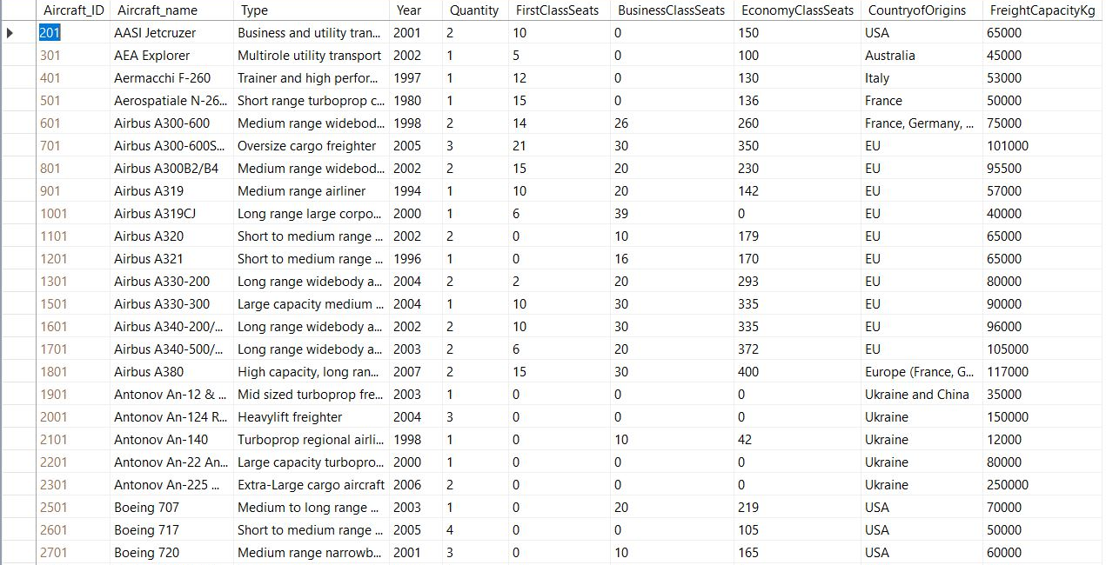
Data Table Design Requirements
An airline will have a list of bought aircrafts with the maximum number of seats per class (first, business, economy) information. The maximum number of seats will be used to assign seat to each customer whenever they get their boarding pass during check-in and to make sure that the flight is not overbooked.

Slide 3
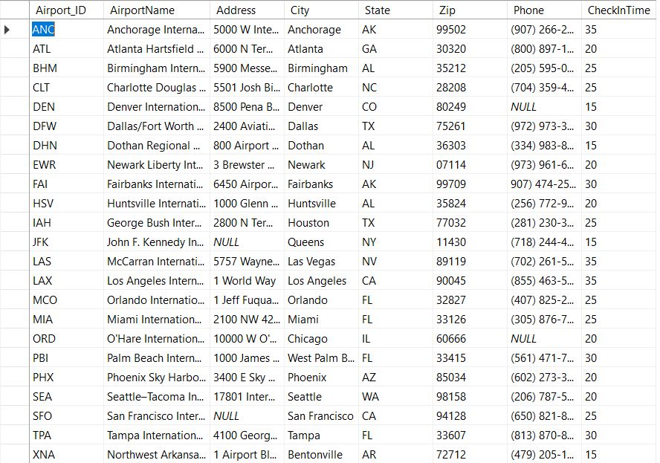
Data Table Design Requirements
Each airport will have specific minimum boarding time. This time will be used to decide the boarding time of each flight based on the departure time

Slide 4
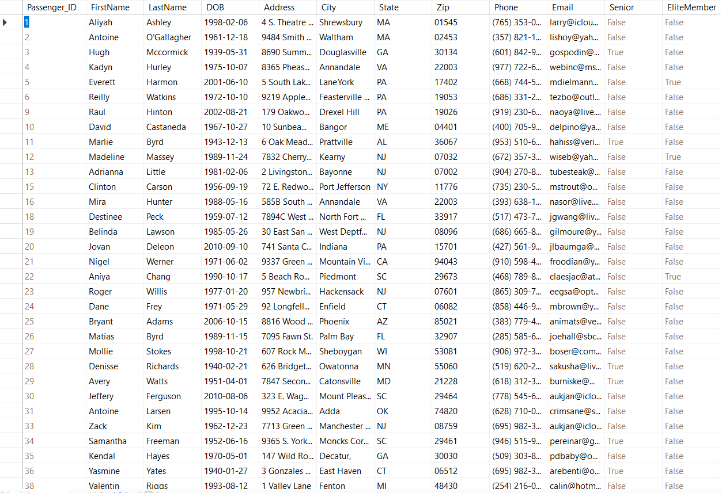
Data Table Design Requirements
Customer’s information is saved only once when they made a first transaction with the airline. People over 65 will get 10% off. If a customer spend >= $1000 in the past 6 months, they will become Elite member who can earn some mileages + benefits for the future flights.

Slide 5
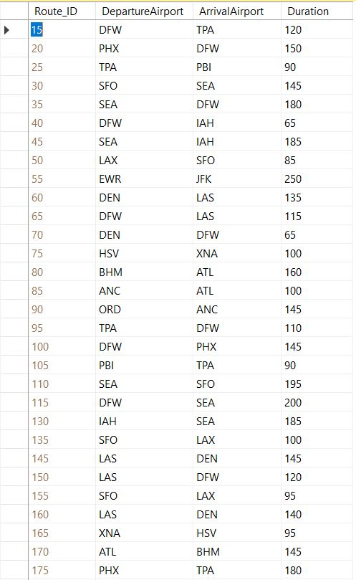
Data Table Design Requirements
The airline will have a list of available non-stop route with time it takes to travel each route. Time to go from A to B in the route list is used to decide arrival time for each flight.
In real life each route will have more specifications (for example, latitude, longitude, alternative airport - to get whenever the flight needs something urgent or cannot reach the arrival airport, etc). However we will not mention them here.

Slide 6
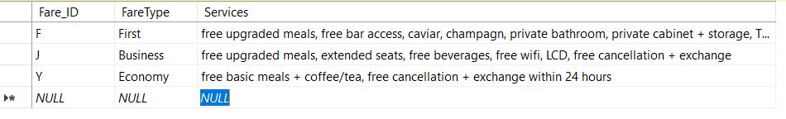
Data Table Design Requirements
3 fare types: first, business, economy class
Customers are free to choose the class for each flight, no matter if they have transit or not.
For example, customer A wants to go from A to D. Because there’s no direct route from A to D, she can take one flight from A to B with economy class, then transit to the second flight from C to D with business class.

Slide 7
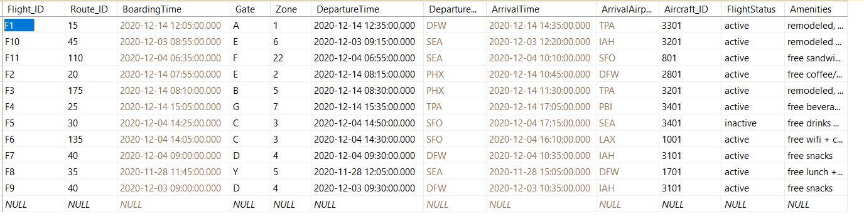
Data Table Design Requirements
Black fields are for users to input. Brown fields are calculated based on the given information from the mentioned previous table(s):
Boarding Time = DepartureTime – minimum minutes the departure airport requires for boarding
Arrival Time = DepartureTime + time it takes to travel a specific route

Slide 8
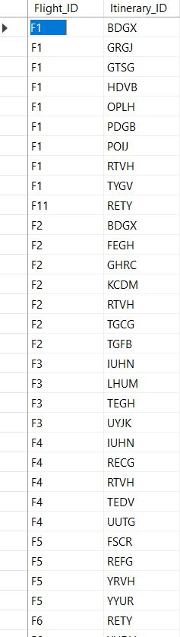
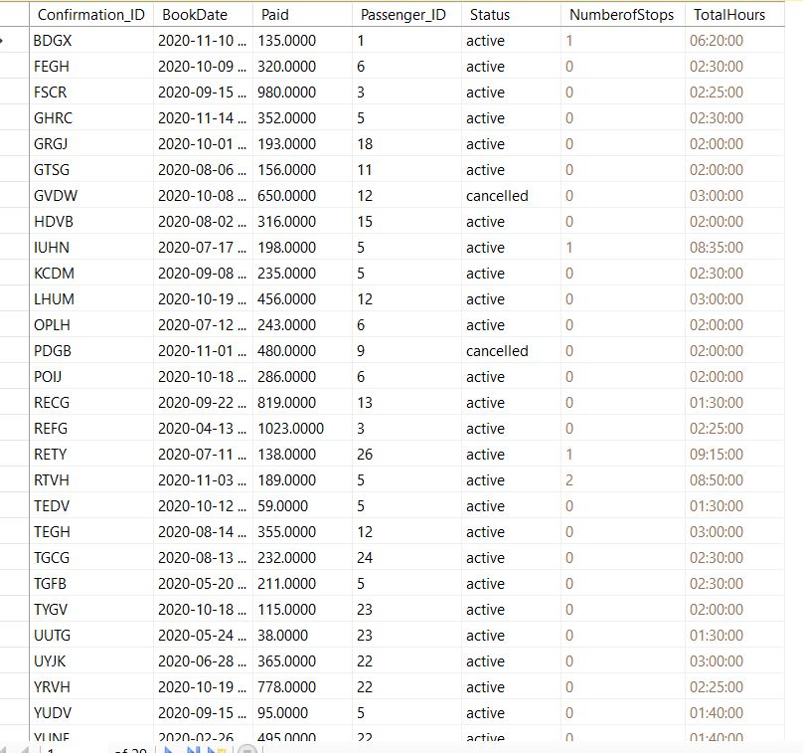
Data Table Design Requirements
_Each itinerary’s confirmation ID will have multiple flight IDs, since customer may have to transit, so they have to take multiple flights.
_Each flight has multiple bookings, so it has multiple itinerary_IDs.
_TotalHours = time it takes a customer to go from A to B (including layover time if there is any transit).
_Book date, payment amount and booking status information will be used to calculate the total amount each customer has spent in the past 6 months (to decide if they qualify for being Elite member or not)

Slide 9
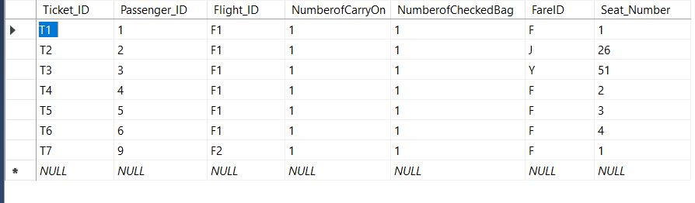
Data Table Design Requirements
Boarding pass will be issued whenever the customer checks in for each flight, so ticket_ID, number of carry-on and number of checked bags will be given on that day.
We set the trigger to check if the passenger really took the flight. If he did, we’ll automatically assign the seat to the customers, also using trigger.

Slide 10
Seat Trigger Design
Assuming that customers are not allowed to choose the seat number beforehand, how we automatically assign seat number and make sure enough seats are available for the flight:
Let say aircraft A has 2 first class seats, 5 business class seats, and 10 economy seats.
The first 1st -class ticket for that aircraft will automatically has seat number 1
The first busines class ticket will be assigned seat number 3 no matter if we have any other booking for the second first-class seat or not;
The first economy class ticket will be assigned seat number 8 (2+5 =7).
Then, we assign the seat accordingly to the fare type by incrementing the seat number by 1.
Once the maximum number of seats for that fare type is reached, a message/ trigger will pop up if we put one more person in that flight.

Slide 11
Analysis
i.Analysis in terms of speed
ii.Analysis in terms of accuracy
iii.What challenges in the development process?
iv.How did I overcome those?
v.What are the limitations of the project?
vi.Path to future work?

Slide 12

References
Name & country of origins of aircrafts for aircraft table: https://www.airliners.net/aircraft-data
Airport list: https://www.world-airport-codes.com/us-top-40-airports.html

