Slide 1
Network Security Basics

Slide 2
Outline
IP Address and Network Interface
TCP/IP Protocols
MAC Protocols
Network Interface
Ethernet frame and MAC header
ARP protocol
ARP cache poisoning attack
DNS

Slide 3
ip address

Slide 4
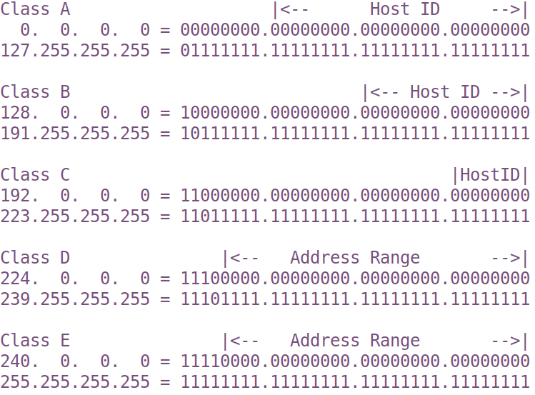
IP Address: the Original Scheme

Slide 5
CIDR Scheme (Classless Inter-Domain Routing)
192.168.60.5/24
Indicate the first 24 bits are network ID
Question: What is the address range of the network 192.168.192.0/19 ?
Notes:
192 = 110 00000
The first three bits are network ID. If we use binary to represent the third byte, the range is
192.168.(110 00000).0 to 192.168.(110 11111).FF, i.e., it is 192.168.192.0 to 192.168.223.255.
Note: many students have trouble answering this question. Without a good understanding of the CIDR notation
of the network prefix, they often struggle in understanding the BGP attack (network prefix hijacking).

Slide 6
Special IP Addresses
Private IP Addresses
10.0.0.0/8
172.16.0.0/12
192.168.0.0/16
Loopback Address
127.0.0.0/8
Commonly used: 127.0.0.1

Slide 7
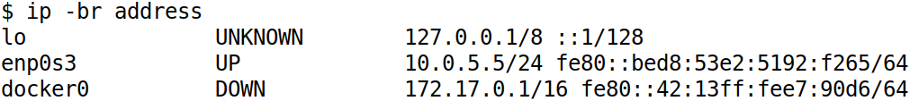
List IP Address on Network Interface
lo => Loopback
en => Ethernet
wl => Wireless
p0 = Bus number
s3 = slot number

Slide 8
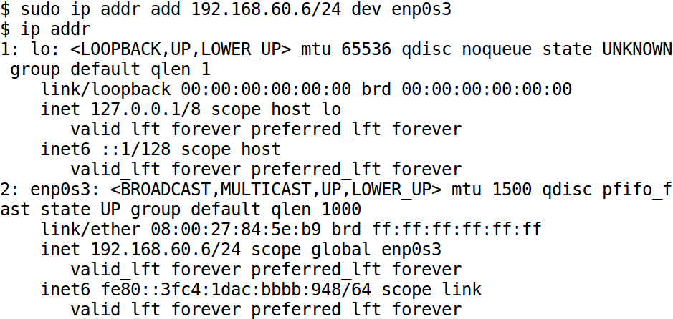
Manually Assign IP Address

Slide 9
Automatically Assign IP Address
DHCP: Dynamic Host Configuration Protocol
โดยปกติคือ Router ทำหน้าที่ DHCP ให้
แจกจ่าย
IP
Subnet mask บอกว่า IP วงในเราครอบคลุม IP อะไรบ้าง
Gateway สำหรับเชื่อมต่อ Internet
ที่อยู่ DNS server
Notes:
Briefly illustrate how DHCP works

Slide 10
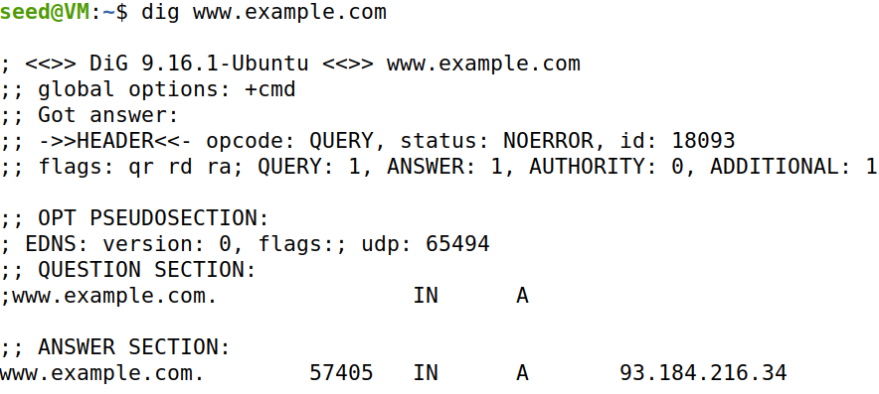
Get IP Addresses for Host Names: DNS

Slide 11
network Stack

Slide 12
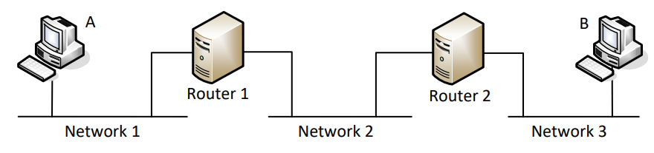
Packet Journey at High Level
Notes:
Use this diagram to illustrate how packet is sent from A to B, hop by hop.

Slide 13
TTL and How Traceroute Works
TTL = 1, 2, 3, …
At each router: TTL --
Packet discarded and trigger ICMP when TTL=0
ถ้าไม่มี TTL จะเกิดอะไรขึ้น?
Notes:
Talk about how traveroute works

Slide 14
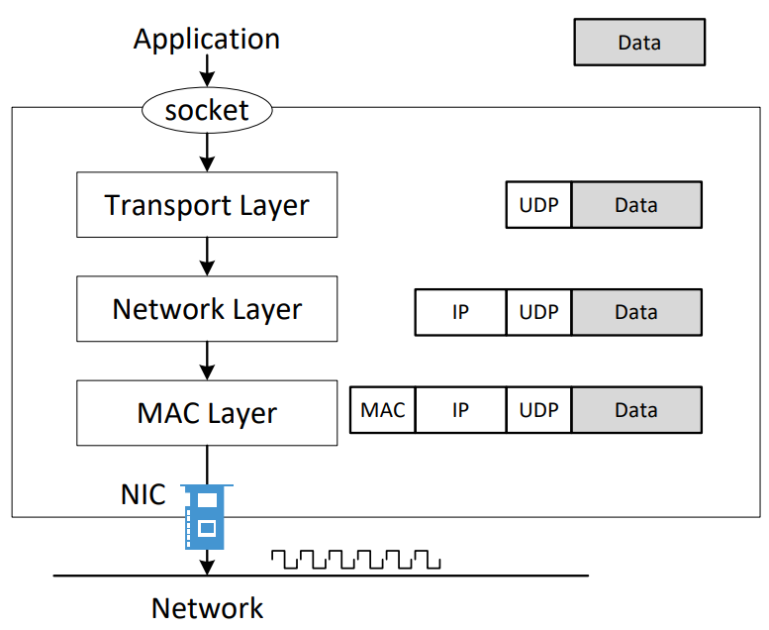
How Packets Are Constructed

Slide 15
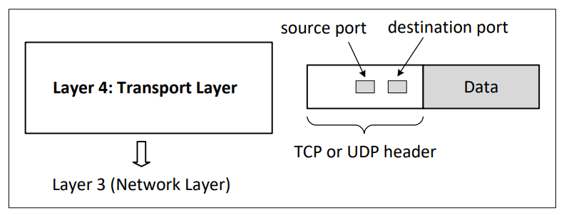
Layer 4: Transport Layer

Slide 16
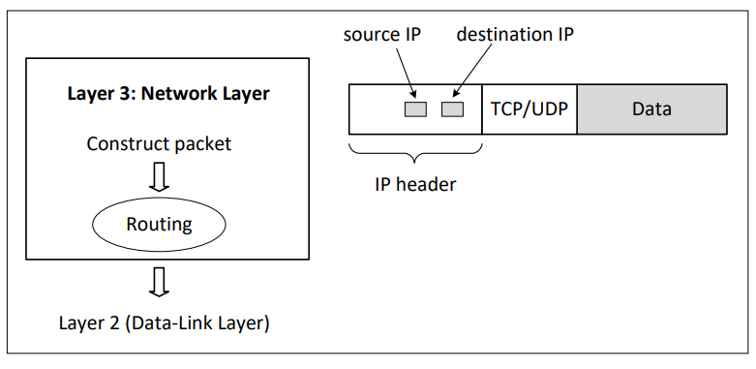
Layer 3: Network Layer

Slide 17
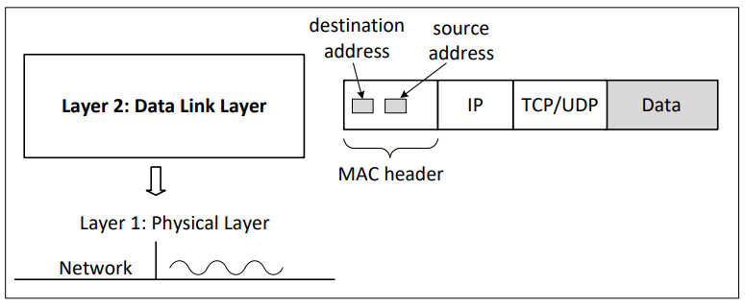
Layer 2: Data Link Layer (MAC Layer)

Slide 18
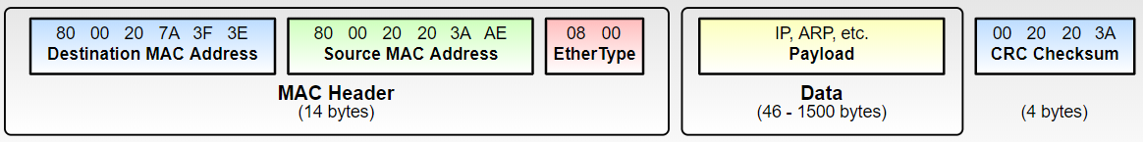
The Need for Fragmentation
Limit of packet size

Slide 19
Network Interface and Ethernet

Slide 20
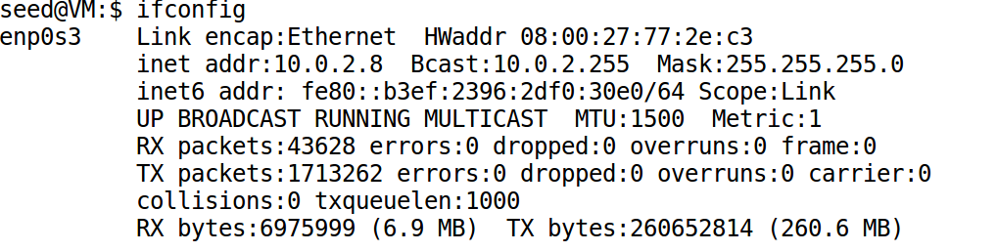
Network Interface Card (NIC)
Physical or logical link between computer and network
Each NIC has a hardware address: MAC address

Slide 21
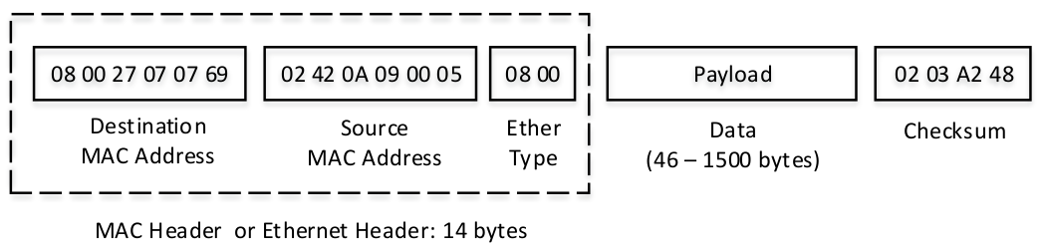
Ethernet Frame & MAC Header

Slide 22
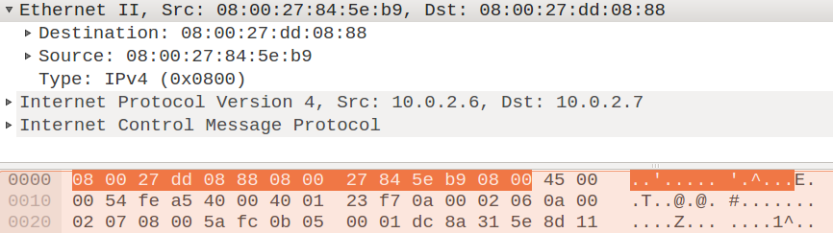
Ethernet Frame Example

Slide 23
Promiscuous Mode
Ethernet is a broadcast medium
NIC check destination MAC address
mine: accept the frame
not mine: discard it
Enable promiscuous mode
Will not check destination MAC
Take in all the packets on the local network
Useful for packet sniffing

Slide 24
The ARP Protocol

Slide 25
The ARP Protocol
Communication on LAN
Need to use MAC address
But we only know the IP address
ARP: Address Resolution Protocol
Find MAC from IP

Slide 26
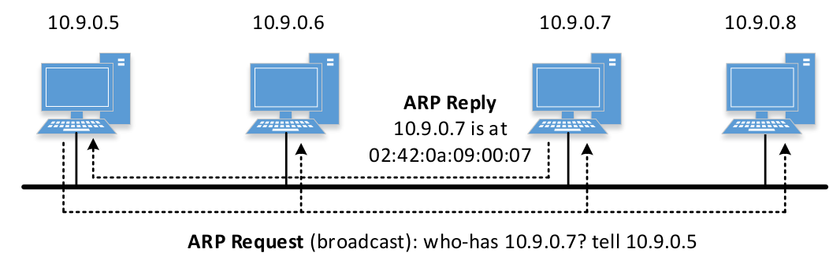
ARP Request/Reply

Slide 27
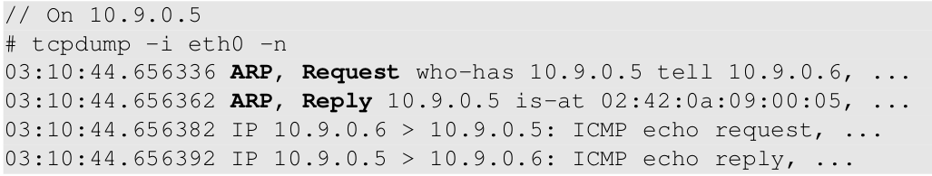
Send ARP Request: Example 1
ping 10.9.0.6 from 10.9.0.5

Slide 28
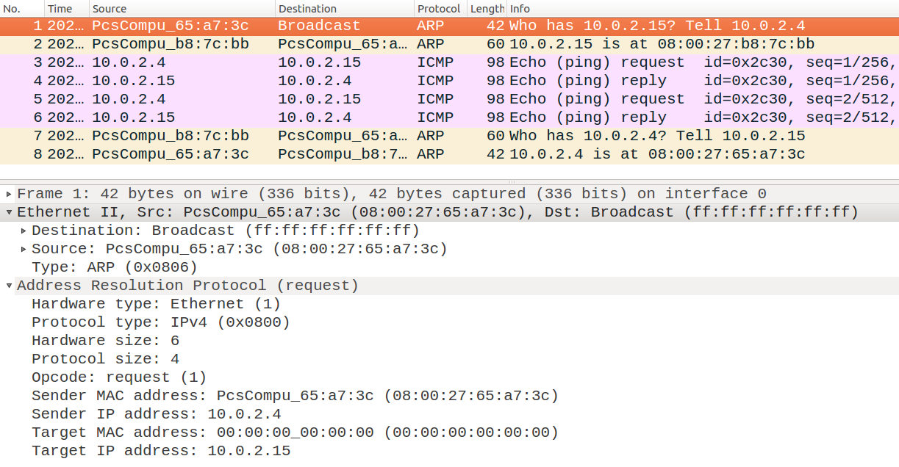
Send ARP Request: Example 2
ping 10.0.2.15 from 10.0.2.4

Slide 29
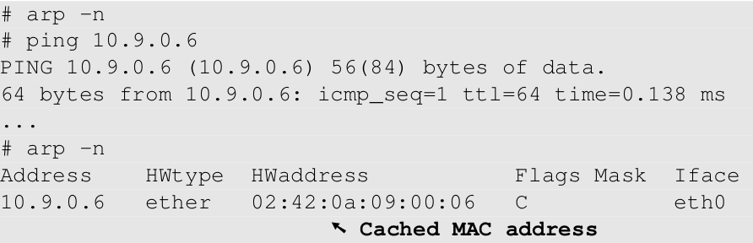
ARP Cache
Avoid sending too many ARP requests
ARP caches received information
empty cache

Slide 30
ARP Cache Poisoning
Spoof ARP Messages
Request
Reply
Gratuitous message
Spoofed message might be cached by the victim
Which type of message will be cached depends on OS implementation

Slide 31
man-in-the-middle Attack

Slide 32
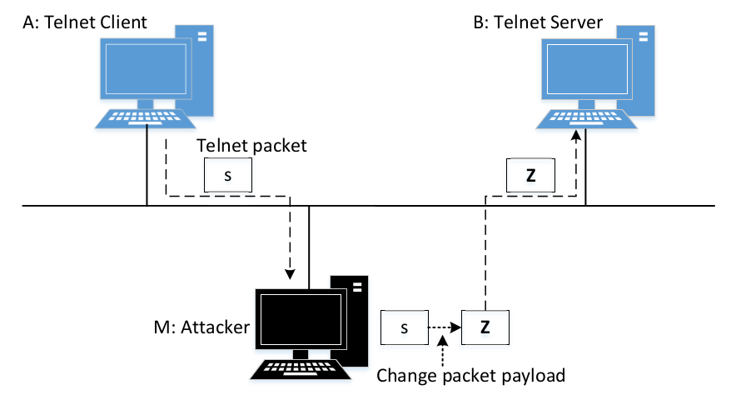
Man-In-The-Middle Attack

Slide 33
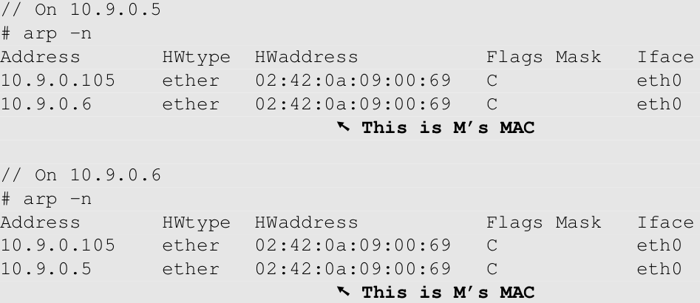
Use ARP Cache Poisoning to Redirect Packets
Poison A’s ARP cache, so B’s IP is mapped to M’s MAC.
Poison B’s ARP cache, so A’s IP is mapped to M’s MAC.
Machine A
Machine B

Slide 34
Layer 3: Network Layer

Slide 35
dns infrastructure

Slide 36
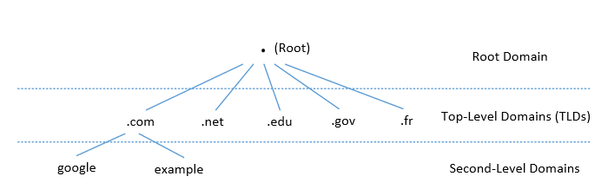
DNS Domain Hierarchy
Domain namespace is organized in a hierarchical tree-like structure.
Each node is called a domain, or subdomain.
The root of the domain is called ROOT, denoted as ‘ . ‘.
Below ROOT, we have Top-Level Domain (TLD). Ex: In www.example.com, the TLD is .com.
The next level of domain hierarchy is second-level domain which are usually assigned to specific entities such as companies, schools etc

Slide 37
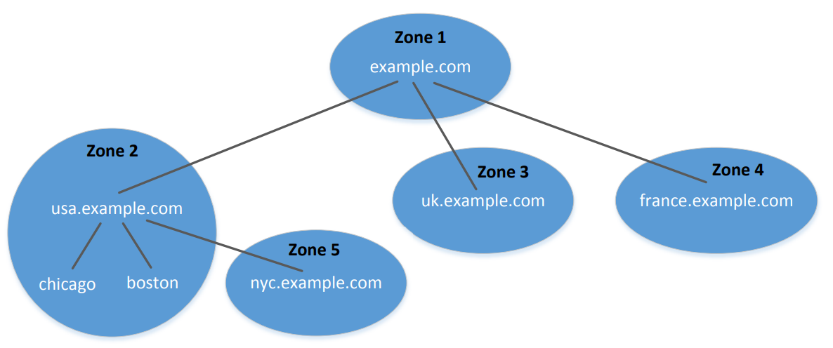
DNS Zones

Slide 38
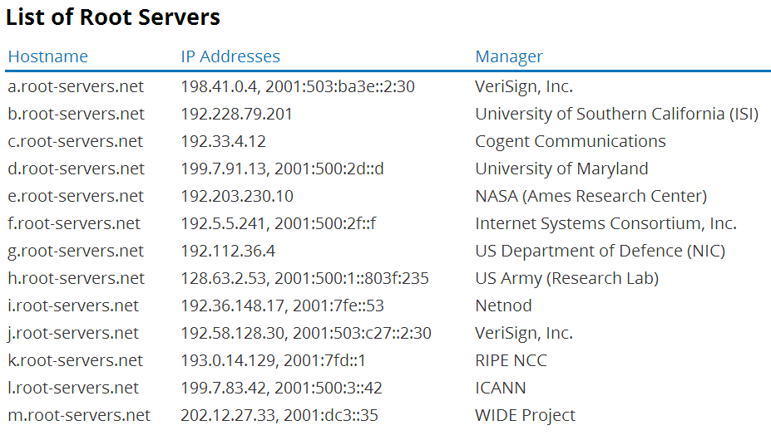
DNS Root Servers

Slide 39
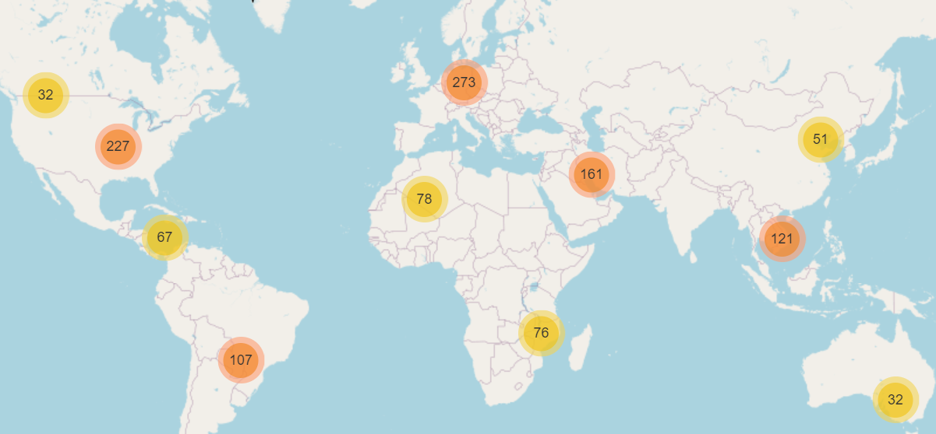
DNS Root Server
source: https://root-servers.org/

Slide 40
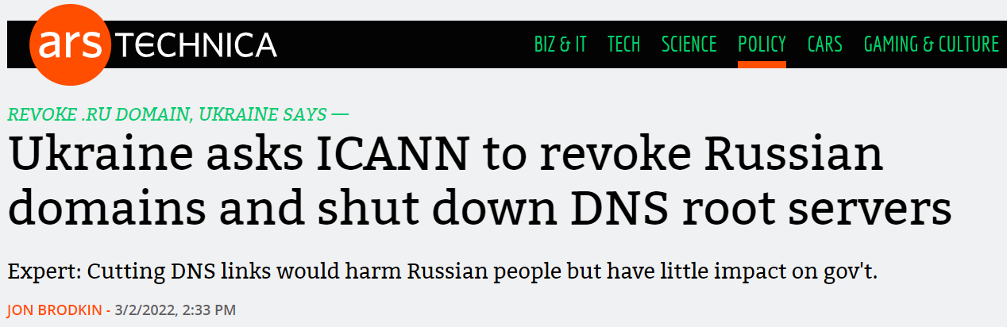
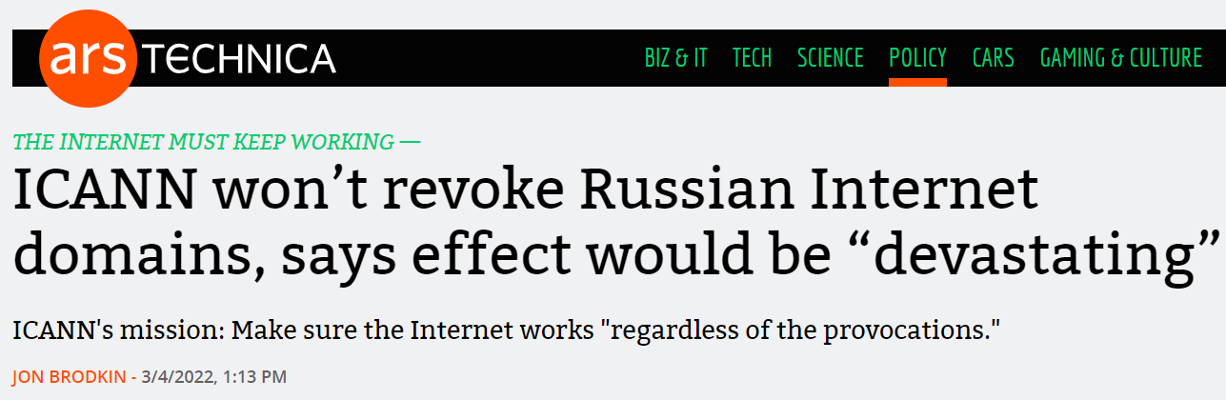
DNS Root Server and Politics

Slide 41
Top Level Domain (TLD)
Infrastructure TLD: .arpa
Generic TLD (gTLD): .com, .net,
Sponsored TLD (sTLD): These domains are proposed and sponsored by private agencies or organizations that establish and enforce rules restricting the eligibility to use the TLD: .edu, .gov, .mil, .travel, .jobs
Country Code TLD (ccTLD): .au (Australia), .cn (China), .fr (France)
Reserved TLD: .example, .test, .localhost, .invalid

Slide 42
dns query process

Slide 43
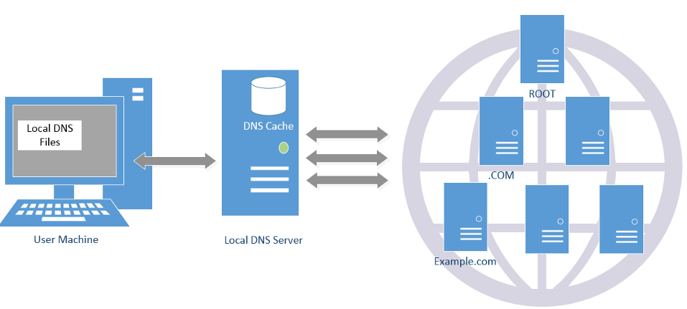
DNS Query Process and Cache

Slide 44
Local DNS Files
/etc/host: stores IP addresses for some hostnames. Before machine contacts the local DNS servers, it first looks into this file for the IP address.
/etc/resolv.conf: provide information to the machine’s DNS resolver about the IP address of the local DNS server. The IP address of the local DNS server provided by DHCP is also stored here.

Slide 45
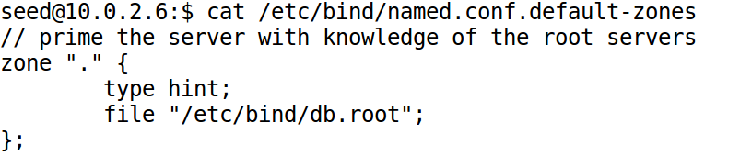
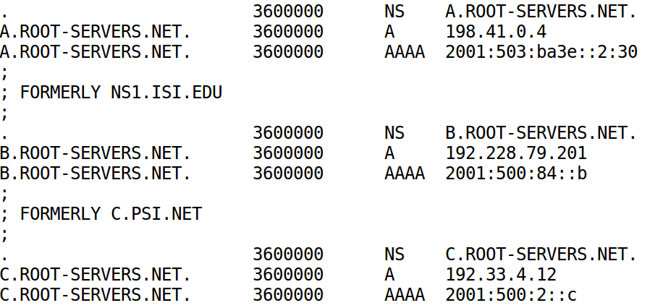
How Local DNS Server Get Root Server's IP

Slide 46
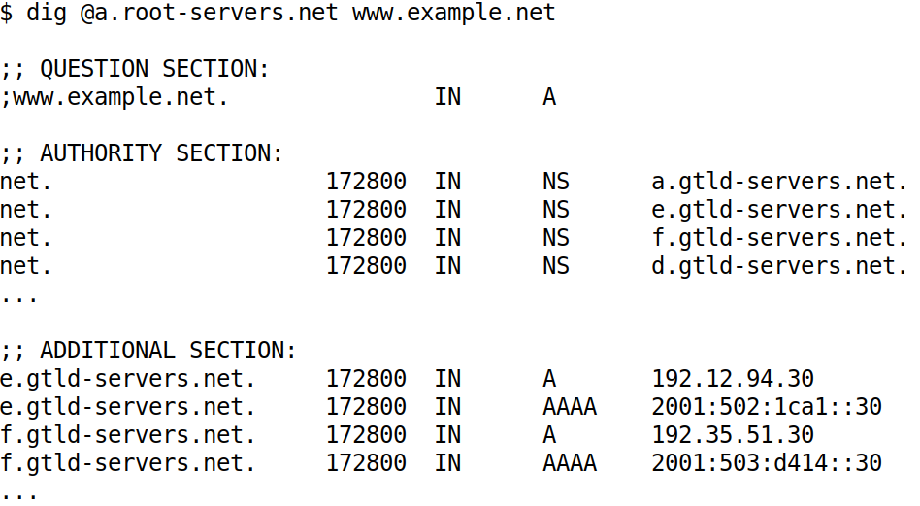
DNS Query Process: Query the Root Server

Slide 47
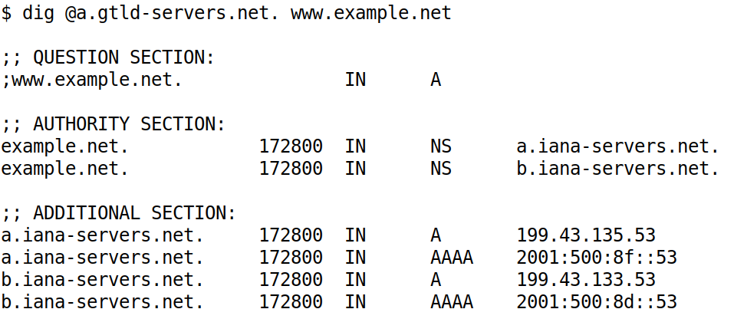
DNS Query Process: Query the net Server

Slide 48
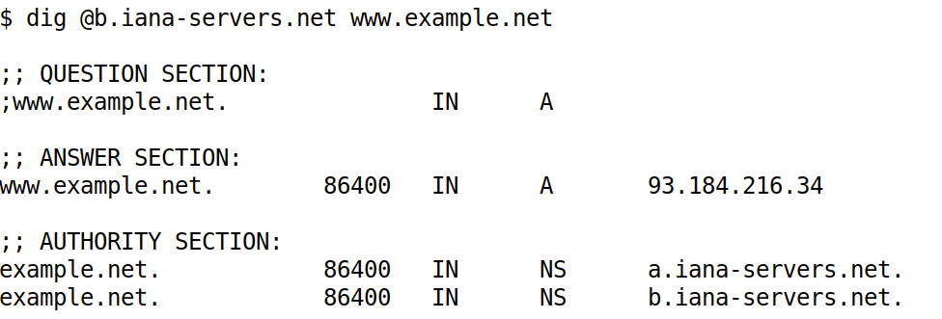
DNS Query Process: Query example.net’s nameserver

Slide 49
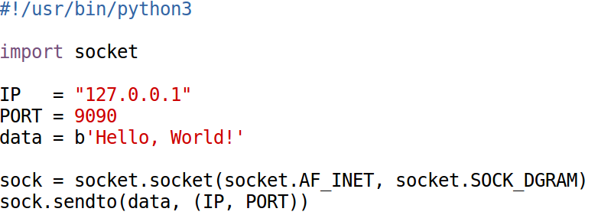
Sending Packet in Python (1)
UDP Client
AF => Address Family
INET => IPV4
INET6 => IPV6
SOCK_DGRAM => Data Gram => UDP
SOCK_STREAM => TCP

Slide 50

Sending Packet in Python (1)
Execution Results
Notes:
Introduce the netcat tool, explain the meaning of “-luv”.

Slide 51
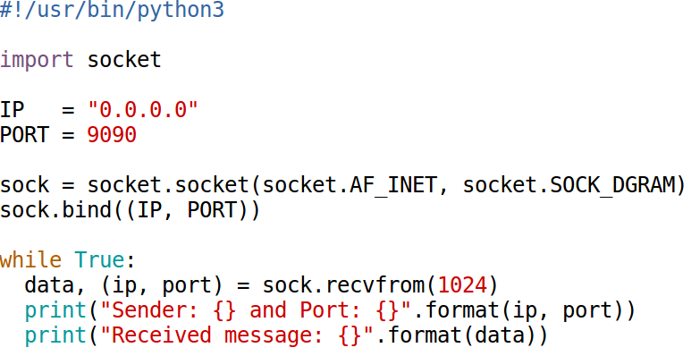
Receiving Packets in Python
UDP Server

Slide 52
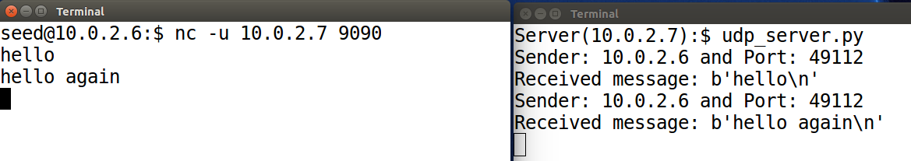
UDP Server

Slide 53
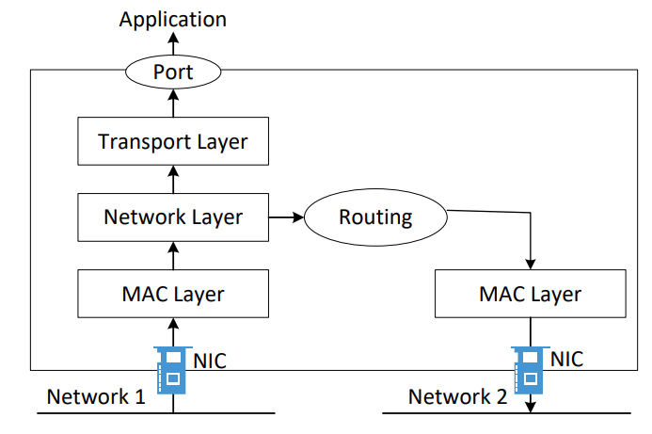
How Packets Are Received

Slide 54
Packet Sending Tools
Using netcat
Bash: /dev/tcp or /dev/udp pseudo device
Others: telnet, ping, etc.

