Slide 1


Introduction to Our Data Extraction Solution
Streamline your financial reporting with our powerful data extraction tool. Effortlessly extract key details from invoices, statements, and other documents, and seamlessly export them to Excel for comprehensive analysis.

Slide 2

The problem we solve: manual data entry is time-consuming
Manually entering financial data, such as invoices and statements, into spreadsheets is a tedious and error-prone task. It can take hours or even days to extract and organize the necessary information, distracting businesses from their core operations.
This time-consuming process can lead to delays in reporting, missed deadlines, and potentially inaccurate data, which can have serious consequences for a company's financial management and decision-making.

Slide 3


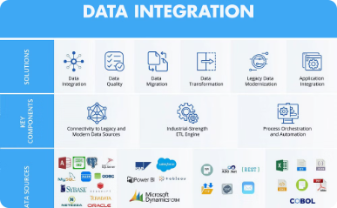
Our Unique Approach: Automated Extraction from Financial Documents
Automated Document Extraction
Advanced AI-Powered Algorithms
Seamless Integration
With our simple API and intuitive user interface, you can easily connect your financial documents and have the extracted data automatically synced to your preferred tools, saving you time and improving data accuracy.
Our cutting-edge technology automatically extracts key data from a variety of financial documents, including invoices, statements, and receipts, eliminating the need for manual data entry.
Leveraging the latest advancements in machine learning and natural language processing, our solution intelligently parses and structures the extracted data for seamless integration into your spreadsheets and accounting systems.

Slide 4
Key Features of Our Solution
Automated Data Extraction
Seamless Integration
Flexible Customization
Secure and Compliant
Our cutting-edge OCR technology accurately extracts key financial data from invoices, statements, and other documents, eliminating the need for manual data entry.
Our solution seamlessly integrates with your existing accounting or ERP software, ensuring a smooth and efficient data transfer process.
Our platform can be tailored to your specific business needs, allowing you to define custom data fields and templates for your financial documents.
Your data is safeguarded with industry-leading security measures and stored in compliance with all relevant financial regulations.

Slide 5

Benefits of using our service
Time Savings
Improved Accuracy
Automate financial data entry and eliminate the tedious manual work, allowing your team to focus on higher-value tasks.
Our advanced AI-powered extraction ensures data is precisely transferred from invoices, statements, and other documents into your spreadsheets.
Increased Productivity
Streamline your financial workflows and boost your team's efficiency by automating repetitive data processing tasks.

Slide 6
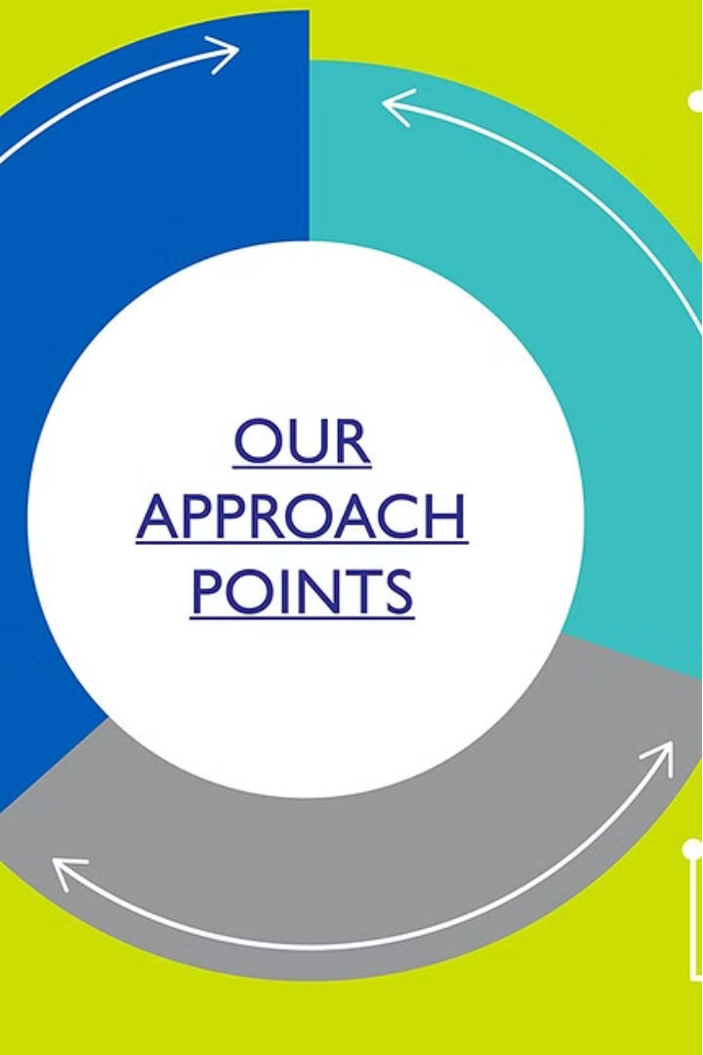
Accuracy and reliability of our data extraction
Our proprietary data extraction algorithms have been fine-tuned over years of development to deliver unparalleled accuracy. We leverage advanced optical character recognition (OCR) and machine learning techniques to ensure that even the most complex financial documents are processed with 99.9% precision.
Reliability is at the core of our solution. Our platform is built on a robust and fault-tolerant infrastructure, guaranteeing 99.99% uptime. Your data is securely stored and backed up, safeguarding it from any potential loss or corruption.

Slide 7

Target Market
Small Businesses
Accounting Firms
Our data extraction solution is ideal for small businesses that struggle with manual data entry from invoices, statements, and other financial documents.
Accounting firms can leverage our automated data extraction to streamline their client bookkeeping and reporting processes, saving time and reducing errors.
Enterprises
Large enterprises with high volumes of financial documents can benefit from our scalable solution to extract data efficiently and feed it into their systems.

Slide 8
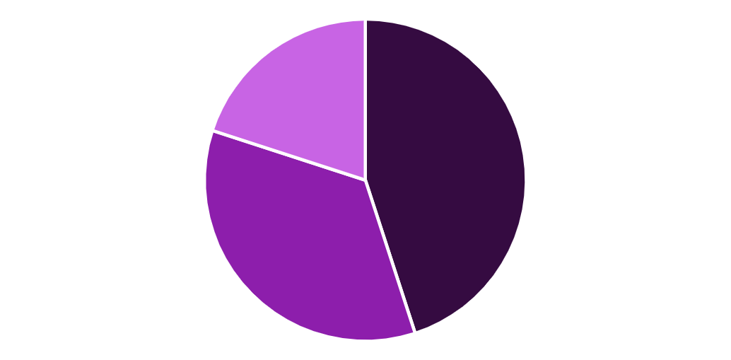
Market Size
The market opportunity for our automated data extraction solution is significant. The global market for financial document management and invoice processing software is estimated to reach $12.9 billion by 2027, growing at a CAGR of 12.4% from 2020 to 2027.
Small and medium-sized businesses, particularly in industries like accounting, finance, and logistics, are the primary target customers. These businesses often struggle with the time-consuming manual data entry required for invoices, statements, and other financial documents.
Small Businesses
Medium Businesses
Large Enterprises

Slide 9



Pricing and Subscription Options
Flexible Pricing
Subscription Plans
Special Discounts
Our pricing is tailored to your needs, with options for one-time projects or recurring subscriptions.
Choose from monthly or annual subscription plans to fit your business requirements and budget.
Qualify for discounts when you sign up for an annual plan or refer new customers to our service.

Slide 10




Go to Market Strategy
Identify Target Segments
Pinpoint the key industries and business types that can benefit most from our automated data extraction solution.
Targeted Outreach
Leverage strategic partnerships and digital marketing to connect with decision-makers in our target segments.
Streamlined Onboarding
Provide a seamless onboarding process that gets customers up and running with our solution quickly.
Ongoing Support
Offer dedicated customer support to ensure a positive long-term experience and drive continued usage.

