Slide 1


SIMPLE VERSION CONTROL SYSTEM
SOFTWARE DESIGN 2 PROJECT
Khuthadzo Makuya
Mnqobi Gumede
Ntsakisi Mahunisi
Mixo Makhongele
Mulanga Phalanndwa
Mukhethwa Bulwana
Thingahangwi Tshivhundo
Zwavhudi Ramagadza

Slide 2
EXPLAINING THE PROBLEM
Students and small teams often manage work by copying folders or sending files to each other
This leads to lost work and overwritten changes
There is no record of who changed what, or when
Git solves this, but it has a steep learning curve for newcomers
project > project_v2 > project_final > project_final_REAL

Slide 3
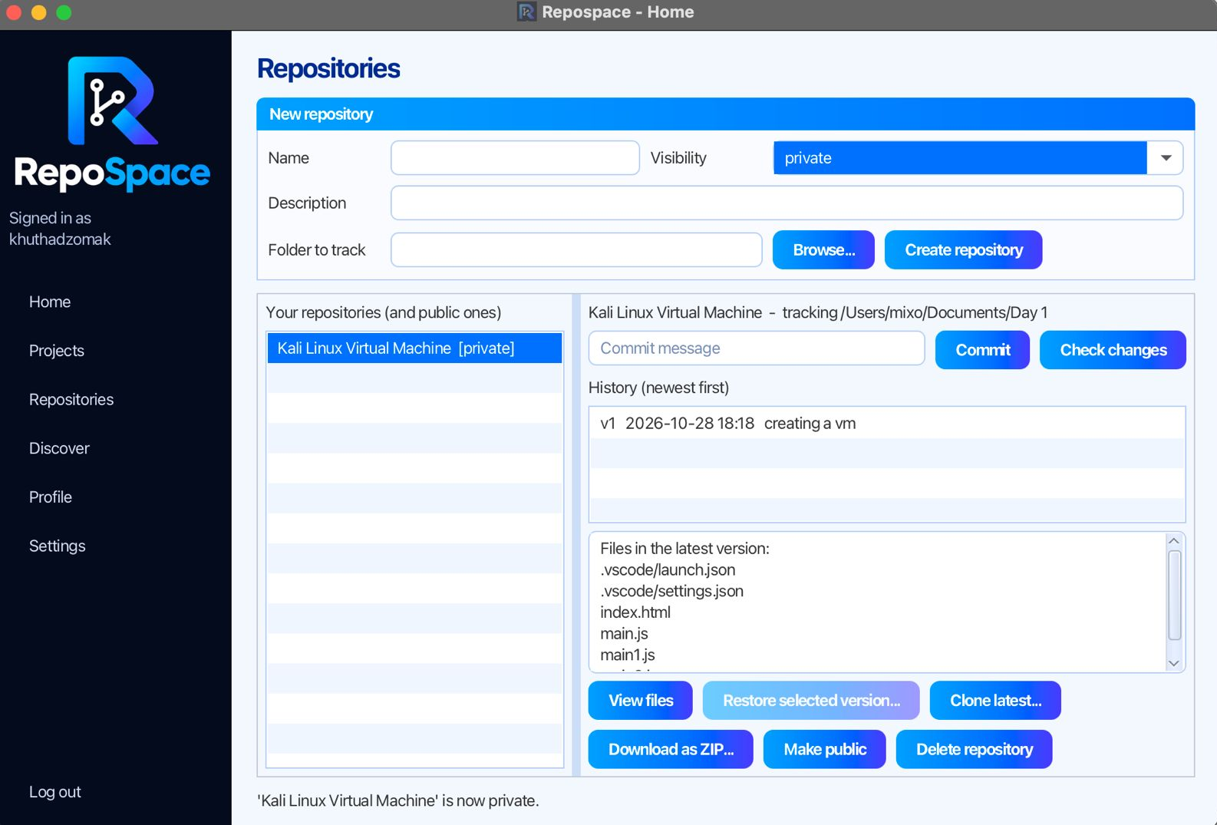
WHAT REPOSPACE DOES
A desktop app built in Java and JavaFX
Tracks a folder and saves numbered versions
Shows files added, modified or deleted
Restores any earlier version
Shares public work with other users

Slide 4
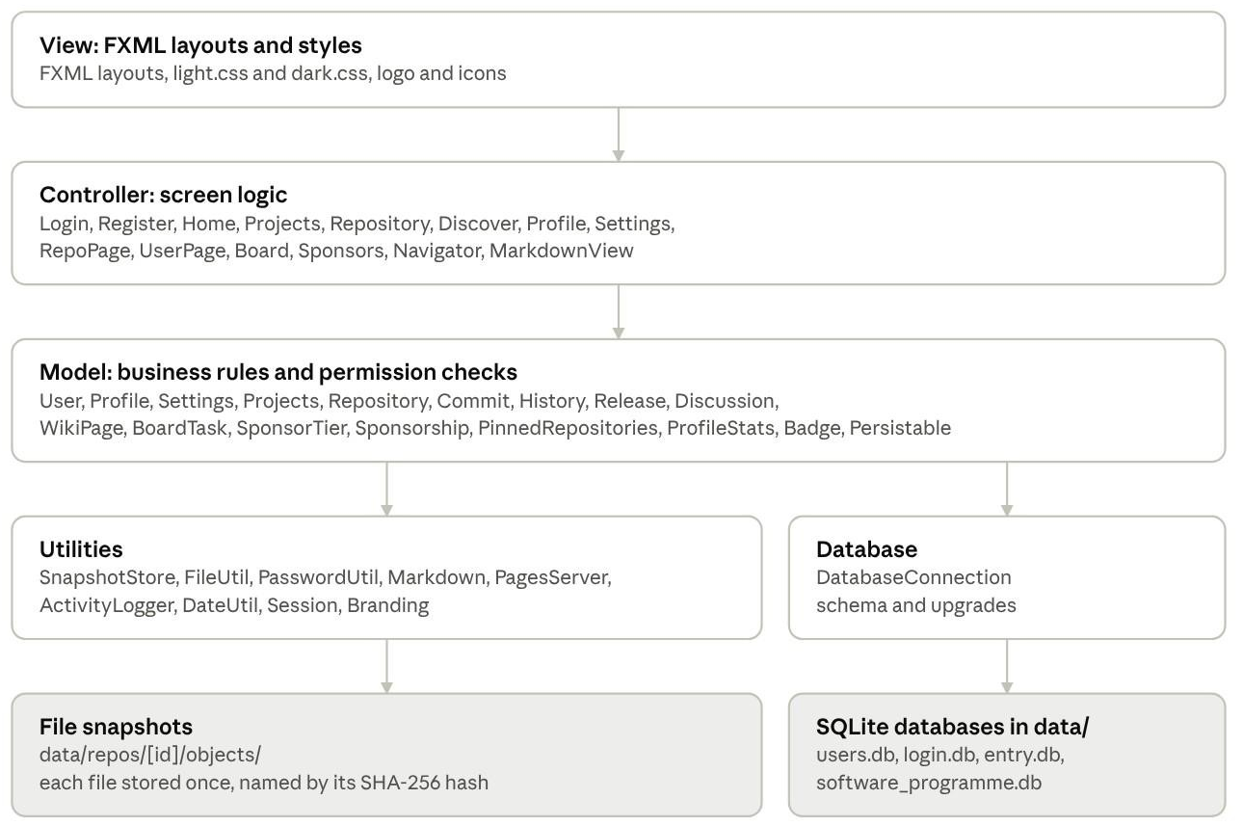
SYSTEM ARCHITECTURE
Layered MVC: views, controllers, model, then utilities and the database
Data is stored locally, so no database server is needed

Slide 5
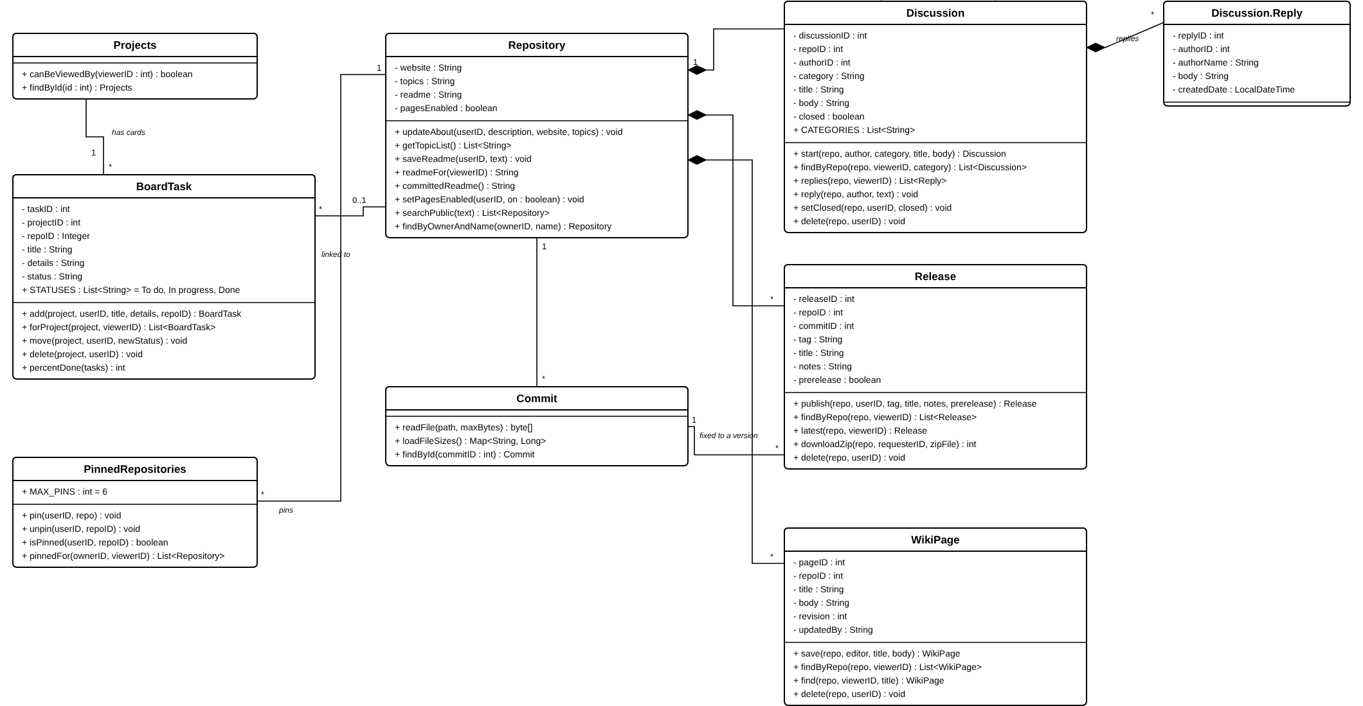
UML: REPOSITORY FEATURES

Slide 6
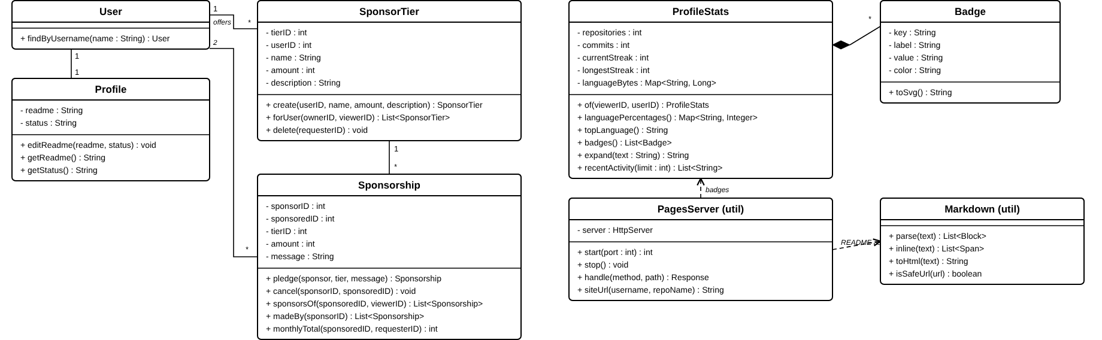
UML: USERS AND PROFILES

Slide 7
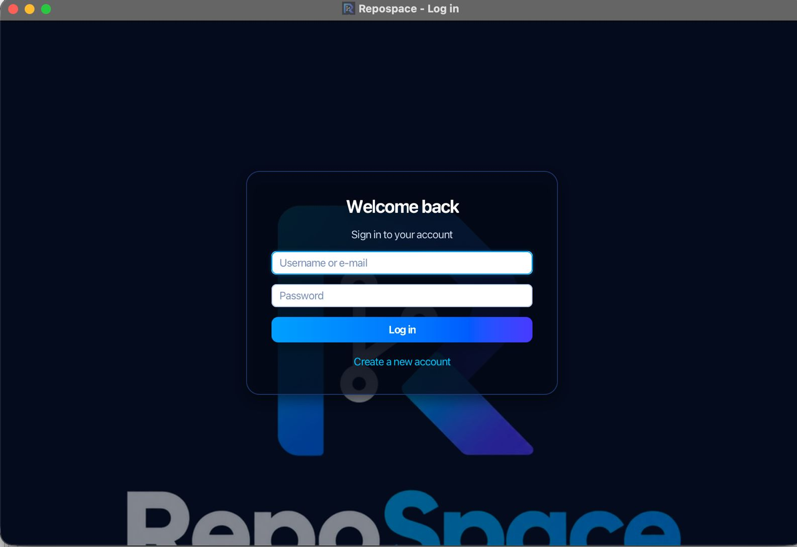
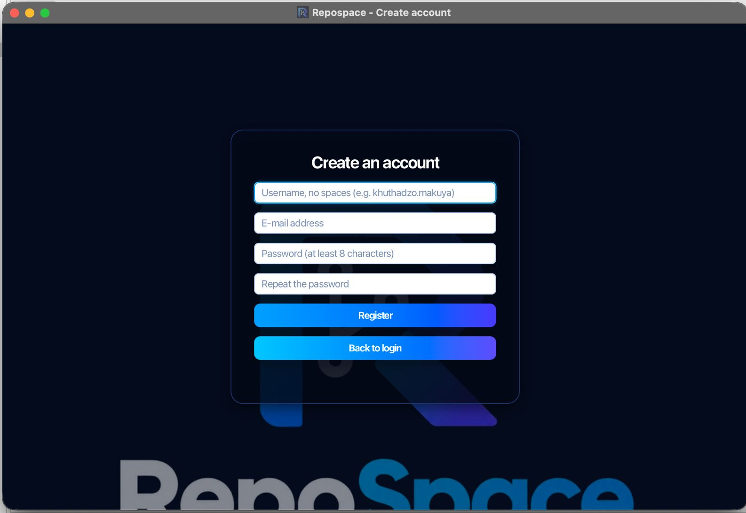
IMPLEMENTATION DETAILS
Built with Java 17, JavaFX 21, SQLite and Maven
Users log in with a username or e-mail address
Passwords are stored only as salted hashes

Slide 8
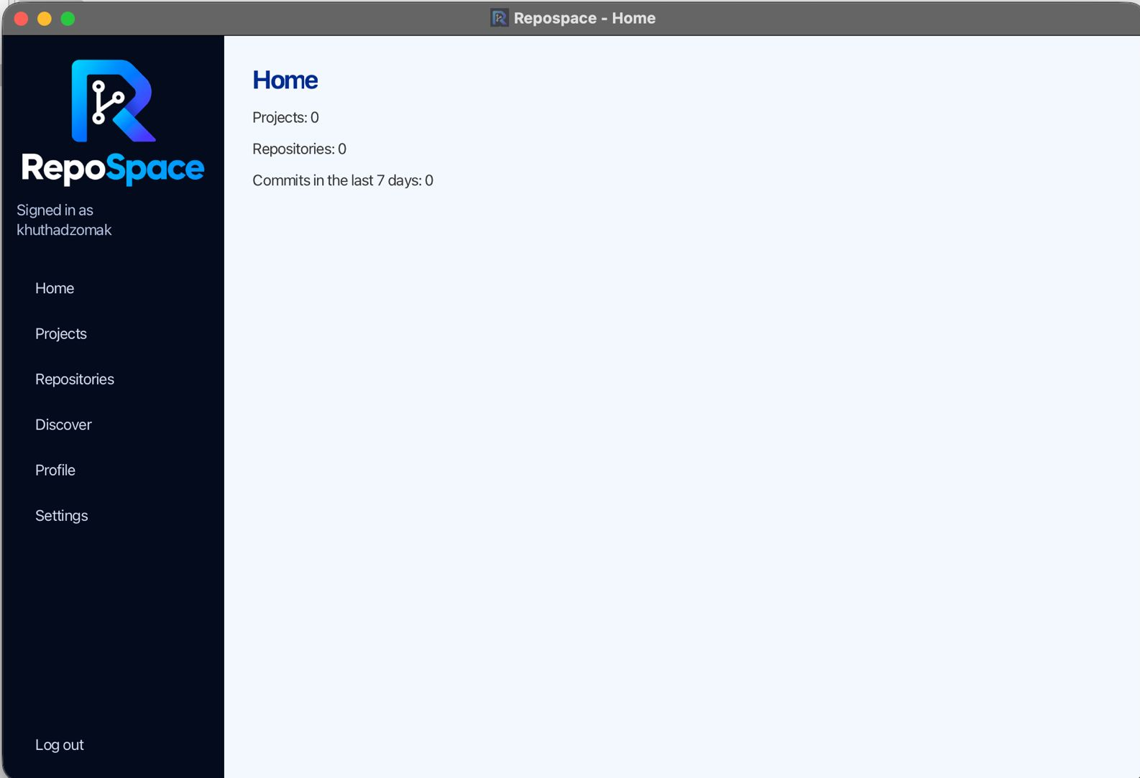
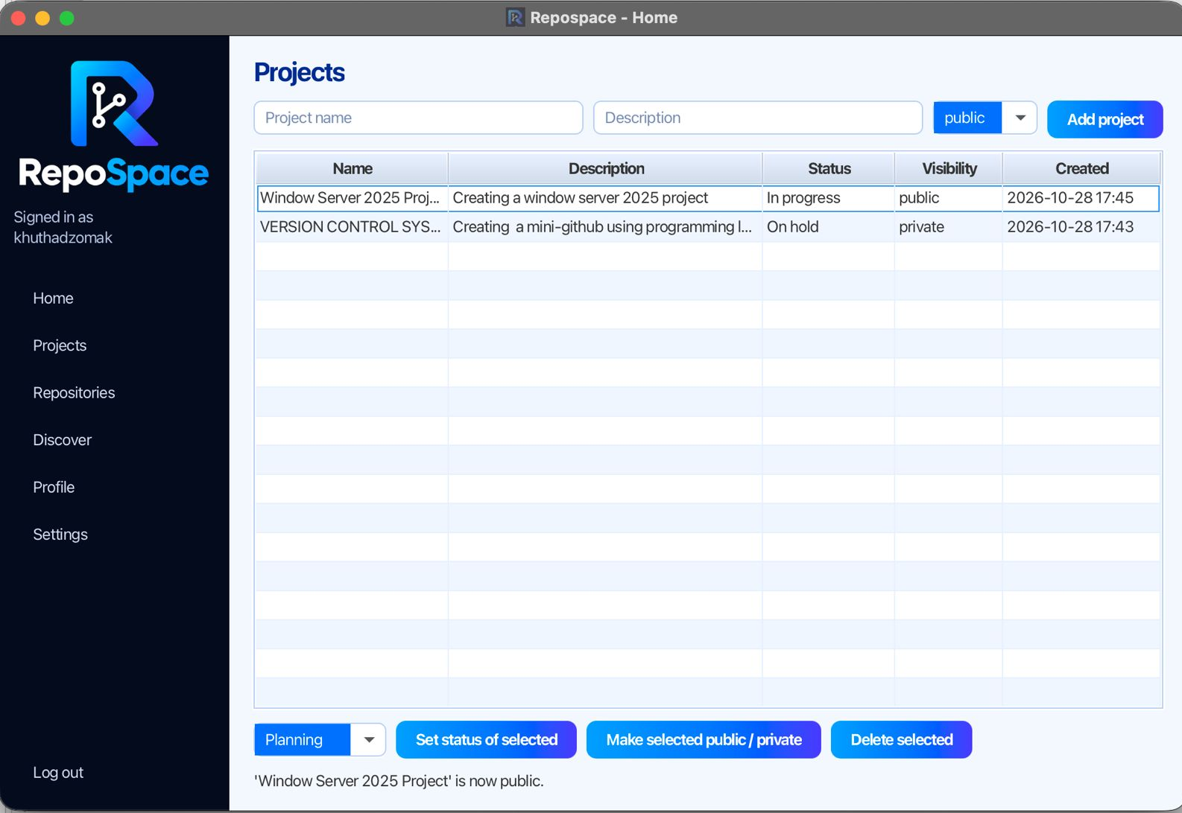
MAIN PAGE AND PROJECTS
The home page counts projects, repositories and recent commits
Each project has a status and can be public or private

Slide 9
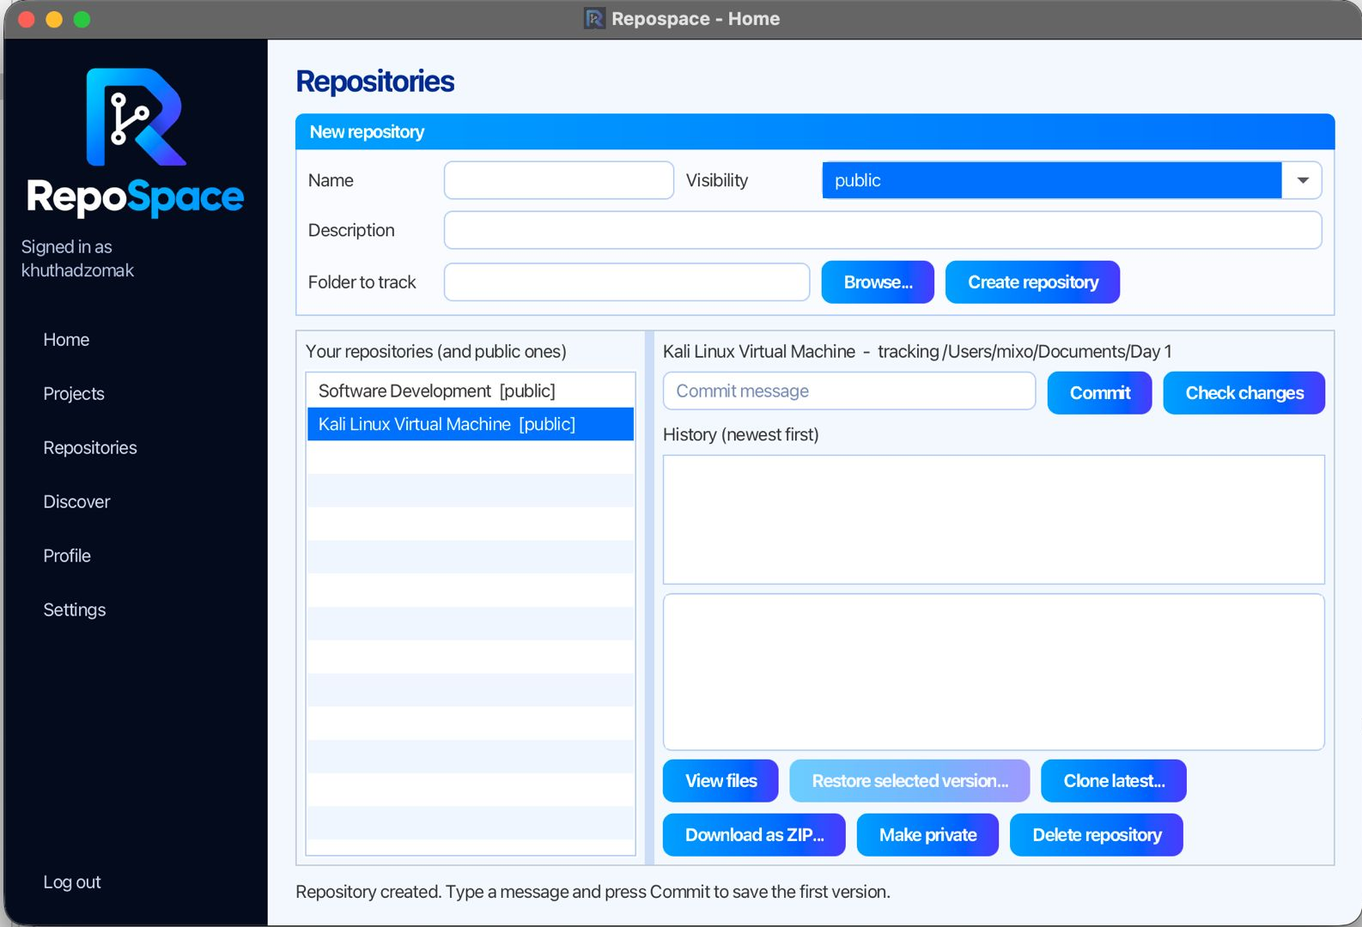
REPOSITORIES AND COMMITS
Choose a folder to track and create the repository
Commit with a message to save the first version as v1

Slide 10
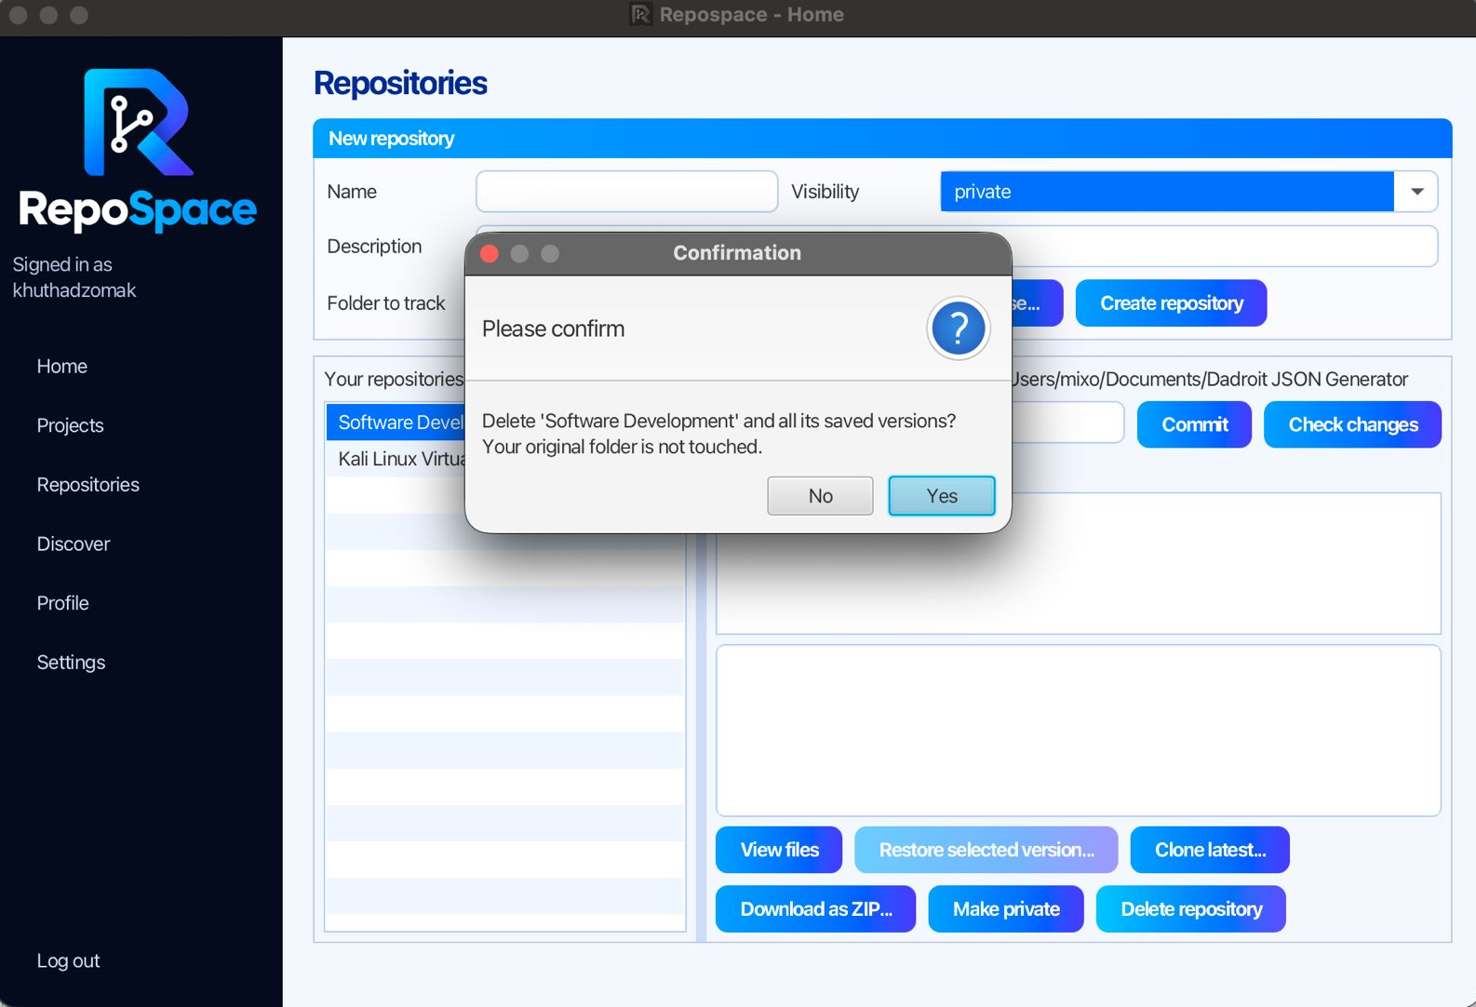
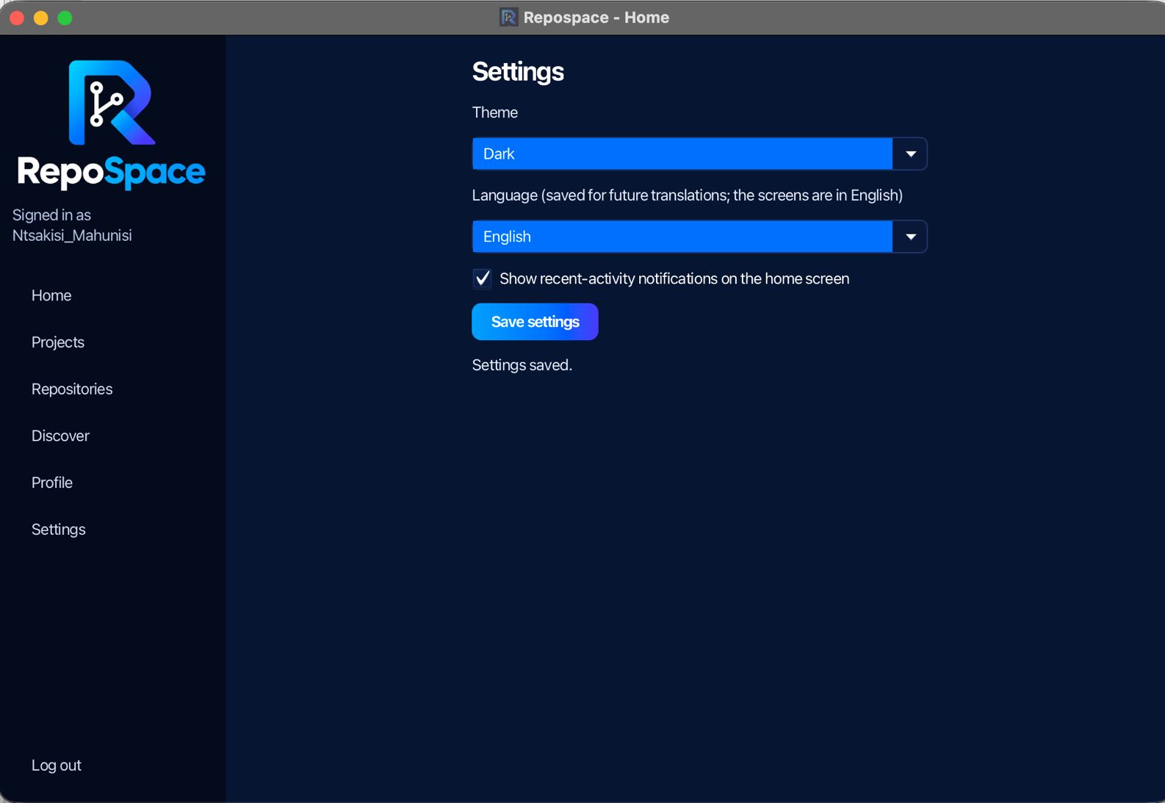
CHANGING THINGS
Deleting a repository asks for confirmation, and your original folder is not touched
Settings switch between light and dark themes

Slide 11
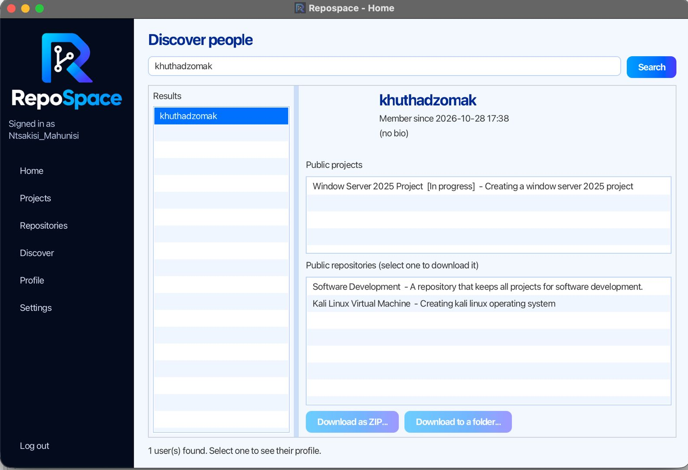
FINDING OTHER USERS
Search for other users by username
See only their public projects and repositories
Download public work as a ZIP or to a folder
Private items are never listed

Slide 12
TESTING AND EVALUATION
77 automated JUnit 5 tests in 9 test classes
Security
Version control
Password hashing, unsafe paths refused
Commit, diff, restore, de-duplication
Edge cases
Sharing
Empty, binary and oddly named files, deep folders, 500 files
Public and private rules, user search, downloads

Slide 13
GA2 AND GA7 REFLECTIONS
GA2: Application of Scientific and Engineering Knowledge
Object-oriented, layered MVC design
SHA-256 hashing to identify file content
Recursion to walk folder trees, plus collections and background tasks
GA7: Sustainability and Impact
Fewer duplicate copies of project files
Unchanged files use no extra storage
Less time finding and restoring old work

Slide 14
CONCLUSION
Repospace lets users track a folder, save versions, see what changed, restore earlier work and share it
Limitations: no branches or merging, and differences are shown per file
Next steps: line-by-line differences, branches and collaborators
Thank You!

