Slide 1

Project: MyTeacher
Purpose: Online learning platform connecting teachers and students

Slide 2
Account Features

Slide 3
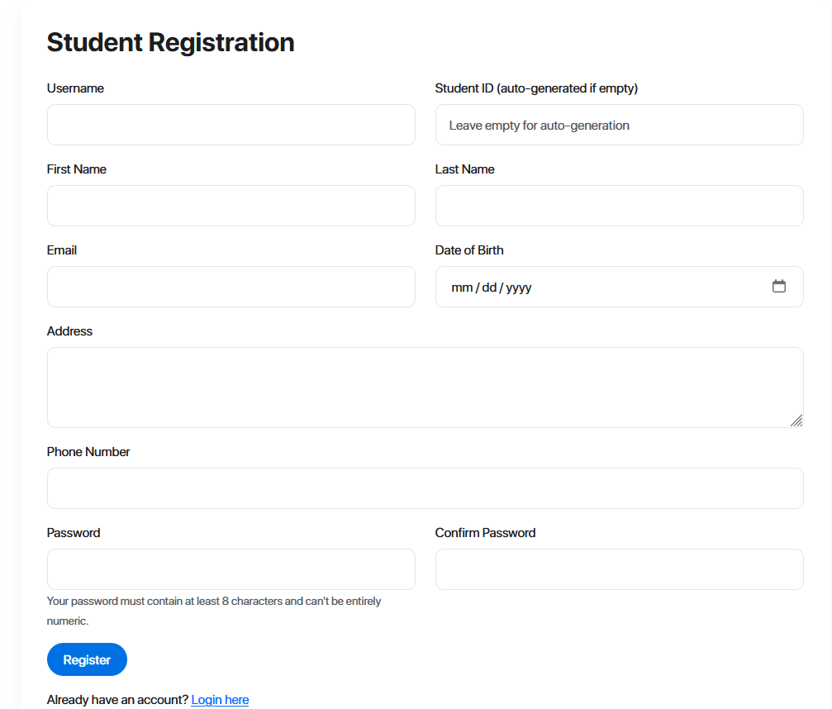
Account
Teacher/student roles
Registration/login

Slide 4
Assignments Features

Slide 5
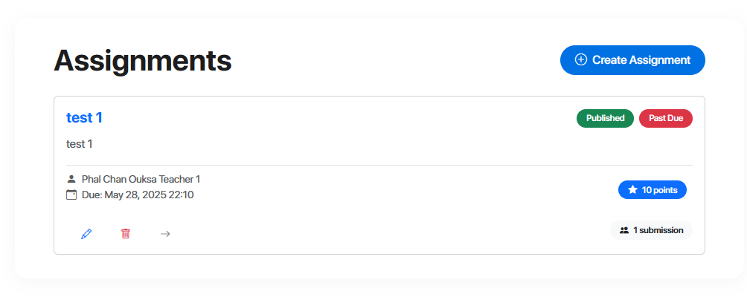
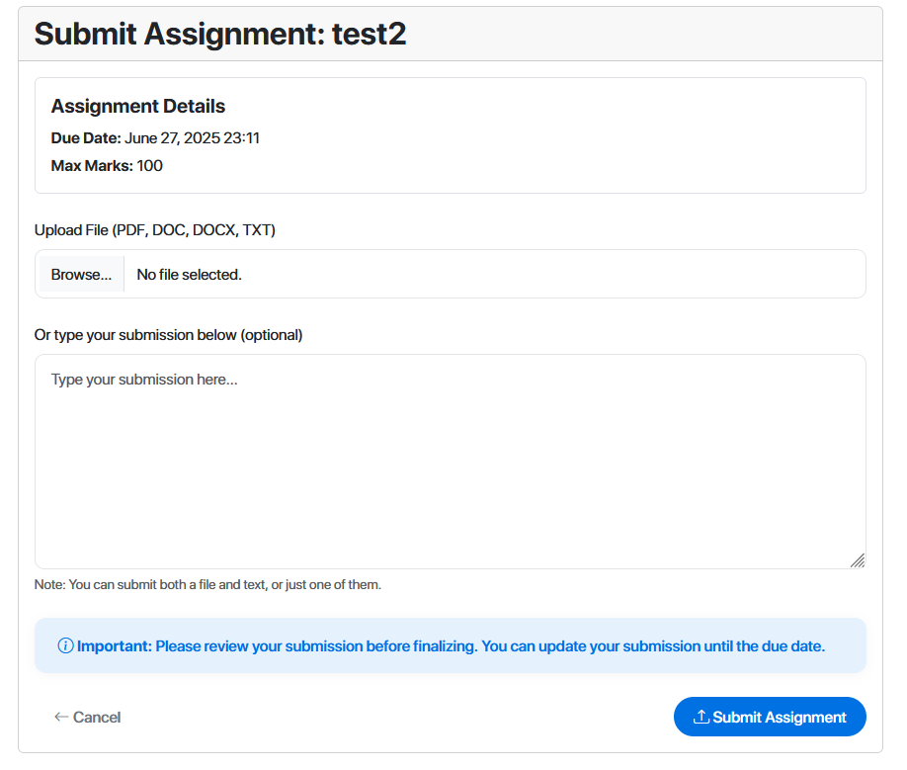
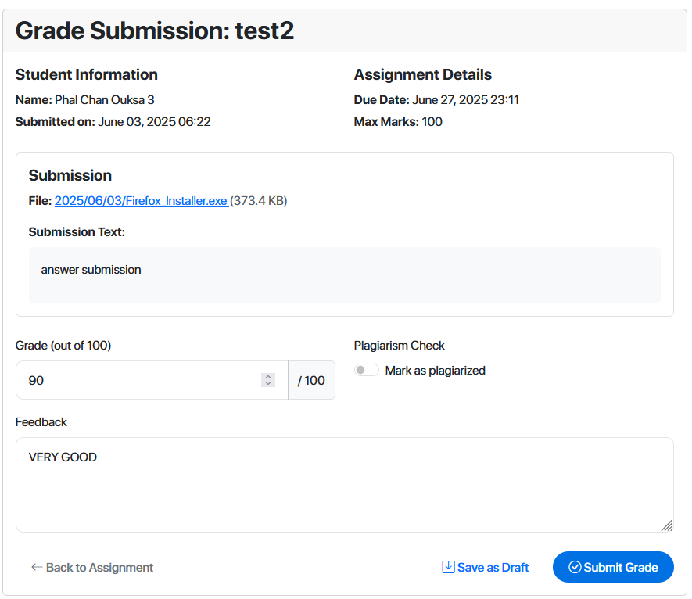
Assignment
Create/Submit assignments
File uploads
Grading system

Slide 6
Chat Features

Slide 7
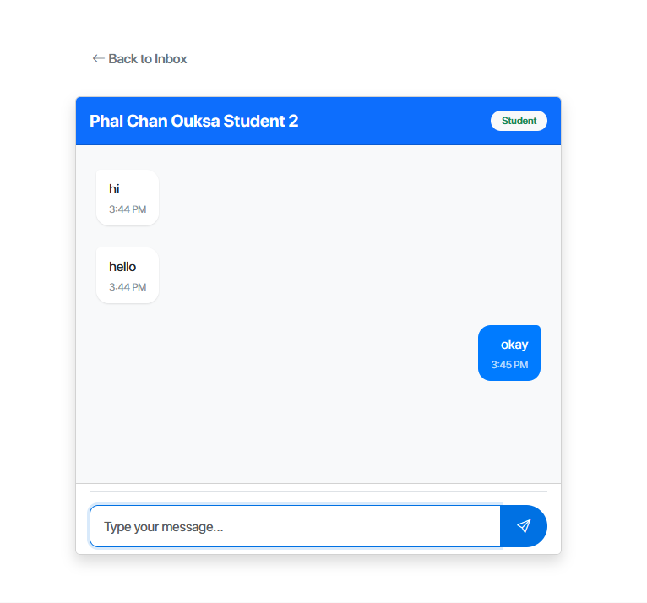
Chat
student and teacher can interact with each
Other through chat
system

Slide 8
Rating Features

Slide 9
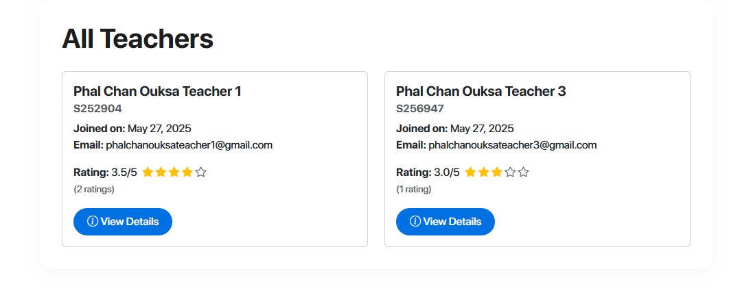
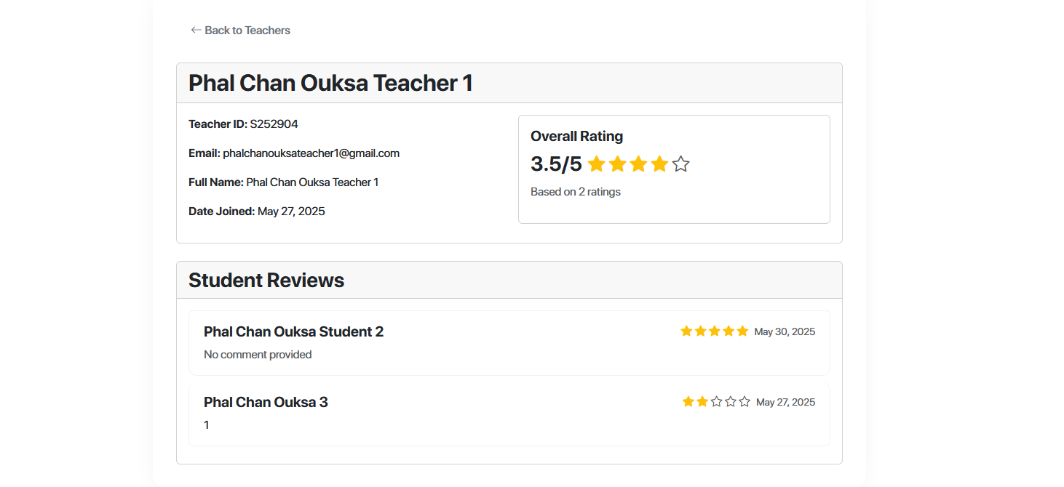
Rating
Student can rate
Teacher and provide
feedback

Slide 10
Resources sharing Features

Slide 11
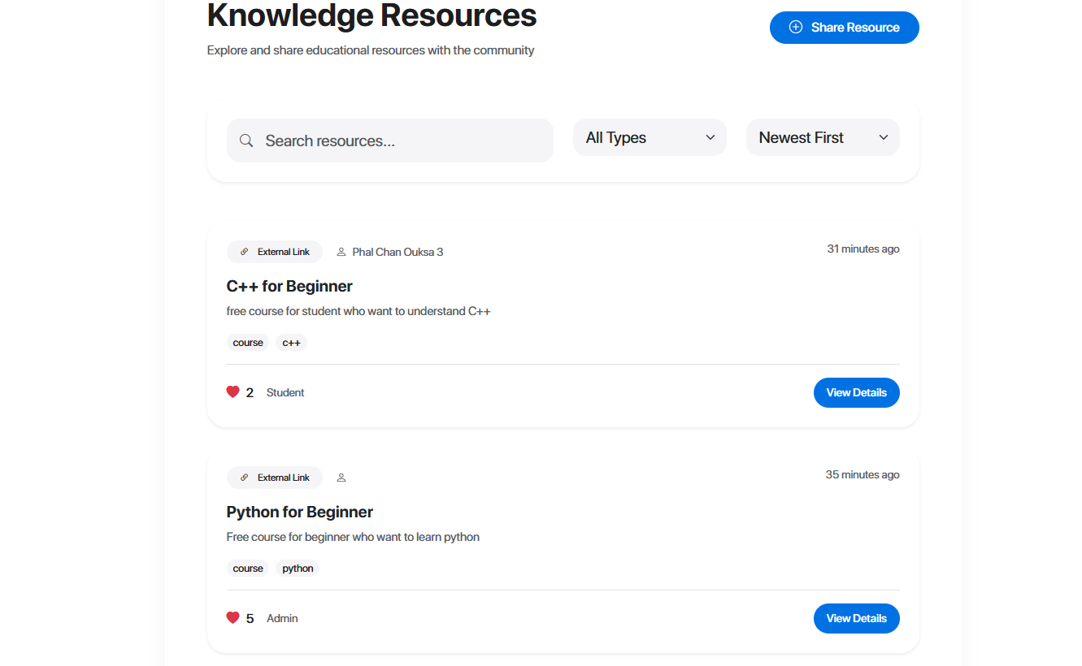
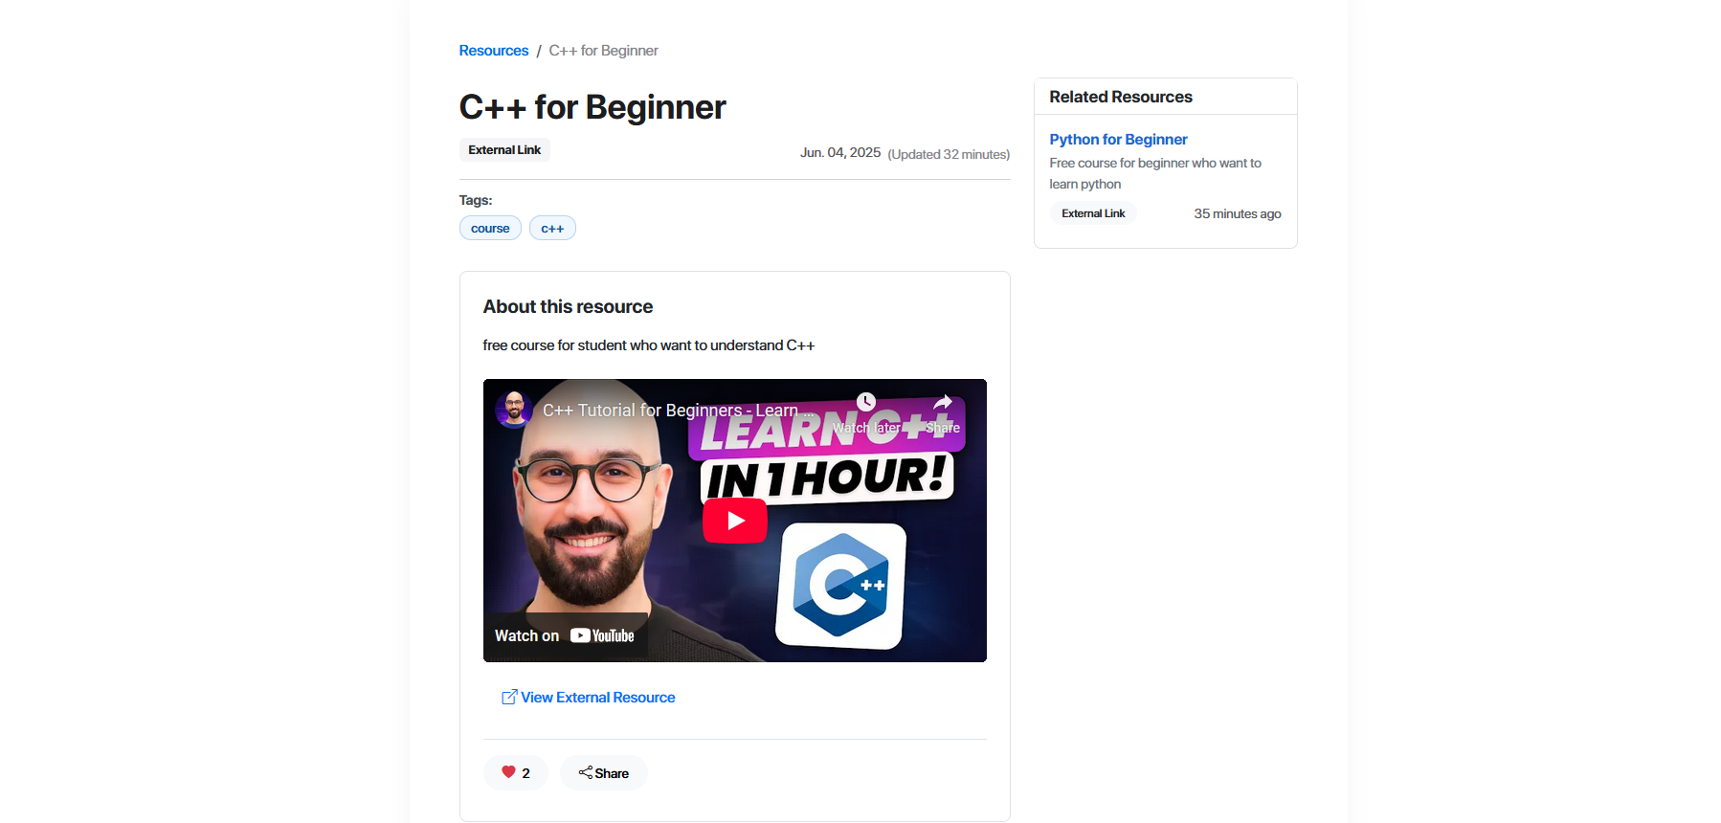
Resources sharing
Student and teacher
Can POSt resources
To share valuable content

