Slide 1
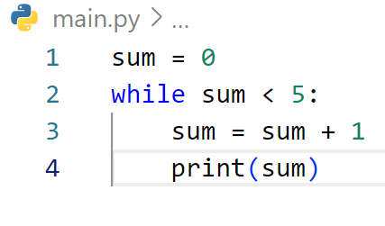
FINE THE OUTPUT

Slide 2
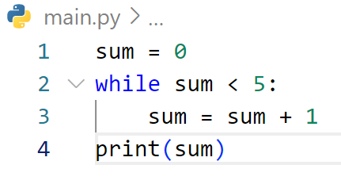
FINE THE OUTPUT

Slide 3
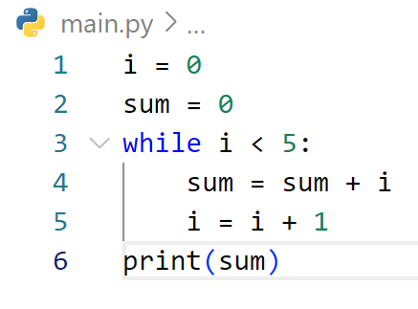
FINE THE OUTPUT

Slide 4
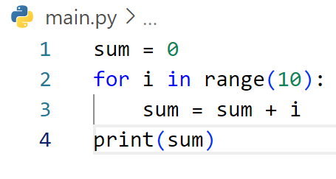
FINE THE OUTPUT

Slide 5
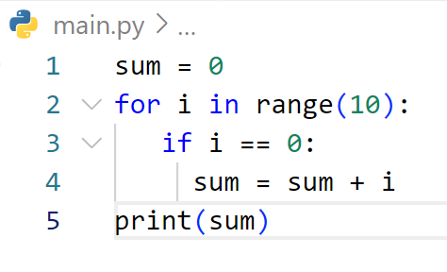
FINE THE OUTPUT

Slide 6
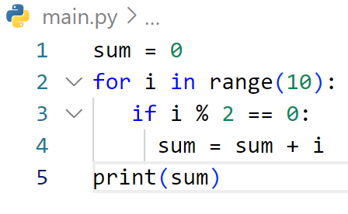
FINE THE OUTPUT

Slide 7
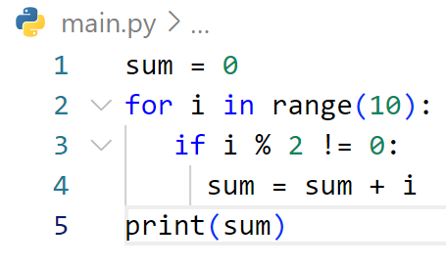
FINE THE OUTPUT

Slide 8
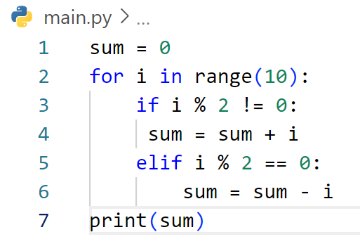
FINE THE OUTPUT

Slide 9
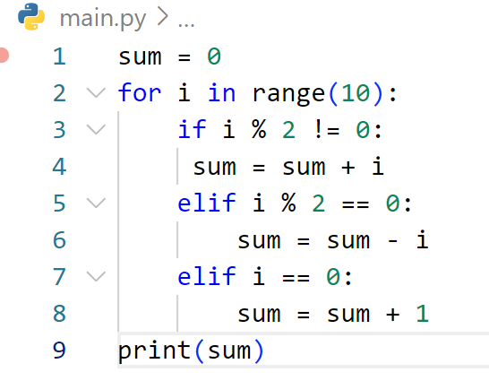
FINE THE OUTPUT

Slide 10
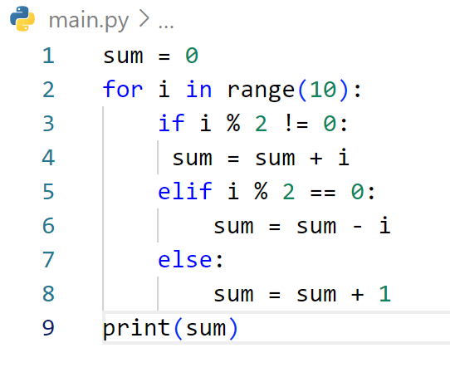
FINE THE OUTPUT

Slide 11
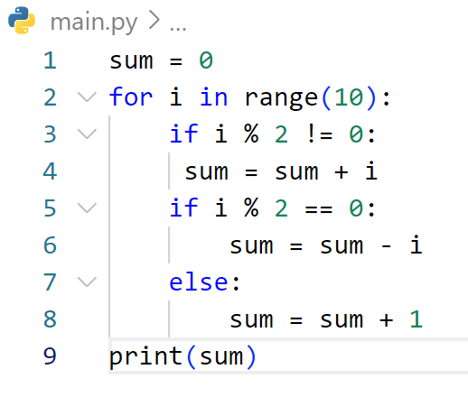
FINE THE OUTPUT

Slide 12
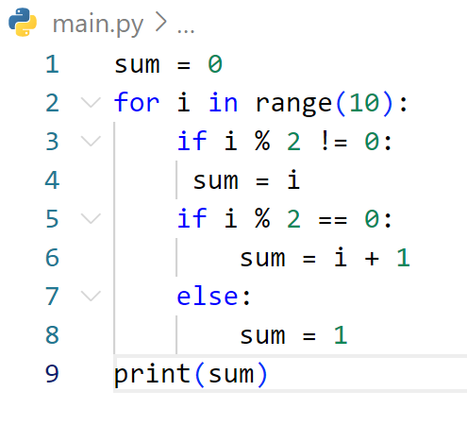
FINE THE OUTPUT

Slide 13
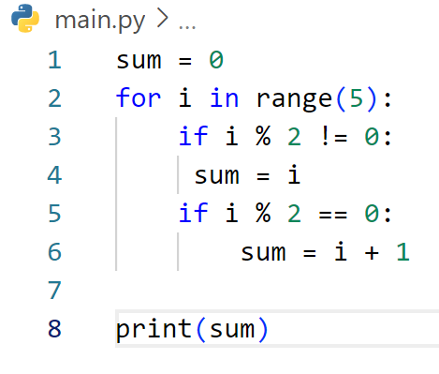
FINE THE OUTPUT

Slide 14
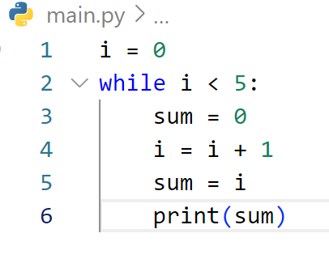
FINE THE OUTPUT

Slide 15
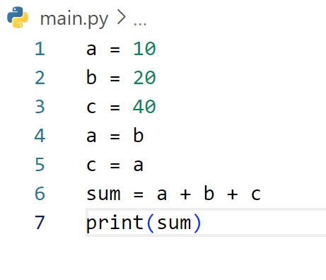
FINE THE OUTPUT

Slide 16
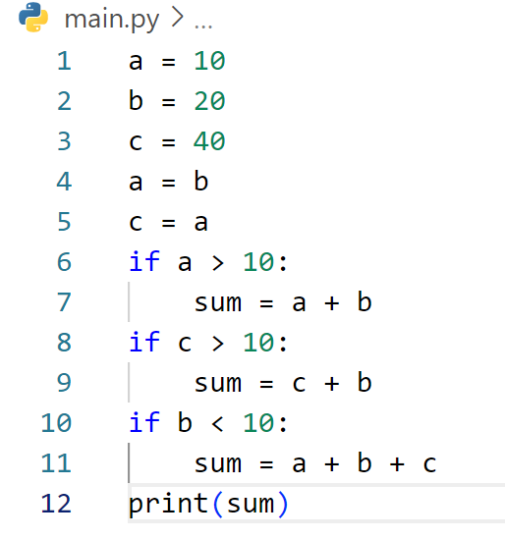
FINE THE OUTPUT

Slide 17
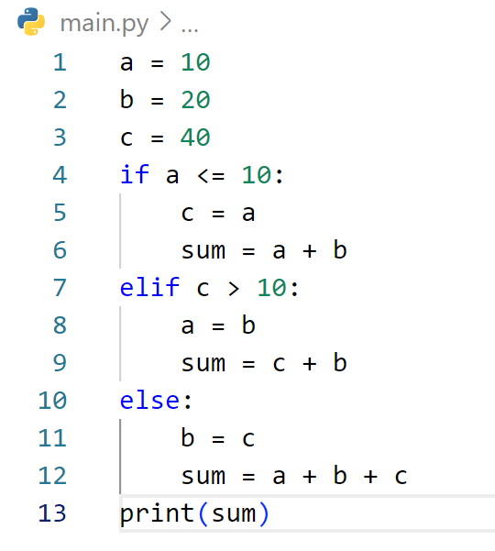
FINE THE OUTPUT

Slide 18
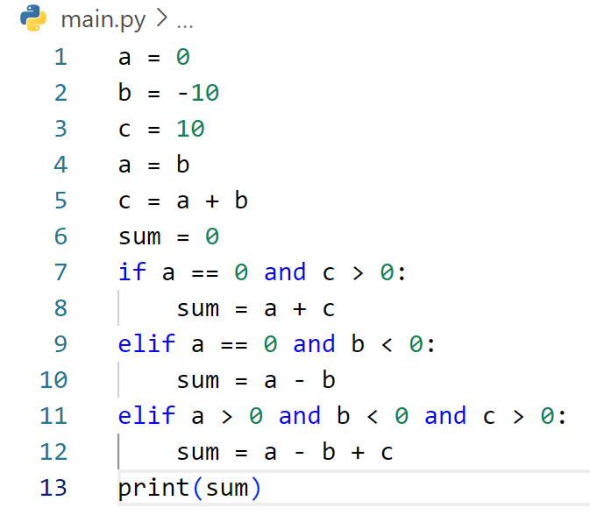
FINE THE OUTPUT

Slide 19
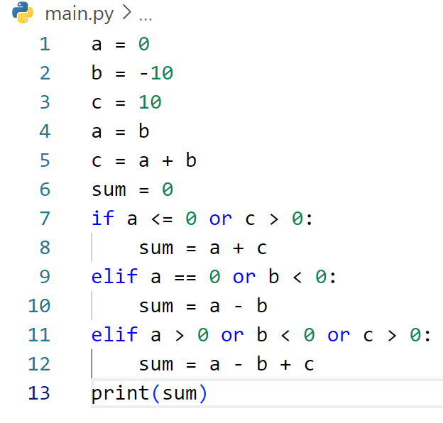
FINE THE OUTPUT

Slide 20
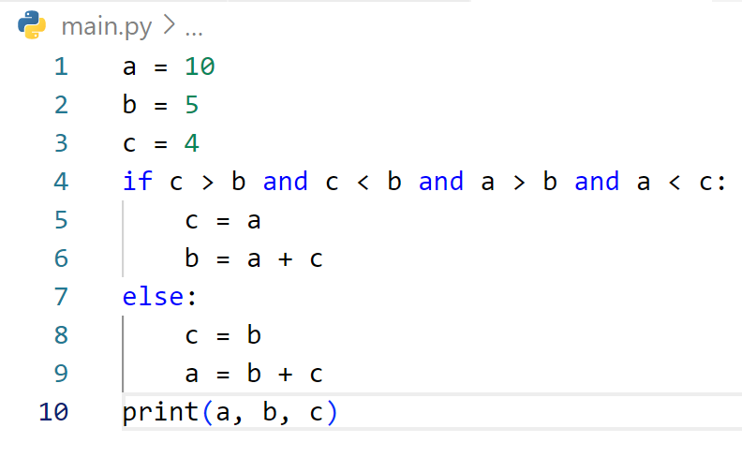
FINE THE OUTPUT

Slide 21
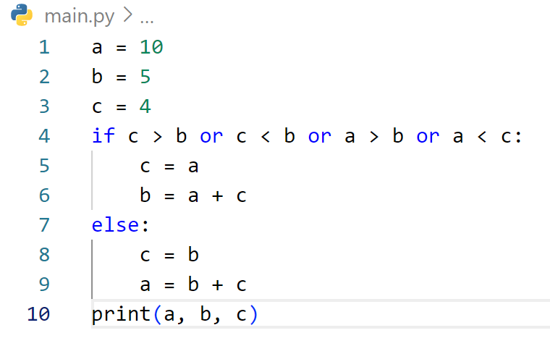
FINE THE OUTPUT

Slide 22
ចប់ដោយបរិបូរណ៍

