Slide 1

Take a paper put your name.
All of your answers need to write on to this paper.

Slide 2

1. Which answer is correct?
STUDENT
Student ID Student Name Date of birth Province
2
1
3
A
B
C
1= Table model or schema
2 = Entity
3 = Attribute
1= Table
2 = Entity
3 = Attribute
1= Table
2 = Attributes
3 = Entity

Slide 3
2. What is the type of : departure attribute ?
FlightBook
departureDate canHaveDogs lastName age company
A
INTEGER
D
BOOLEAN
B
STRING
E
FLOAT
C
DATE

Slide 4
3. What is the type of : age attribute ?
FlightBook
departureDate canHaveDogs lastName age compagny
A
INTEGER
D
BOOLEAN
B
STRING
E
FLOAT
C
DATE

Slide 5
4. What is the type of : company attribute ?
FlightBook
departureDate canHaveDogs lastName age compagny
A
INTEGER
D
BOOLEAN
B
STRING
E
FLOAT
C
DATE

Slide 6
5. What is the type of : canHaveDogs attribute ?
FlightBook
departureDate canHaveDogs lastName age compagny
A
INTEGER
D
BOOLEAN
B
STRING
E
FLOAT
C
DATE

Slide 7
6. how many PYTHON contests Cham performed ?
HACKER RANK CONTEST
HACKER RANK RESULTS
Contest ID | Contest name | Language
1 | Python basics | PYTHON
2 | Python Advanced | PYTHON
3 | Javascript DOM | JAVASCRIPT
Member ID | Contest ID | Result | Time
1 | 1 | 40 | 5
2 | 3 | 50 | 10
1 | 2 | 100 | 40
2 | 2 | 50 | 60
3 | 2 | 60 | 40
3 | 1 | 70 | 10
1 | 2 | 100 | 30
HACKER RANK MEMBERS
Member ID | Member name | Nickname
1 | Cham | The warrior
2 | Soklim | The crazy
3 | Sreymoa | The amazing

Slide 8
7. how much time in total Soklim competed on HackerRank ?
HACKER RANK CONTEST
HACKER RANK RESULTS
Contest ID | Contest name | Language
1 | Python basics | PYTHON
2 | Python Advanced | PYTHON
3 | Javascript DOM | JAVASCRIPT
Member ID | Contest ID | Result | Time
1 | 1 | 40 | 5
2 | 3 | 50 | 10
1 | 2 | 100 | 40
2 | 2 | 50 | 60
3 | 2 | 60 | 40
3 | 1 | 70 | 10
1 | 2 | 100 | 30
HACKER RANK MEMBERS
Member ID | Member name | Nickname
1 | Cham | The warrior
2 | Soklim | The crazy
3 | Sreymoa | The amazing

Slide 9
8. Which contest is the most popular ?
HACKER RANK CONTEST
HACKER RANK RESULTS
Contest ID | Contest name | Language
1 | Python basics | PYTHON
2 | Python Advanced | PYTHON
3 | Javascript DOM | JAVASCRIPT
Member ID | Contest ID | Result | Time
1 | 1 | 40 | 5
2 | 3 | 50 | 10
1 | 2 | 100 | 40
2 | 2 | 50 | 60
3 | 2 | 60 | 40
3 | 1 | 70 | 10
1 | 2 | 100 | 30
HACKER RANK MEMBERS
Member ID | Member name | Nickname
1 | Cham | The warrior
2 | Soklim | The crazy
3 | Sreymoa | The amazing

Slide 10

OBJECTIVES FOR TODAY
Understand the relation many to many between entities
What is a primary key ?
What is a foreign key ?

Slide 11
DB
MANY TO MANY RELATION

Slide 12
Relation between Student and Course
STUDENT
Student ID Student Name Date of birth Province
COURSE
Course ID Course Name Teacher Department
?
?
How many courses can follow a student?
How many students can follow one course?

Slide 13
Many to many relation
STUDENT
Student ID Student Name Date of birth Province
COURSE
Course ID Course Name Teacher Department
many
many
A student has many courses
A course can welcome many students

Slide 14

ACTIVITY 1
10 MIN
STUDENT
ENROLMENT
COURSE
Student ID | Student Name | Date of birth | Province
1001 | Mengyi | xxx | xxx
1002 | Tim | xxx | xxx
1003 | Narong | xxx | xxx
1004 | Nork | xxx | xxx
1005 | Sophim | xxx | xxx
Enrolment ID | Student ID | Course ID
10011001 | 1001 | 1002
10021002 | 1002 | 1002
10031002 | 1003 | 1002
10031001 | 1003 | 1001
10041001 | 1004 | 1001
10051001 | 1005 | 1001
10011004 | 1001 | 1004
10021004 | 1002 | 1004
Course ID | Course name | Teacher | Department
1001 | JavaScript | Clément | WEP
1002 | Oral comprehension | Sokhom | English
1003 | Algorithm | Ronan | WEP
1004 | Drawing | Him | Art
What courses follows Mengyi?
Who are the students that follow the Javascript course?
How many students follow the Drawing course?
Notes:
Complete the tables with examples

Slide 15
CORRECTION
What courses follows Mengyi?
ENROLMENT
STUDENT
Enrolment ID | Student ID | Course ID
10011001 | 1001 | 1002
10021002 | 1002 | 1002
10031002 | 1003 | 1002
10031001 | 1003 | 1001
10041001 | 1004 | 1001
10051001 | 1005 | 1001
10011004 | 1001 | 1004
10021004 | 1002 | 1004
Student ID | Student Name
1001 | Mengyi
1002 | Tiim
1003 | Narong
1004 | Nork
1005 | Sophim
COURSE
Course ID | Course name | Teacher | Department
1001 | JavaScript | Clément | WEP
1002 | Oral comprehension | Sokhom | English
1003 | Algorithm | Ronan | WEP
1004 | Drawing | Him | Art
Notes:
What courses follow Lyhour

Slide 16
CORRECTION
Who are the students that follow the Javascript course?
ENROLMENT
STUDENT
Enrolment ID | Student ID | Course ID
10011001 | 1001 | 1002
10021002 | 1002 | 1002
10031002 | 1003 | 1002
10031001 | 1003 | 1001
10041001 | 1004 | 1001
10051001 | 1005 | 1001
10011004 | 1001 | 1004
10021004 | 1002 | 1004
Student ID | Student Name
1001 | Mengyi
1002 | Tiim
1003 | Narong
1004 | Nork
1005 | Sophim
COURSE
Course ID | Course name | Teacher | Department
1001 | JavaScript | Clément | WEP
1002 | Oral comprehension | Sokhom | English
1003 | Algorithm | Ronan | WEP
1004 | Drawing | Him | Art
Notes:
Who follows JavaScript

Slide 17
Many to many relation
one to many relation between students and enrolments
STUDENT
Student ID Student Name Date of birth Province
ENROLMENT
Enrolment ID Student ID Course ID Date
COURSE
Course ID Course Name Teacher Department
1
many
many
1

Slide 18
Many to many relation
one to many relation between course and enrolments
STUDENT
Student ID Student Name Date of birth Province
ENROLMENT
Enrollment ID Student ID Course ID
COURSE
Course ID Course Name Teacher Department
1
many
many
1

Slide 19
Enrolment is an intersection table
STUDENT
Student ID Student Name Date of birth Province
ENROLMENT
Enrollment ID Student ID Course ID
COURSE
Course ID Course Name Teacher Department
1
many
many
1

Slide 20
If there is an additional attribute, it is called a ASSOCIATIVE TABLE
STUDENT
Student ID Student Name Date of birth Province
ENROLMENT
Enrollment ID Student ID Course ID Date
COURSE
Course ID Course Name Teacher Department
1
many
many
1

Slide 21
ACTIVITY 2
10 MIN
PARENT
parent_id gender last_name job_name
STUDENT_PARENT
parent_id student_id
STUDENT
student_id gender last_name shool_name
1
many
many
1
1 What is the relation between Students and Parents?
2 The table Student_Parents is called an Intersection table or an Associative table or is it just a normal table? Explain why.

Slide 22

A primary key is a unique identifier of an entity record
Primary key
Student ID | Student Name | Date of birth | Province | Classroom ID
1001 | Lyhour | XXX | XXX | 1
1002 | Srey Haem | XXX | XXX | 1
1003 | XXX | XXX | XXX | 2
1004 | XXX | XXX | XXX | 3
1005 | XXX | XXX | XXX | 2
1006 | XXX | XXX | XXX | 5
Entity record
Notes:
A key is a column whose values are used to identify a row

Slide 23
A foreign key is a reference to another entity record
foreign key
Primary key
Student ID | Student Name | Date of birth | Province | Classroom ID
1001 | Lyhour | XXX | XXX | 1
1002 | Srey Haem | XXX | XXX | 1
1003 | XXX | XXX | XXX | 2
1004 | XXX | XXX | XXX | 3
1005 | XXX | XXX | XXX | 2
1006 | XXX | XXX | XXX | 5
Classromm ID
1
2
3
4
5
6
It is a primary key in another table
Notes:
A key is a column whose values are used to identify a row

Slide 24
What is a ERD?
Entity Relational Diagram ?
ENTITY
KEY TYPE
ENTITY | STUDENT
PK FK | Key ID property Property Foreign ID | Numeric String Data/time String Numeric
ENTITY | STUDENT
PK FK | Key ID property Property Foreign ID | Numeric String Data/time String Numeric
1
many
RELATION
TYPE
ATTRIBUTE
TYPE

Slide 25
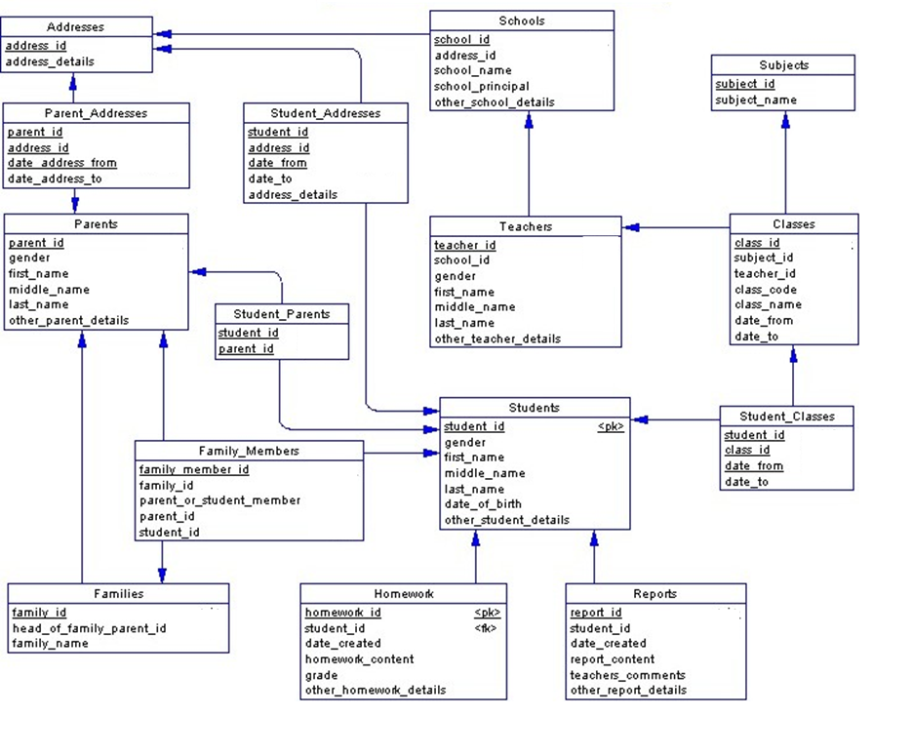
ACTIVITY 3
10 MIN
Complete the model to precise for each id if they are a Primary Key (PK) or a Foreign Key (FK)
EXAMPLE
PK
PK FK
FK
FK
FK
FK
FK
FK
PK
FK
FK
PK
PK
FK
FK
FK
PK
PK
PK
FK
PK
FK
PK
FK
PK
PK
FK
PK

Slide 26
ACTIVITY 4
10 MIN
STUDENT
student_id gender name province
COURSE
coure_id course_name departement
many
many
Add a new table to manage the MANY to MANY relation ship
For each attribute, write the TYPE and for the keys, specify PK or FK

Slide 27

Can you answer to those questions ?
Understand the relation many to many between entities
What is a primary key ?
What is a foreign key ?
What is a ERD?

