Slide 1
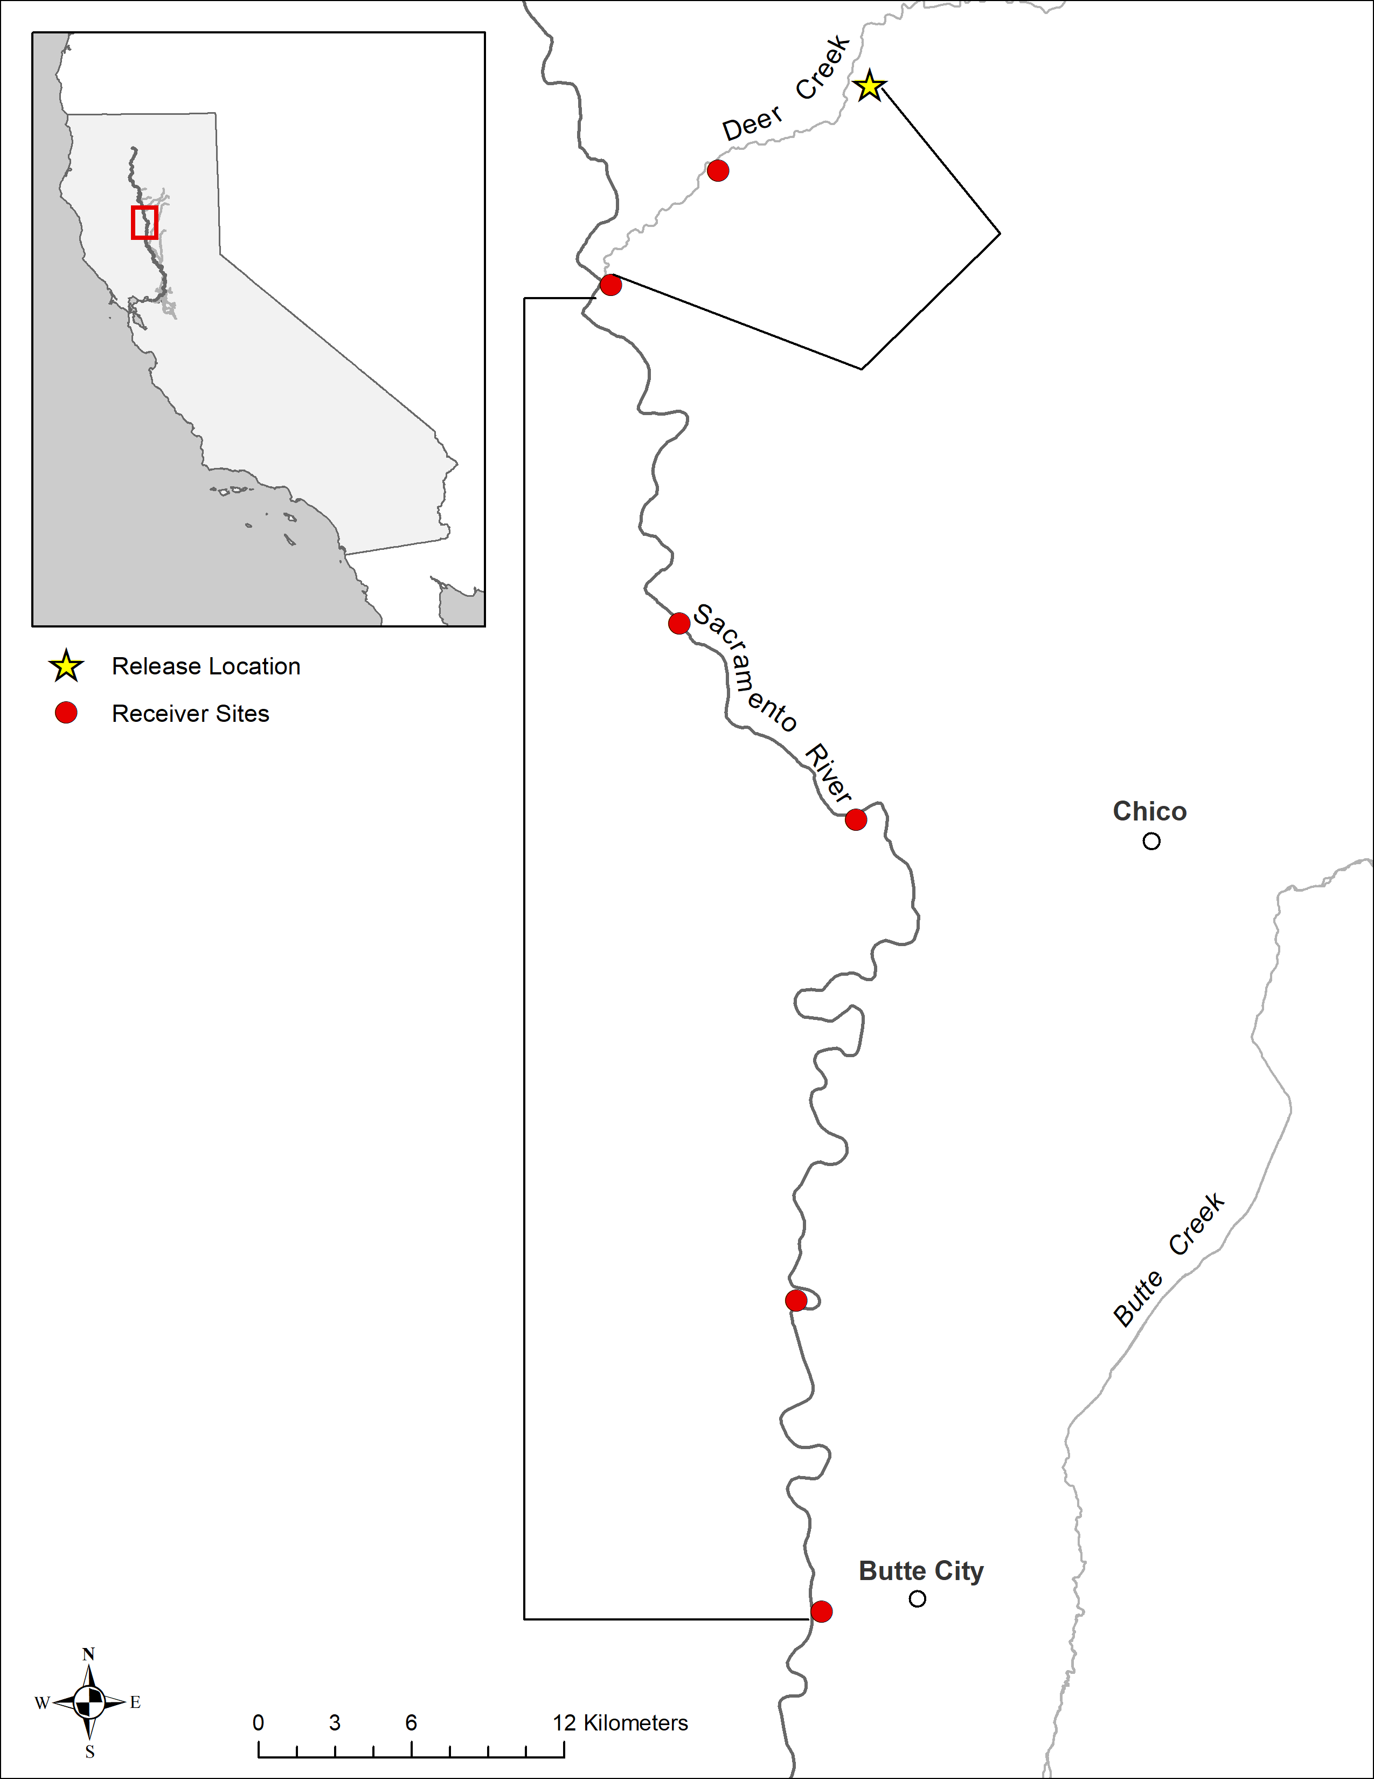
1
2
Deer Creek
3
4
Lower Sacramento
5
6

