Slide 1
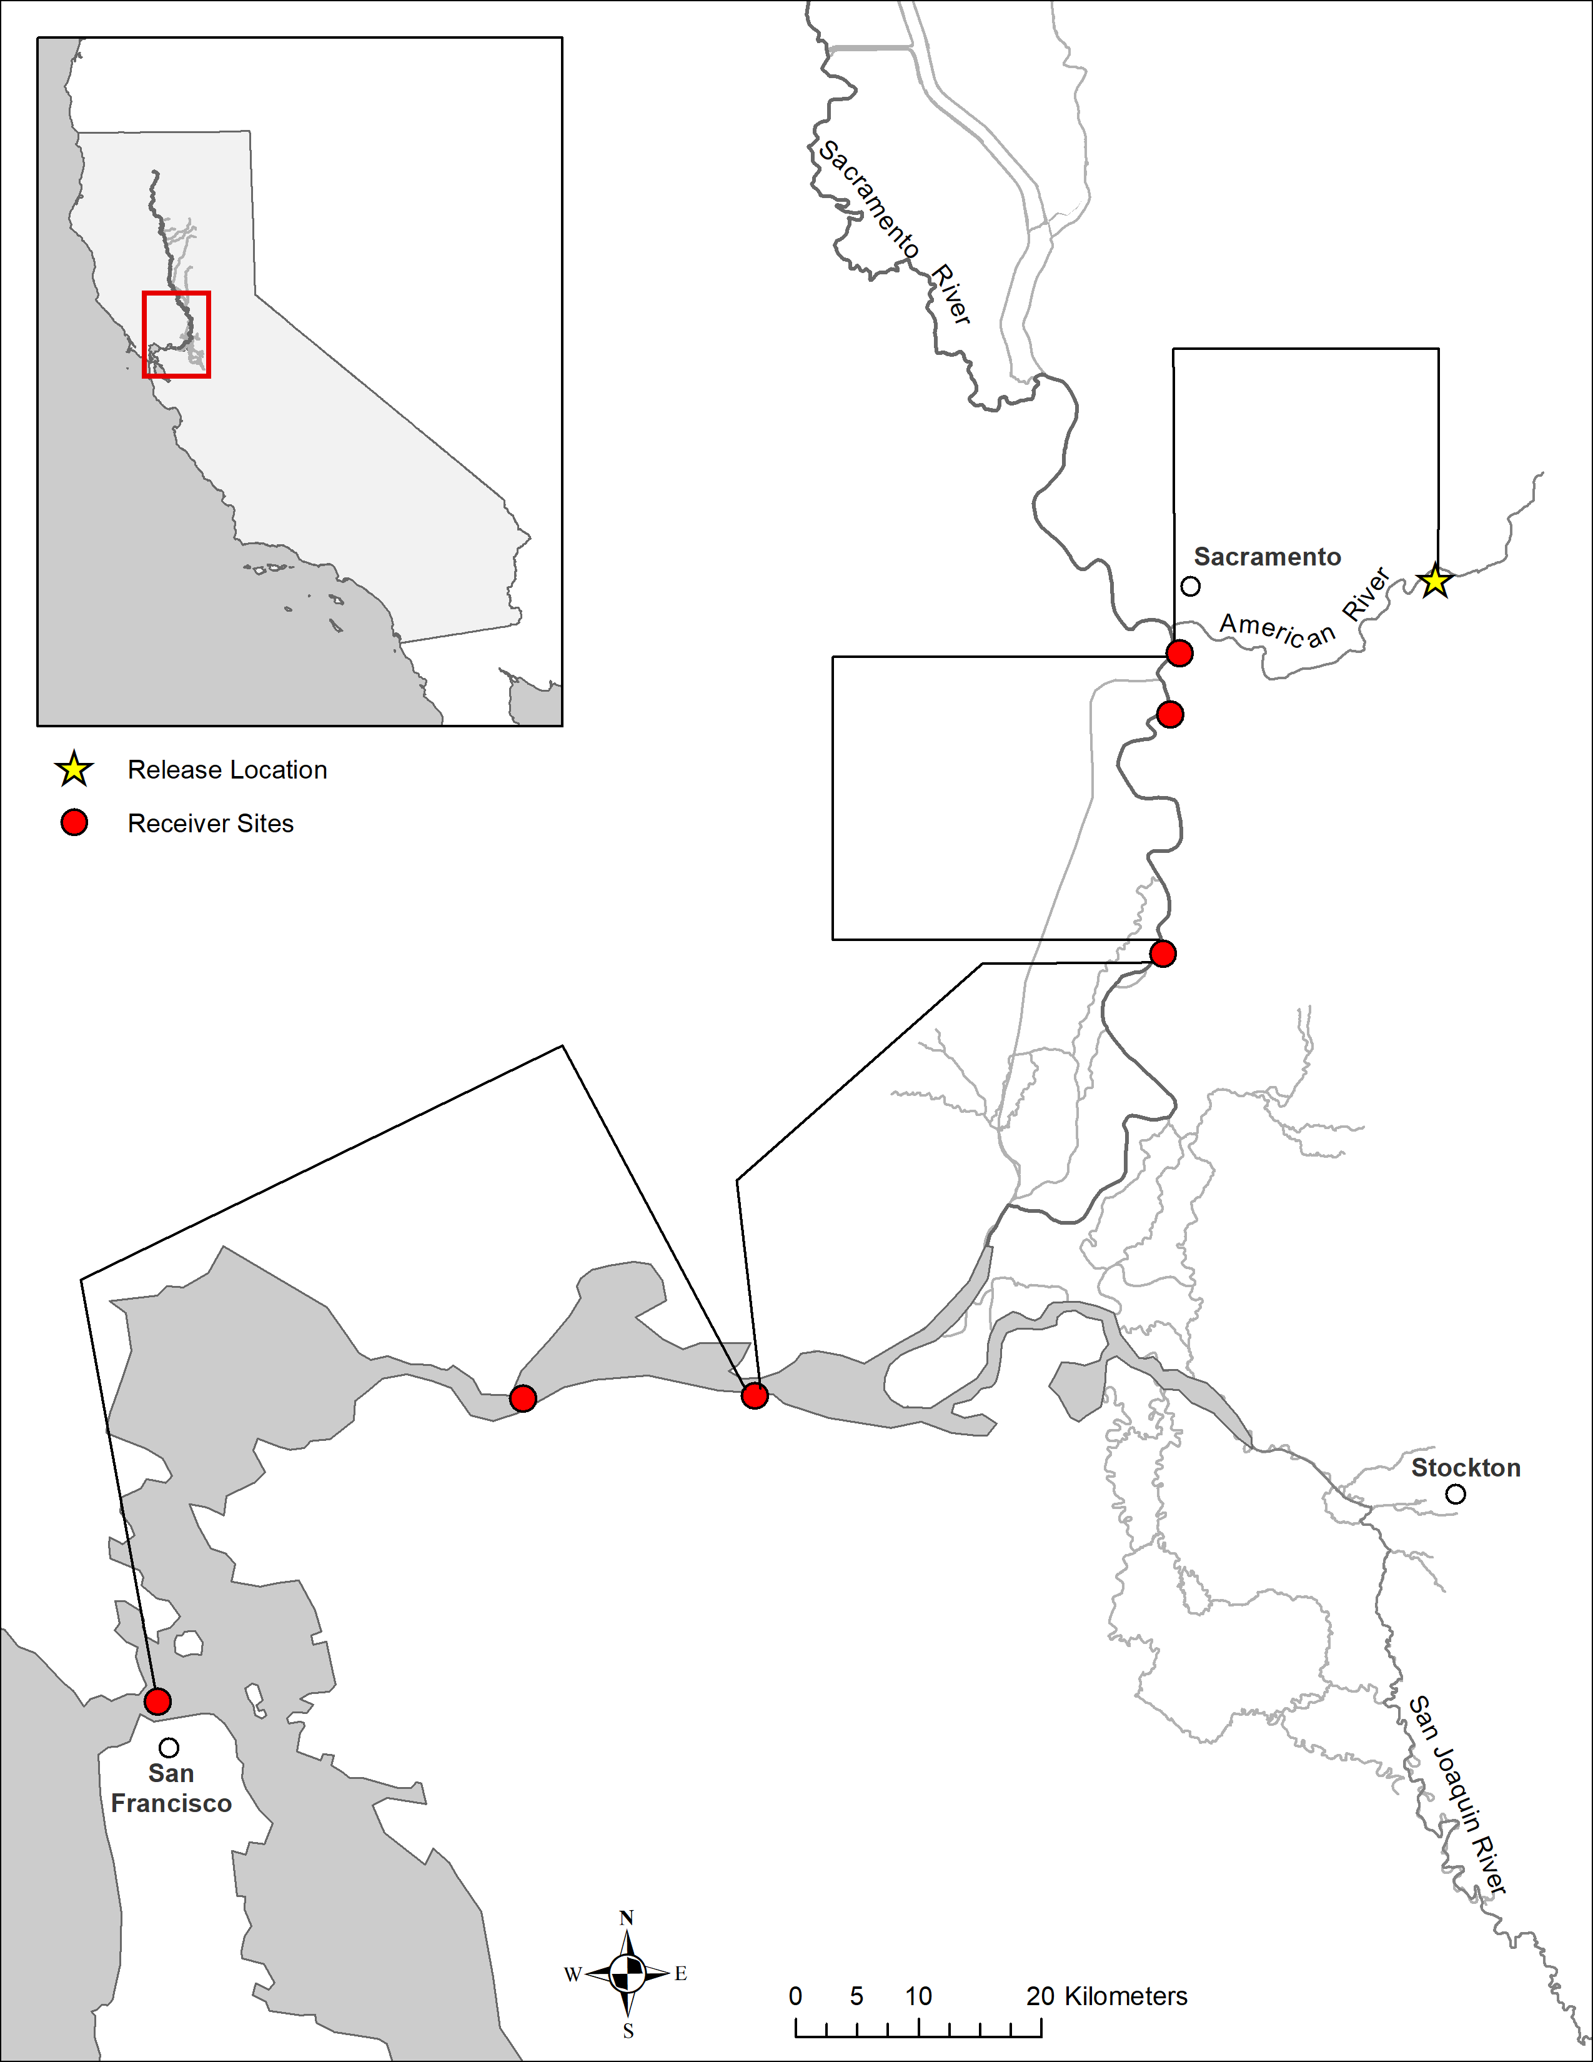
American River
2
1
Lower Sacramento
3
Delta
Bay
4
6
5

