Slide 1
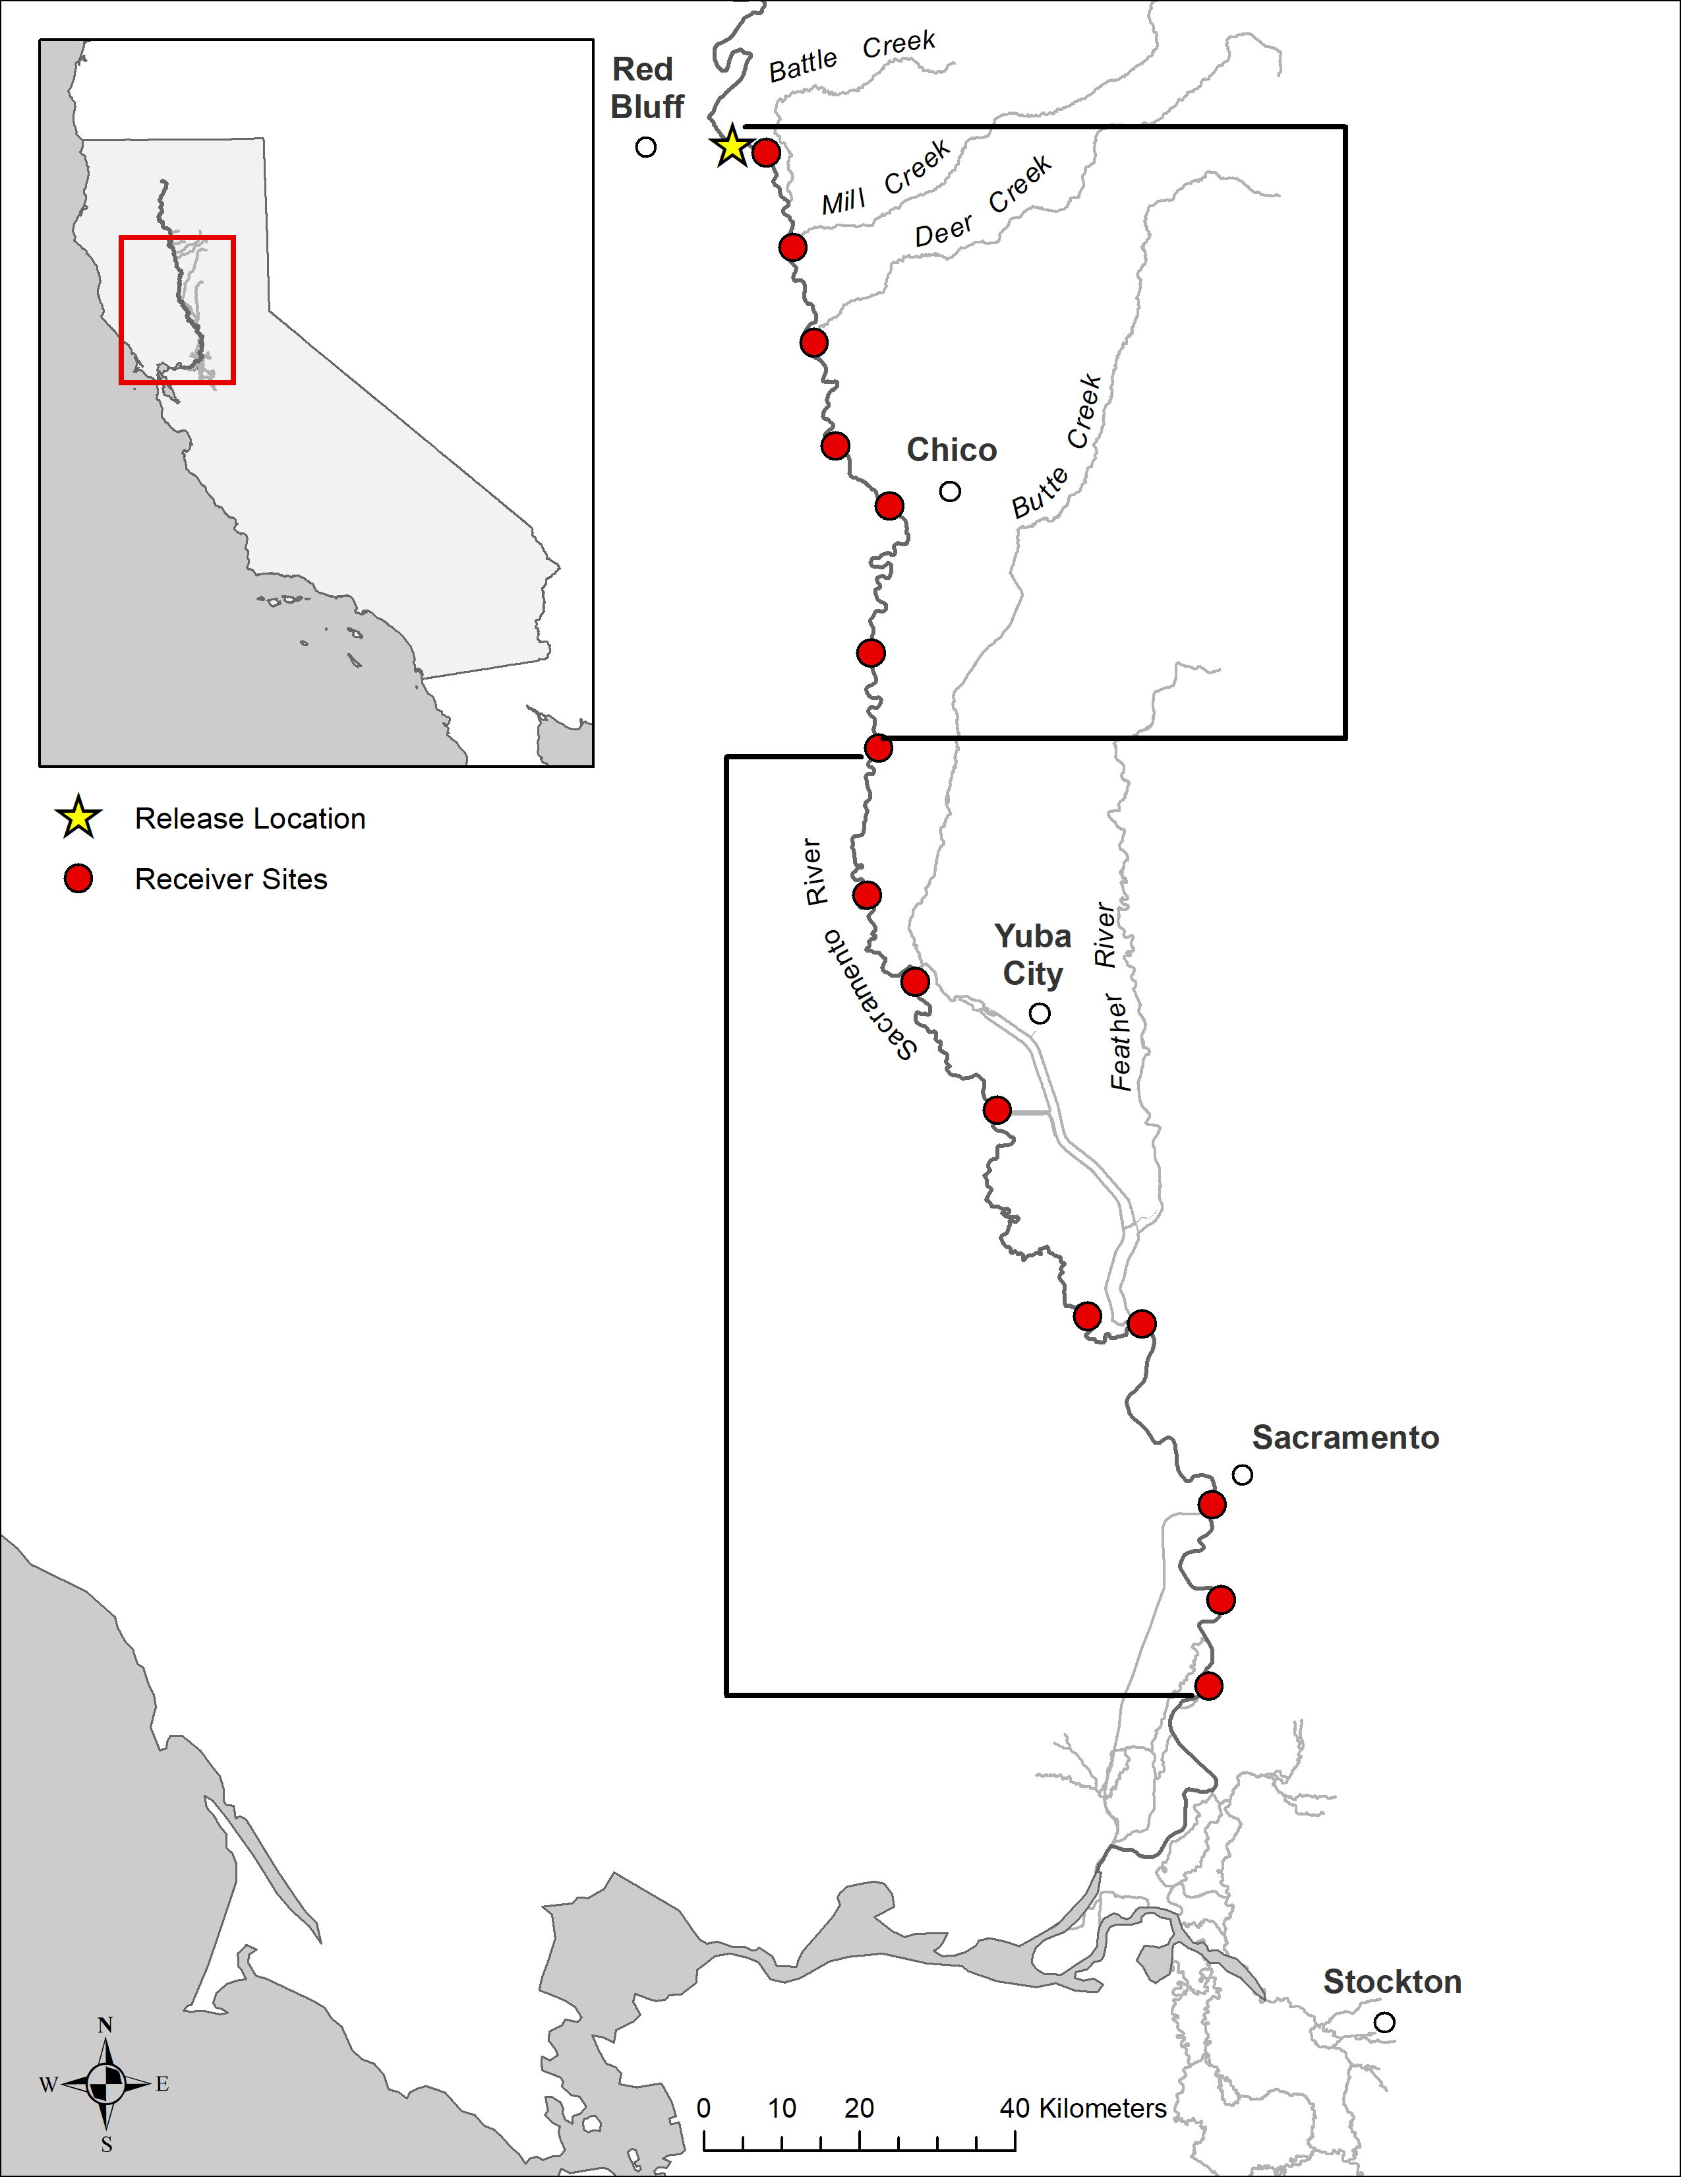
1
2
3
4
Upper Sacramento
5
6
7
8
9
10
Lower Sacramento
11
12
13
14
15

