Slide 1
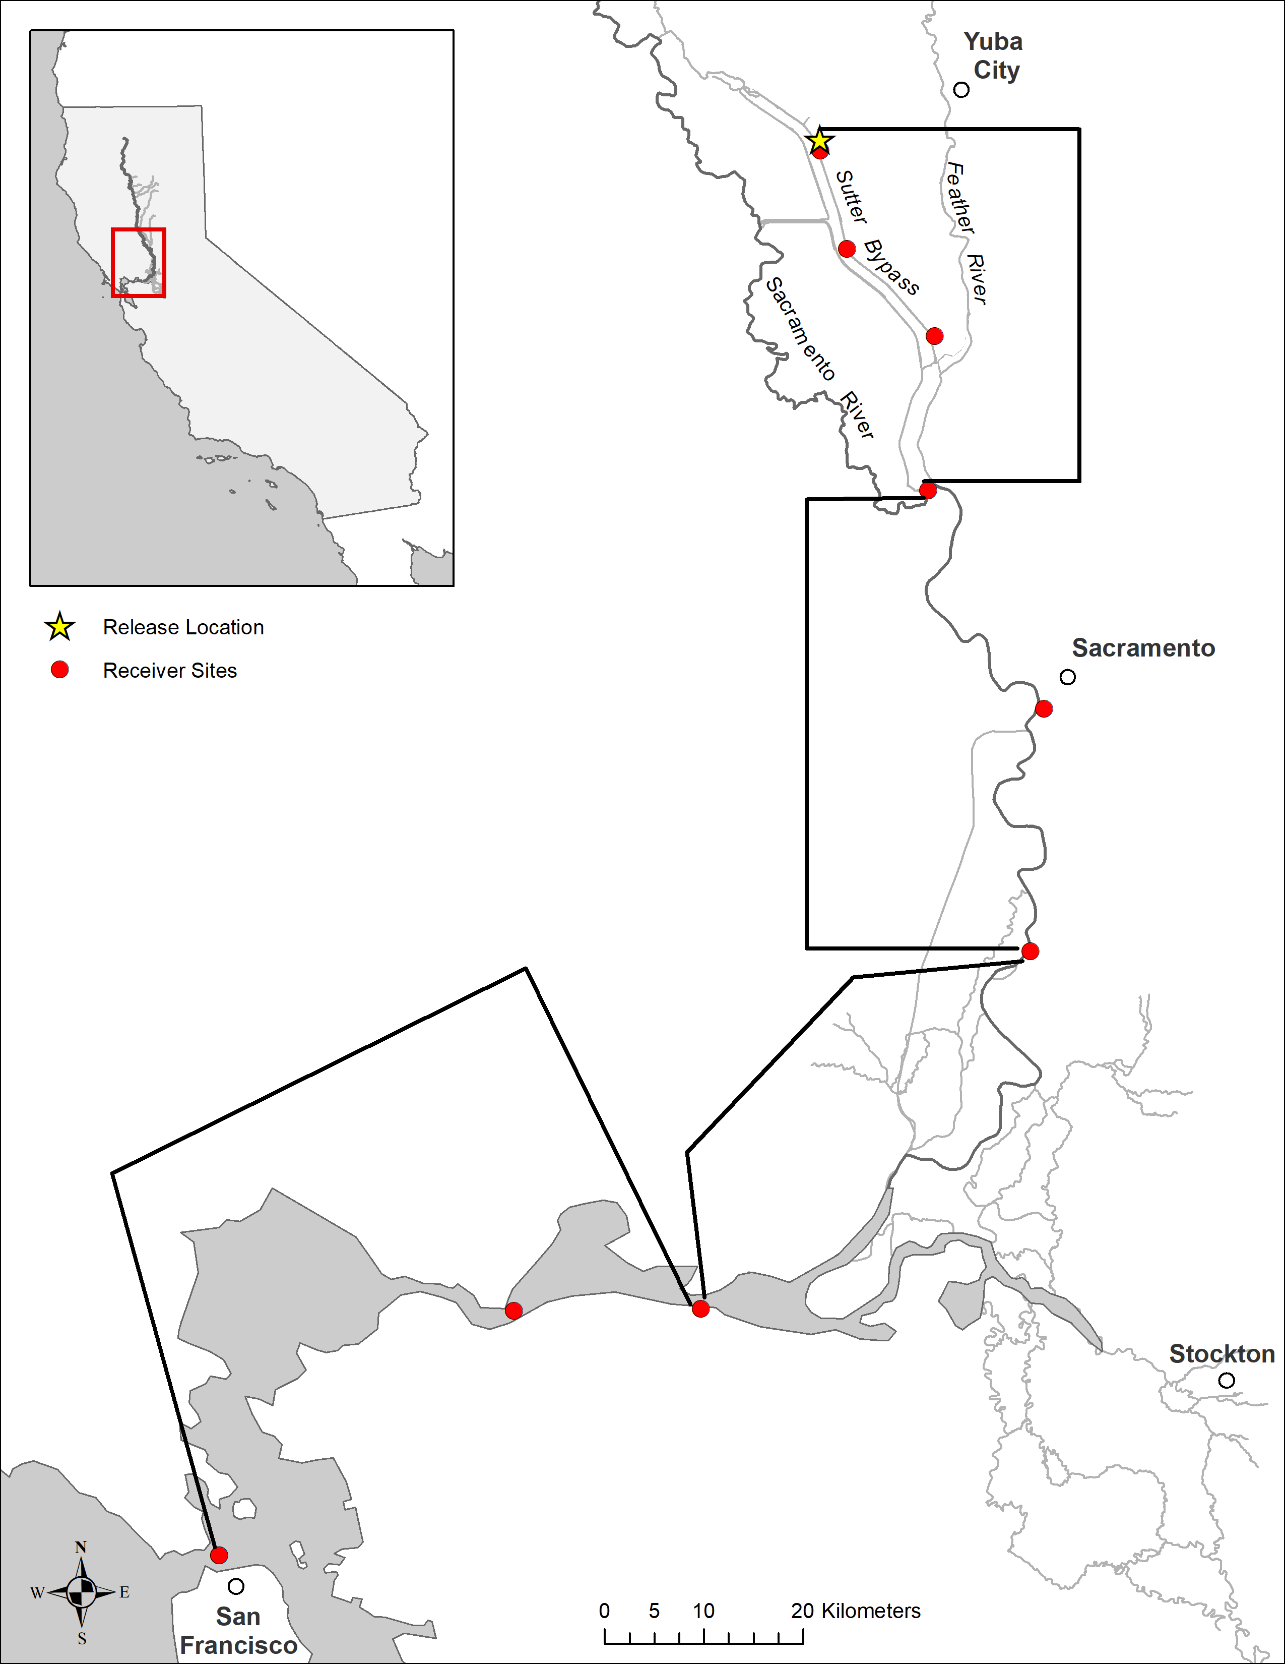
1
2
3
Sutter Bypass
4
5
Lower Sacramento
6
Bay
Delta
7
9
8

