Slide 1
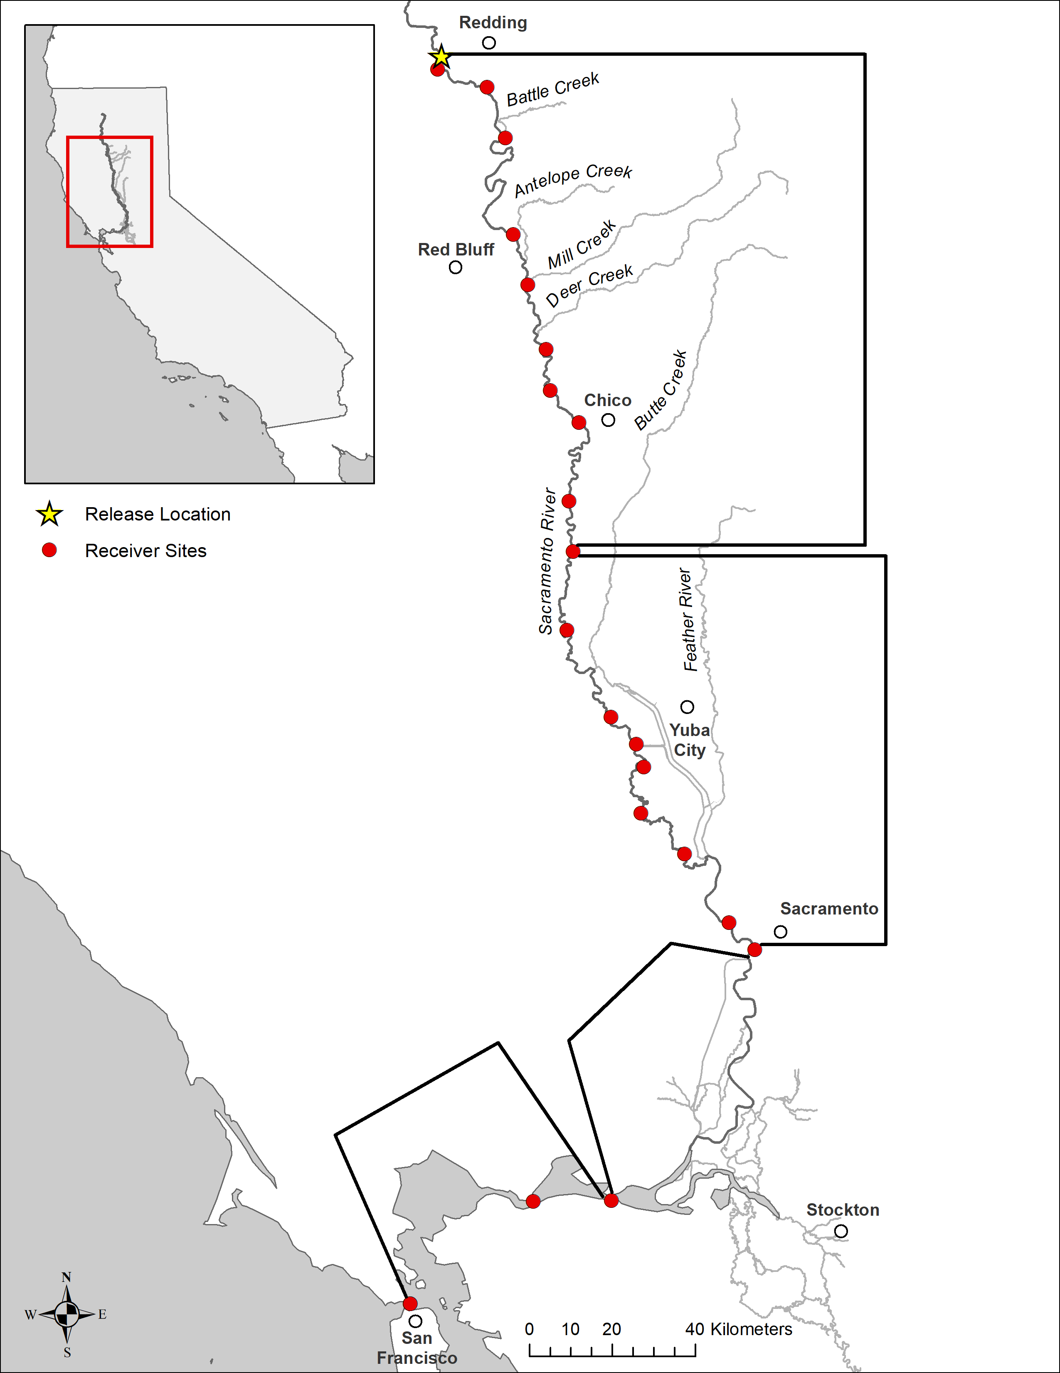
1
2
3
4
5
Upper Sacramento
6
7
8
9
10
11
12
13
14
Lower Sacramento
15
16
17
18
Delta
Bay
19
21
20

