Slide 1

SMES PLAN
Contents
Master Plan
1. DATA BASE & UI
2. CORE FUNCTION
3. BASIC FUNCTION
4. MAIN MODULE
3rd. Dec. 2019

Slide 2
Simple MES
Master Plan
TASK
CATEGORIES
ITEMS
STATUS
2019
2020
Nov
Dec
Jan
Feb
Mar
Apr
May
Jun
Jul
Aug
Sep
Oct
Nov
Dec
DATABASE
1. DATA BASE & UI
UI ( FORM, TABLE … )
2. CORE FUNCTION
Data base connection, upload, generate UI code
SMES
3. BASIC FUNCTION
USERS, ACCESS, COMPANY, MATERIAL,….
1, BOM logic
5/12
4. MAIN MODULE
2, PRINT Label
3, Traceability
2/1
Test & Improve
4, Input Productivity
25/2
5, QA ISSUE Control
15/12
Test & Improve
Nov
Dec
Jan
Feb
Mar
Apr
May
Jun
Jul
Aug
Sep
Oct
Nov
Dec

Slide 3
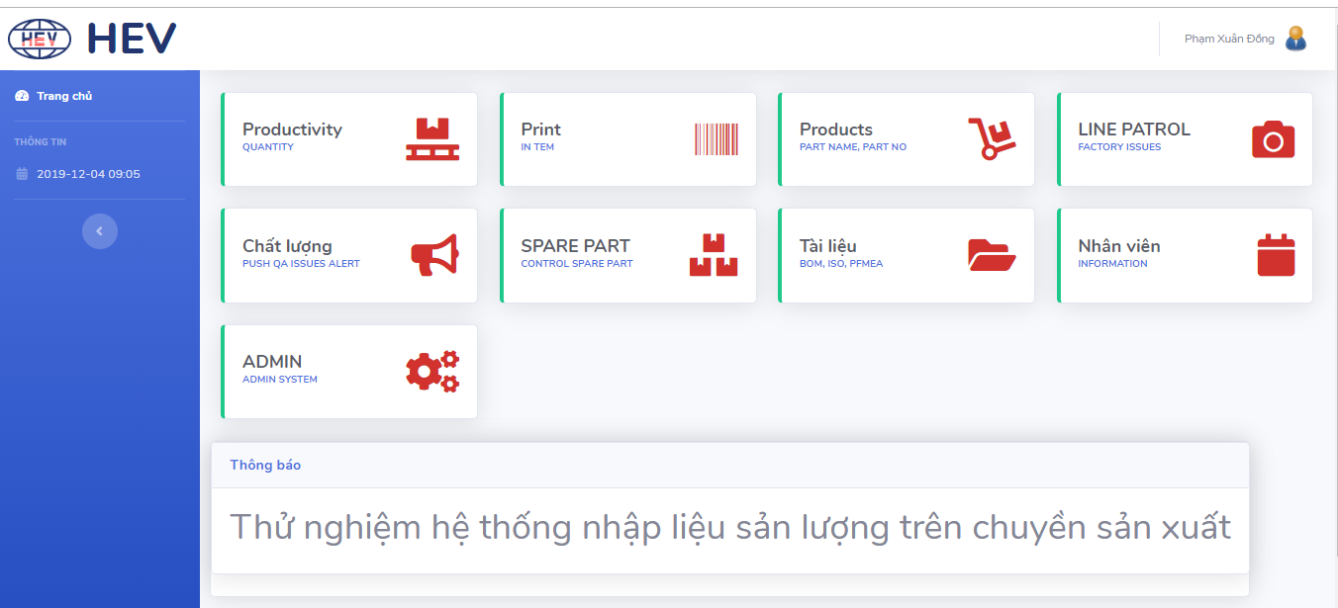
1 UI

Slide 4
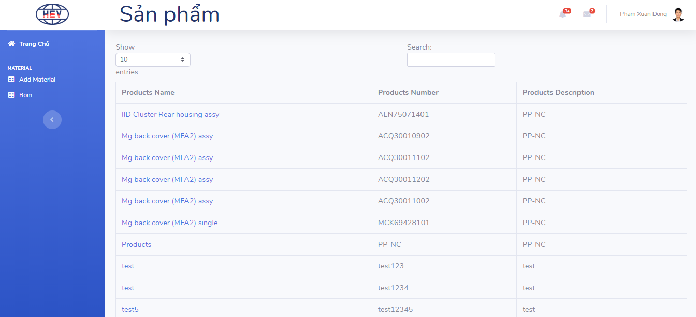
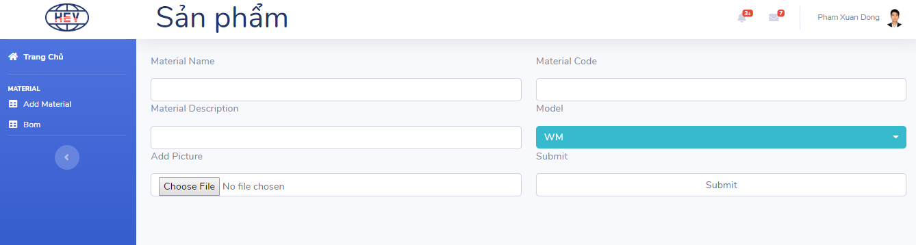
1 UI

Slide 5













4.3 Traceability
FI
2nd Floor
Out
Coating
Die casting
Trimming
& tapping
CNC
Delivery
QR code record system
Ware house
Data input manual/ hour

Slide 6
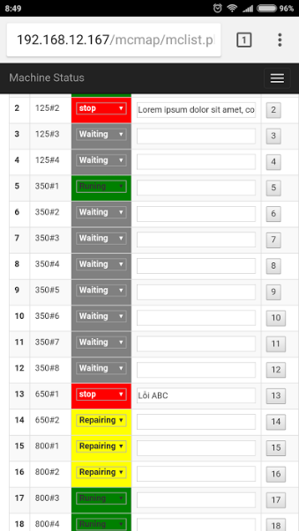
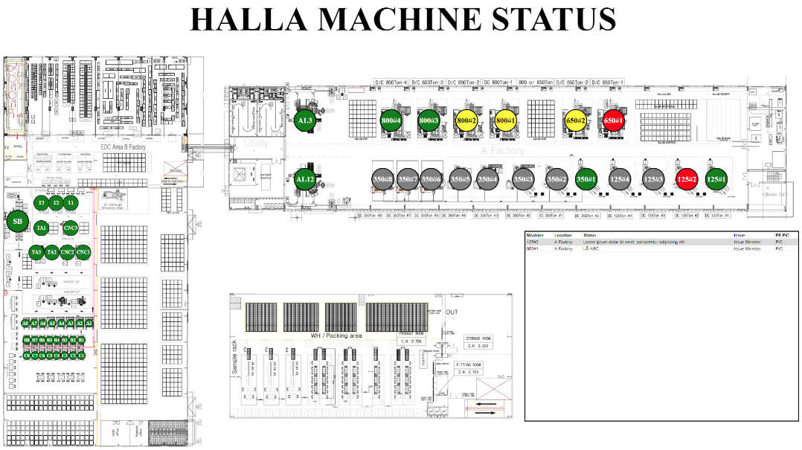
6.MRP system define
6.5.1 Machine Map view
Mobile Change Status
Monitor Screen
Issue Description
Change status
Input Issue Description

Slide 7
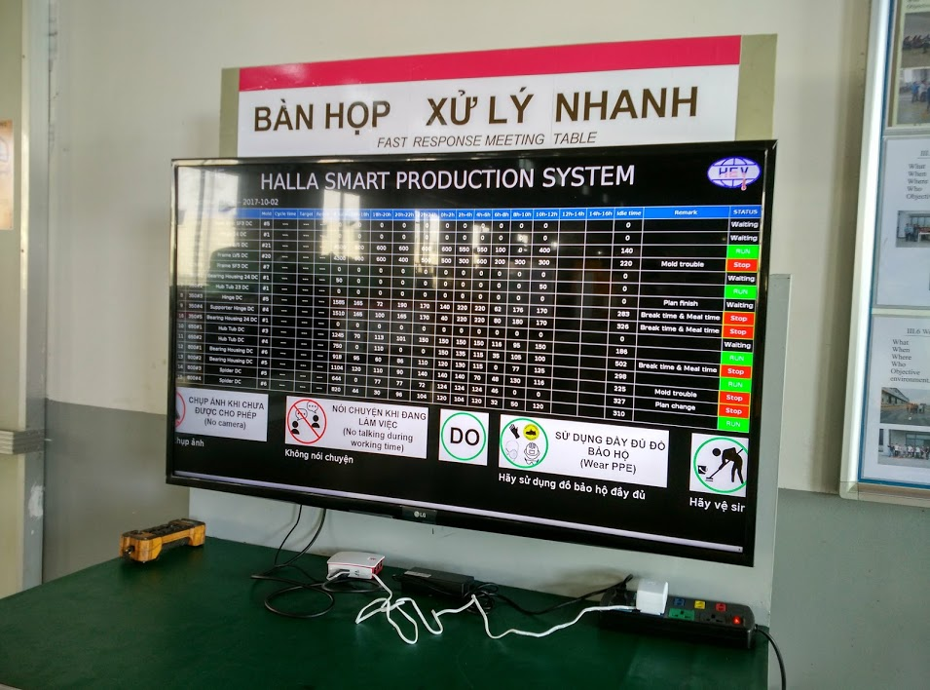
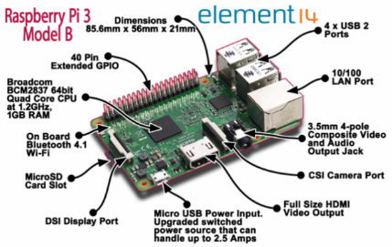
7. Halla IOT Project
7.1 Monitor
Hardware : Raspberry Pi 3

Slide 8
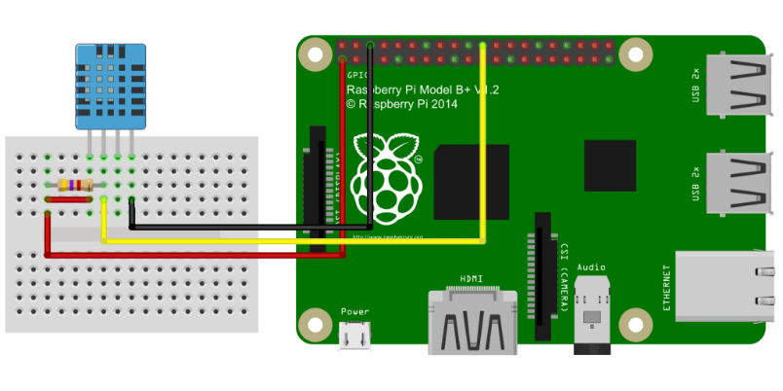
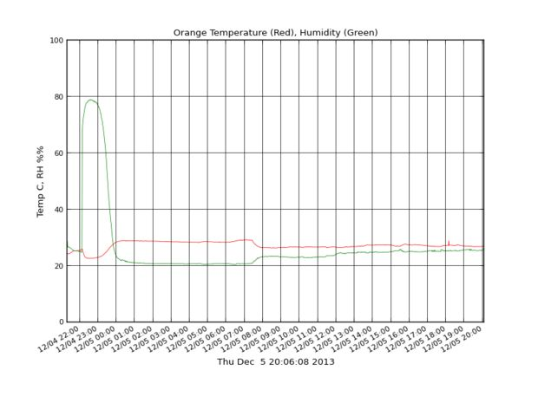
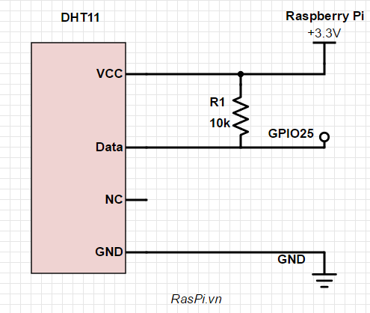
7. Halla IOT Project
7.1 Control Humidity&Temp
Hardware : Raspberry Pi 3

