Slide 1
HTML

Slide 2
BEFORE WE GET STARTED
Using Windows.
Install Git.
Install Visual Studio Code Text Editor – with extensions : Beautify, Bootstrap 4 Snippet, HTML Snippets, Live Server.
Chrome Web Browser – with extensions : Ddict Translate.
Register an account in Github.com & create your Repository in Git Hub with convention : Aptech-php-13-your-name
* Note it on your paper then we move on to next slide, install it immediately.

Slide 3
WHAT IS HTML ?
HTML is the standard markup language for creating Web pages – Web Page is a document which can be display in a web browser such as Firefox, Google Chrome and Website is a collection of webpages.
HTML stands for Hyper Text Markup Language. Extension file HTML is .html.
HTML elements are the building blocks of HTML pages and represented by tags.
Browsers do not display the HTML tags, but use them to render the content of the page.

Slide 4
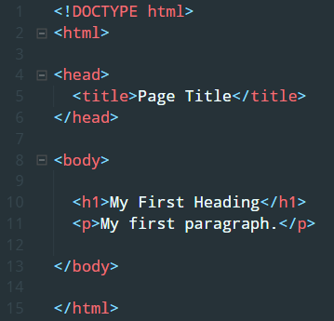
HTML DOCUMENT
All HTML documents must start with a document type declaration : <!DOCTYPE html> , represented for HTML5.
The <html> element is the root element of an HTML page and end with </html>.
The <head> element contains meta information about the document.
The <body> element contains the visible page content.
Do not care about another element. Will be learned it later.

Slide 5

HTML ELEMENT
HTML tags are element names surrounded by angle brackets :
HTML tags normally come in pairs, but sometime go alone.
The first tag is the opening tag and the other one is closing tag. Carefully with forward slash of closing tag.
Some of special tag do not have the close tag, it is called empty elements. It is normal in HTML.
HTML elements can be nested.

Slide 6
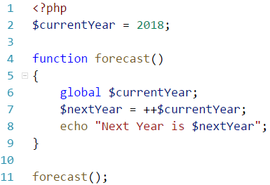
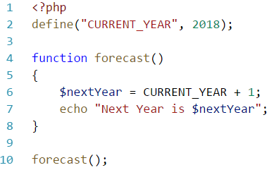
VARIABLE, CONSTANT
Variable starts with “$” (dollar sign), no need to declare type of variable.
Variable name must start with a letter or underscore character “_” and can not start with number.
Variable name can only contain alpha-numeric characters and underscores (A-z, 0-9 and _ ).
Using “global”, “static” keyword to make variable “special”.
Using function “define” to create a constant.

Slide 7
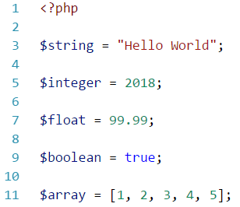
DATA TYPES
String : a sequence of characters.
Integer : non-decimal number between -2,147,483,648 and 2,147,483,647.
Float : decimal number.
Boolean : TRUE/FALSE.
Array : stores multiple values.
Object : stores data and information or properties and function.
NULL : is NULL.

Slide 8
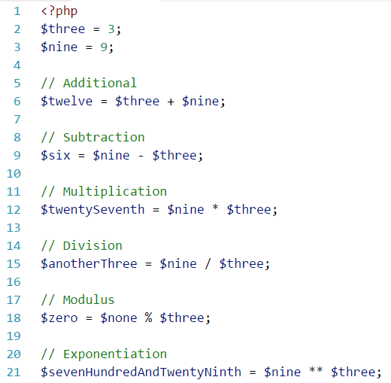
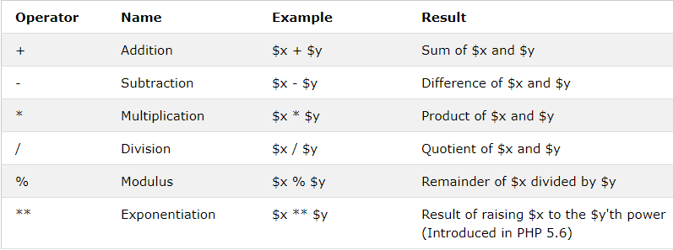
OPERATORS
Arithmetic Operators

Slide 9
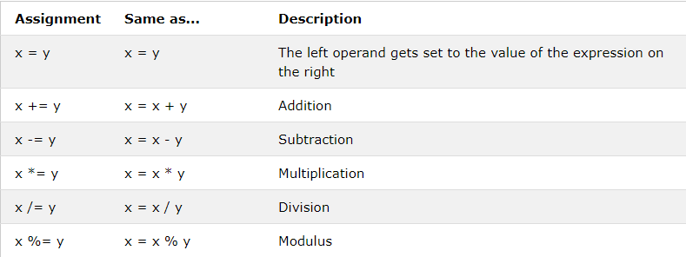
OPERATORS (cont. 1)
Assignment Operators

Slide 10
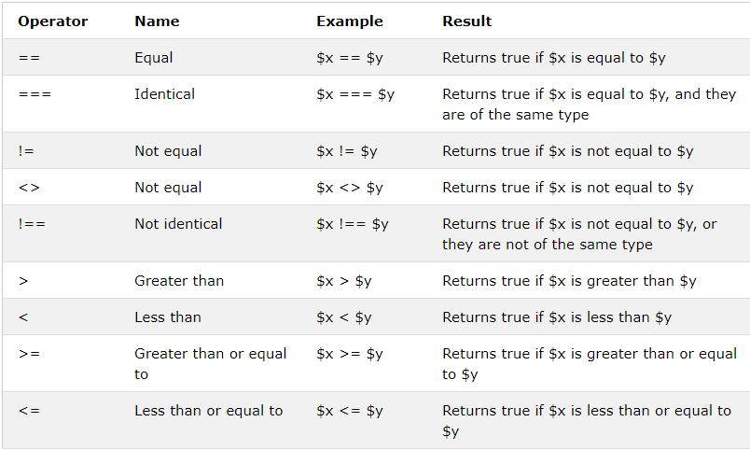
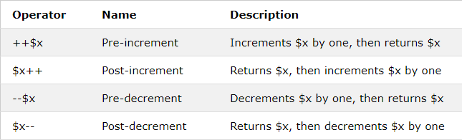
OPERATORS (cont. 2)
Comparison Operators
Increment/Decrement Operators

Slide 11
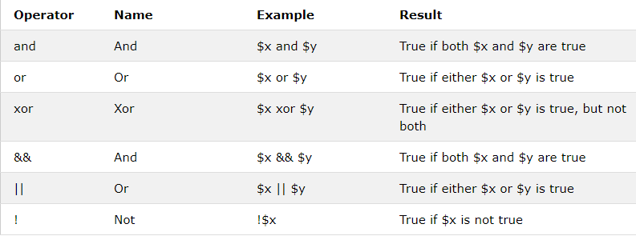
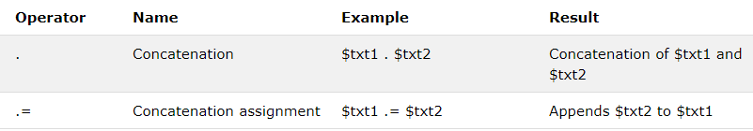
OPERATORS (cont. 3)
Logical Operators
String Operators

Slide 12
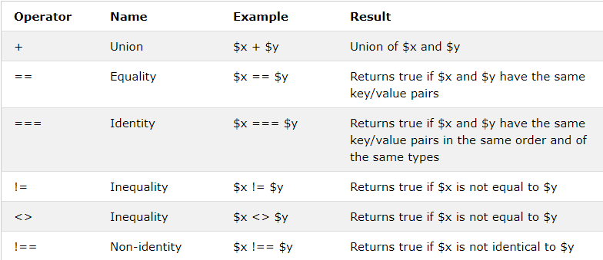
OPERATORS (cont. 4)
Array Operators

Slide 13
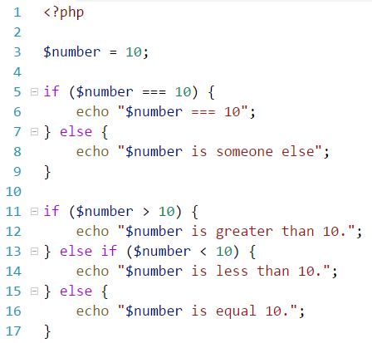
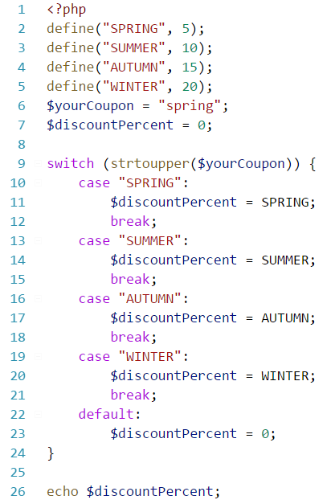
CONDITION STATMENTS
If
If … else
If … else if … else
Switch case

Slide 14
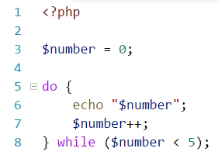
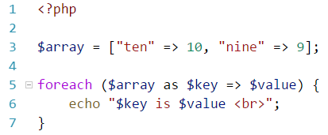
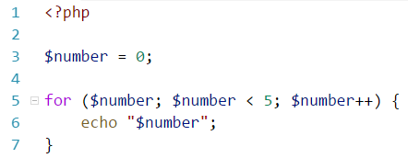
LOOPS
While
Do ... While
Foreach
For

Slide 15
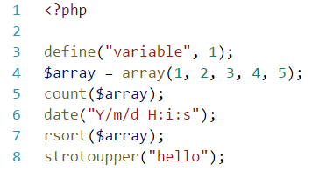
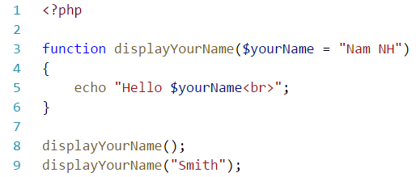
FUNCTIONS
A function name can start with a letter or underscore (not a number).
Give the function a name that reflects what the function does!
PHP has more than 1000 built-in functions.

Slide 16
SUPERGLOBALS
Built-in variables that are always available in all scopes.
Always accessible, regardless of scope, can access from any function or file.
$GLOBALS
$_SERVER
$_REQUEST
$_POST
$_GET
$_FILES
$_ENV
$_COOKIE
$_SESSION

Slide 17
TIME TO PRACTICE.

