Slide 1

Vertex Cover Problem
Jess Pham

Slide 2

Decision Problem
Optimization Problem
Given an undirected graph G = (V, E) and an integer k, does there exist a set V' ⊆ V such that |V'| ≤ k and for every edge (u, v) ∈ E, at least one of u and v belongs to V?
Is there a set V of size k or less where a vertex of each edge is in the set?
Given an undirected graph G = (V, E), find a set V' ⊆ V of minimum size such that for every edge (u, v) ∈ E, at least one of u and v belongs to V’.
Find the minimum number of vertices that satisfy the problem.

Slide 3
Example inputs/outputs
Edge List:
a b
b c
b d
b e
e f
e g
Edge List:
a c
b d
b e
e f
e g
a
c
a
c
b
b
d
e
f
d
e
f
g
g
output: b e
output: b c e

Slide 4

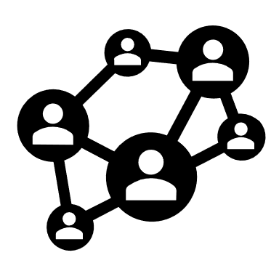

Applications
Image Processing
Vertices: pixels
Edges: relationship between pixels (same color/location)
Benefit: reduce images down to only essential pixels, reducing size of image
Network Design
Vertices: the places that the network needs to connect
Edges: the possible connections between places
Benefit: minimum number of routers / switches needed to connect everything
Social Network Analysis
Vertices: people
Edges: their relationships
Benefit: Find the minimum number of people needed to reach all people in a network, meaning that the entire network can be influenced (via marketing/ad campaigns)

Slide 5
Certifier Process Is Polynomial
A certifier process checks if a potential solution is correct or not
For each edge, E, check if one of its vertices is part of the set, V, that is the potential solution of the vertex problem.
There is a polynomial number of potential solutions, so the process is polynomial
Certifier Process
(Is the potential solution correct? )
yes
potential solutions
no

Slide 6
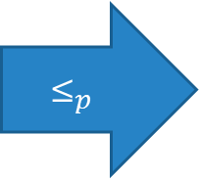
Reduction to max clique
To find the max clique, find the largest possible set of vertices where all share edges with each other
a
c
a
c
b
complement graph
b
d
e
f
d
e
f
if there is a solution to max clique, there is a solution to vertex cover
$${\text{≤}}_{p}$$
a
c
b
d
e
f

Slide 7

Code

Slide 8
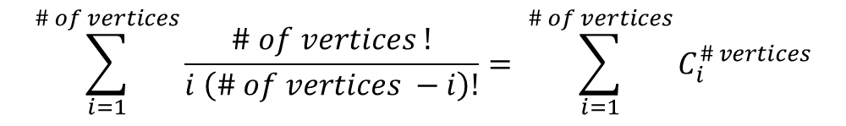
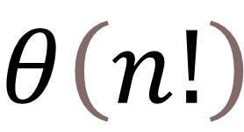
Analytical Runtime analysis
$$\sum_{i=1}^{\# of vertices}{\frac{\# of vertices !}{i \left(\# of vertices −i\right)!}}= \sum_{i=1}^{\# of vertices}{C_{i}^{\# vertices}}$$
$$θ\left(n!\right)$$

Slide 9
Empirical runtime analysis

Slide 10
sources
Lecuyer, F. (n.d.). Quality certification of vertex cover heuristics on real-world networks.

