Slide 1
CS 350 – Software Engineering
November 15, 2017
Week 12, Class #37
Refactoring
Mark Seaman
MWF – 10:00-11:30 - Kepner 0095F

Slide 2
This Week – Risk Managment
Last Week
Dev Ops
Next Week
Teams
Monday, 11-13
Technical Debt
Wednesday, 11-15
Refactoring
Friday, 11-17
Reusable Apps

Slide 3
Refactoring
What is refactoring?

Slide 4
Refactoring
What is refactoring?
disciplined technique for restructuring an existing body of code, altering its internal structure without changing its external behavior
The system is kept fully working after each small refactoring, reducing the chances that a system can get seriously broken during the restructuring.
https://refactoring.com – Martin Fowler

Slide 5
Refactoring
When do you do it?
Problem code
Getting ready to add a feature
After adding a feature
How do you do it?
Find something that needs improved
Build a test
Select a refactoring
Repeat until done

Slide 6
Refactoring
Kent Beck’s Rules for Simple Design
Runs all tests
Contains no duplication
Expresses the intent of the programmer
Minimizes classes and methods
Evolutionary Design
Incremental improvements
Adapting to new realities

Slide 7
Refactoring Goals
Simplicity
Testability
No duplication
Expressive
Minimal

Slide 8
Refactorings
Rename
Move
Copy
Extract
Inline
Delete
Object
Variable
Constant
Field
Method
Parameter
Superclass

Slide 9
Simpler is better
A good day programming is when you
add 200 lines of code
A great day programming is when you
remove 200 lines of code without breaking anything

Slide 10
Boy scouts and Doctors
Leave the campsite better than you find it.
Do no harm!
Software developers are professionals.
-- Uncle Bob (Robert Martin)

Slide 11
Exercises
Git Push 11/13 -- Install Github Desktop
Fork Repo 11/15
Pull Request 11/27

Slide 12
See you Friday

Slide 13
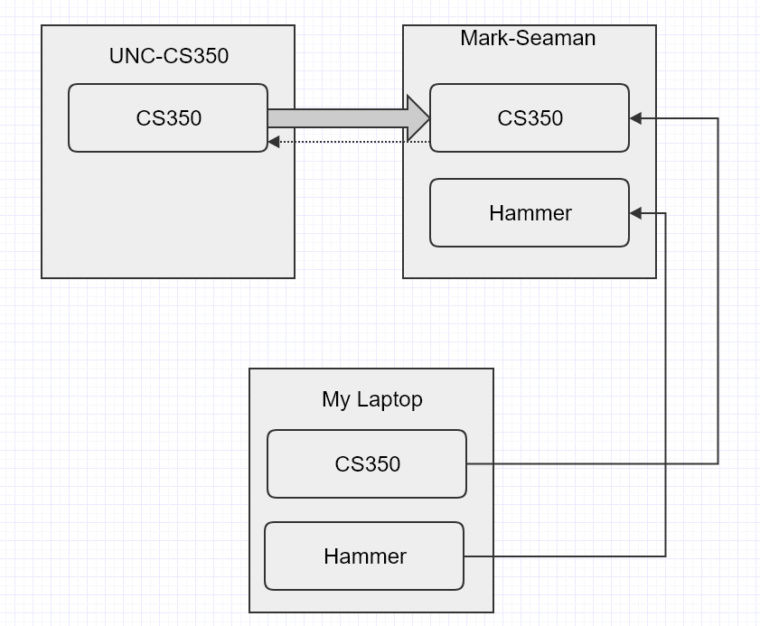
Github Repos

Slide 14
Technical Debt
What is technical debt?
Promise of later work
Shortcut for immediate benefit
Compromise of the right way
Cumulative effects of bad decisions

Slide 15


Leverage Principle
Technical Debt determines cost
Best Practices reduce debt
Areas of concern
Development
Operations
Teams

Slide 16

T
S
x

Slide 17
Development Lifecycle
Technology
Fitness of tools used
Technical skill level
Design
Too much or too little design
Code
Complexity
Non-incremental development
Test
Lack of test or maintenance
Poor coverage

Slide 18
Software Operations
Deployment
Capabilities of hosting service
Lack of automation
Release Cycle
Too long until next release
Services
Complexity of service interactions
Inappropriate scale
Monitoring
Lack of transparency
Human observation

Slide 19
Building Teams
Knowledge
Lacking knowledge management system
Teamwork
Tolerating bad team members - knowledge hoarders and primadonas
Learning
Not investing in the training of the developers
Project Planning
Lack of flexibility
Ambiguous priorities
No leverage

Slide 20
T
S
x

