Slide 1
CS 350 – Software Engineering
November 17, 2017
Week 13, Class #38
Reusable Apps
Mark Seaman
MWF – 10:00-11:30 - Kepner 0095F

Slide 2
This Week – Risk Management
Last Week
Dev Ops
Next Week
Teams
Monday, 11-13
Technical Debt
Wednesday, 11-15
Refactoring
Friday, 11-17
Reusable Apps

Slide 3
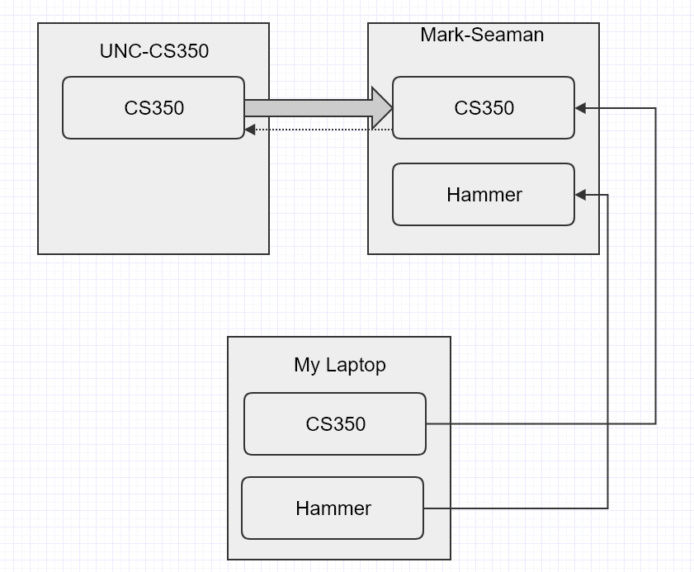
Github Repos

Slide 4
Git Exercises
Git Push 11/13 -- Install Github Desktop
Fork Repo 11/15
Pull Request 11/27

Slide 5


Leverage Principle
Technical Debt determines cost
Best Practices reduce debt
Areas of concern
Development
Operations
Teams

Slide 6
Reusable Web Apps
Typical application
Manage data
Forms entry
Business logic
Database
Leverage what you did last
Build a reusable infrastructure

Slide 7
Reusable Web Apps
How many times should you write the code?

Slide 8
Reusable Web Apps
How many times should you write the code?
Explore the problem
Build the solution
Improve structure
Build for reuse

Slide 9
50 Tricks
Any project can be completed with about 50 tricks
A day to learn and an hour to apply
Prototype in a week; MVP in a month

Slide 10
50 Tricks for Web Development
Project
User Experience (UX)
Views (Front-end)
Data (Back-end)
Test
Automation
Hosting

Slide 11
50 Tricks for Web Development
Project
Milestones
Core features
Rapid prototype
Task breakdown
Burn-down graph
Weekly deliverable
Customer feedback

Slide 12
50 Tricks for Web Development
User Experience (UX)
User Stories
View wireframes
View matrix (list, add, edit, detail, delete)
Users and security
Data input and output
Automation interfaces

Slide 13
50 Tricks for Web Development
Views (Front-end)
Templates (HTML)
Style (CSS)
Business logic (JS)
Forms
Page rendering
System logging
Model reformatting

Slide 14
50 Tricks for Web Development
Data (Back-end)
Object Models (ORM)
Queries
Combining data
Sorting and searching
Persistence
Import
Export

Slide 15
50 Tricks for Web Development
Test
Run all test
Development Loop – Quick test
Expected results
Approve results
Cached test results
Escalating test results
Presentation of results

Slide 16
50 Tricks for Web Development
Automation
Application command shell
Hourly task
Single command deploy
Script generation
Ssh
Email integration
Command sequences

Slide 17
50 Tricks for Web Development
Hosting
Digital Ocean Droplets
Multi-domain hosting
Backup & Virtual Images
Lets Encrypt
Basic SLA
Monitoring System Logs

Slide 18
See you Monday, Nov 27
HAPPY THANKFULNESS !

Slide 19
x
x

