Slide 1
CS 350 – Software Engineering
December 1, 2017
Week 14, Class #41
Contribution
Mark Seaman
MWF – 10:00-11:30 - Kepner 0095F

Slide 2
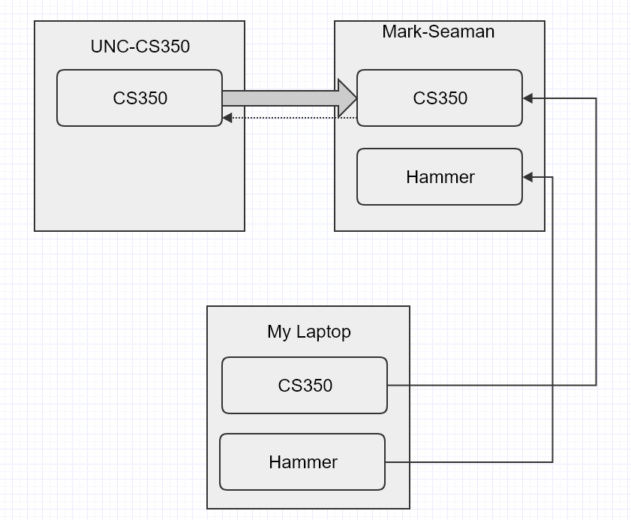
Github Repos

Slide 3
Git – Modern Control
Why is Git the only tool to use?
Peer-to-peer
Every repo retains control
Push
Pull request
Web services
Github
Bitbucket
Interactions
GUI apps – source tree, github desktop, git gui
IDE integration
Bash & CMD
Change Sets

Slide 4
This Week – The Profession
Monday, 11-27
Teams
Wednesday, 11-29
Jobs
Friday, 12-1
Contribution
Last Week
Risk
Next Week
Final Exam

Slide 5
Success
What is college worth?
Twice the earnings
Engineering degree will be triple
Greater earnings in five years than any other major

Slide 6
Success
You are well positioned for success
Engineering is one of the highest paying professions
No advanced education is required
There is a very wide array of opportunities
Your skills are in high demand (coming labor shortage)

Slide 7
Build the life you want
Take the long-term view
Don't lose hope
Stand up for what is right
Build incrementally
Join forces

Slide 8
The world is messed up
Refugees
Slavery
Poverty
Broken governments

Slide 9
You can make a difference
Use your opportunities
Build margin
Activate kindness
Invest yourself in things that matter
Don't squander your unique skills
You are what brings me hope

Slide 10
Examples
Bill Gates
Code for America
Learning Tools

Slide 11
The Happy Engineer
What makes people happy at work?
Identify your personal goals
Contribution
Growth
Pay
Fun

Slide 12
Personal Note
Unexpected Opportunities
Personal Discovery
Thank you!

