Slide 1
A report on the Mountain Hiking Challenge Registration Java program

Slide 2

Background
FPT University has launched a movement titled "Because a Generation of Intellectuals Dares to Think and Do", sponsored by Viettel and VNPT. To support this initiative, a program needs to be developed to manage the registration information of FPT University students.
The program would enable students from all campuses nationwide to register and select mountains (MountainList.csv) to conquer. The program's main features would allow the admin/user to manage the registrations effectively, which fundamentally contributes to the initiative.

Slide 3


Description
This is a brief introduction slide for the "Mountain Hiking Challenge Registration" program, a Java console application designed to manage student registrations for a mountain hiking event held by FPT University, used by managing admins of the event. The program is built entirely using Java, providing a flexible and user-friendly interface to meet the requirements of the project while keeping it simple. The system supports the specifications as required by the project, including new registrations, updates, deletions, methods of searching, filtering, showing registration data, and finally, saving and loading the registrations, ensuring the management of the event could go smoothly.

Slide 4
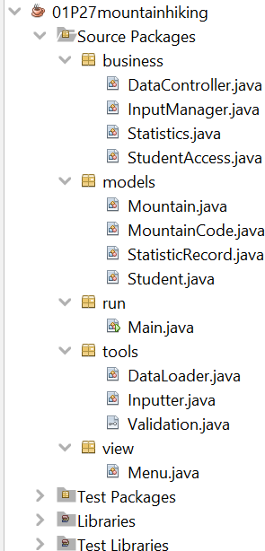

Decomposition
The system is divided into smaller modules to manage complexity: Models: Classes representing the core data entities: Student, Mountain, MountainCode, and StatisticRecord.
Tools: Utility classes for handling necessary side operations such as file loading (DataLoader), user input (Inputter), and data validation (Validation).
Business: including
Classes data
that contain the main program object access
logic, data user
(StudentAccess), (DataController),
management and business logic
interaction (InputManager), and statistics handling (Statistics). View (Menu): presents a clear, interactive menu for the user.
Run (Main): serves as the program's entry point, initializing all components.

Slide 5


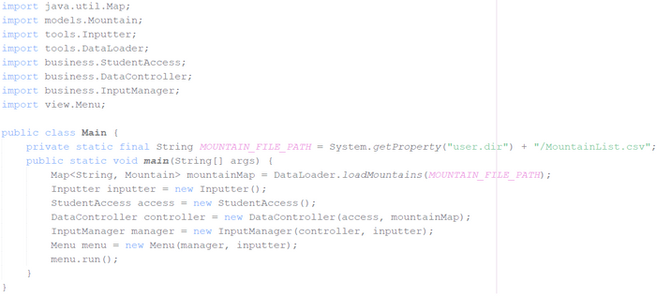



package models;
package run;
Student implements Serializable
StatisticRecord
implements Serializable
Main
ADMIN
(user)
MountainCode
Mountain
package tools;
package business;
<interface> Validation
Statistics
DataController
package view;
Menu
DataLoader
Inputter
StudentAccess
InputManager

Slide 6
Program Flow
Starting program:
Immediately load registrations.dat (if existed) and prompt user for choices
If program crashes with unsaved changes from previous session, it instead load recovered data and prompt the user to either integrate these data into current session or discard entirely
Initiating one of the operations with a choice input:
New Registration: receive inputs, validate each input, receive if valid then add object to list of registrations
Update Registration Information: determine student to update using id, receive inputs and validate each input. If user inputted nothing, program will keep old information, if user inputted new valid data, the program would receive, and if any data has been updated, the program would then update information of that object
Display Registered List: display all student registrations using a table format
Delete Registration Information: determine student to delete using id, display relevant details and ask for confirmation before proceeding with the delete (if yes) or cancel and backing out (if no)
Search Participants by Name: search student from list using name or partial name, then display matches using a table format Filter Data by Campus: filter student from list based on an input of campus code, and calculate the total cost of registrations of that campus only, then display filtered results using a table format
Statistics of Registration Numbers by Location: displays statistics on the number of students by registered location, as well as calculate the total cost of all registrations, using a table format
Save Data to File: Prompt user if they want to save now (provided there are unsaved changes). If yes, save all data to registrations.dat. If no, resume session without saving
Exit the Program: exit the program. If there are still unsaved data, the program will prompt user to save first. If yes, save all data to registrations.dat and exit the session. If no, exit the session immediately (without saving)

Slide 7
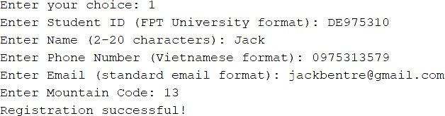
Algorithm Design
Example: "New Registration" process:
Step 1: Get the current list of registered students for validation. Step 2: Prompt the user for a Student Id.
Step 3: Validate the Student Id for correct format and uniqueness against the existing list.
Step 4: Prompt the user for name, phone, and email, validating each for format and uniqueness. Step 5: Prompt for a Mountain Code and validate its existence.
Step 6: Calculate the tuition fee based on the phone number's service provider. Step 7: Create a new Student object with inputted details and add it to the list. Step 8: Display a message signaling success.

Slide 8
Pattern Recognition
Some patterns of this program:
The program provides the full set of Create, Read, Update, and Delete (CRUD) operations for student registrations.
Each student is uniquely identified by their ID, which is validated to prevent duplicates. This pattern is extended to ensure the uniqueness of phone numbers and email addresses, since it is logical to do so.
Aside from that, all variables holding data have pattern constants validating them closely based on the project requirements, ensuring no faulty or illogical data exists and/or breaking the program.
The system consistently follows a pattern of loading data from a file at startup and prompting the user to save changes before exiting (if any changes are unsaved), ensuring data integrity.

Slide 9


Abstraction
Essential attributes have been identified and abstracted into classes:
Student: Attributes include id, name, phone, email, mountainCode, and tuitionFee. Unnecessary personal details are omitted.
Mountain: Attributes include mountainCode, name, province, and description, focusing on information relevant to the challenge.
Data Persistence: The underlying storage mechanism (serialization to a .dat file) is abstracted away from the core business logic, allowing the program to save and load data without other parts of the application needing to know the technical details.

Slide 10
Some design choices: @SuppressWarnings("unchecked") prgram first initiated without compiler will then display a
annotation before readFromFile to avoid compiler
is
warning when without it the
or with warning
empty storage file. This
optional, but
every time the user compile the file, which is generally
discouraged in professional code systems, as it can hide important warnings. some functions, if not called or will be made to be called by other classes, to isolate the internal workings of the class, strengthening security
can be made private
A lot of functions use do-while loop instead of while loop. do-while loop then check condition, ensuring code runs at least once, while loop check
runs code condition
body first
first, before
running code body and might lead to code body failing to run even once, therefore making this loop more ideal for UI and input. Replacing them with while loop make the code less clean and more prone to awkward initialization scenarios, despite results being practically the same
models classes need default constructors in cases
that require objects to be removed, but
be created
first, and ideal for
then populated via setter methods, otherwise can
keeping is more
flexibility
Statistics class has default constructor for more flexibility when we get statistics, although it is not needed at the moment (the program only uses parameterized constructor)
for core business and view classes, having a default constructor might lead to creating an object that cannot function correctly, undermining the program structure. Having only parameterized constructors forces Main class to provide necessary dependencies before creating a valid object

Slide 11


