Slide 1
Final Project TO-DO LIST APPLICATION
Lecturer: M.Sc. Vu Hoang Dieu
Pham Dinh Dat
Vu Phuong Thuy
Pham Dang Khai

Slide 2
Contents
Introduction
Backgrounds
Solution/Methods
Results/Application
Conclusion and Recommendation

Slide 3
1. Introduction
Antoine de Saint-Exupéry said: “A goal without a plan is just a wish”
Dale Carnegie said: “An hour of planning can save your 10 hours of doing”
Planning.
Better organized, less procrastinated and more productive.

Slide 4
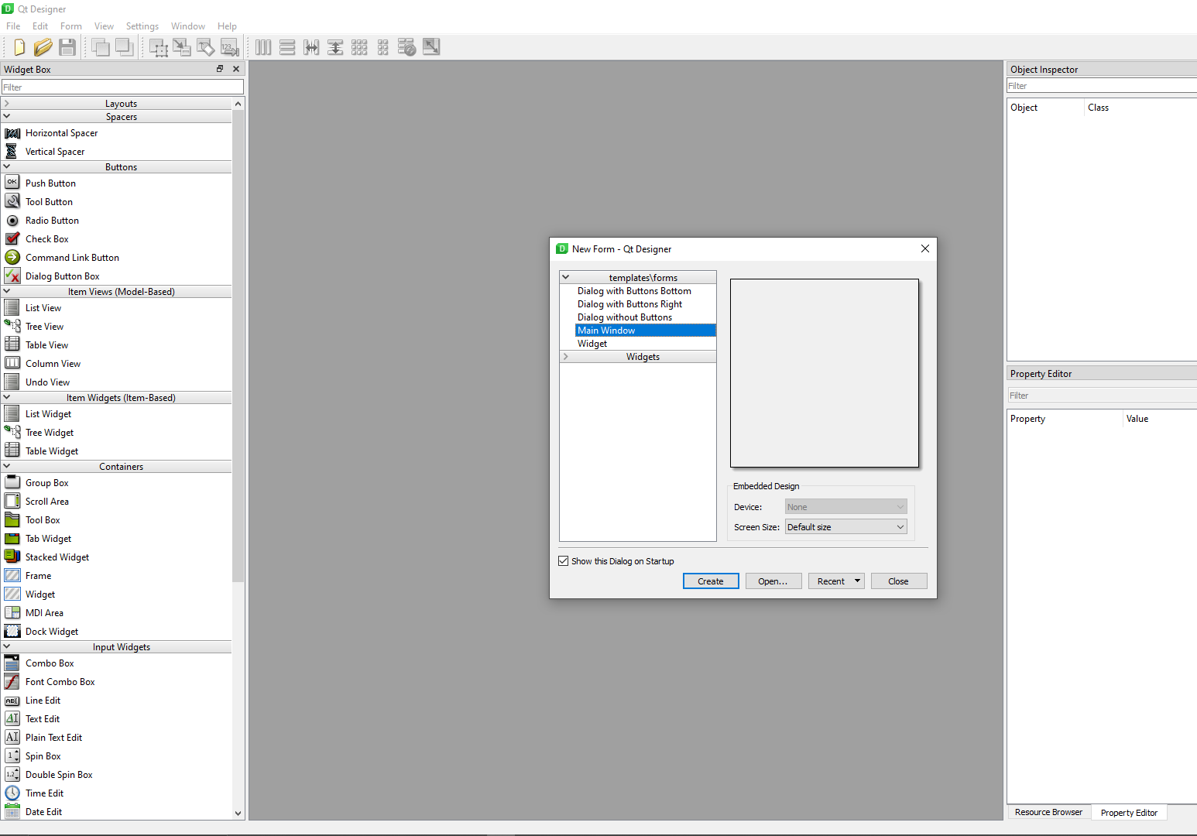
2. Backgrounds
Python
Python object-oriented programming concepts (classes, objects, encapsulation, inheritance, abstraction, polymorphism)
PyQt5

Slide 5
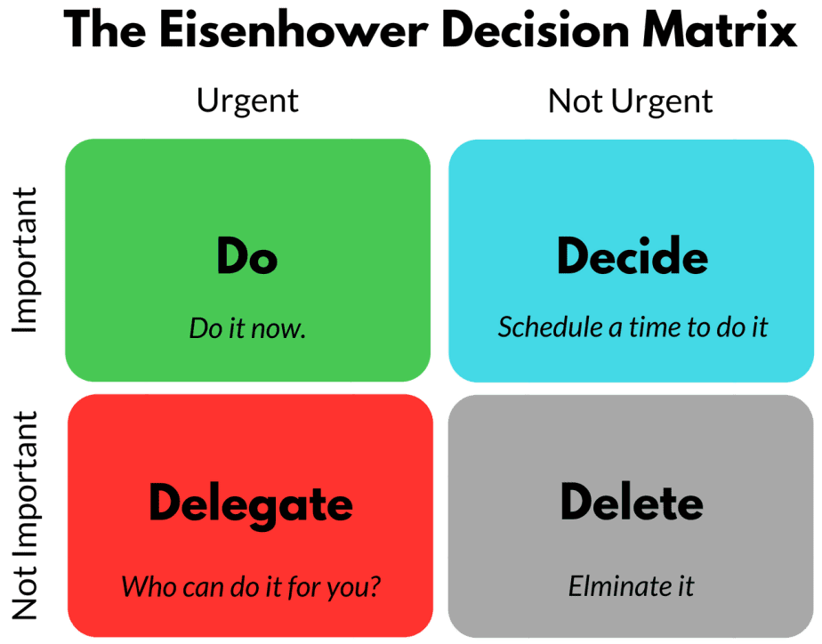
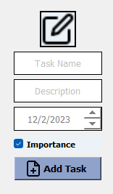
3. Solutions
Applications works based on The Eisenhower Matrix
1
2
3
4
if due_date - current_time > threshold:
return True
else:
return False

Slide 6
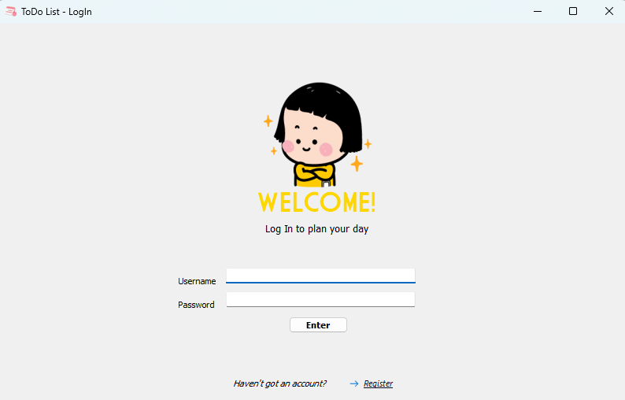
4. Results/Applications
Login and Register
Enter username and password
Don’t have account → Register

Slide 7
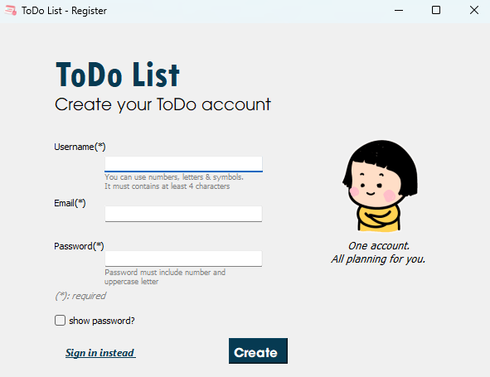
4. Results/Applications
enter valid user’s information
Login and Register
visible password
direct to sign in window
Create account

Slide 8
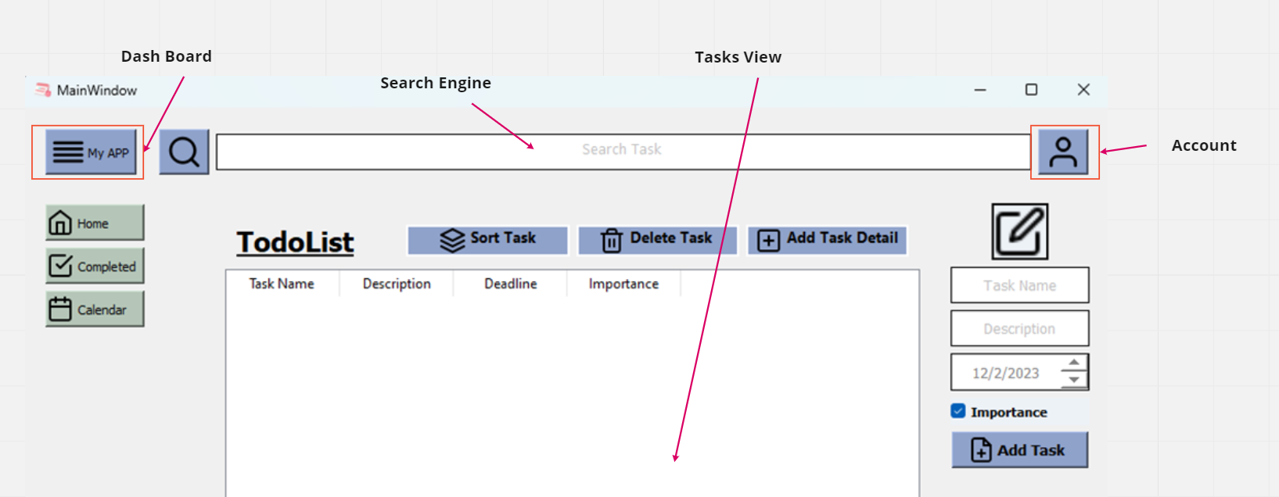
4. Results/Applications
To-Do List

Slide 9
4. Results/Applications
To-Do List
Combo box: enter task, task description, and due date.
Click on the “importance” button it the task is necessary to complete.
→ “Add task” button, the new task will be already shown in the task’s tables.

Slide 10
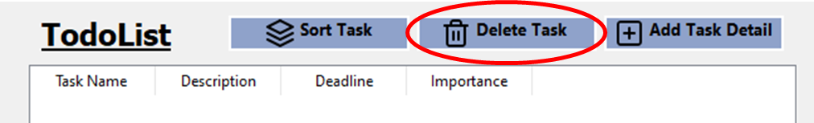
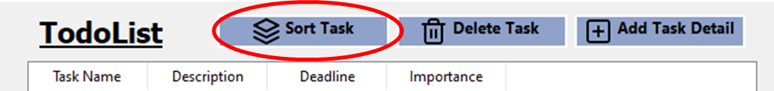
4. Results/Applications
To-Do List
Delete task
Search task
Sort tasks

Slide 11
5. Conclusion and Recommendation
Conclusion
We have built an application which solves the planning problem raised on the introduction part.
This app can help users plan their day by adding their tasks, automatically sorting tasks as its priority.
User-friendly, the user can easily interact with the application.
The implementation using concepts of object-oriented programming.

Slide 12
5. Conclusion and Recommendation
Recommendation
Implement more functions such as alarm clock, Pomodoro timer, and more functions of sorts – sorting by deadline, sorting manually, etc.
Besides, we also make this application executable with installation and optimizing database management.

Slide 13
THANK YOU
FOR YOUR ATTENTION

