Slide 1
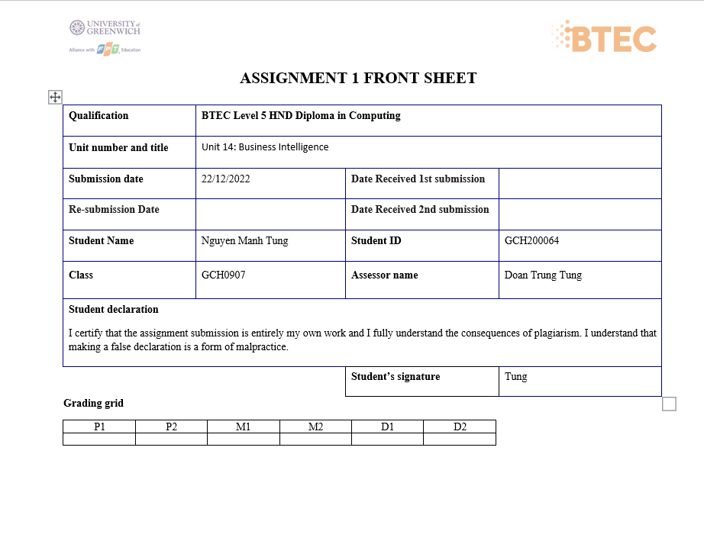

Slide 2
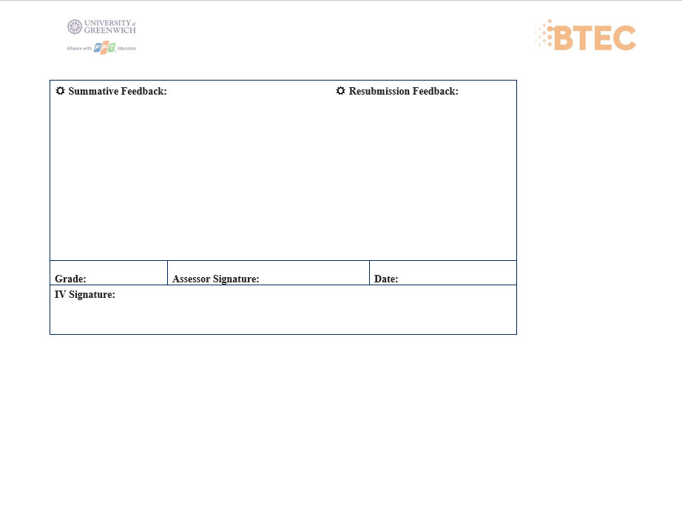

Slide 3
Intelligence
Business

Slide 4




OUR TEAM
Mạnh Tùng
Phương Anh
Phú Trọng
Anh Quân
(Leader)

Slide 5




TTPQ Company

Slide 6
table of contents
01
02
Task 1
Task 2
Business processes
Activity diagram
Types of data
List software
Decision making
Examples of decisions
Activity diagrams to illustrate decision making process

Slide 7
01
Task 1
Business process

Slide 8

Definition
It is an event-driven end-to-end processing path that begins with a customer request and ends with a result for the customer. Business processes frequently cross departments and even organizational boundaries
Advantage:
Streamline and standardize how employees get their work done
System congestion prediction
More aligned with core strategies
Securing the future for the company's system

Slide 9
Activity diagram

Slide 10
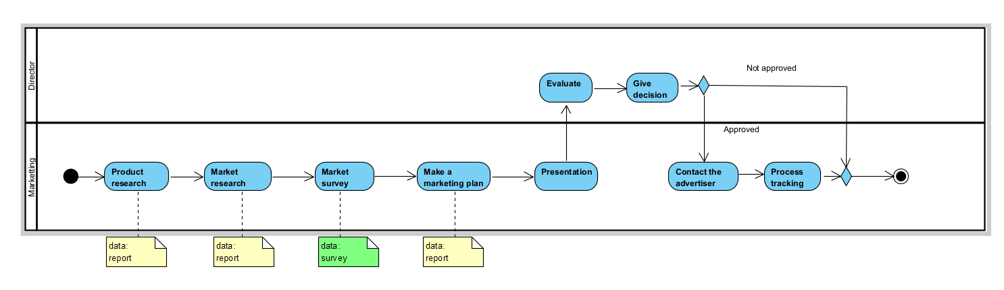
Marketing Process

Slide 11
Marketing Process
First, the marketing department will product research to see what the product has and what advantages it has; After researching the product, they will continue to do market research to see if the market likes this product. After completing the above 2 steps, they must market survey to see if the product is available anywhere, and what the price is. The next step, they will have to make a marketing plan to sell that product where, how to advertise. In the fifth step, they will present to the director. There the director will evaluate, and make a decision, whether the marketing strategy is implemented or not, if not, it will end, and if it is approved, it will continue to the process of finding advertising recipients, after finding The campaign will start and the company's marketing team will follow up until the end of the campaign

Slide 12
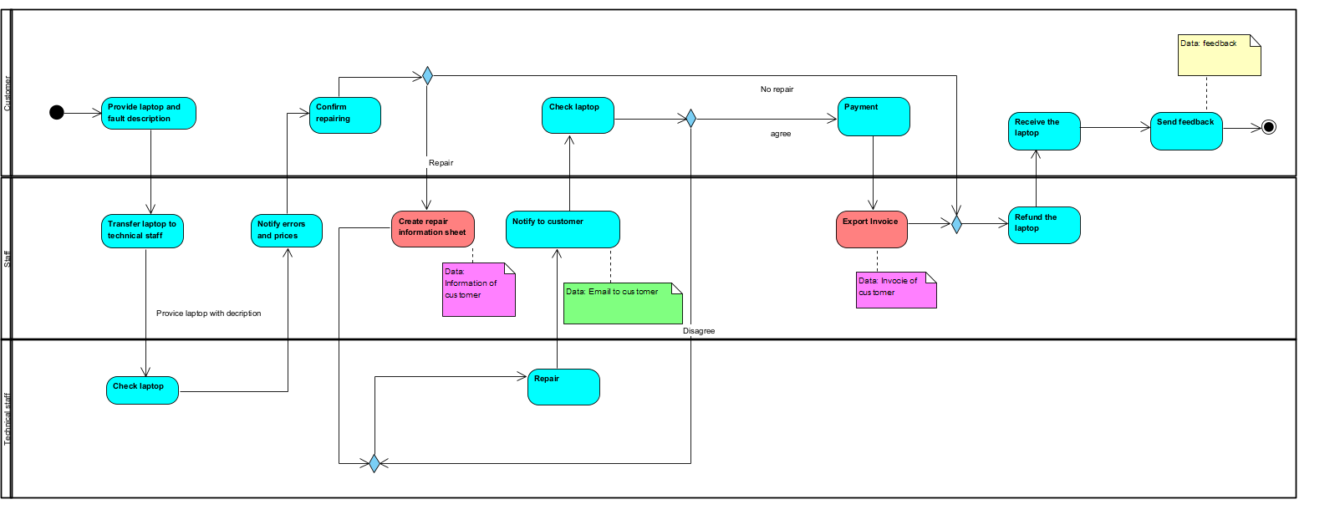
Laptop Repair Process

Slide 13
Laptop Repair Process
The customer will provide the laptop to the staff, the staff will transfer the laptop to the repair department to check and then provide the results to the staff, the staff will report the error and the price to the customer. If the customer does not confirm the repair, he will receive the laptop back from the staff, send feedback and finish. If the customer agrees to repair, after the repair staff is finished, they will notify the customer, the customer will confirm the error has been fixed. If it is not completed, the customer can request a revision. If agreed, the customer pays and receives the bill from the staff. Then get the laptop back, send feedback and finish.

Slide 14
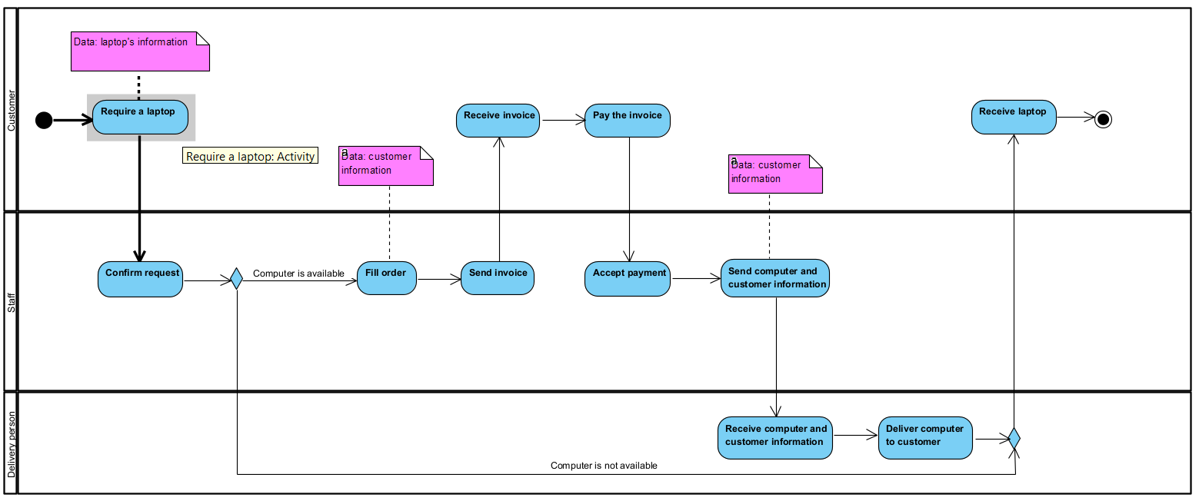
Order Business Process

Slide 15
Order Business Process
The ordering process has 3 participants: customers, employees and carriers. Customers first order a laptop, then the staff will receive the request. The staff will check if the laptop ordered by the customer is available or not. If so, the staff will set up the order, send the invoice to the customer. The guest will receive the bill and pay it. The staff approves the payment and sends the customer and laptop information to the carrier. The carrier is responsible for transporting the laptop to the destination.

Slide 16



Type of datas
Structured data
Semi -Structured data
Unstructured data

Slide 17
Structure data
Structured data is the data which conforms to a data model, has a well define structure, follows a consistent order and can be easily accessed and used by a person or a computer program.

Slide 18
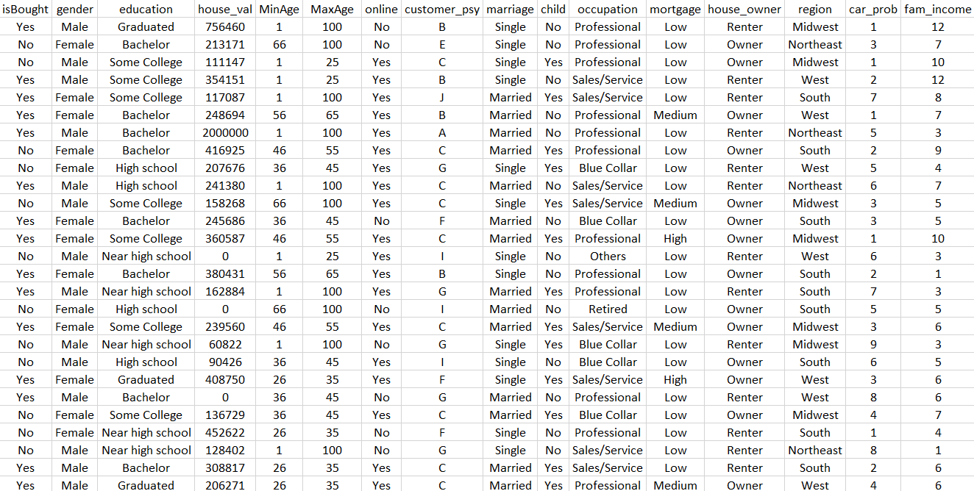
Example:
We use structured data like gender, education, house_val, etc. Organized data control functionality is simple. We store information for customer loyalty purposes.

Slide 19
Semi - structure data
Semi-structured data is data that has some structure but does not adhere to a particular data model. It doesn't have a set or strict structure. We can store certain processes in the relational database.

Slide 20

Example: Email
Email is a type of semi-structured data used frequently by many employees and businesses. The written content of an email is considered unstructured data because computers are not capable of understanding or organizing text written in human languages.

Slide 21
Unstructure data
Unstructured data are datasets that have not been structured in a predefined manner. Unstructured data can include non-textual, such as photos, video, and audio, although it is often text-based, like open-ended survey replies and social media chats.

Slide 22
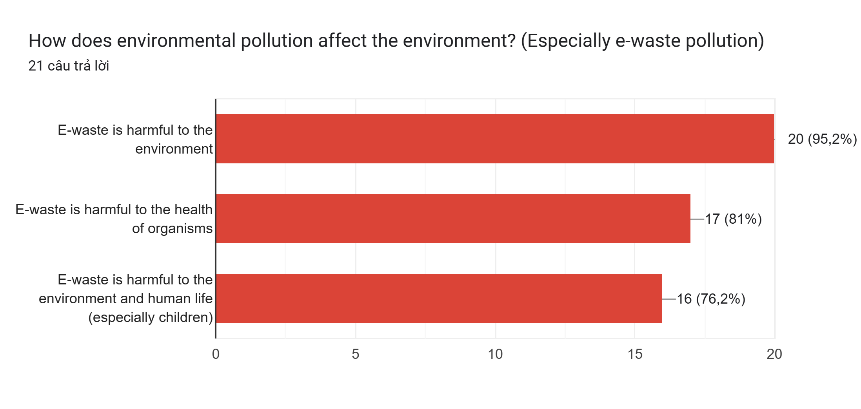
Example: Survey responses:
A questionnaire for conducting market research or employee engagement that typically includes multiple choice and open-ended questions. The answer to such open-ended questions is unstructured text. These questions are important because they help researchers uncover aspects they may not have considered, deepen their understanding, and build connections with respondents.

Slide 23
Marketing Process

Slide 24
Laptop Repair Process

Slide 25
Order Business Process

Slide 26
List Software
Customer Service Management Software (CSMS)
E-Commerce Exchange

Slide 27
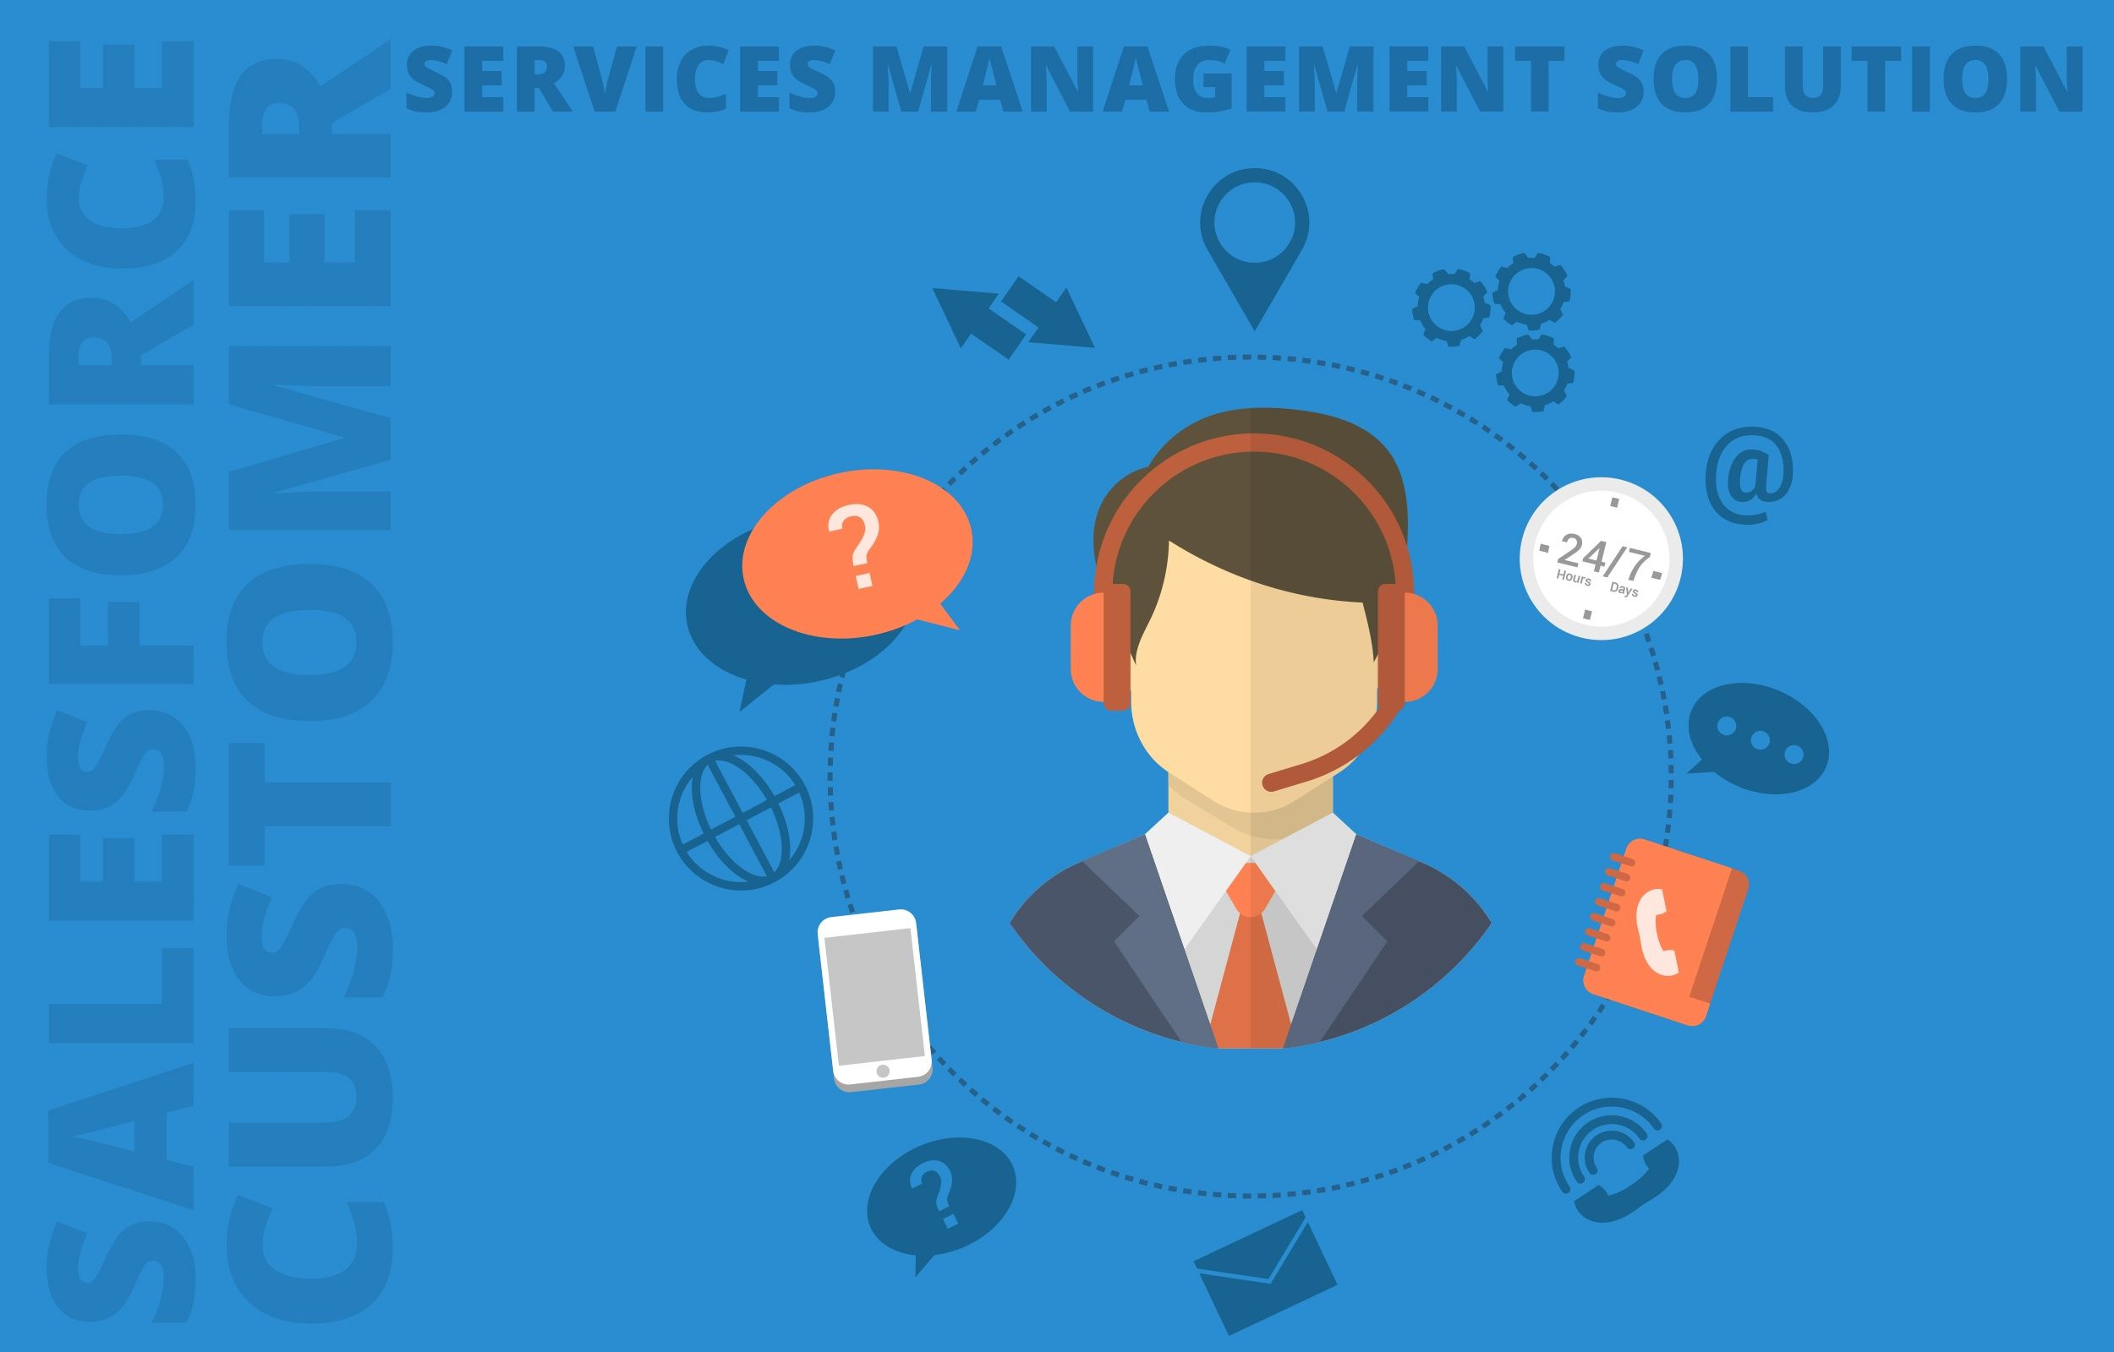
Customer Service Management Software (CSMS)
Advantages: Easily manage service activities such as laptop repair with available tools such as creating, editing, deleting tickets. Provide detailed, complete information for the invoice. Manage invoice list and repair customer information easily.

Slide 28
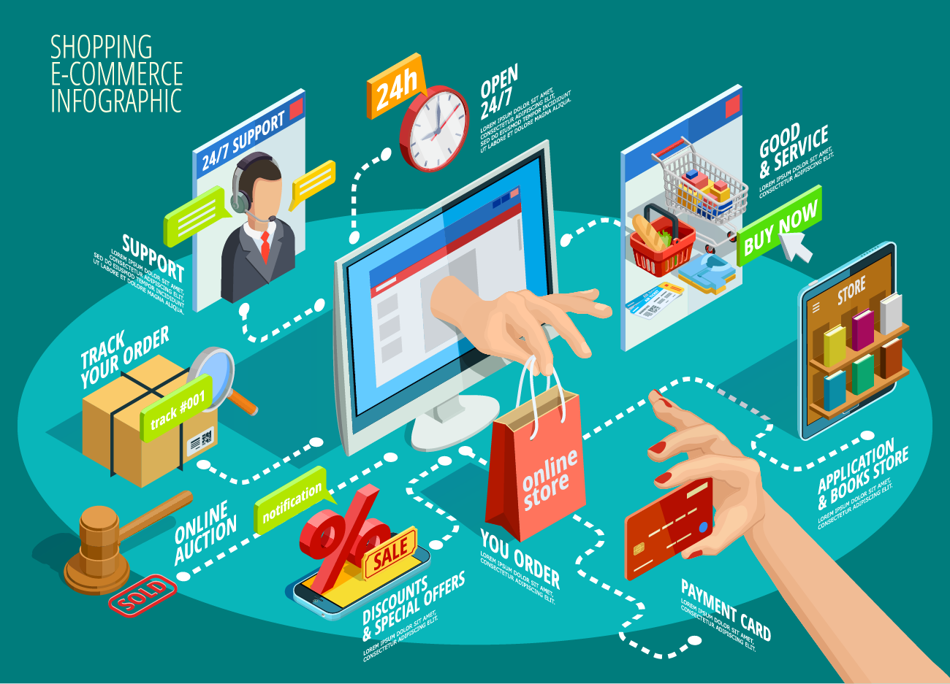
E-Commerce Exchange
Advantage:
Market expansion
Cost savings
Increase profits
Reduce inventory
Reduce purchasing costs
Sales, customer care 24/7

Slide 29
02
Task 2
Decision making

Slide 30
—Indeed Career Guide—
ʻ
ʻ
“Any choice made by a business professional that determines the short-term or long-term activities of a company.”
Reference: Indeed Career Guide. (n.d.). What Is a Business Decision? Definition and Types. [online] Available at: https://www.indeed.com/career-advice/career-development/business-decision.
‌

Slide 31
Types of decisions and how to make them
How to make decisions
Types of decisions
Identify the decision
Collect information
Figure out alternatives
Evaluate your evidence
Pick an option
Take action
Operational decision
Tactical decision
Strategic Decision

Slide 32

Operational decision
Operational decisions are short-term decisions made on a weekly, daily, or hourly basis, primarily focusing on the details of day-to-day operations and resource allocation.
These activities include:
Manage daily work
Deciding to reduce inventory price

Slide 33
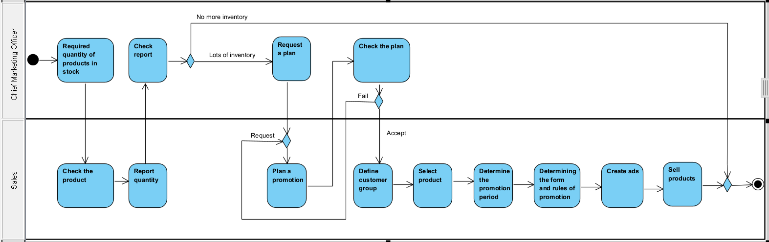
Example of operational decision: Decision on inventory promotion

Slide 34
Periodically, the Chief Marketing Officer will ask the sales to check the inventory for this quarter. Staff will check, if there are few sales as usual, if there are many, they will ask for promotion planning. If the plan has not been approved, the employee will make a new plan. And if the plan is approved, the process will begin: Define customer group, Select product, Determine the promotion period, Determining the form and rules of promotion, Create ads and Sell products.

Slide 35

Tactical decision
Tactical decision-making is a business strategy in which decisions are made with the end result of making the company as successful as possible.
These activities include:
Decide to change marketing strategy
Decision to promote to head of department
Build a sales website

Slide 36
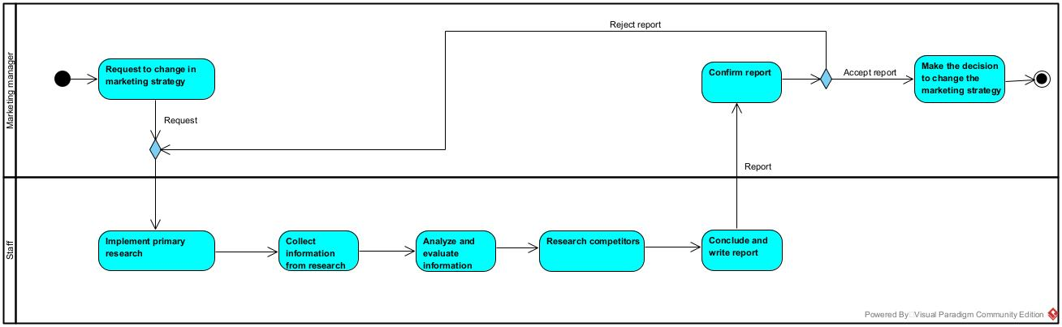
Example of tactical decision: Decide to change marketing strategy

Slide 37
Marketing Manager will issue a research request to change the marketing strategy for the business, staff will receive the request and perform primary research including survey, interview to collect data. Then, analyze and evaluate the information gathered. The next job is to conduct research on the actions of competitors. With the information obtained, proceed to write a report and send it to the manager. The manager will confirm the report, if it cannot be persuaded, it will refuse and the staff will study it again. If yes, then make the decision to change the marketing strategy and end the process.

Slide 38

Strategic Decision
Strategic decisions are choices made taking into account the company's mission and strategic goals.
These activities include:
Open more branches
Modify company culture
Define the company's vision 10 years from now

Slide 39
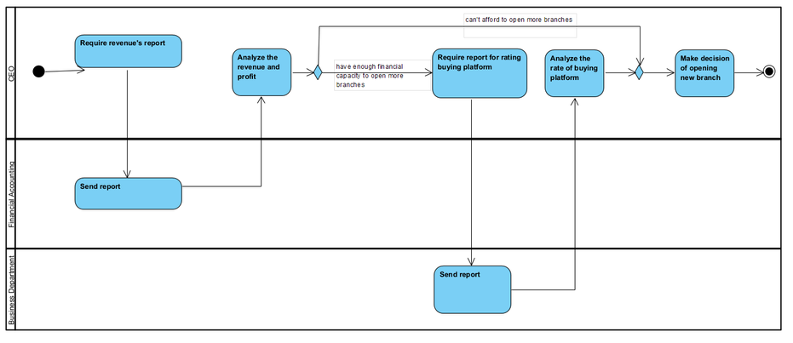
Example of Strategic Decision: Open more branches

Slide 40
The decision to open a new branch is under the authority of the CEO, he needs to evaluate and consider factors to be able to make this decision. The first factor should examine the company's revenue and profit. He will send a request for a revenue report to the finance department. If this factor is assessed as having enough financial capacity to open a new facility, the second element will come. In the second factor, the CEO needs to evaluate the percentage of shoppers on two platforms, direct trade and online shopping. This parameter will be provided by the sales department. The CEO, after completing the assessment, will make the final decision.

Slide 41
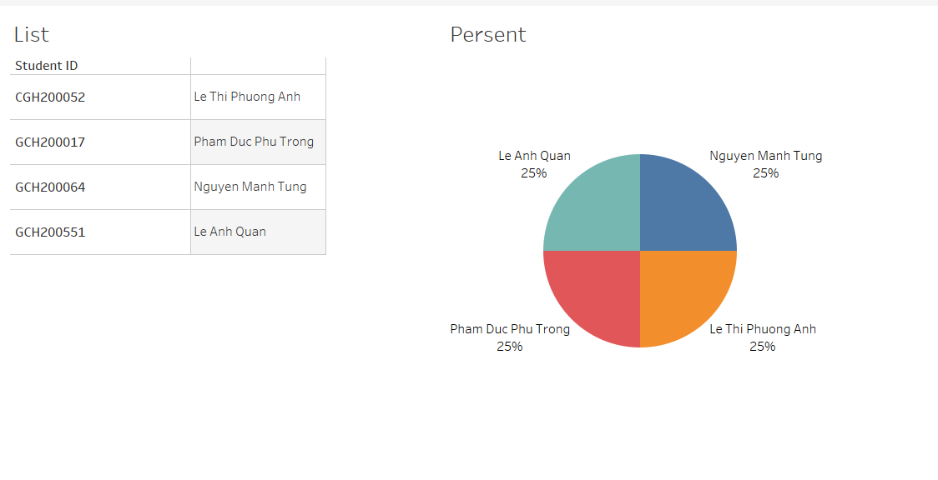
Evaluation about team work

Slide 42
THANKS For Listening

