Slide 1
ReactJS
Pages:
Login
Users:
Use list
Create user
Edit user
Logs list
Change password
Forgot password
Reset password
Libraries:
MobX
Toast
Axios
Node-forge
React idle timer
Yup

Slide 2
Serverless
AWS services:
Lambda function
S3
Cloudfront
RDS
SES
API Gateway
Event Bridge Scheduler
Cloudwatch
Libraries:
AWS SDK
Node-forge
Sequelize ORM
YUP
File type
Yup

Slide 3
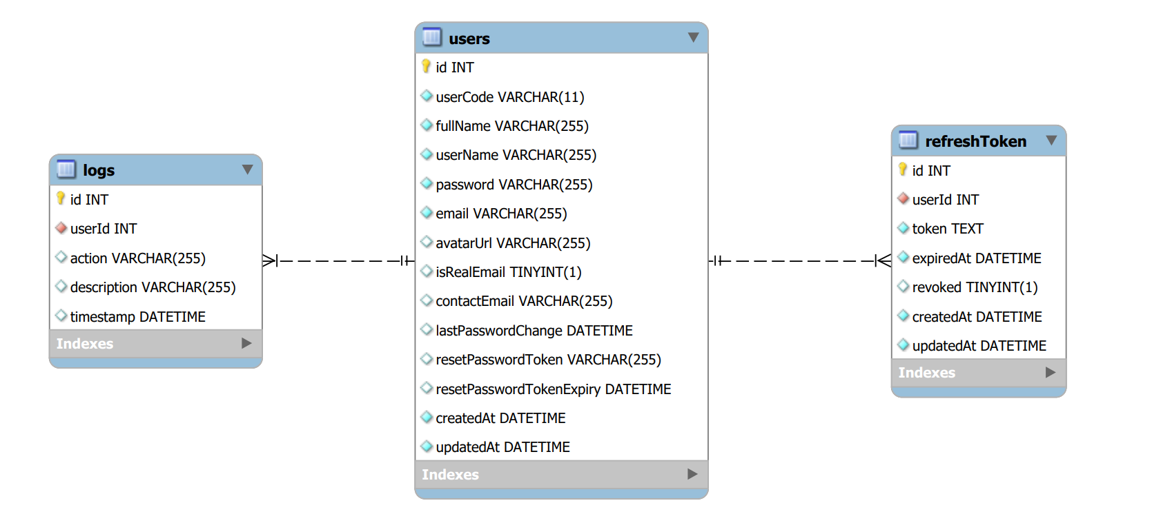
Database

Slide 4
Usecase diagram

Slide 5
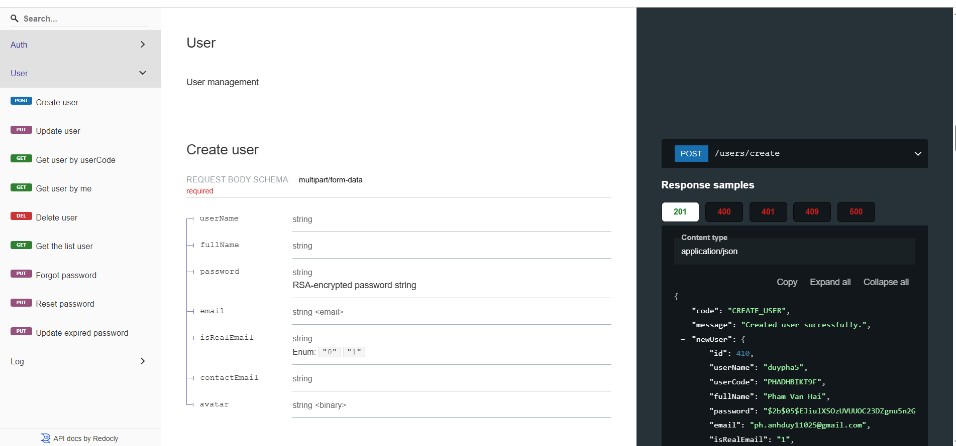
API doc

Slide 6
Demo

