Slide 1
Generic Collections
Chapter 18

Slide 2
Objectives
You will be able to
Use generic collection classes available in the .NET framework

Slide 3
Generalized Collection Classes
Array-like data structures (Chapter 10)
  ArrayList
  Queue
  Stack
  Hashtable
  SortedList
Offer programming convenience for specific access needs.
Store objects
  Add anything.
  Typecast on removal.

Slide 4
Generics
Generics (Chapter 18) offer typesafe alternatives.
  New in .NET 2.0 (Visual Studio 2005)
Generics are generally the preferred alternative.
  Object collection classes offer advantages in certain unusual cases.

Slide 5
Collection Classes
To use these classes we must write
  using System.Collections.Generic; for generics
  Included in the default C# template
  using System.Collections;
  for object collections
  Not included in the default C# template

Slide 6
Generics
C# generics are like C++ templates.
Classes written with blanks to be filled in by the user (parameters)
  Cannot be instantiated directly.
  We create a specialized version for a specific type by supplying the name of the type when the class is used.
    Not a macro!
Supplying the parameter effectively creates a new class, which can be instantiated.

Slide 7
The Generic List Class
List<T> is the generic List class
  T represents a class name parameter to be supplied in declarations.
Provides traditional list operations
  Insert
  Delete
Also provides array operations
  Access by position, using index notation

Slide 8
List<T> Methods
Add (T item)
  Add item at end of list
Insert (int index, T item)
  Insert item at a specific position
Remove (T item)
  Remove first occurance of item
RemoveAt (int index)
  Remove item at specified position

Slide 9
List<T> Methods
Clear()
  Removes all items from the list
bool Contains(T item)
  Determines if item is in the list
int IndexOf(T item)
  Returns index of item, or -1 if not in list.
Sort()
... more

Slide 10
List<T> Indexer
Array index notation can be used to get or set a specified item.
  int_list[5] = 17;
  int temp = int_list[5];
Throws an exception if int_list[5] does not exist.

Slide 11
List<T> Properties
Count Number of items in the list

Slide 12
List<T> Example
Create new C# Console Application project.

Slide 13
List<int> Example
static void Main(string[] args)
{
List<int> ints = new List<int>();
ints.Add(1);
ints.Add(2);
ints.Add(3);
foreach (int i in ints)
{
Console.WriteLine(i.ToString() );
}
Console.ReadLine();
}

Slide 14
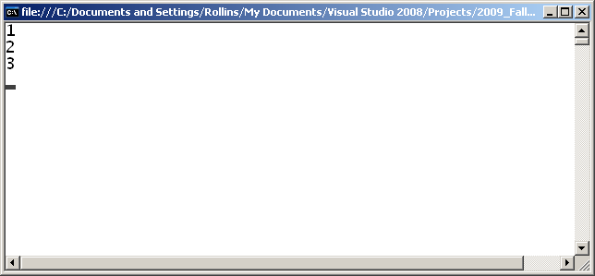
List<int> Example Running

Slide 15
A List of Circles
Download Circles.cs from class web site Downloads area into project directory.
http://www.cse.usf.edu/~turnerr/Software_Systems_Development/Downloads/
Add Circles.cs to the project
Delete namespaces.

Slide 16
List<Circle> Example
using System;
using System.Collections.Generic;
class Program
{
static void Main(string[] args)
{
List<Circle> circles = new List<Circle>();
circles.Add(new Circle("C1", 1.0));
circles.Add(new Circle("C2", 2.0));
circles.Add(new Circle("c3", 3.0));
foreach (Circle c in circles)
{
Console.WriteLine(c.Name());
}
Console.ReadLine();
}
}

Slide 17
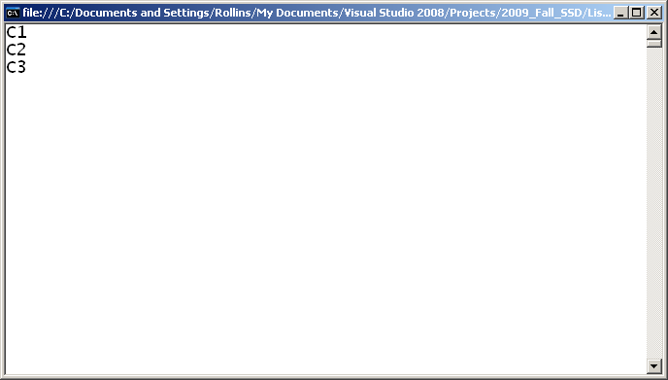
List<Circle> Example Running

Slide 18
Accessing List by Position
static void Main(string[] args)
{
List<Circle> circles = new List<Circle>();
circles.Add(new Circle("C1", 1.0));
circles.Add(new Circle("C2", 2.0));
circles.Add(new Circle("c3", 3.0));
for (int i = 0; i < circles.Count; ++i)
{
Console.WriteLine(circles[i].Name());
}
Console.ReadLine();
}
Same result

Slide 19
Inserting
static void Main(string[] args)
{
List<Circle> circles = new List<Circle>();
circles.Add(new Circle("C1", 1.0));
circles.Add(new Circle("C2", 2.0));
circles.Add(new Circle("c3", 3.0));
Circle c4 = new Circle("C4", 4.0);
circles.Insert(2, c4);
for (int i = 0; i < circles.Count; ++i)
{
Console.WriteLine(circles[i].Name());
}
Console.ReadLine();
}

Slide 20
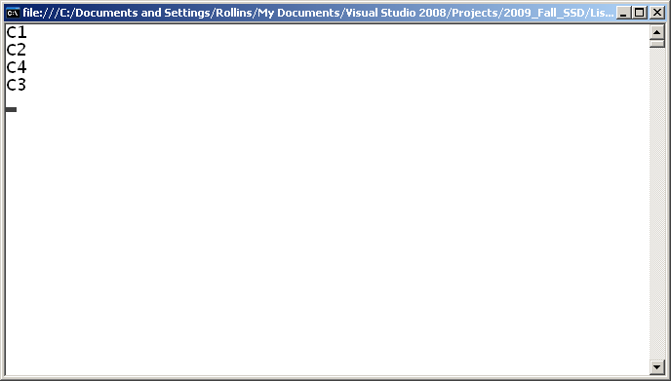
Inserting

Slide 21
Inserting and Deleting
static void Main(string[] args)
{
List<Circle> circles = new List<Circle>();
circles.Add(new Circle("C1", 1.0));
circles.Add(new Circle("C2", 2.0));
circles.Add(new Circle("c3", 3.0));
Circle c4 = new Circle("C4", 4.0);
circles.Insert(2, c4);
circles.RemoveAt(1);
for (int i = 0; i < circles.Count; ++i)
{
Console.WriteLine(circles[i].Name());
}
Console.ReadLine();
}

Slide 22

Inserting and Deleting

Slide 23
Sorting
List<T> has a Sort method.
Parameter class must implement the IComparable<T> interface.
Example:
class Schedule_Record : IComparable<Schedule_Record>
{
private String college;
...

Slide 24
IComparable interface
Class must implement CompareTo() method, taking an object of the same type as its parameter.
  Return negative int if this object < other
  Return 0 if this object == other
  return positive int if this object > other
    Same as strcmp() in C

Slide 25
Implementing IComparable
class Circle : IComparable<Circle>
{
private String name;
private double radius = 0.0;
...
public int CompareTo(Circle other)
{
if (this.radius < other.radius)
return -1;
else if (this.radius > other.radius)
return 1;
else
return 0;
}

Slide 26
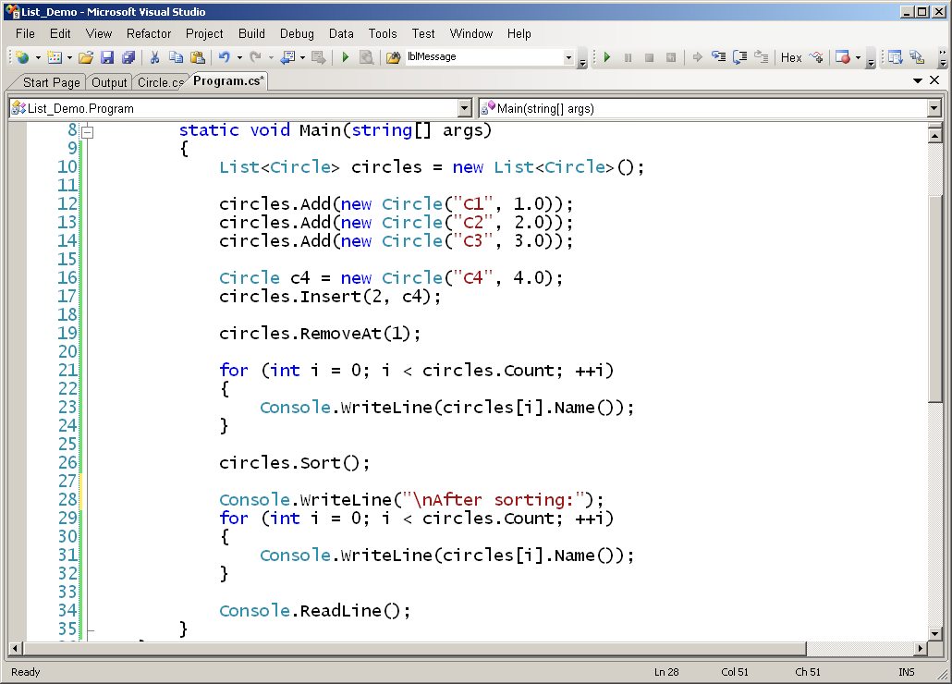
Using Sort()

Slide 27
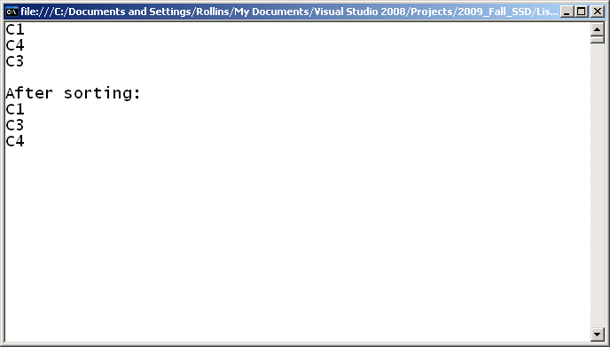
Program Running
End of Section

Slide 28
The Generic Queue
Queue<T>
  http://msdn.microsoft.com/en-us/library/7977ey2c.aspx
Methods
  Enqueue (T item)
    Add an item to the end of the queue
  T Dequeue()
    Removes and returns object at the head of the queue
  Clear(), Contains(), Peek(), ... many more

Slide 29
Queue<Circle> Example
static void Main(string[] args)
{
Queue<Circle> circles = new Queue<Circle>();
circles.Enqueue(new Circle("C1", 1.0));
circles.Enqueue(new Circle("C2", 2.0));
circles.Enqueue(new Circle("c3", 3.0));
while (circles.Count > 0)
{
Circle c = circles.Dequeue();
Console.WriteLine(c.Name());
}
Console.ReadLine();
}

Slide 30
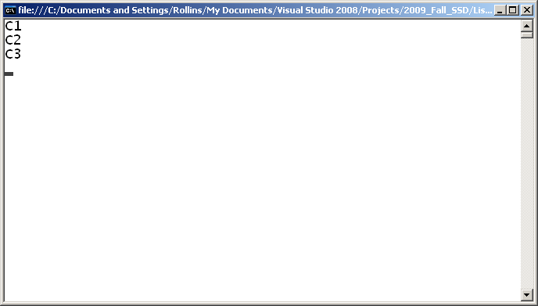
Queue<Circle> Example Running

Slide 31
Dictionary<K,V>
http://msdn.microsoft.com/en-us/library/xfhwa508(VS.80).aspx
Stores (Key, Value) pairs
  Class KeyValuePair<K,V>
Template parameters
  K is type of Key
  V is type of Value

Slide 32
Dictionary<K,V> Example
static void Main(string[] args)
{
Dictionary<String, Circle> circles =
new Dictionary<String, Circle>();
circles.Add("c1", new Circle("C1", 1.0));
circles.Add("c2", new Circle("C2", 2.0));
circles.Add("c3", new Circle("c3", 3.0));
foreach (KeyValuePair<String, Circle> kvp in circles)
{
String k = kvp.Key;
Circle c = kvp.Value;
Console.WriteLine("Circle {0} has radius {1}",
k, c.Radius());
}
Console.ReadLine();
}

Slide 33
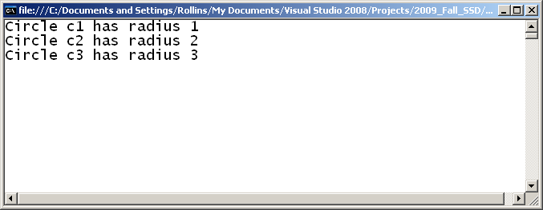
Dictionary<K,V> Example

Slide 34
Using Key as Indexer
static void Main(string[] args)
{
Dictionary<String, Circle> circles =
new Dictionary<String, Circle>();
circles.Add("c1", new Circle("C1", 1.0));
circles.Add("c2", new Circle("C2", 2.0));
circles.Add("c3", new Circle("c3", 3.0));
Circle c = circles["c2"];
Console.WriteLine("Circle {0} has radius {1}",
c.Name(), c.Radius());
Console.ReadLine();
}

Slide 35
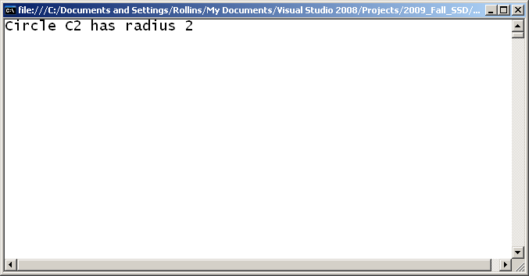
Indexer Example Running

Slide 36
About Dictionary<K,V>
Key class must have a compare for equality operation.
Keys must be unique.
  Attempting to Add an item with a key already in the Dictionary will result in an exception.
  Can set entry with an existing key, using indexer notation.

Slide 37
Adding with Existing Key
static void Main(string[] args)
{
Dictionary<String, Circle> circles =
new Dictionary<String, Circle>();
circles.Add("c1", new Circle("C1", 1.0));
circles.Add("c2", new Circle("C2", 2.0));
circles.Add("c3", new Circle("c3", 3.0));
Circle c = circles["c2"];
Console.WriteLine("Circle {0} has radius {1}",
c.Name(), c.Radius());
circles["c2"] = new Circle("New C2", 200.0);
c = circles["c2"];
Console.WriteLine("Circle {0} has radius {1}",
c.Name(), c.Radius());
Console.ReadLine();
}

Slide 38
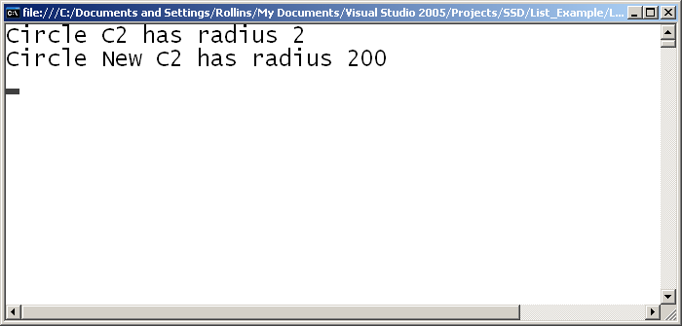
Adding with Existing Key

Slide 39
Other Generic Container Classes
Linked List (No array operations)
SortedDictionary
SortedList
Stack
See .NET documentation

Slide 40
Summary
The .NET Generics make life easier.
Use List<T> like an array
    without worrying about size.
    Plus additional features!
Use Dictionary<K,V> to store and retrieve objects by Key value.
Use Stack and Queue when you need those concepts.
End of Presentation

