Slide 1
Stream in Csharp

Slide 2
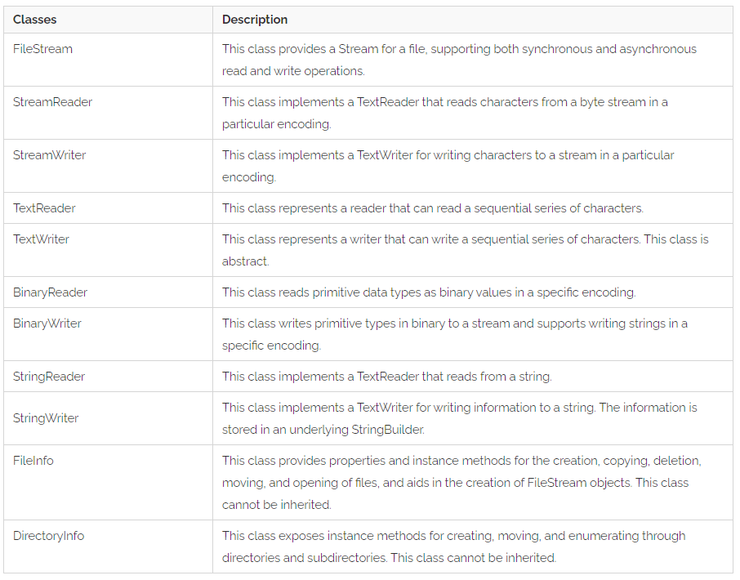
The System.IO Namespace

Slide 3
Writing a text file
public static void WriteAllText(string path, string contents);
public static void WriteAllText(string path, string contents, Encoding encoding);

Slide 4
Reading a text file
public static string ReadAllText(string path);
public static string ReadAllText(string path, Encoding encoding);

Slide 5
FileStream Class
using System;
using System.IO;
namespace FileHandlingDemo{
public class Example {
public static void Main(string[] args) {
FileStream fi = new FileStream("e:\\file.txt", FileMode.OpenOrCreate);
fi.WriteByte(12);
fi.WriteByte(6);
fi.WriteByte(30);
fi.Close();
FileStream fo = new FileStream("e:\\file.txt", FileMode.OpenOrCreate);
int i = 0;
Console.WriteLine("The contents of the file are:");
while ((i = fo.ReadByte()) != -1) {
Console.WriteLine(i);
}
fo.Close();
}
}
}

Slide 6
StreamReader and StreamWriter Class
using System;
using System.IO;
namespace FileHandlingDemo
{
public class Example {
public static void Main(string[] args) {
FileStream f1 = new FileStream("e:\\file.txt", FileMode.OpenOrCreate);
StreamWriter s1 = new StreamWriter(f1);
s1.WriteLine("File Handling in C#");
s1.Close();
f1.Close();
FileStream f2 = new FileStream("e:\\file.txt", FileMode.OpenOrCreate);
StreamReader s2 = new StreamReader(f2);
string data = s2.ReadLine();
Console.WriteLine("The data in the file is as follows:");
Console.WriteLine(data);
s2.Close();
f2.Close();
}
}
}

Slide 7
TextReader Class and TextWriter Class
using System;
using System.IO;
namespace FileHandlingDemo
{
class Example {
static void Main(string[] args) {
using (TextWriter tw = File.CreateText("e:\\file.txt"))
{
tw.WriteLine("C# File Handling");
tw.WriteLine("TextReader Class and TextWriter Class");
}
using (TextReader tr = File.OpenText("e:\\file.txt"))
{
Console.WriteLine(tr.ReadToEnd());
}
}
}
}

Slide 8
BinaryReader Class and BinaryWriter Class
using System;
using System.IO;
namespace FileHandlingDemo{
class Example {
static void Main(string[] args) {
string fName = "e:\\file.dat";
using (BinaryWriter bw = new BinaryWriter(File.Open(fName, FileMode.Create)))
{
bw.Write("File Handling in C#");
bw.Write("BinaryReader class and BinaryWriter class");
}
using (BinaryReader br = new BinaryReader(File.Open("e:\\file.dat", FileMode.Open)))
{
Console.WriteLine(br.ReadString());
Console.WriteLine(br.ReadString());
}
}
}
}

Slide 9
StringReader Class and StringWriter Class
using System;
using System.IO;
namespace FileHandlingDemo{
class Example {
static void Main(string[] args) {
StringWriter sw = new StringWriter();
sw.WriteLine("File Handling in C#");
sw.WriteLine("StringReader Class and StringWriter Class");
sw.Close();
StringReader sr = new StringReader(sw.ToString());
while (sr.Peek() > -1)
{
Console.WriteLine(sr.ReadLine());
}
}
}
}

Slide 10
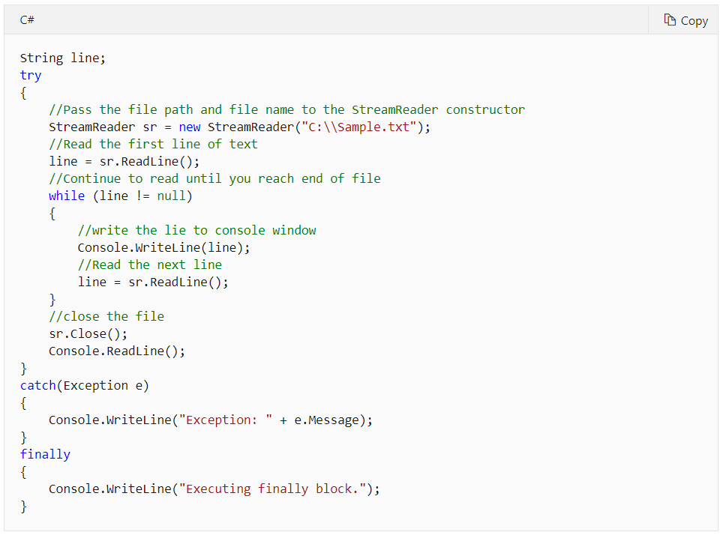
Read from a text file

Slide 11
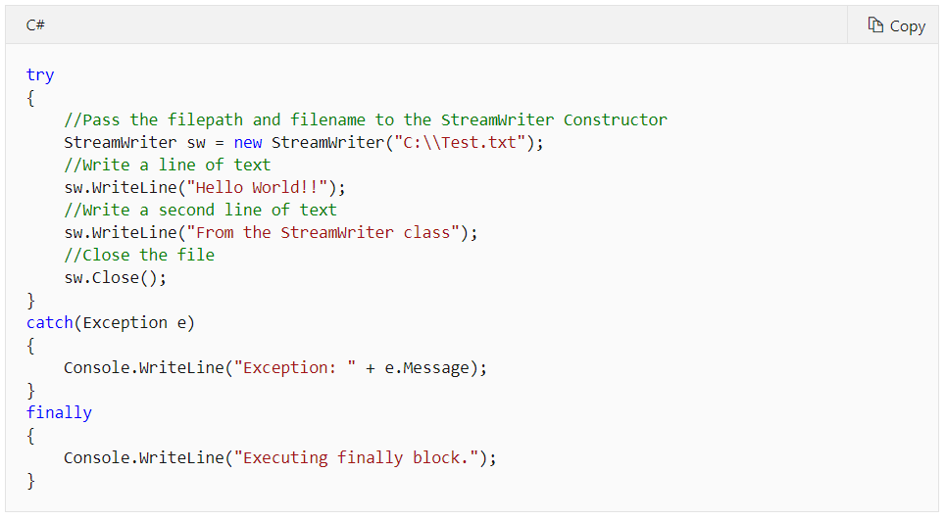
Write to file

Slide 12
Serialization in C#
namespace SerializationDemo{
[Serializable]
class Student {
public int rno;
public String name;
public double marks;
static void Main(string[] args) {
Student s1 = new Student();
s1.rno = 1;
s1.name = "John Smith";
s1.marks = 87.5;
IFormatter f = new BinaryFormatter();
Stream str = new FileStream(@"E:\SerializableFile.txt",FileMode.Create,FileAccess.Write);
f.Serialize(str, s1);
str.Close();
str = new FileStream(@"E:\SerializableFile.txt",FileMode.Open,FileAccess.Read);
Student s2 = (Student)f.Deserialize(str);
Console.WriteLine("Roll Number: {0}", s2.rno);
Console.WriteLine("Name: {0}", s2.name);
Console.WriteLine("Marks: {0}", s2.marks);
}
}

Slide 13
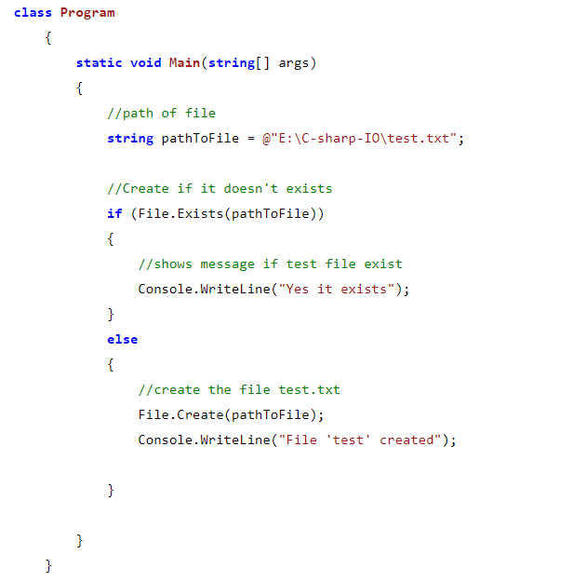
Creating a File programmatically in C# using System.IO

Slide 14
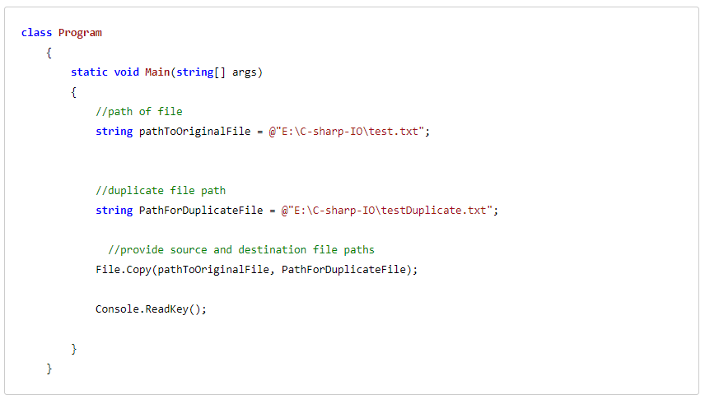
Copying File using File.Copy in C#

Slide 15
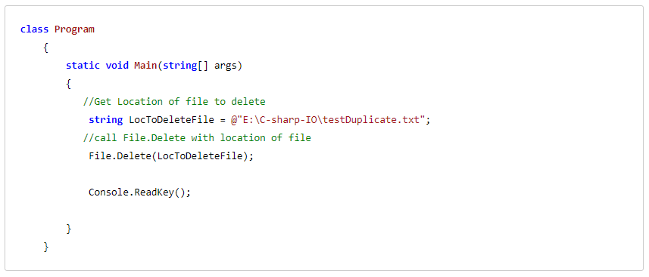
Deleting a file using File.Delete

Slide 16
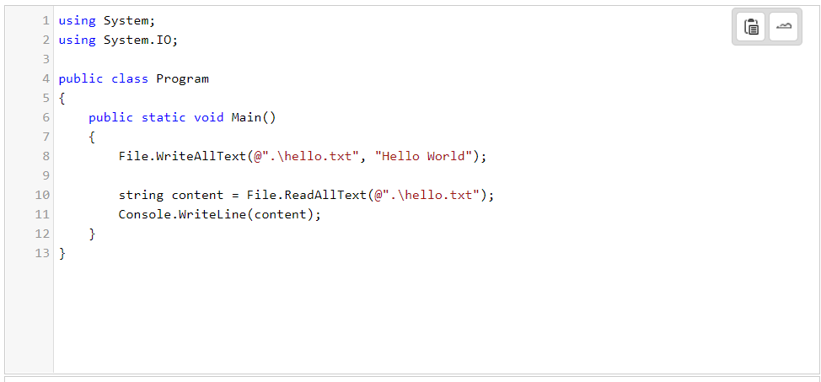
Reading and Writing files

