Slide 1
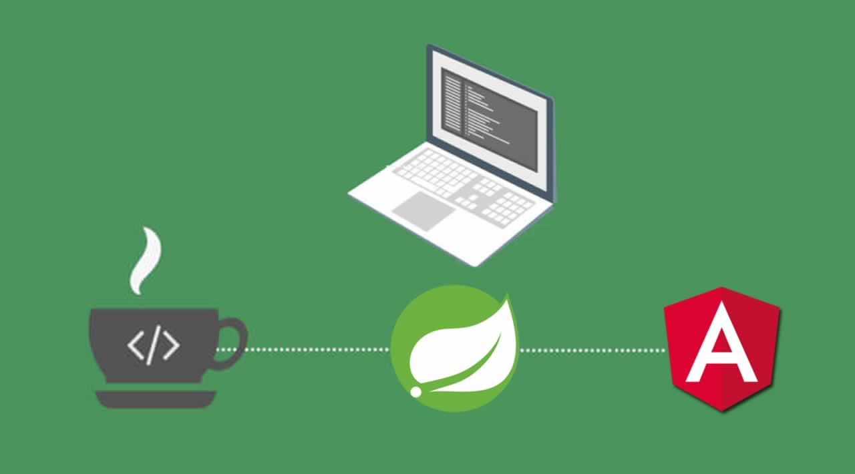

Presenter : Duy Nguyen
Mentor : Tan Le

Slide 2
CONTENT
Basic of Java Programming
Object-Oriented Programming
Creation Patterns
OOD principles
Hibernate 1
Hibernate 2
Spring
JavaScript
Angular 1
Angular 2
Angular material

Slide 3
Basic of Java Programming
Objects, Object References
Static members and Instance members
Comments
Primitive Data Types and Wrapper classes
Exceptions

Slide 4
Basic of Java Programming
Object references
A references is an address that indicates where an object’s variables and method are stored.
Object
Objects have states and behaviors
Static and Instance member
Variables and Methods declared using keyword static are called static members of a class.
Comments
Comments can be used to explain Java code, and to make it more readable.

Slide 5
Basic of Java Programming
Primitive Data Types
A variable provides us with named storage that our programs can manipulate.
Exceptions
When executing Java code, different errors can occur: coding errors made by the programmer, errors due to wrong input, or other unforeseeable things
Wrapper classes
Wrapper classes provide a way to use primitive data types (int, boolean, etc,..) as object.

Slide 6
Object-Oriented Programming
Encapsulation
Inheritance
Polymorphism
Overriding, Overloading
Overriding hash Code() and equals()
Collections: List, Set, Map, Queue
Sorting a Collections
Generic and wildcards

Slide 7
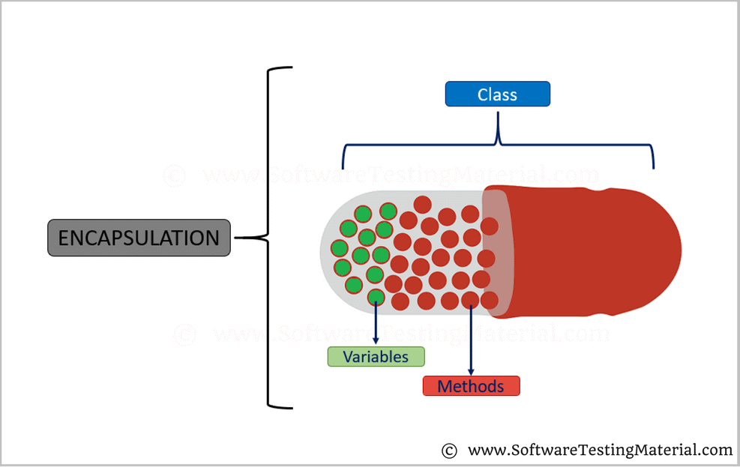
Object-Oriented Programming
Encapsulation

Slide 8
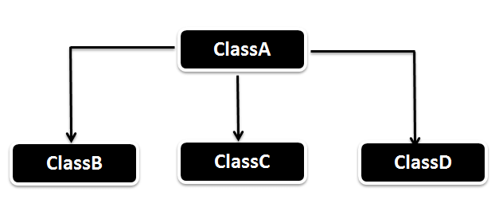
Object-Oriented Programming
Inheritance

Slide 9
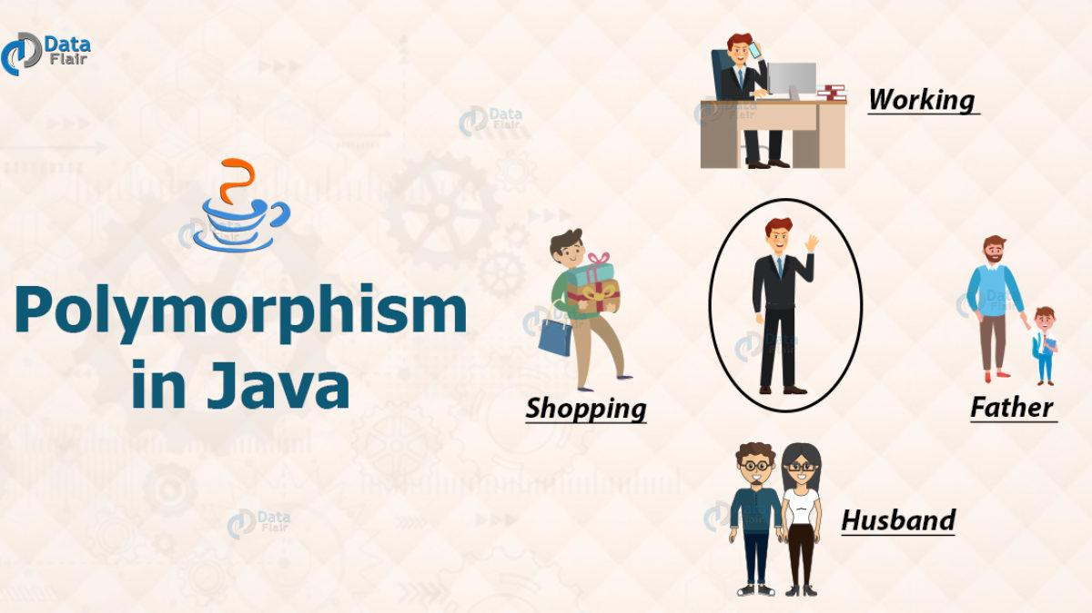
Object-Oriented Programming
Polymorphism

Slide 10
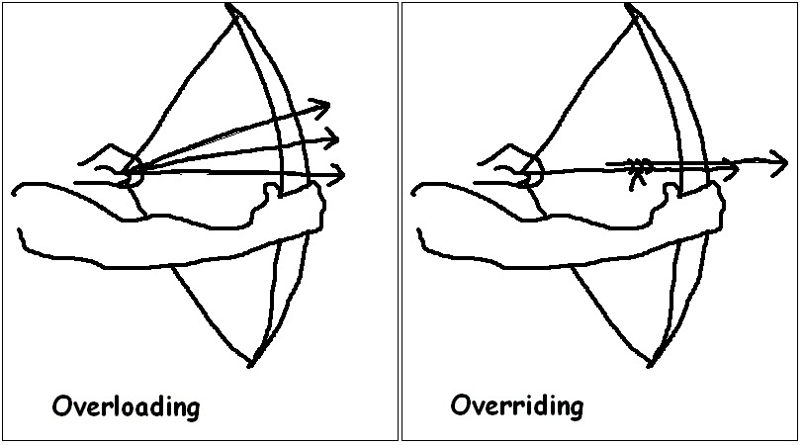
Object-Oriented Programming
Overriding, Overloading

Slide 11
Object-Oriented Programming
Overriding hash Code() and equals()
Hash Code()
Is an integer value associated with every object in java, facilitating the hasing in hash tables.
equals()
Is a method of lang.Object class, and it is use to compare two object.

Slide 12
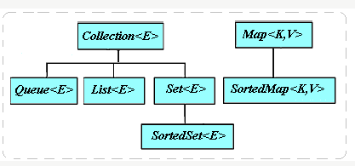
Object-Oriented Programming
Collections

Slide 13
Object-Oriented Programming
Collections
Generic
Generic in Java are a way to define specific types for classes and methods in different contexts.
Sort
Sort is a method of Java collections class is used to sort the elements parents in the specified list.
Wildcards
The ? Symbol reprensent the wildcard element . It means any type.

Slide 14
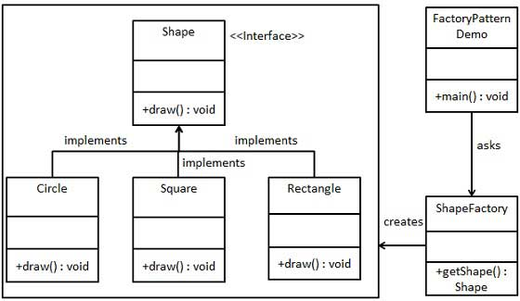
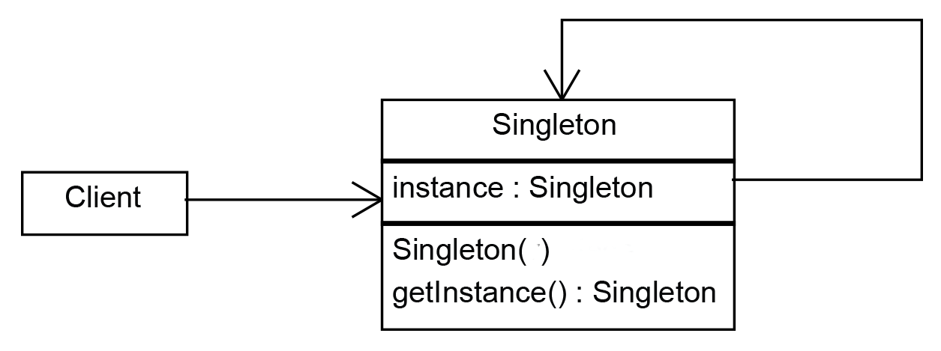
Creation Patterns
Singleton
Factory

Slide 15
OOD (Object Oriented Design Principles in Java)
1
Single Responsibility Principle
4
Interface Segregation Principle
2
Open-Close Principle
5
Dependency Inversion Principle
3
Liskov Substitution Principle

Slide 16
OOD (Object Oriented Design Principles in Java)
Single Responsibility Principle
Each class should be responsible for a
single part or functionality of the system.
Open-Close Principle
Software components should be open
for extension, but not for modification.
Liskov Substitution Principle
Objects of a superclass should be replaceable
with objects of its subclasses without breaking the system.

Slide 17
OOD (Object Oriented Design Principles in Java)
Interface Segregation Principle
Dependency Inversion Principle
No client should be forced to depend on
methods that it does not use.
High-level modules should not depend
on low-level modules,
both should depend on abstractions.

Slide 18
Hibernate 1
Understanding what is ORM, what is Hibernate and its concepts
Understanding Hibernate architecture
Association and Collection Mapping
Component and Inheritance Mapping

Slide 19
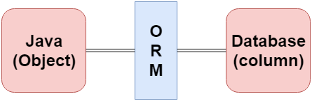
Hibernate 1
ORM And Hibernate

Slide 20
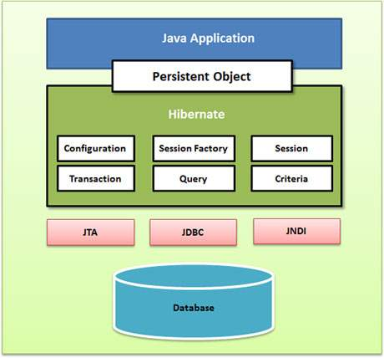
Hibernate 1
Hibernate architecture

Slide 21
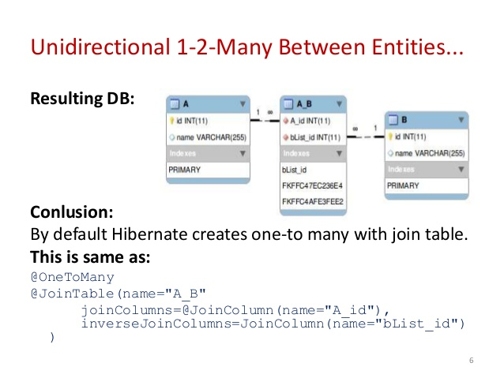
Hibernate 1
Association
and Collection Mapping

Slide 22
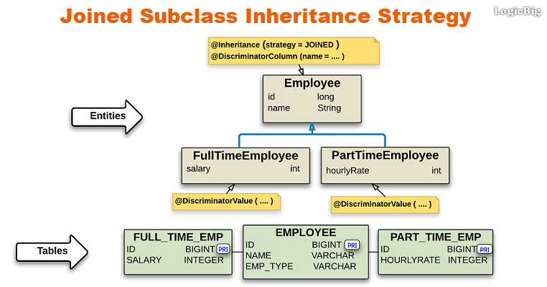
Hibernate 1
Component and Inheritance Mapping

Slide 23
Hibernate 2
Object Lifecycle, Persistence, and Session Management
Transaction Management
Hibernate Query Language and Native SQL
Understanding Hibernate Caching, Caching Strategies

Slide 24
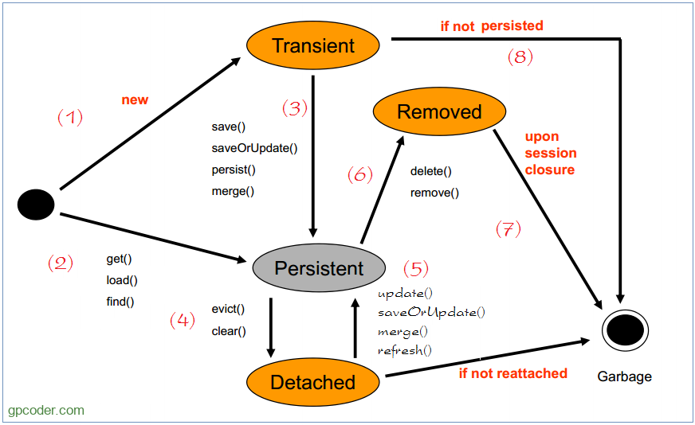
Hibernate 2

Slide 25
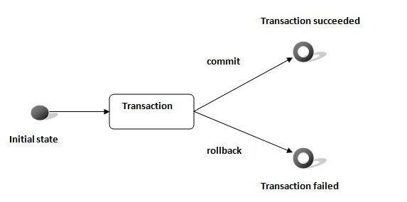
Hibernate 2
Transaction Management

Slide 26
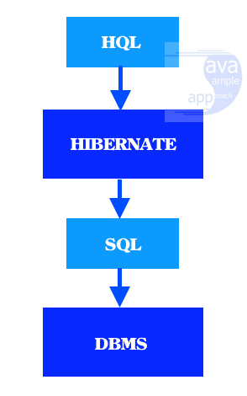
Hibernate 2
Hibernate Query Language and Native SQL

Slide 27
Spring
Understanding Spring Architecture
Understanding Dependency Injection and its concepts
Hibernate with spring
Understanding AOP and its concepts

Slide 28
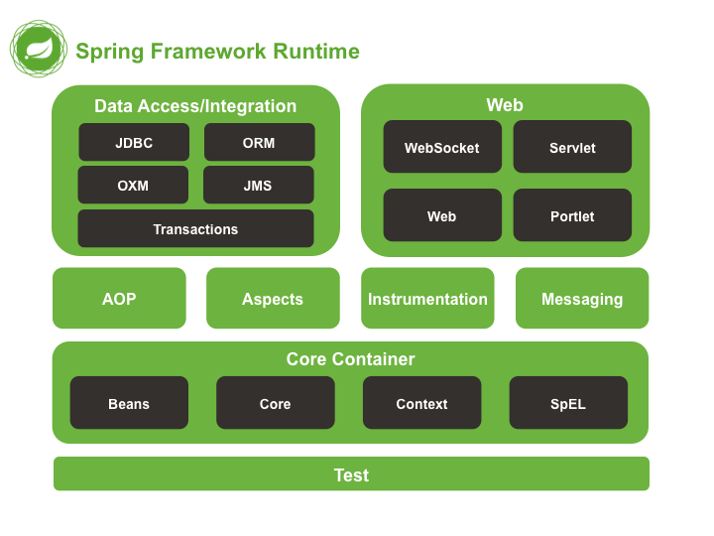
Spring

Slide 29
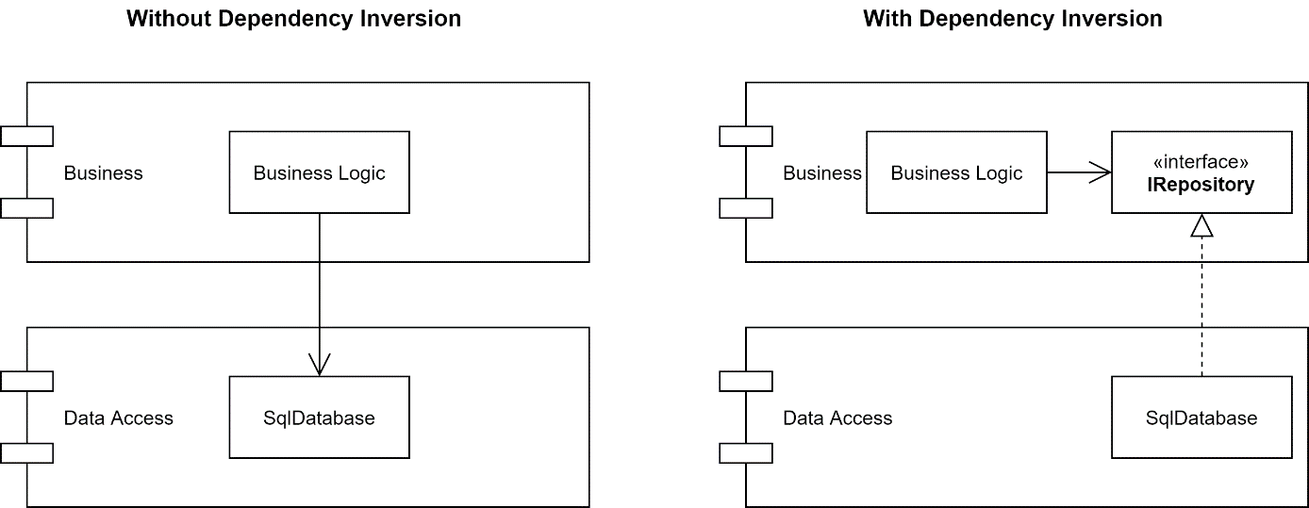
Spring
Dependency Injection

Slide 30
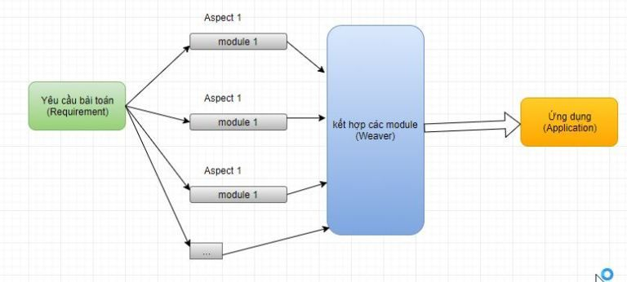
Spring
AOP

Slide 31
JAVASCRIPT
Overview
Syntax
Functions
Events
Cookies
Error Handling
Validations
Debugging
Browsers
Objects
Reg Exp
HTML DOM

Slide 32
JAVASCRIPT
Syntax
JavaScript syntax is the set of rules
Events
The change in the state of an object is known as an Event.
Functions
Function is block of code designed to perform a particular task. Executed when “Something” calls it.
Cookies
Are data, stored in small text files, on your computer.

Slide 33
JAVASCRIPT
Objects
Are variables too. But objects can contain many values
HTML DOM
Allows JavaScript to change the content of HTML elements.
RegExp
Is a sequence of characters that forms a search pattern.

Slide 34
JAVASCRIPT
Error handling
JavaScript catches adddlert as an error , and executed the catch code to handle it.
Validations
Provides a way to validate form’s data on the client before sending it to the server.
RegExp
Is a sequence of characters that forms a search pattern.
Debugging
Set any breakpoints, and examine variables while the code is executing.

Slide 35
ANGULARJS
Modules, Dependency injection
Scope, Controller
Data binding, expressions
Service, Factory, Provider
Directive
Angular Lifecycle

Slide 36
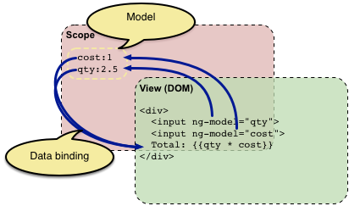
ANGULARJS

Slide 37

JAVASCRIPT

