Slide 1

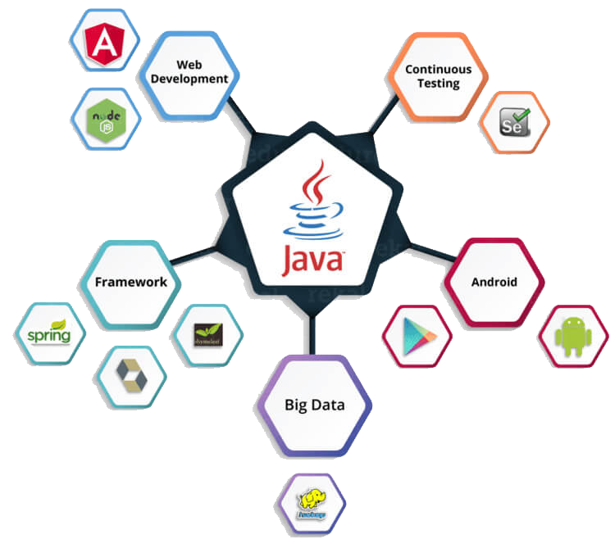
Presenter : Nghia Pham
Mentor : Tan Le

Slide 2
CONTENT
Java core
Design Patterns
OOD principle
Hibernate
Spring
JavaScript
Angular

Slide 3
JAVA CORE
Object, Object references
01
Static and Instance member
02
Comments
03
Primitive and Wrapper
04
Exceptions
05
3

Slide 4
JAVA CORE
Object
Objects have states and behaviors.
Software objects also have a states and behaviors. States is stored in fields and behaviors is shown via methods
Object references
A references is an address that indicates where an object’s variables and method are stored.
Comments
Comments can be used to explain Java code, and to make it more readable.
Static and Instance member
Variables and Methods declared using keyword static are called static members of a class.
4

Slide 5
JAVA CORE
Primitive Data Types
A primitive data type specifies the size and type of variable values, and it has no additional methods.
Exceptions
When executing Java code, different errors can occur: coding errors made by the programmer, errors due to wrong input, or other unforeseeable things
Wrapper classes
Wrapper classes provide a way to use primitive data types (int, boolean, etc,..) as object.
5

Slide 6
JAVA CORE
Object
O
Oriented
O
Programming
P

Slide 7

JAVA CORE
01
Encapsulation
02
Inheritance
INHERITANCE
03
Polymorphism
04
Abstraction

Slide 8
JAVA CORE
Overloading
Overloading is a technique that allows in the same class to have many methods of the same name but with different number of parameters or parameter data types.
Overriding
Overriding is used in cases where the child class inherits from the parent class and wants to redefine a method already in the parent class.

Slide 9


JAVA CORE
Equals
EQUALS is a method of lang.Object class, and it is use to compare two object.
01
Hash code
HASHCODE is an integer value associated with every object in java, facilitating the hashing in hash tables.
02

Slide 10
JAVA CORE
01
LIST in Java provides the facility to maintain the ordered collection
LIST
02
SET interface extends the collection interface. An unordered collection or list in which duplicates are not allowed.
SET
03
MAP contains values on the basic of key, i.e key and value pair. Each key and value pair is known as an entry.
MAP
04
QUEUE interface orders the element in FIFO manner. In FIFO, first element is removed first and last element is removed at last.
QUEUE
COLLECTIONS

Slide 11
JAVA CORE
Sort
Sort is a method of Java collections class is used to sort the elements parents in the specified list.
Generic
Generic in Java are a way to define specific types for classes and methods in different contexts.
Wildcards
The ? Symbol represent the wildcard element . It means any type.

Slide 12
DESIGN PATTERN
Singleton
Abstract
Factory
Prototype
Factory
Builder
DESIGN PATTERN

Slide 13
DESIGN PATTERN
Singleton
A class must ensure that only single instance should be created and single object can be used by all other classes.
Factory
Subclasses are responsible to create the instance of the class.

Slide 14
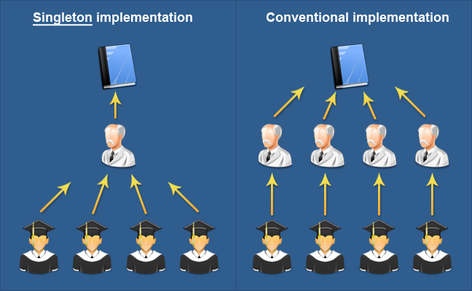
DESIGN PATTERN

Slide 15
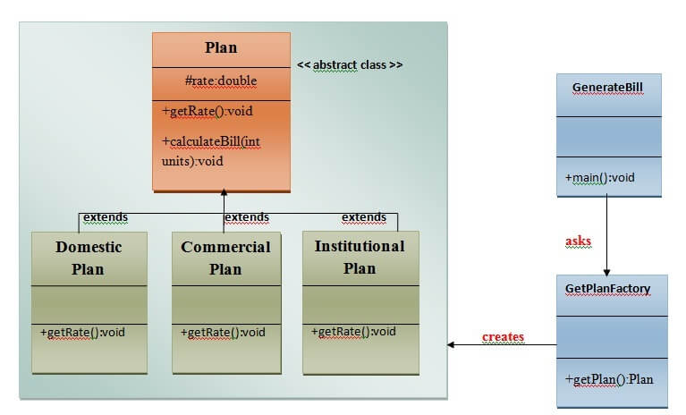
DESIGN PATTERN

Slide 16





OOD PRINCIPLE
Single
Liskov
Dependency
Responsibility
Substitution
Inversion
Open/close
Interface
Principle
Segregation

Slide 17
HIBERNATE
Hibernate
Is a high-performance Object/Relational persistence and query service.
ORM
converting data between relational databases and object oriented programming languages.

Slide 18
HIBERNATE
JAVA APPLICATION
Persistent Object
Hibernate
Hibernate.Properties
XML Mapping
Database

Slide 19
HIBERNATE
Association
The relationship between two database tables as attributes in your domain model.
Collection mapping
In this mapping, the collection are mapped into a separate table
Component
Is a mapping for a class having a reference to another class as a member variable.
Inheritance
Means that we can use polymorphic queries for retrieving all the sub-class entities when querying for a super-class.

Slide 20
HIBERNATE
Object lifecycle
Transaction
Persistence
HQL and Native SQL
Session
Caching and Caching strategies

Slide 21

SPRING

Slide 22
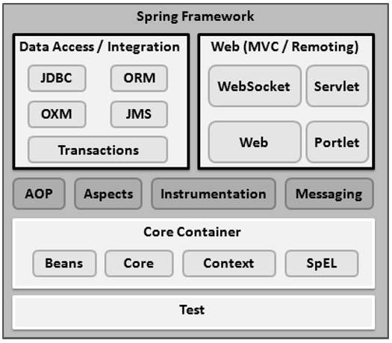
SPRING

Slide 23
SPRING
DI
Dependency Injection
Constructor-based
Setter-based

Slide 24
Aspect
Proxy
Join point
AOP
Weaving
Advice
Target Object
Pointcut

Slide 25

JAVASCRIPT

Slide 26
JAVASCRIPT
Syntax
JavaScript syntax is the set of rules
Events
The change in the state of an object is known as an Event.
Functions
Function is block of code designed to perform a particular task. Executed when “Something” calls it.
Cookies
Are data, stored in small text files, on your computer.

Slide 27
JAVASCRIPT
Objects
Are variables too. But objects can contain many values
HTML DOM
Allows JavaScript to change the content of HTML elements.
RegExp
Is a sequence of characters that forms a search pattern.

Slide 28
JAVASCRIPT
Error handling
JavaScript catches adddlert as an error , and executed the catch code to handle it.
Validations
Provides a way to validate form’s data on the client before sending it to the server.
RegExp
Is a sequence of characters that forms a search pattern.
Debugging
Set any breakpoints, and examine variables while the code is executing.

Slide 29

ANGULARJS

Slide 30
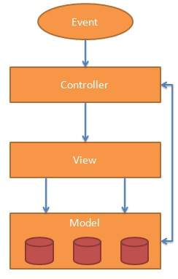
ANGULARJS

Slide 31
ANGULARJS
Controller
Modules
Dependency injection
Data binding
Expression
Scope
Service
Provider
Factory
Directive

