Slide 1

JAVA TRAINING
Presenter : Quy Nguyen
Mentor = Tan Le

Slide 2
MAIN CONTENT
Java Core
Design Patterns
OOD principle
Hibernate
Spring
JavaScript
Angular

Slide 3
Creation Patterns
JAVA CORE CONTENT
Java Core: Object – Oriented
Programming
Java Core: Basic of Java Programming

Slide 4
Basic of Java
Primitive Data Types and Wrapper classes
Static member and Instance member
Comments
Objects, Object References
Exceptions
4

Slide 5
Basic of Java
Objects, Object References
An object is simply an instance of the class. It represents the structure of the class and follows the blueprint instructions for all the elements present within it, such as methods and variables.
A reference is something that provides the address to the place where the object memory has been allocated.
Static member and Instance member
In some cases, certain members should only belong to the class, and not be part of any object created from the class. It belongs to the class, and not to any object of the class. Similarly, a class can have static methods that belong only to the class, and not to any objects of the class.
Each object created will have its own copies of the fields defined in its class. The fields of an object are called instance variables. The methods of an object define its behavior. These methods are called instance methods.

Slide 6
Basic of Java
Comments
The Java comments are the statements that are not executed by the compiler and interpreter. The comments can be used to provide information or explanation about the variable, method, class or any statement. It can also be used to hide program code.
Primitive Data Types and Wrapper classes
Primitive types are the most basic data types available within the Java language.
Wrapper classes provide a way to use primitive data types as objects.
Exceptions
When an error occurs, Java will normally stop and generate an error message. The technical term for this is: Java will throw an exception (throw an error).

Slide 7
Object – Oriented
Encapsulation
Overriding hashCode() and equals() method
Inheritance
Collections: List, Set, Map, Queue
Polymorphism
Sorting a Collections
Overriding, Overloading Methods
Generic and wildcards

Slide 8
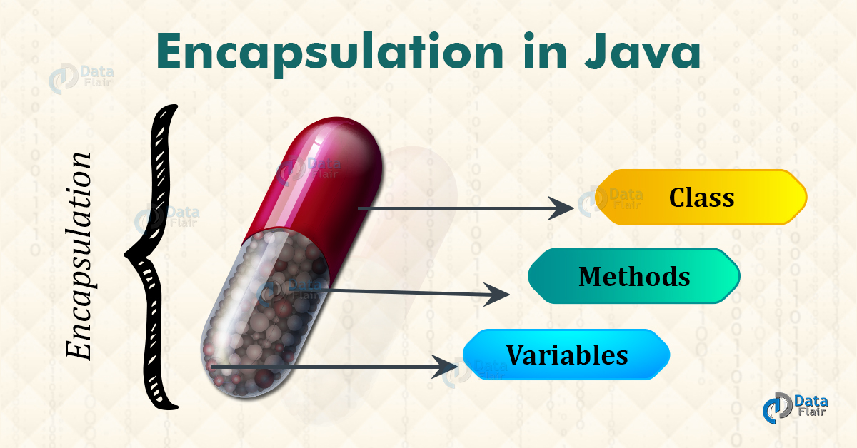
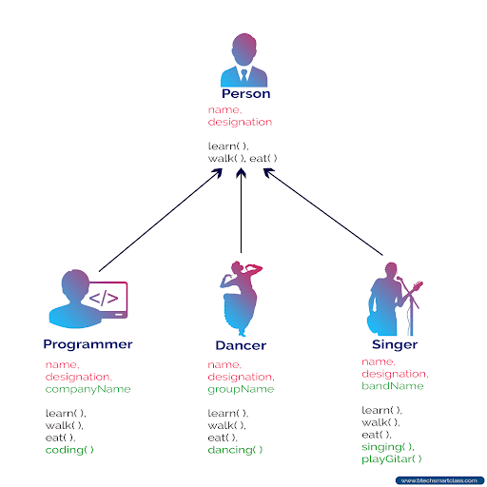
Object – Oriented
Encapsulation
Inheritance
Polymorphism
The meaning of Encapsulation, is to make sure that "sensitive" data is hidden from users.
In Java, it is possible to inherit attributes and methods from one class to another.
Polymorphism means "many forms", and it occurs when we have many classes that are related to each other by inheritance.

Slide 9
Object – Oriented
Overriding, Overloading Methods
Overriding hashCode() and equals() method
If subclass (child class) has the same method as declared in the parent class, it is known as Method Overriding in Java.
If a class has multiple methods having same name but different in parameters, it is known as Method Overloading.
You must override hashCode() in every class that overrides equals(). Failure to do so will result in a violation of the general contract for Object.hashCode(), which will prevent your class from functioning properly in conjunction with all hash-based collections, including HashMap, HashSet, and Hashtable.

Slide 10
Object – Oriented
Collections: List, Set, Map, Queue
List in Java provides the facility to maintain the ordered collection. It contains the index-based methods to insert, update, delete and search the elements. It can have the duplicate elements also.
A Set is a Collection that cannot contain duplicate elements. It models the mathematical set abstraction.
A map contains values on the basis of key, i.e. key and value pair. Each key and value pair is known as an entry. A Map contains unique keys.
Java Queue interface orders the element in FIFO(First In First Out) manner. In FIFO, first element is removed first and last element is removed at last.
List
Set
Map
Queue

Slide 11
Object – Oriented
Sorting a Collections
Generic and wildcards
.sort();
.reverse();
A generic type is a generic class or interface that is parameterized over types.
In generic code, the question mark (?), called the wildcard, represents an unknown type. The wildcard can be used in a variety of situations: as the type of a parameter, field, or local variable; sometimes as a return type (though it is better programming practice to be more specific). The wildcard is never used as a type argument for a generic method invocation, a generic class instance creation, or a supertype.

Slide 12
Creation Patterns
Singleton
Factory
Exercises

Slide 13
Creation Patterns
Singleton
The Singleton's purpose is to control object creation, limiting the number of objects to only one. Since there is only one Singleton instance, any instance fields of a Singleton will occur only once per class, just like static fields. Singletons often control access to resources, such as database connections or sockets.

Slide 14
Creation Patterns
Factory
Factory method is a creational design pattern which solves the problem of creating product objects without specifying their concrete classes.

Slide 15
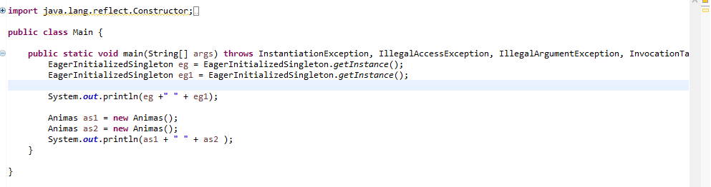
Creation Patterns
Exercises
Singleton

Slide 16
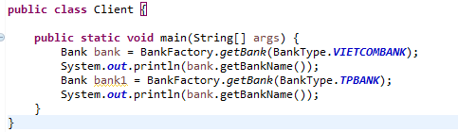
Creation Patterns
Exercises
Factory

Slide 17
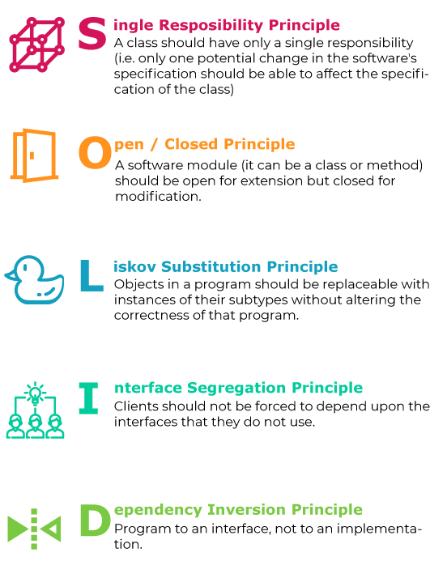
OOD PRINCIPLES

Slide 18
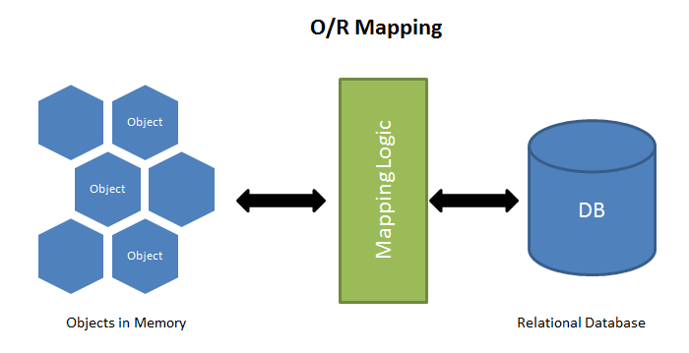

HIBERNATE
ORM

Slide 19
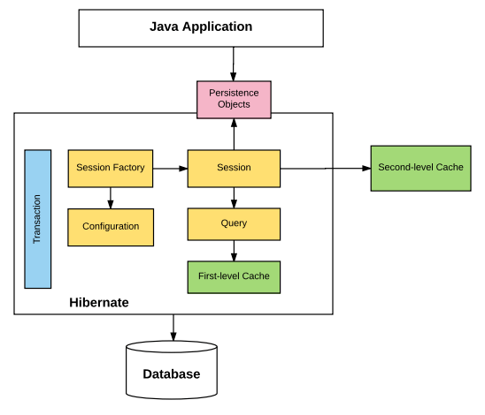
HIBERNATE
Hibernate architecture

Slide 20
HIBERNATE
Association
Mapping
One to one
One to many
Many to many

Slide 21
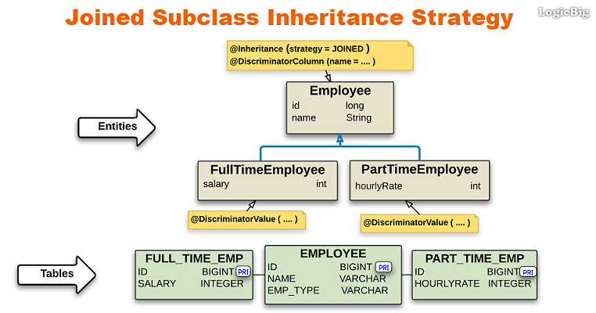
HIBERNATE
Inheritance Mapping

Slide 22


Slide 23
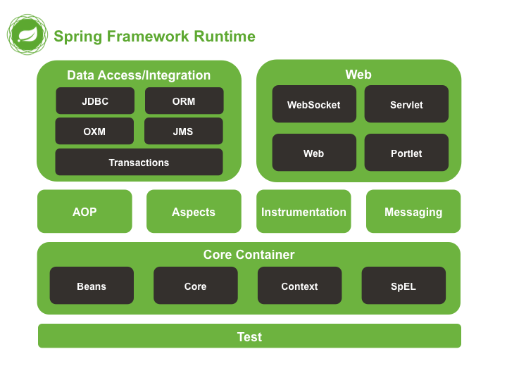

Slide 24
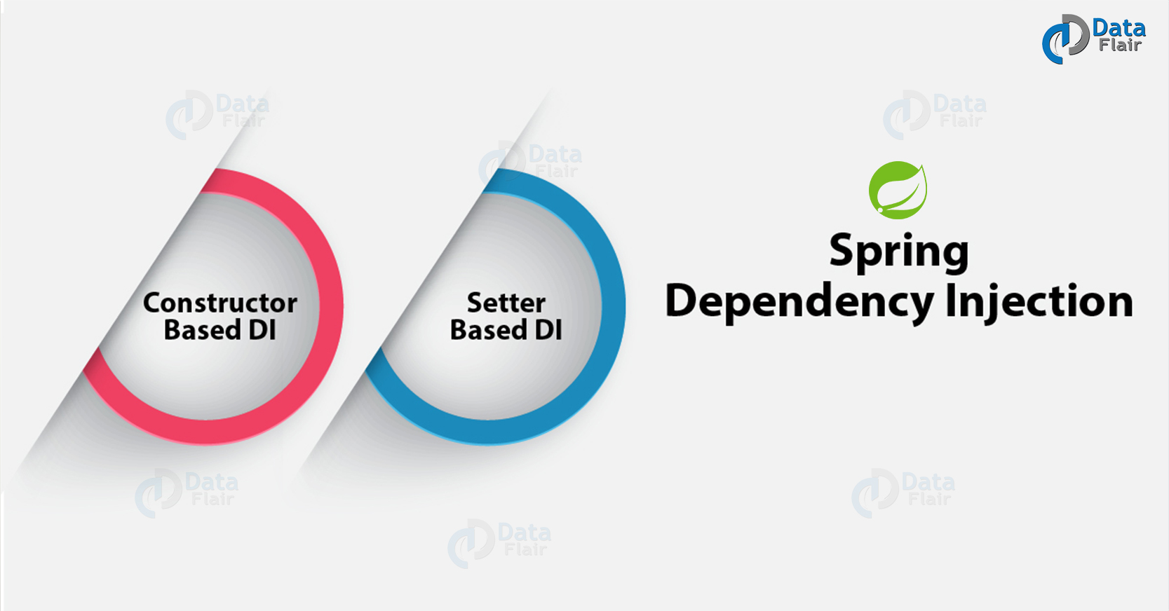

Slide 25
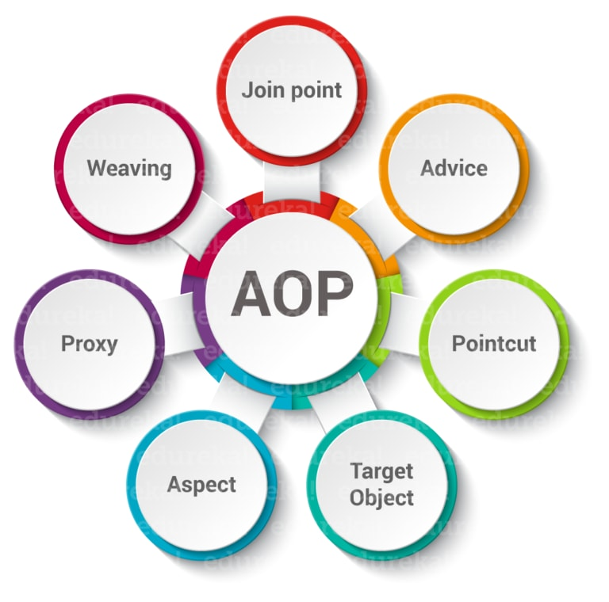

Slide 26
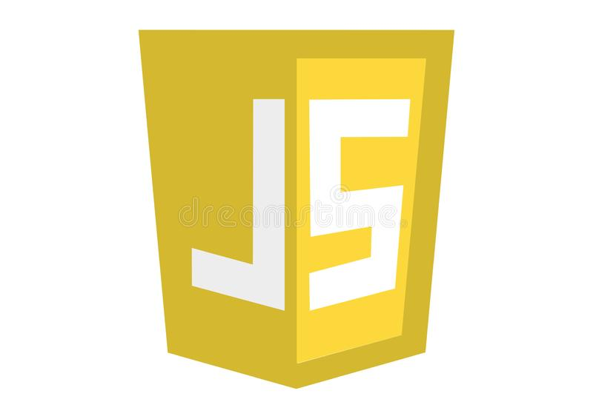

Slide 27
Syntax
Functions
Events
Cookies

Slide 28
Objects
RegExp
HTML DOM

Slide 29
Error Handling
Validations
Debugging
Browsers

Slide 30


Slide 31
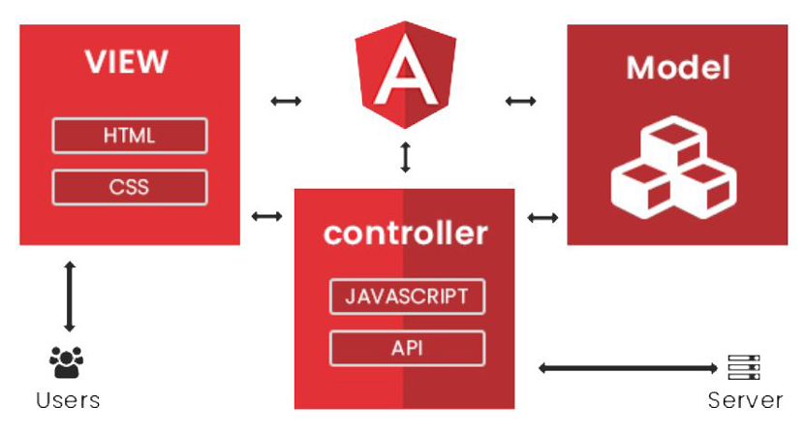

Slide 32
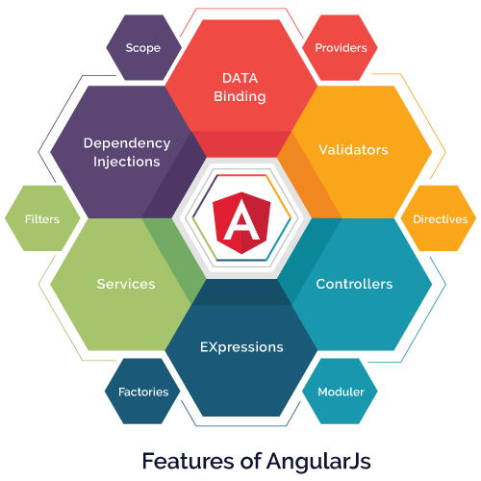

Slide 33
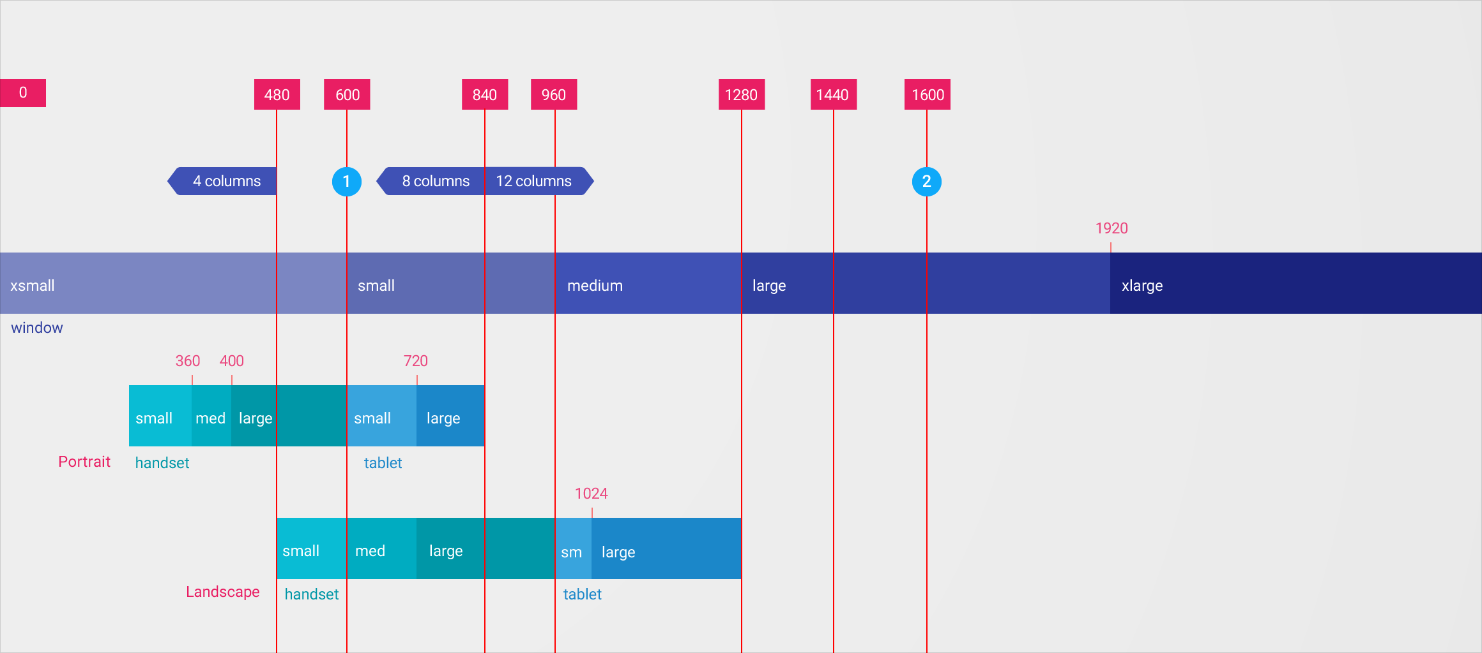
Angular Material

Slide 34


