Slide 1

JAVA TRAINING
Presenter: Thanh Bui
Mentor: Tan Le
<number>

Slide 2
<number>
Java Core:
Basic of java Programming
MAIN CONTENT
Java Core:
Object-Oriented Programming
Creation Patterns

Slide 3
3
OOD principles
MAIN CONTENT
Hibernate
Spring

Slide 4
4
JavaScript
MAIN CONTENT
Angular Js

Slide 5
<number>
JAVA CORE (Basic of Java Programming)
Objects, Object References
01
Static members and Instance members
Exceptions
05
02
Primitive Data Types and Wrapper classes
04
03
Comments

Slide 6
<number>
JAVA CORE (Basic of Java Programming)
Objects
An entity that has state and behavior is known as an object e.g., chair, bike, pen, car, etc.
Object References
Is an address that indicates where an object's variables and methods are stored.
Static members and Instance members
Variables and Methods declared using keyword static are called static members of a class.

Slide 7
<number>
JAVA CORE (Basic of Java Programming)
Primitive Data Types
Primitive Data Type is the type data that is provided by Java for us to use. In Java 8 there are the following types of databases: byte, short, int, long, char, boolean, float, and double.
Wrapper classes
Wrapper class in java provides mechanism to convert primitive data type to object type and from object to primitive data type.

Slide 8
<number>
JAVA CORE (Basic of Java Programming)
Exceptions
Exception is an event that interrupts the normal flow of the program. It is an object thrown at runtime.
Comments
Comments can be used to explain Java code, and to make it more readable.

Slide 9
<number>
JAVA CORE (Object – Oriented Programming)
01
02
Inheritance
Encapsulation
OOP
03
04
Abstraction
Polymorphism

Slide 10
<number>
JAVA CORE (Object – Oriented Programming)
Inheritance
Inheritance can be defined as the process where one class acquires the properties (methods and fields) of another. With the use of inheritance the information is made manageable in a hierarchical order.
Polymorphism
Polymorphism is the ability of an object to take on many forms. The most common use of polymorphism in OOP occurs when a parent class reference is used to refer to a child class object.

Slide 11
<number>
JAVA CORE (Object – Oriented Programming)
Encapsulation
Encapsulation in Java is a mechanism of wrapping the data (variables) and code acting on the data (methods) together as a single unit.
Abstraction
Abstract class: is a restricted class that cannot be used to create objects (to access it, it must be inherited from another class).

Slide 12
<number>
JAVA CORE (Object – Oriented Programming)
Overriding
Overriding occurs when a class exists, a method defined with the same name and the same number of parameters as the method of the parent class.
Overloading Methods
Method Overloading is a feature that allows a class to have more than one method having the same name, if their argument lists are different.

Slide 13
<number>
JAVA CORE (Object – Oriented Programming)
Equals()
Equals () is a built-in method. It is used to compare two objects
HashCode()
HashCode() is an integer value associated with every object in java, facilitating the hasing in hash tables.
List
Is an ordered collection that allows us to add and remove elements as an array.
Set
Is allows us to store elements in different sets similar to sets in math.
Map
Contains values on the bacsic of key, i.e key and value pair. Each key and value pair is known as an entry.
Queue
Is used when we want to store and access elements in the way First In, First Out.

Slide 14
<number>
JAVA CORE (Object – Oriented Programming)
Sorting a Collections
Layer Collections in java provide a static method to order collections of elements.
Generic
Generics is a Java feature that allows programmers to specify the type of data they want to work with a class, an interface, or a method.
Wildcards
Wildcards in Java are basically the question mark used in general programming, it basically represents the undefined type.

Slide 15
<number>
Creation Patterns
Singleton
Factory
Exercies

Slide 16
<number>
Creation Patterns
Singleton
Singleton makes sure that only one instance is created and it will give you a way for you to have unique access anytime, anywhere in your program.
Factory
Factory Design Pattern is used when we have a superclass with many subclasses and based on input, we need to return one of the subclasses.
Exercises

Slide 17
<number>
OOD principles
Single-Responsibility Principle
S
O
Open-Closed Principle
L
Liskov Substitution Principle
I
Interface Segregation Principle
D
Dependency Inversion Principle

Slide 18
<number>
Hibernate
Hibernate
Is a high-performance Object/Relational persistence and query service
ORM
Object-relational mapping in computer science is a programming technique for converting data between incompatible type systems using object-oriented programming languages.

Slide 19
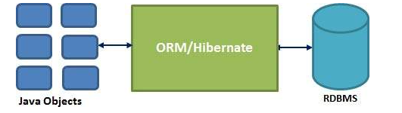
<number>
Hibernate

Slide 20
<number>
Hibernate
Association
Modeling relationships between 2 tables in the database into attributes in Entity class.
Collection
An entity or class has a set of values ​​in a particular Collection variable, then we can map those values ​​using any one of the interface collections available in java.
Component
Is used to map all the Address entity fields to the table.
Inheritance
Can use polymorphic queries for retrieving all the sub-class entities when querying for a super-class.

Slide 21
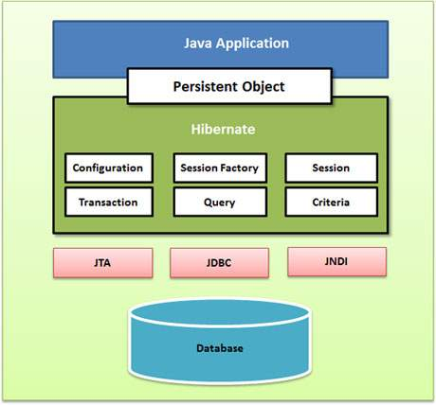
<number>
Hibernate

Slide 22

<number>
Spring

Slide 23
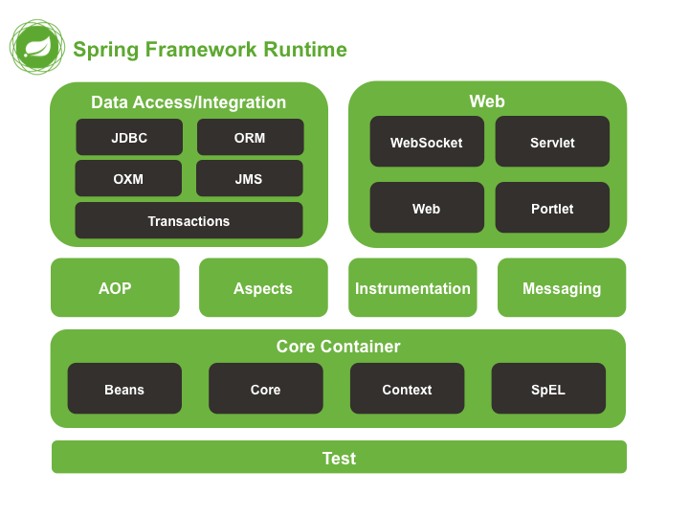
<number>
Spring

Slide 24
<number>
Spring
Aspect
Proxy
Join point
AOP
Weaving
Advice
Target Object
Pointcut

Slide 25
<number>
JavaScript
Syntax
Most are borrowed from Java, but JS is also influenced by syntax of other programs
Functions
Is a block of code designed to perform a particular task.
Cookies
Is data, stored in small text files, on your computer.
Events
Is an indispensable component in the program structure.
Debugging
Set any breakpoints, and examine variables while the code is executing.

Slide 26
<number>
JavaScript
Objects
Is an independent entity, with properties and types
RegExp
Is a sequence of characters that forms a search pattern.
HTML DOM
Model of the objects in the HTML document.
Error Handling
JavaScript catches adddlert as an error , and executed the catch code to handle it.
Validations
Provides a way to validate form’s data on the client before sending it to the server.

Slide 27
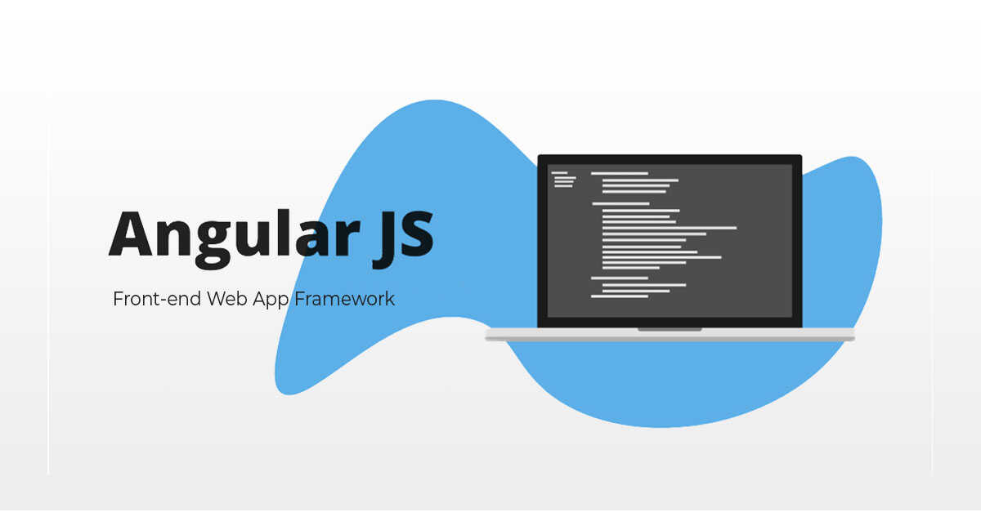
<number>
Angular Js

Slide 28
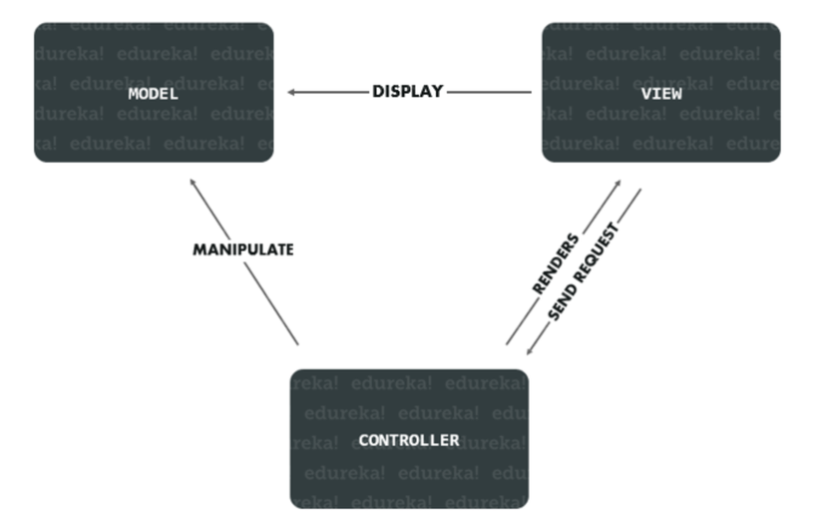
<number>
Angular Js

Slide 29
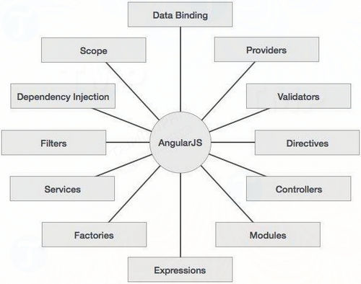
<number>
Angular Js

Slide 30
<number>
THANK YOU
END

