Slide 1
Database Project Report
Phạm Hữu An - 20176676

Slide 2
Purpose
Use database to statistical English Premier League 2018-2019 result
Create next season Fixture
Predict the score
Bonus: Create Minesweeper Game

Slide 3
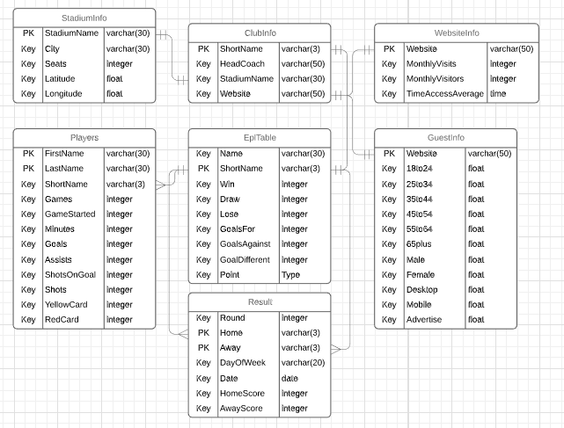
Entity Relationship Model

Slide 4
Tables
Include 7 tables
EplTable
Players
ClubInfo
StadiumInfo
WebsiteInfo
GuestInfo
Result

Slide 5
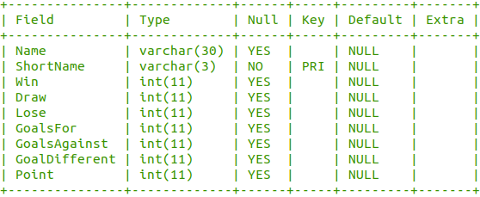
EplTable

Slide 6
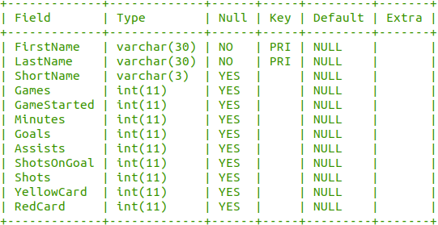
Players

Slide 7
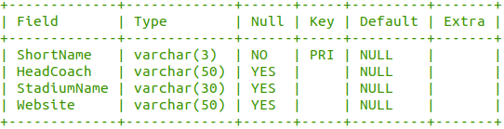
ClubInfo

Slide 8
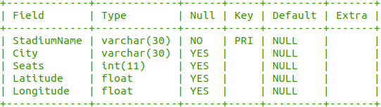
StadiumInfo

Slide 9
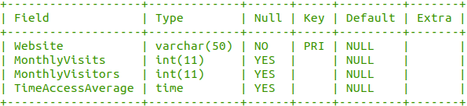
WebsiteInfo

Slide 10
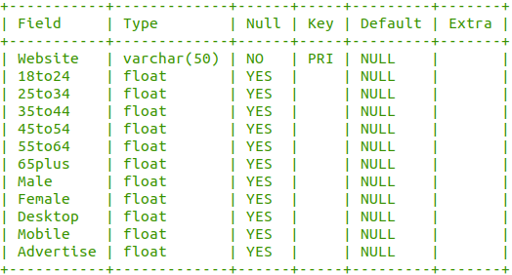
GuestInfo

Slide 11
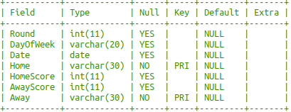
Result

Slide 12
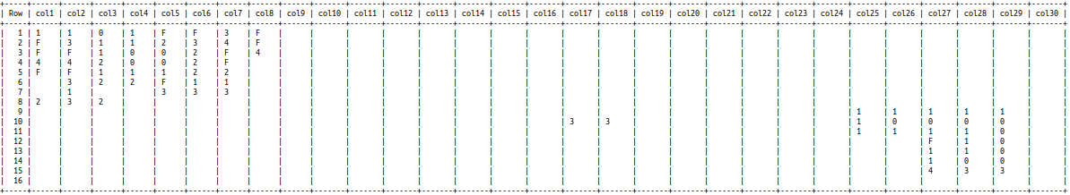
Bonus: Game Minesweeper
Use table to save numbers and bombs
Size 16 Rows x 30 Columns, 99 Bombs

