Slide 1

2nd MECOP INTERNSHIP
JACOBS ENGINEERING
Kevin Pham - Software Intern
Summer - Fall 2019
Electronics Group (PDX)

Slide 2
Safety Moment
Walking on Campus
Don’t be glued to your phone screens!
Stay on the right side of the walkway
Keeps the flow of traffic moving without issues
When crossing the road, always check both sides
Especially since on campus, bikers tend to just go without stopping

Slide 3
What is Jacobs Engineering?
Engineering Design Consultant
Industry-leading
Advanced sciences
Digital technologies
Big data analytics
Program and construction management disciplines
Operations and facilities management services
Jacobs is a safe & caring culture
Safety is a top priority at Jacobs as well as your voice to be heard

Slide 4
Company History
1947: Founded by Dr. Joseph J. Jacobs
1970: Jacobs initiated its IPO
1983: US President Ronald Reagan presented Dr. Jacobs with the Hoover Medal for outstanding extra-career to humanity
1989: Jacobs is listed on the NYSE
1991: Reached $1 billion annual revenue
1997: Employed 15,000 people
1999: Fortune Magazine named Jacobs the “Most Admired E&C Company”
2010: Forbes Magazine names Jacobs as one of America’s “100 Most Trustworthy Companies”
2015: Steve Demetriou appointed Jacobs CEO
2017: Acquired CH2M to set a new benchmark in the professional services sector
2018: ENR ranked Jacobs as the #1 “Global Design Firm”
Notes:
2019: Divestiture of ECR further transforming Jacobs portfolio

Slide 5
Organizational Reporting Structure
Terry Wheeler
(Electronics Dept. Manager)
Gary Mays
(Engineering Manager)
PDX
Kat Valentine (Mentor)
John Beaudry
(I&C Manager)
Kevin Pham
(Intern)

Slide 6
Work Environment
Flexible Work Hours
Competitive Pay
Paid Sick Time, No Vacation/ Paid Time Off
Business Casual Attire
Lunch & Learn
Opportunities for interns to learn about other employees and what they do for the company and what sorts of ways different disciplines work together
Culture of learning & openness to new ideas and tasks
Field trips to sites that the company is working with

Slide 7

Project: QuickBase
Cloud database software platform
Lots of functionality; show data, graphs, forms, color-code cells, etc
Worked on many small projects
Setting up, making changes to tables that company employees and some clients use
Given the opportunity to see other disciplines make use of the databases
Specific Project works
Designer Review Comments
Package Information for I&C Team

Slide 8
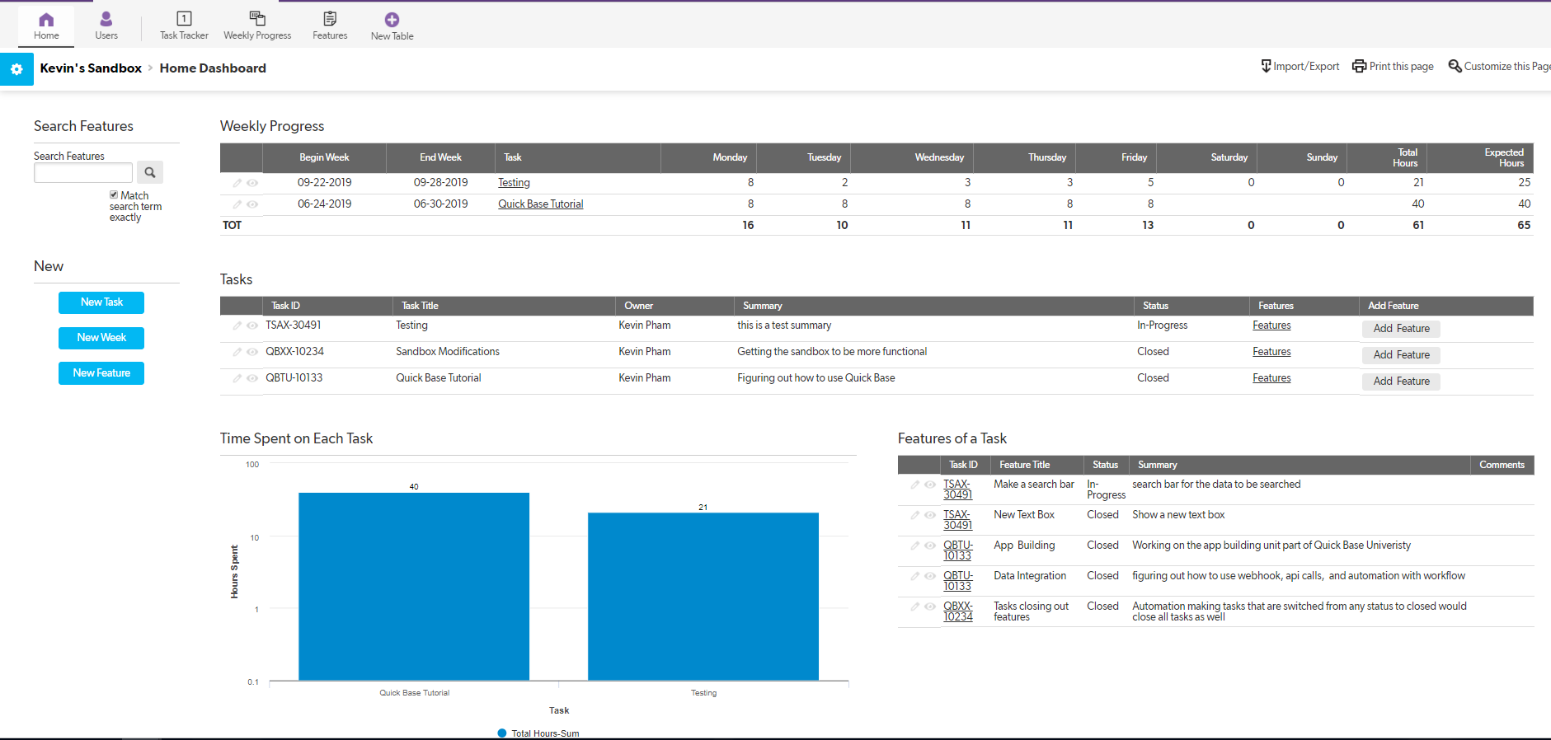

Slide 9
Project: Secure Access Tool
Requires all employees who are working on projects to sign NDAs (confidential information agreement)
Not to share the project with anyone except the clients and those working on that SPECIFIC project
Keeping track of employees and their accesses to projects
Helps with managements and visually see what accesses each employee has on a specific project
Allow Project Managers to assign accesses to each user for the projects
Shows project names, user (and their roles), who’s assigned to which projects, and the tools needed for each project

Slide 10
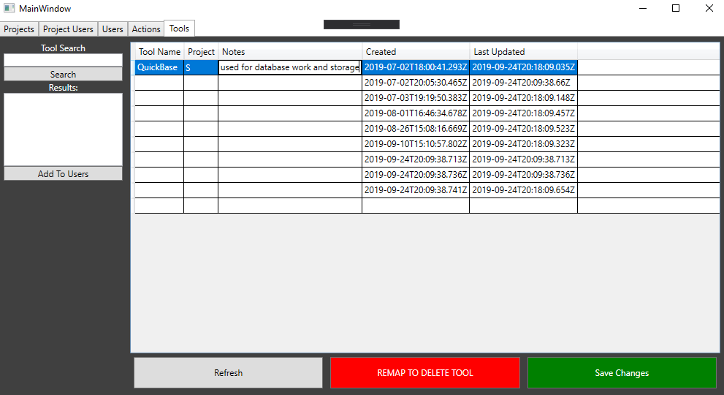

Slide 11
What I learned
Learning how to use QuickBase
Similar to SQL but a lot less code-based, deals with a lot of data
How to communicate and work with other employees
Given the opportunity to find creative solutions
Will be given tasks without step to step guides
Use engineering judgement skills to make good decisions in projects
Always ask for help and clarifications when stuck

Slide 12
Helpful Courses
Database (CS 340)
SQL understanding and structures of database
Software Engineering I & II (CS 361, 362)
How to communicate with others & breakdown tasks
Usability Engineering (CS 352)
Inclusive Design HCI (CS 468)
Helps with understanding how to design user-interface better and visually

Slide 13
Internship Experience Comparison
Fiserv
Software Development Company
Company internal projects
Projects that did not affect anyone using them, offline projects
Work with the same group in the office
Onboarding Process was online
Jacobs
Multiple Engineering Disciplines
Dealing with projects that assist other employees and work for clients
Get to see your work being utilized in real-time
Provides more opportunity to connect & work with different groups
Not everyone you work with is in the same office
Onboarding Process

Slide 14
Questions?

