Slide 1
FInal PRoposal
MSA30DN-IAD591

Slide 2
Smart AC Control System

Slide 3
Nhóm 2
Giảng viên: Nguyen The Nghia.
Thành viên:
  Nguyen Kim Thinh - 25MSA33051
  Nguyen Tran Quang Manh - 25MSA33060
  Pham Manh Dung - 25MSA33050

Slide 4
Problem Identification
Traditional air conditioning units often operate at constant settings regardless of actual occupancy or environmental changes, leading to significant energy waste and user discomfort
Expected Outcomes: Tracking power consumption and enhanced user convenience through automated cooling and remote monitoring.
Stakeholder: Homeowners ensuring immediate comfort regardless of their position in the room.

Slide 5
Features
Real-time Environmental Monitoring: Continuous tracking of ambient temperature and humidity levels using DHT sensors.
Intelligent Occupancy-Based Airflow: Utilizing PIR sensors to detect user presence and automatically adjusting the SG90 Servo to direct the air vent toward the occupant.
Automated Climate Logic: Dynamic adjustment of cooling intensity based on real-time environmental data to maintain optimal comfort.
Maintenance Alerts: notifications via Telegram or Firebase for temperature change.
Energy Saving (Auto-Off): Automatically powering down the AC unit when no motion is detected for a specific duration to reduce electricity waste.

Slide 6

Edge Layer (Hardware)
Hardware: Controller: ESP32 for its integrated Wi-Fi and Bluetooth capabilities.
Sensors: DHT11 for temperature/humidity and a PIR sensor for motion detection.
Actuators: SG90 Servo to control the air vent direction and an IR Transmitter to send commands to the AC unit.
Visualize: Using LCD I2C 16x2 to visualize temperature/humidity.

Slide 7
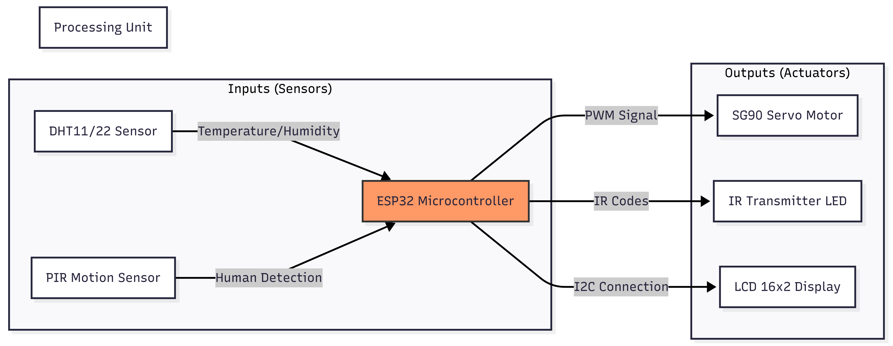

Slide 8
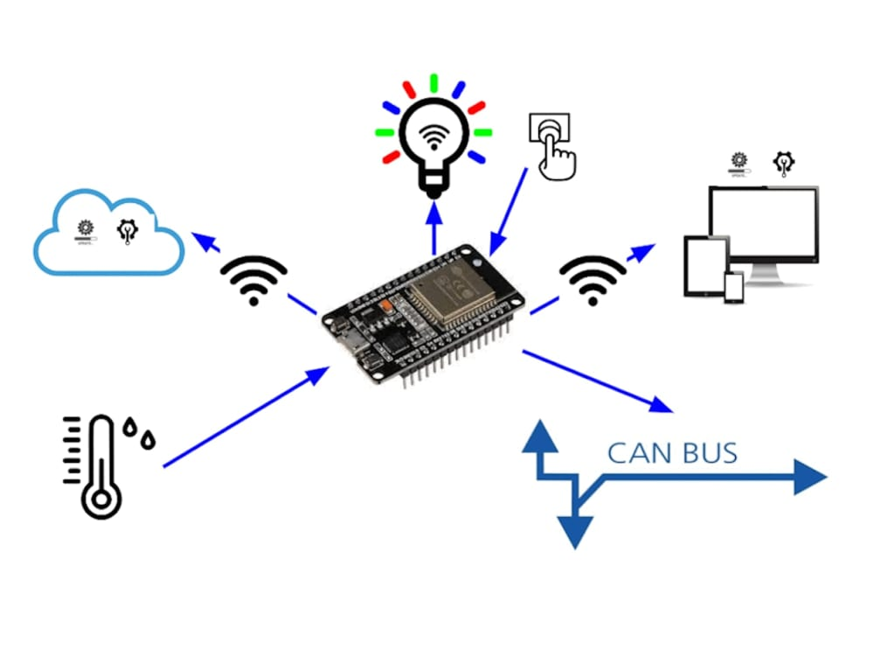
Communication & Cloud Layer
Hardware Integration: Utilize an LCD 16x2 with an I2C interface to provide a real-time local display of environmental data.
Data Representation: Implement a continuous monitoring display that visualizes precise ambient temperature (°C) and humidity (%) levels directly on the device.
User Feedback: Program the LCD to display system status updates, such as "AC ON/OFF" or "Human Detected," providing immediate feedback to the user without needing the web dashboard.

Slide 9
Application Layer (User Interface)
Real-time Environmental Visualization: Dynamic gauges and line charts displaying live temperature and humidity data retrieved from the DHT sensor.
Device Status & Control: Toggle switches to power the AC on/off and sliders to adjust the target temperature via RESTful APIs.
Push Notifications: Utilizing Firebase Cloud Messaging (FCM) or Telegram Bot API to send instant mobile alerts when motion is detected or when the AC is automatically shut down.
Technical:
  Data Communication: Integration with the backend via WebSockets for instant updates and RESTful APIs for command execution.
  Responsive Design: The UI is optimized for both desktop and mobile views to ensure accessibility from any device. Using Next.js with Windtail css.

Slide 10
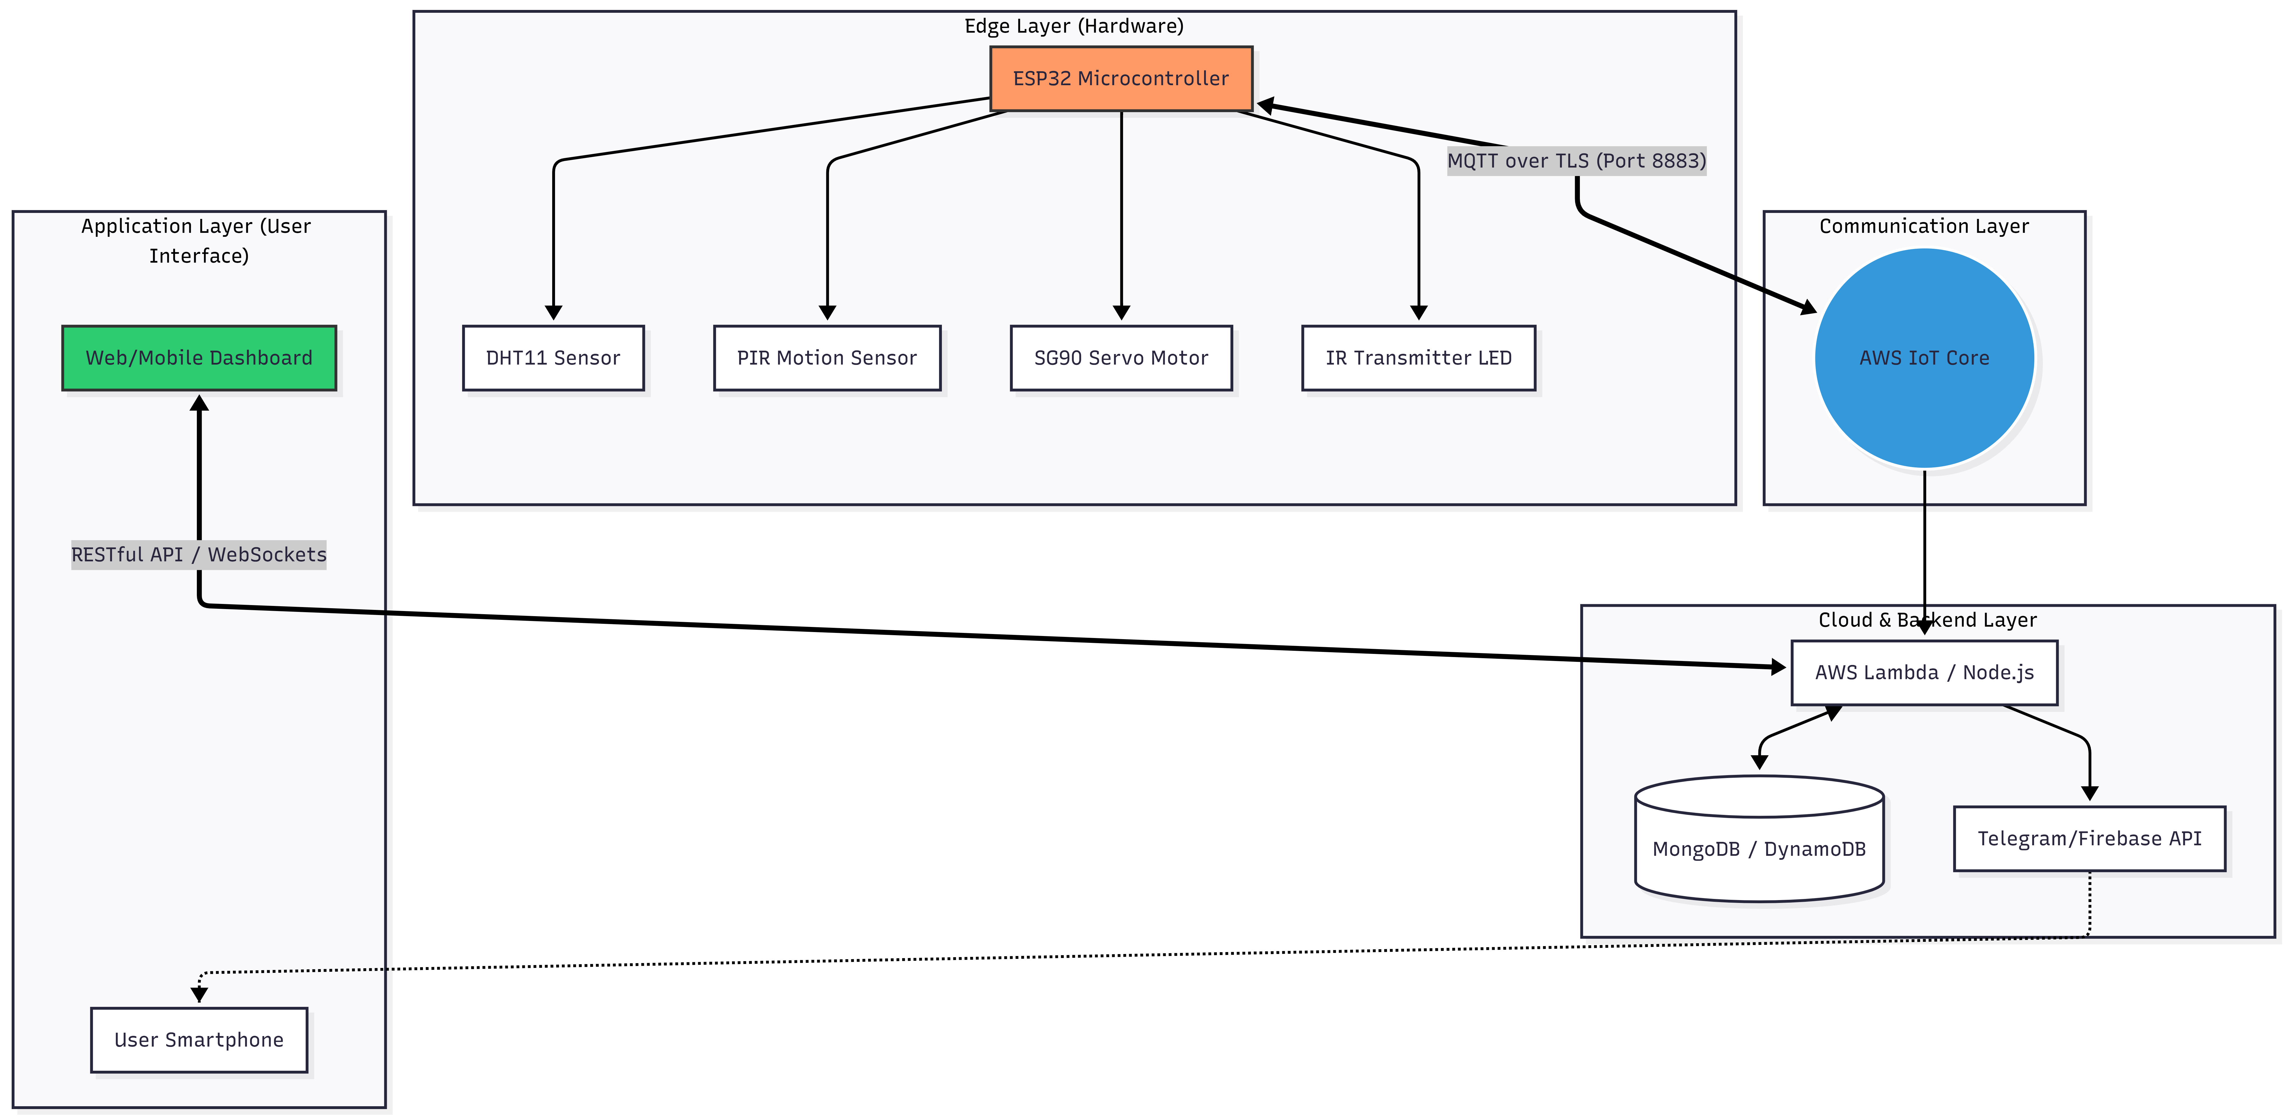

Slide 11
Work Breakdown
Hardware: Shared by Dũng, Thịnh, and Mạnh
Cloud & Infrastructure: Dũng
User Interface: Mạnh.
Server/Backend: Thịnh.

Slide 12
Thank you for listening

