Slide 1


Slide 2


-Life
Technology for Easy Life

Slide 3

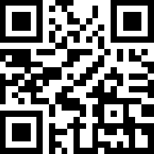
Phạm Minh Hải
General Manager
Số 7, An Dương Vương, TP.Đà Nẵng
Tel: 0511.3.951.315
Mobile: 0984.999.892
Email: PhamMinhHai8x@gmail.com
Website: www.Xlife.com.vn
Facebook: www.faceboook.com/Tech4EasyLife

Slide 4
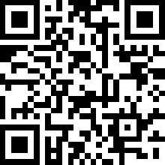
Hồ Viết Như Đạo
Senior Engineer
Số 7, An Dương Vương, TP.Đà Nẵng
Tel: 0511.3.951.315
Mobile: 0948.478.378
Email: NhuDao8x@gmail.com
Website: www.Xlife.com.vn
Facebook: www.faceboook.com/Tech4EasyLife

Slide 5
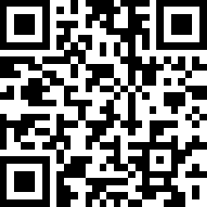
Trần Thanh Minh
Senior Technician
Số 7, An Dương Vương, TP.Đà Nẵng
Tel: 0511.3.951.315
Mobile: 0935.599.716
Email: MinhClear@gmail.com
Website: www.Xlife.com.vn
Facebook: www.faceboook.com/Tech4EasyLife

