Slide 1

RSA key cryptosystem

Slide 2

Part 1
Background Theory

Slide 3
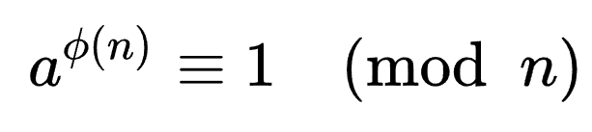
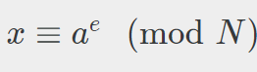
1
Euler’s Theorem
a, n is relative prime.
By this theorem, encryption can be performed by two prime.

Slide 4
1
Euler’s Theorem
N=pq
gcd(e,p-1)=gcd(e,q-1)=1
ed=1(mod (p-1)(q-1))

Slide 5
Part 2
Header

Slide 6
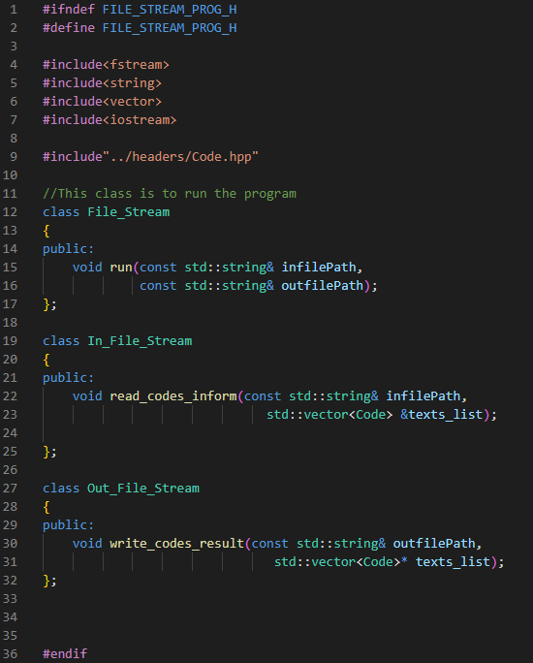
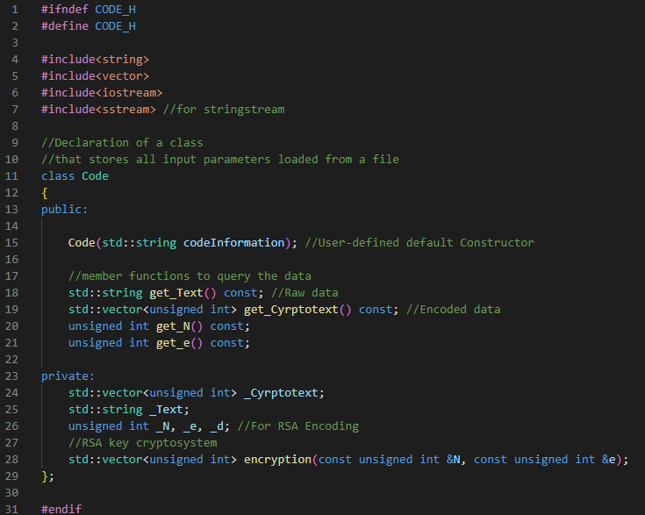
2
Header File
There is no special difference with class code.
(Except there is no get_d method.)

Slide 7
2
Header File
Member Instance
std::string _Text : Raw string to encrypt
std::vector<unsigned int> _Cyrptotext : Enecrypted string
unsigned int _N, _e, _d : Key for RSA algorithm
Member Function
std::vector<unsigned int> _encryption(const unsigned int &N, const unsigned int &e)
: Enecrypt from _Text to _Cryptotext

Slide 8
Part 3
Source Code

Slide 9
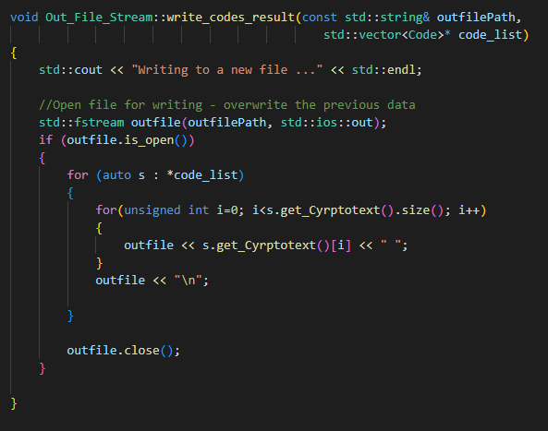
3
Source Code
To write the vector type data,
Loop was used when OFilestream.

Slide 10
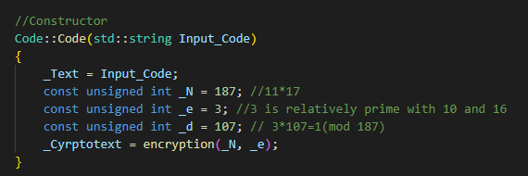
3
Source Code
Input data is not belong to stringstream.
To calculate fast, set e as 3.
In the real case, use more larger p and q.
This algorithm convert to the number between 0 and N.
Thus, N is larger than 128(ascii 7 bit).

Slide 11
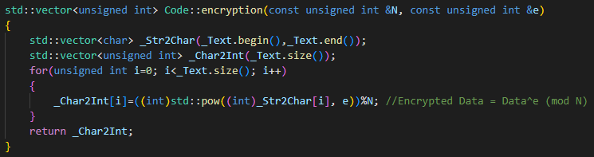
3
Source Code
Inverting string data to vector<char>,
then every character has each ascii code.
Using e=3, encrypting of ascii code is perform.

Slide 12
Part 4
Test case

Slide 13
4
Simple check
Hello World!
ABCDEFG
AaBbCcDd
!@#$%^&
183 118 80 80 100 43 76 100 130 80 111 33
109 77 67 85 137 42 180
109 113 77 21 67 143 85 111
33 157 52 93 163 117 81

Slide 14
4
Test result
Mod 187
A B C D E F G
X
65 66 67 68 69 70 71
X^2
111 55 1 136 86 38 179
X^3
109 77 67 85 137 42 180
109 77 67 85 137 42 180

Slide 15
4
Test result
Mod 187
A B C D E F G
X
65 66 67 68 69 70 71
X^2
111 55 1 136 86 38 179
X^3
109 77 67 85 137 42 180
109 77 67 85 137 42 180

Slide 16
4
Failure case
＃＆＊＠§※
52 18 6 52 18 25 52 18 53 52 18 64 13 124 31 156 153
When the character is not represented by ascii code,
(Unicode) Encrypt has the failure.

Slide 17
Part 4
Test case

Slide 18
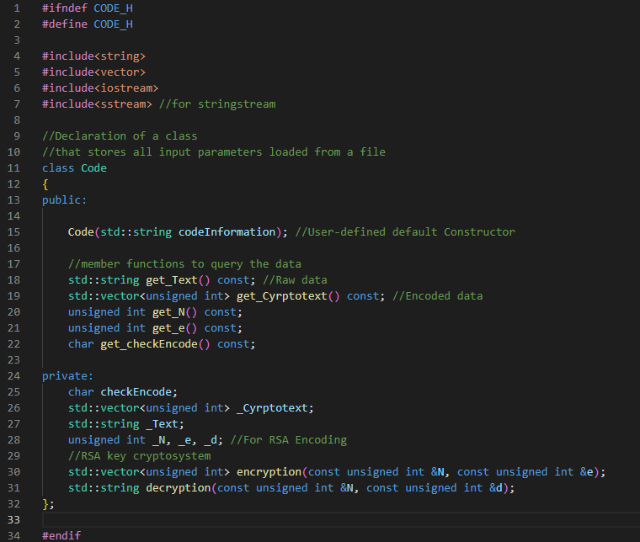
4
Failure code
At first, there are two type input,
-encoded data
-raw data
And they has information that whether it is cryptotext or not.
Since the size of cryptotext is varied,
there is difficulty in reading stringstream.

Slide 19

THANK YOU

