Slide 1

계산과학 이론 및 실습2
comparing the plurality representation system & the proportional representation system in political election
made by Jeongwoo Kim

Slide 2



Background – Korean assembly election results
Democratic Party
People Power Party
Justice Party
2016 | Ratio of votes | 25.5% | 33.5% | 7.2%
 | Seats | 123 | 122 | 6
2020 | Ratio of votes | 33.4 | 33.8% | 9.7%
 | Seats | 180 | 103 | 6

Slide 3
Background
the plurality representation system
: The candidate with the most votes in each constituency is elected.
=> It is known that there is a large discrepancy between the percentage of votes and the number of seats won. vs
the proportional representation system
: The number of votes in all constituencies is combined, and seats are allocated to political parties according to the proportion.
=> It is known that small parties can win seats more easily.

Slide 4
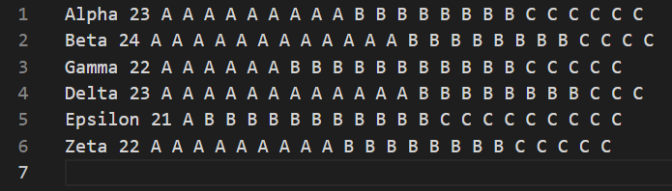
Input file

Slide 5
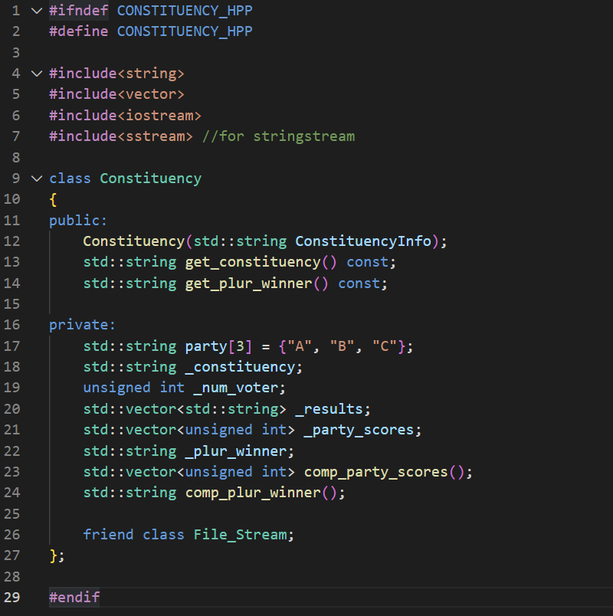
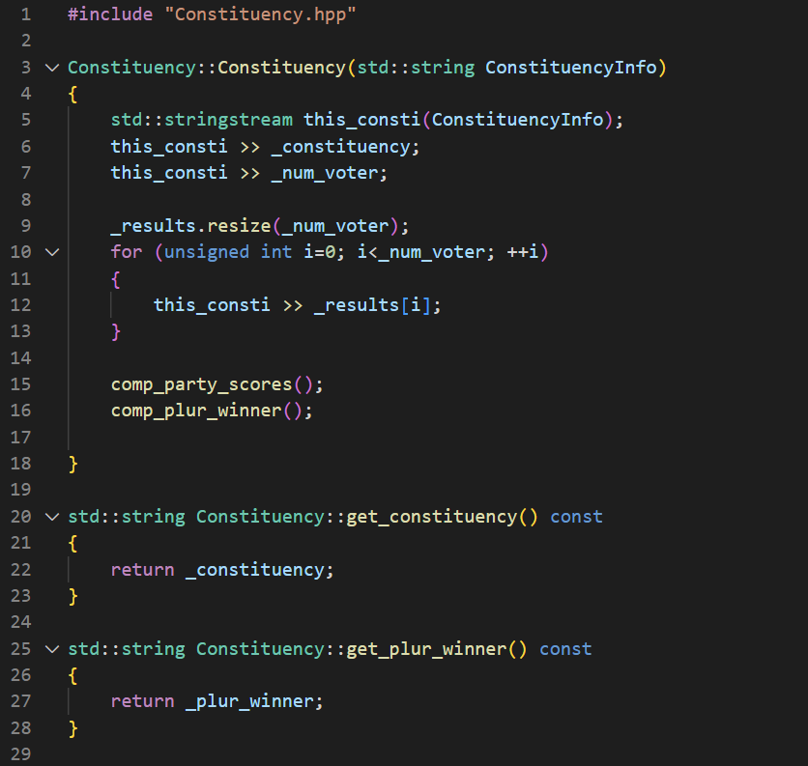
Program code: Constituency.hpp & .cpp

Slide 6
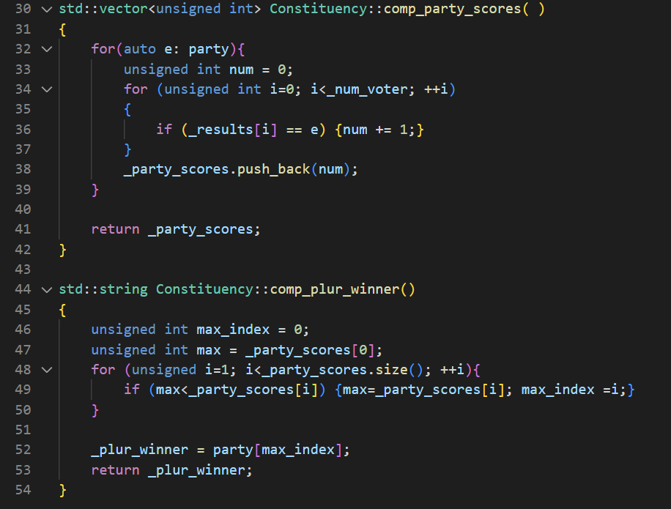
Program code: Constituency.hpp & .cpp

Slide 7
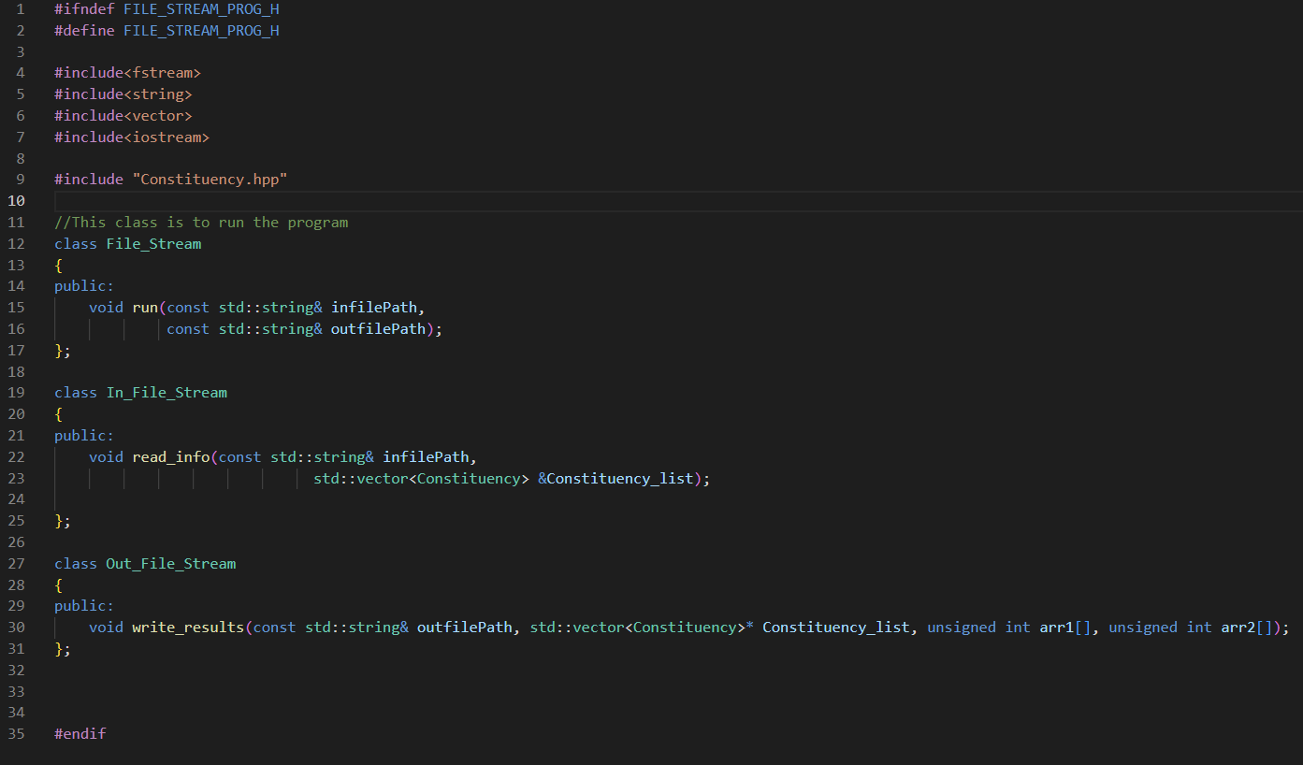
Program code: File_Stream_Prog.hpp & .cpp

Slide 8
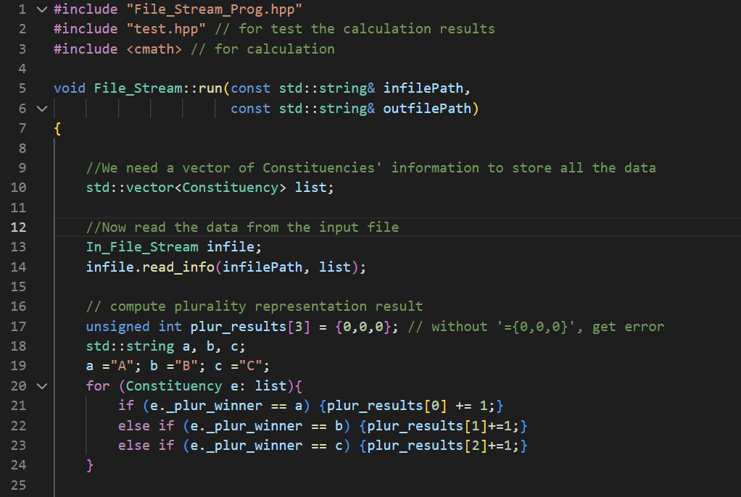
Program code: File_Stream_Prog.hpp & .cpp

Slide 9
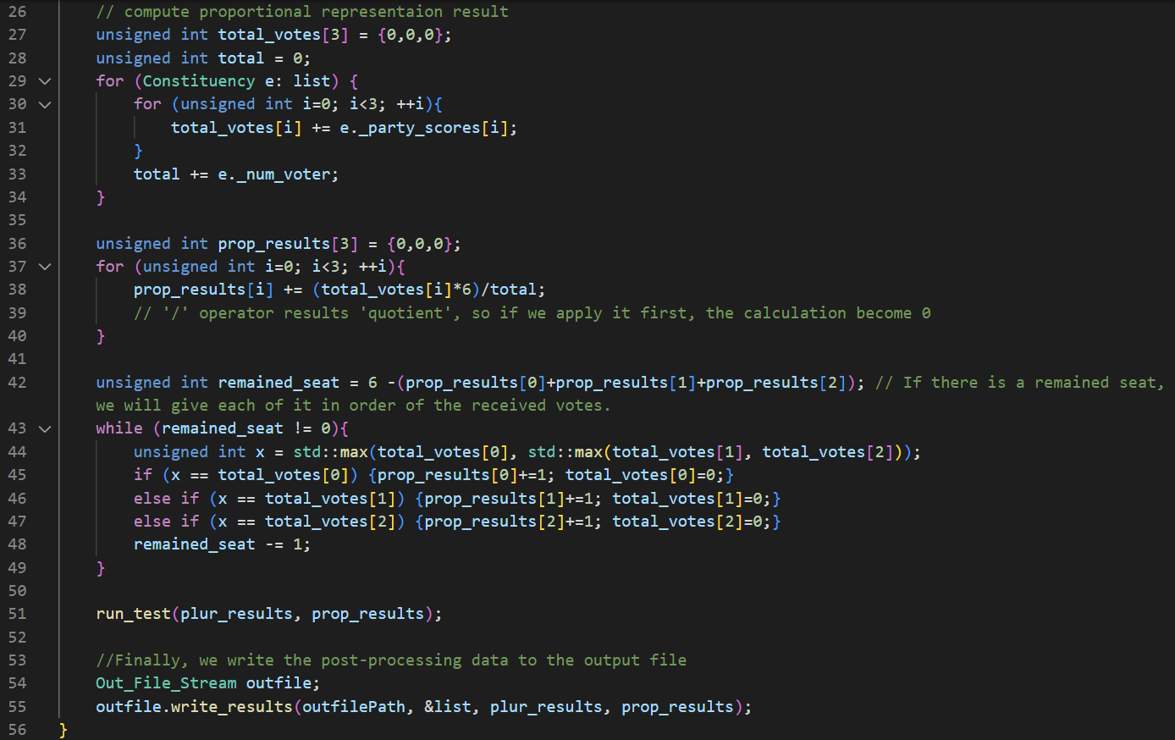
Program code: File_Stream_Prog.hpp & .cpp

Slide 10
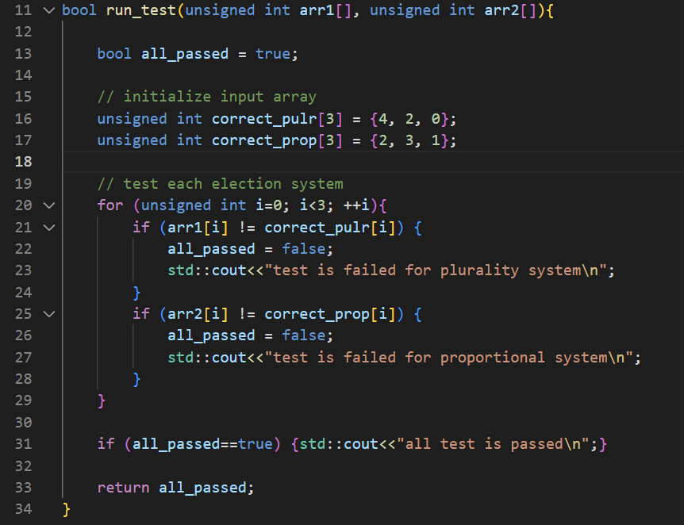
Program code: test.hpp

Slide 11
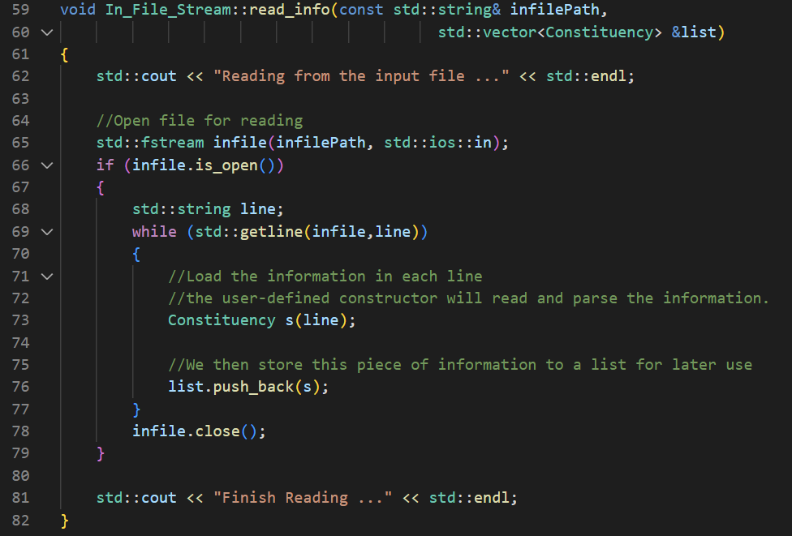
Program code: File_Stream_Prog.hpp & .cpp

Slide 12
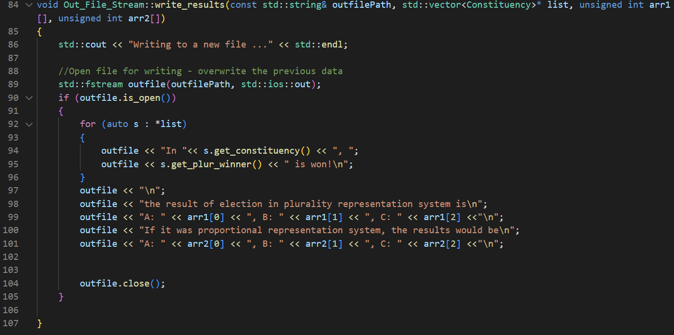
Program code: File_Stream_Prog.hpp & .cpp

Slide 13
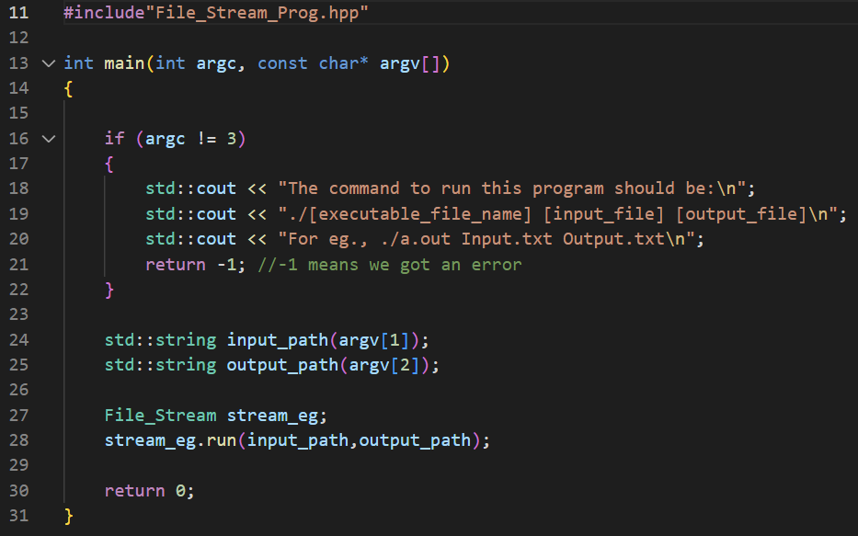
Program code: main.cpp

Slide 14
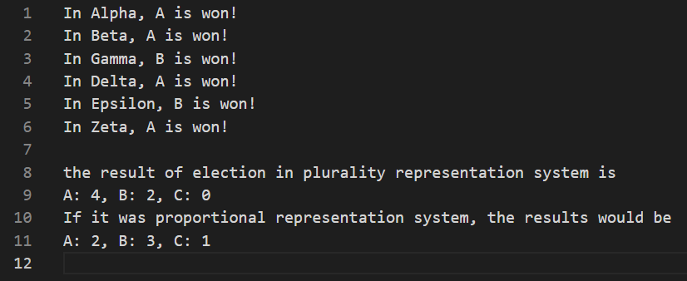
Output file

Slide 15
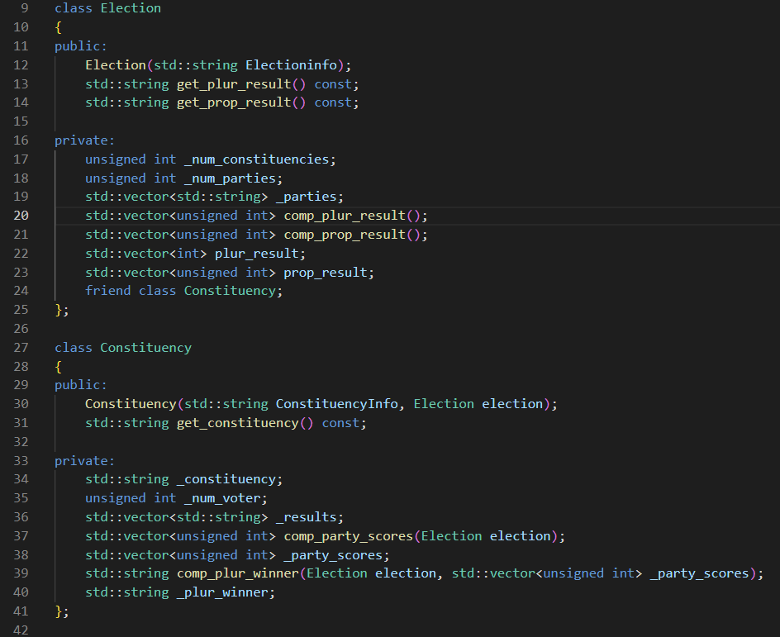
My failures
At first, I tried to create two classes and put election information into the Election class.
However, the calculation between the two classes was so complicated that I quit.

Slide 16
계산과학 이론 및 실습2
THANK
YOU
made by Jeongwoo Kim

