Slide 1

BOSTON HOUSING PRICES
Pham Quang Hieu | 20194432
Nguyen Vu Thien Trang | 20194459
Nguyen Van Thanh Tung | 20190090

Slide 2



CONTENTS
PROBLEM STATEMENT
APPROACHES
DISCUSSION
Problem and Data set discription
Algorithms and approaches introduction
Q&A

Slide 3

PROBLEM STATEMENT
crim: crime rate
zn: residential land zoned
indus: non-retail business acres
chas: river dummy variables
nox: n₂o concentration
rm: rooms
age: owner-occupied
dis: distances to centres
rad: accessibility to highways
tax: tax rate
ptratio: pupil-teacher ratio
black: proportion of blacks
lstat: lower status

Slide 4
crim: crime rate
zn: residential land zoned
indus: non-retail business acres
chas: river dummy variables
nox: n2o concentration
rm: rooms
age: owner-occupied
medv median value of owner-occupied homes in \$1000s.
dis: distances to centres
rad: accessibility to highways
tax: tax rate
ptratio: pupil-teacher ratio
black: proportion of blacks
lstat: lower status

Slide 5




PROJECT PROCESS
Data collection
Data Preparation
Choosing a model
Training the model
Model evaluation
Hyperparameter Tunning
Prediction

Slide 6

EVALUATION METRIC
R² =1 - $\frac{\text{SS}\text{res}}{\text{S}\text{tot} }$
SS_{tot} = $\sum_{i}{{\left(\overline{y}−y_{i}\right)}^{2}}$: sum of square total
SS_{res}= $\sum_{i}{{\left(y_{i}−f_{i}\right)}^{2}}$: sum of square residual

Slide 7
TREE-BASED ALGORITHMS
XGBoost
Decision Tree
Random Forest

Slide 8
TREE-BASED ALGORITHMS
RM <= 6.9
MEDV = 22.5
Decision Tree
RM <= 5.9
MEDV = 20.0
RM <= 7.4
MEDV = 36.7

Slide 9
TREE-BASED ALGORITHMS
Random Forest

Slide 10
TREE-BASED ALGORITHMS
Initial guess
XGBoost
+
Learning rate x
+
Learning rate x

Slide 11

TREE-BASED ALGORITHMS
RM <= 6.95,
20.6, 21.4, 23.7, 25
XGBoost
MEDV =
20.6, 21.4, 23.7
MEDV =
25
Sum of Residuals, Squared
Similarity Score =
Number of Residuals + $λ$
Initial guess = 0.5

Slide 12
TREE-BASED ALGORITHMS
RM <= 6.95,
20.6, 21.4, 23.7, 25
XGBoost
MEDV =
20.6, 21.4, 23.7
MEDV =
25
((20.6-0.5) + (21.4-0.5) + (23.7-0.5) + (24.5-0.5)) ²
Similarity Score =
= 1967
4
Initial guess = 0.5

Slide 13
TREE-BASED ALGORITHMS
RM <= 6.95,
20.6, 21.4, 23.7, 25
XGBoost
1967
MEDV =
20.6, 21.4, 23.7
MEDV =
25
1374
625
Gain = Left _{similarity} + Right _{similarity} – Root _{similarity}

Slide 14
TREE-BASED ALGORITHMS
RM <= 6.95,
20.6, 21.4, 23.7, 25
XGBoost
1967
MEDV =
20.6, 21.4, 23.7
MEDV =
25
1374
625
Gain = 32

Slide 15
TREE-BASED ALGORITHMS
23.7
25
22
21.4
XGBoost
20.6
threshold
((20.6-22) + (20.9-22))²
Similarity Score =
= 2
2

Slide 16
TREE-BASED ALGORITHMS
23.7
25
x
22
x
x
21.4
XGBoost
20.6
threshold
((20.6-22) + (21.4-22) + (23.7 -22))²
Similarity Score =
3
((-1.4) + (-0.6) + (1.3))²
=
= 0.16
3

Slide 17
TRAINING
XGBoost
TRAINING
TRAINING
TRAINING
Training score: 0.97
Testing score: 0.89
Random Forest
Decision Tree
Training score: 0.97
Testing score: 0.88
Training score: 1.00
Testing score: 0.72
Create baseline

Slide 18
TRAINING
TRAINING
TRAINING
Decision Tree
Random Forest
XGBoost
RM | 0.55
LSTAT | 0.21
DIS | 0.08
CRIM | 0.08
TAX | 0.03
AGE | 0.02
NOX | 0.01
PTRATIO | 0.009
INDUS | 0.008
B | 0.006
RAD | 0.004
ZN | 0.001
CHAS | 0.001
RM | 0.47
LSTAT | 0.32
DIS | 0.06
CRIM | 0.05
NOX | 0.03
AGE | 0.02
TAX | 0.01
PTRATIO | 0.01
B | 0.01
INDUS | 0.006
RAD | 0.003
ZN | 0.001
CHAS | 0.001
LSTAT | 0.38
RM | 0.32
NOX | 0.08
DIS | 0.05
PTRATIO | 0.04
TAX | 0.03
CRIM | 0.03
B | 0.02
AGE | 0.02
CHAS | 0.01
RAD | 0.008
INDUS | 0.008
ZN | 0.004
Feature Selection
Create baseline

Slide 19
TRAINING
TRAINING
XGBOOST
learning_rate
gamma
max_depth
0.09
0.0
5
RANDOM FOREST
Tunning
n_estimators
max_features
min_samples_leaf
710
0.5
Feature Selection
1
DECISION TREE
max_depth
5
Create baseline

Slide 20
TRAINING
Training score: 0.97
Testing score: 0.89
XGBoost
Training score: 0.97
Testing score: 0.88
Training score: 0.98
Testing score: 0.91
Training score: 1.00
Testing score: 0.72
Random Forest
Final
Decision Tree
Training score: 0.98
Testing score: 0.90
Tunning
Training score: 0.91
Testing score: 0.85
Feature Selection
Create baseline

Slide 21
2ND ROUND
PHASE 1
PHASE 2
PHASE 3
PHASE 4
Data Process
K-means
Ridge Regression
KNN

Slide 22
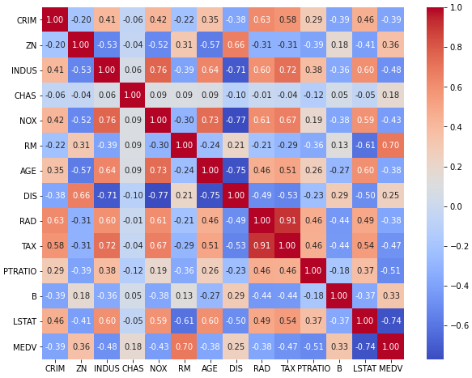

Slide 23
Hypothesis
CHAS = 1, higher RAD
CHAS = 0, lower RAD

Slide 24
Hypothesis
3.0
1.3
y_{i} = y_{ioriginal} $×$(100% + $\frac{\text{p}\text{1} × \text{x}\text{i}\text{[}\text{′}\text{CHAS}\text{′}\text{]}}{\text{100}}$ + $\frac{\text{p}\text{2}× \text{x}\text{i}\text{[}\text{′}\text{RAD}\text{′}\text{]}}{\text{100}}$)

Slide 25
APPROACH 2
APPROACH 2
K-means
Regression
KNN

Slide 26
APPROACH 2
K-means

Slide 27

APPROACH 2
Ridge Regression
$L\left(y_{i},x_{i},ω\right)= \sum_{ⅈ=1}^{N}{{\left(yⅈ−ωx_{i}\right)}^{2}}$ + $λ\sum_{j=1}^{m}{w_{j}^{2}}$
0.01
Regression

Slide 28
APPROACH 2
Training score:
0.87
Testing score:
0.86
K-means
Regression
KNN

Slide 29
THANKS FOR YOUR ATTENDING!
Pham Quang Hieu | 20194432
Nguyen Vu Thien Trang | 20194459
Nguyen Van Thanh Tung | 20190090

