Slide 1
SUBSTRUCTURE DISCOVERY IN REAL WORLD SPATIO-TEMPORAL DOMAINS
Jesus A. Gonzalez
Supervisor: Dr. Lawrence B. Holder
Committee: Dr. Diane J. Cook
Dr. Lynn Peterson

Slide 2
OUTLINE
Motivation and Goal.
Knowledge Discovery with Subdue.
Application to two Real-World Relational Databases.
Comparison of Subdue with ILP Systems.
Conclusion and Future Work.

Slide 3
MOTIVATION AND GOAL
Need to analyze large amounts of information in real world databases.
Information that standard tools can not detect.
Aviation Safety Reporting System Database.
Earthquake Database.
Previous knowledge: Spatio-Temporal relations.

Slide 4
THE KDD PROCESS
DATA
SELECTION
DATA
SPECIFIC
COLLECTION
PREPARATION
DOMAIN
DATA
DATA
SET
CLEAN,
PREPARED
DATA
DATA
TRANSFORMATION
DATA
PATTERN
MINING
KNOWLEDGE
KNOWLEDGE
EVALUATION
APPLICATION
SUBDUE
FOUND
PATTERNS
FORMATTED AND
STRUCTURED
DATA

Slide 5
SUBDUE KNOWLEDGE DISCOVERY SYSTEM
SUBDUE discovers patterns (substructures) in structural data sets.
SUBDUE represents data as a labeled graph.
Inputs: Vertices and Edges.
Outputs: Discovered patterns and instances.

Slide 6
EXAMPLE
Vertices: objects or attributes
Edges: relationships
shape
triangle
object
on
shape
square
object
4 instances of

Slide 7
SUBDUE’S SEARCH
Starts with a single vertex and expand by one edge.
Computationally Constrained Beam Search.
Space is all Sub-graphs of Input Graph.
Guided by Compression Heuristics.

Slide 8
EVALUATION CRITERION
Minimum Encoding.
Graph Compression.
Substructure Size (Tried but did not work).
Notes:
ME: Based in the MDL principle.
GS: Based in # vertices of the compressed graph.
SS: Based in the size of the substructures.

Slide 9
EVALUATION CRITERION
MINIMUM DESCRIPTION LENGTH
Minimum Description Length (MDL) principle. The best theory to describe a set of data is the one that minimizes the DL of the entire data set.
DL of the graph: the number of bits necessary to completely describe the graph.
Search for the substructure that results in the maximum compression.

Slide 10
THE ASRS DATABASE
The Aviation Safety Reporting System (ASRS).
Reports of incidents that might affect the aviation safety.
Some fields modified or omitted to keep the pilot’s identity confidential.
72,504 records, with 74 fields each.

Slide 11
THE ASRS DATABASE KNOWLEDGE REPRESENTATION
Acft
_type
Small_Transport
Detectors
ATC
EVENT 1
Detectors
Cockpit
Detectors
Num
_engine
Others
2.000000
Near_in_distance
Surface
Land_Plane
EVENT 2
EVENT m

Slide 12
THE ASRS DATABASE
PRIOR KNOWLEDGE
Connections between events where related airports are near to each other.
An airport is near another airport if the distance between them is not more than 200 km.
Spatial relations represented with “near_in_distance” edges.

Slide 13
THE ASRS DATABASE
RESULTS
Data set:
  “CONSEQUENCES”: “ACFT_DAMAGED” or “INJURY”.
  “ACFT_TYPE”: “MED_LARGE_TRANSPORT”.
Graph:
  1,053 events, 42,723 vertices, 41,669 directed edges and 18,373 undirected edges.
  File size: 2,143,356 bytes.

Slide 14
THE ASRS DATABASE RESULTS
MINIMUM ENCODING HEURISTIC
Substructure 1 Found with the Minimum Encoding Heuristic with 374 instances.
2.000000
Crew_ size
Acft
_type
Med
_Large_Transport
2.000000
Crew_ size
Acft
_type
Med
_Large_Transport
IFR
Flt
_plan
Engine_
typ
Turbojet
Engine_
typ
Turbojet
Passenger
Mission
Lndg
_gear
Retractable
Lndg
_gear
Retractable
Operator
Event
Operator
Event
Role
Num
_engine
Num
_engine
Air_Carrier
2.000000
Air_Carrier
2.000000
Report_
typ
Report_
typ
Flight_Crew
Occ
Occ
Wings
Surface
Wings
Surface
Low_Wing
Land_Plane
Low_Wing
Land_Plane
Near_in_distance

Slide 15
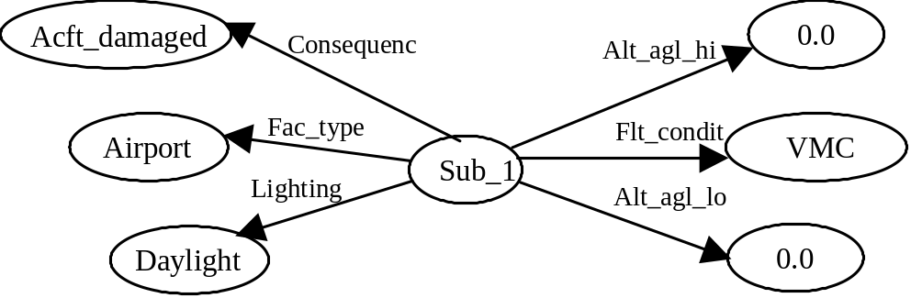
THE ASRS DATABASE RESULTS
MINIMUM ENCODING HEURISTIC
Substructure 3 Found with the Minimum Encoding Heuristic with 286 instances.
Notes:
Extension of some instances of Substructure 1.

Slide 16
THE ASRS DATABASE RESULTS
MINIMUM ENCODING HEURISTIC
Substructure 4 Found with the Minimum Encoding Heuristic with 67 instances.
Near_in_distance
Sub_2
Event
Notes:
Subdue found an event linked to a Sub_2 with a Near_in_distance edge.

Slide 17
THE ASRS DATABASE RESULTS
MINIMUM ENCODING HEURISTIC
Subdue was able to geographically relate incidents that occurred near to each other and with the same characteristics.
This information is valuable for investigating similar events in a particular region that might be caused for the same reason.

Slide 18
THE ASRS DATABASE RESULTS
GRAPH COMPRESSION HEURISTIC
Substructure 3: Problem happening in a region determined by the area where the substructures were found.
Substructure 3 interpretation:
  Two incidents that happened near to each other.
  If airplane identification and complete date and time.
  Might find and trace an airplane that failed near one airport, was reported and later had to land close to this first airport due to another failure.

Slide 19
THE EARTHQUAKE DATABASE
Several catalogs.
Sources like the National Geophysical Data Center.
Each record with 35 fields describing the earthquake characteristics.

Slide 20
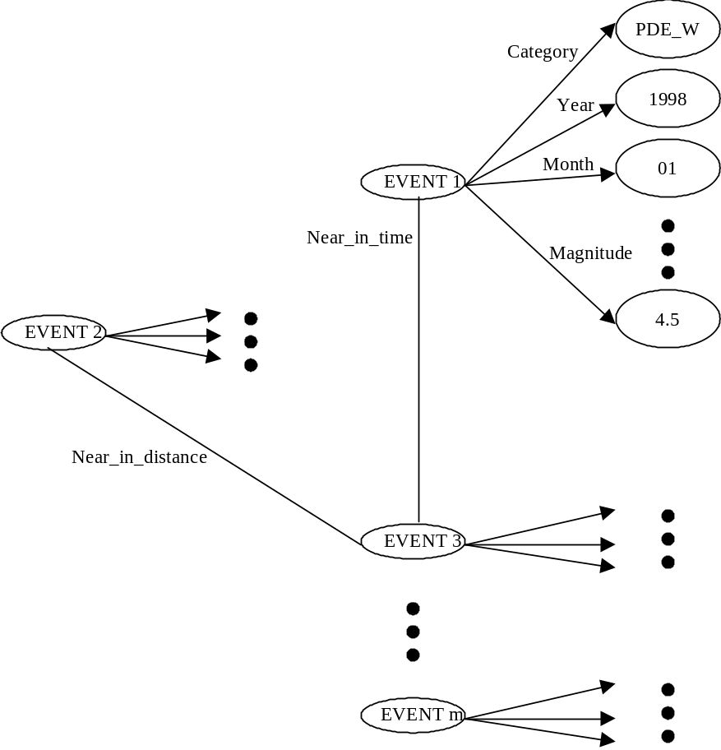
THE EARTHQUAKE DATABASE
KNOWLEDGE REPRESENTATION

Slide 21
THE EARTHQUAKE DATABASE
PRIOR KNOWLEDGE
Connections between events whose epicenters were close to each other in distance (<= 75 kilometers).
Connections between events that happened close to each other in time (<= 36 hours).
Spatio-Temporal relations represented with “near_in_distance” and “near_in_time” edges.

Slide 22
THE EARTHQUAKE DATABASE
RESULTS
Sample of the events that happened in one year.
All the fields in the records were considered.
Graph:
  10,135 events, 136,077 vertices, 125,941 directed edges and 757,417 undirected edges.
  Graph file size: 26,963,605 bytes.

Slide 23
THE EARTHQUAKE DB RESULTS
GRAPH COMPRESSION HEURISTIC
Substructure 8 Found with the Graph Compression Heuristic with 140 instances.
Near_in_time
Sub-1
Sub-7
Depth
33.0000

Slide 24
THE EARTHQUAKE DB RESULTS
Graph Compression works faster --> more iterations.
Given enough time MDL could find those substructures. MDL finds substructures using Spatio-Temporal relations.
Subdue found relations with fields like “Catalog”, “Month”, “Mag1 Scale”, and “Depth”.
More earthquakes happened in the months of May and June.
Most frequent earthquake depths were 33 and 10 kilometers.
Notes:
MDL Heuristic finds structures using spatio-temporal relations.
Given enough time, MDL could find the same or similar patterns.

Slide 25
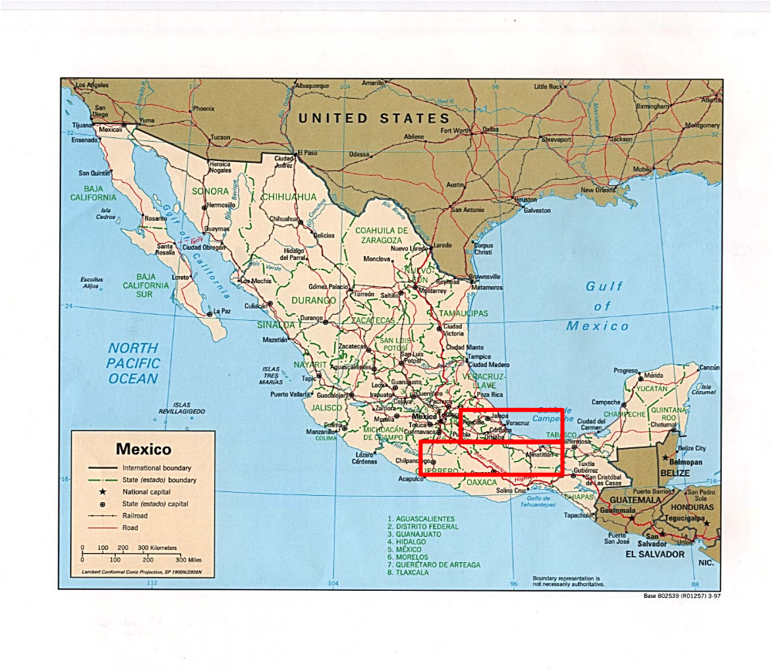
DETERMINING EARTHQUAKE ACTIVITY
Geologist Dr. Burke Burkart.
Study of seismology caused by the Orizaba Fault.

Slide 26
DETERMINING EARTHQUAKE ACTIVITY
Geologist Dr. Burke Burkart.
Study of seismology caused by the Orizaba Fault.
Fault: A fracture in a surface where a displacement of rocks also happened.
Selection of the area of study, two squares:
  First Longitude 94.0W through 101.0W and Latitude 17.0N through 18.0N.
  Second Longitude 94.0W through 98.0W and Latitude 18.0N through 19.0N.

Slide 27
DETERMINING EARTHQUAKE ACTIVITY
Divide the area in 44 rectangles of one half of a degree in both longitude and latitude.
Sample the earthquake activity in each sub-area.
Run Subdue in each sub-area.

Slide 28
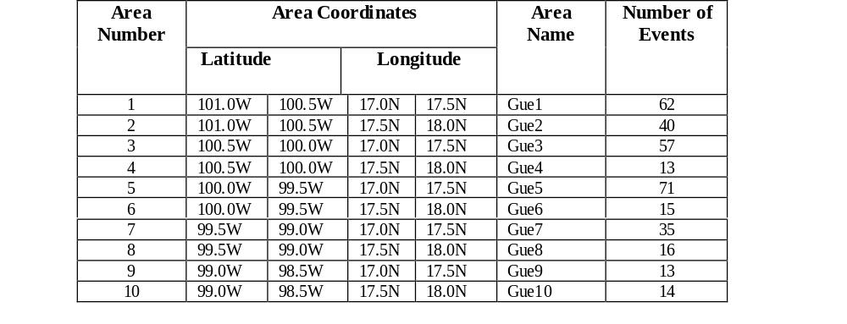
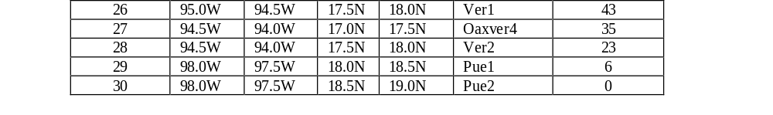

DETERMINING EARTHQUAKE ACTIVITY

Slide 29
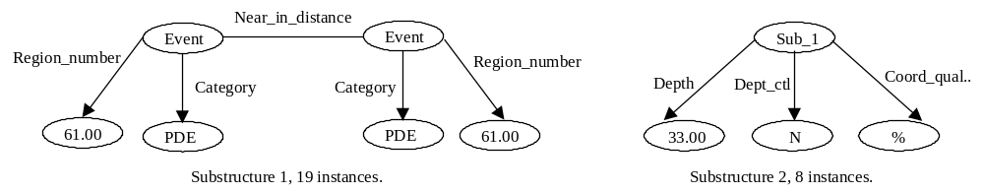
DETERMINING EARTHQUAKE ACTIVITY
Substructure 1 (with 19 instances) and substructure 2 (with 8 instances) found in sub-area 26.

Slide 30
DETERMINING EARTHQUAKE ACTIVITY
This pattern might give us information about the cause of the earthquakes.
Subduction also affects this area but it affects at a specific depth according to the closeness to the Pacific Ocean.

Slide 31
SUBDUE’S POTENTIAL
Subdue finds not only shared characteristics of events, but also space relations between them.
Dr. Burke Burkart is studying the patterns to give direction to this research.
Expect to find patterns representing parts of the paths of the involved fault.
Time relations not considered by Subdue.
  Earthquake’s characteristics.
  Important for other areas.

Slide 32
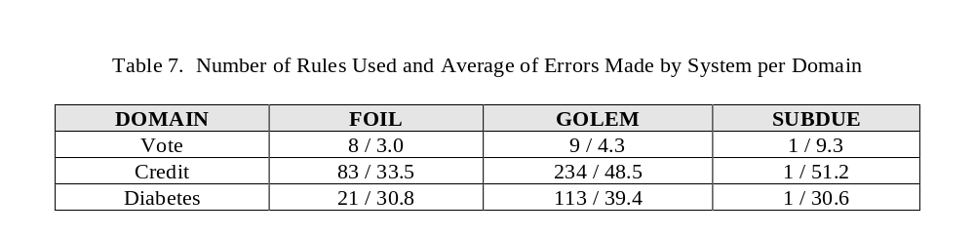
COMPARISON OF SUBDUE WITH ILP SYSTEMS
Inductive Logic Programming (ILP) learn logical relations.
FOIL, GOLEM, PROGOL.
SUBDUE competitive in several domains.

Slide 33
CONCEPT LEARNING SUBDUE
ILP systems take positive and negative examples represented with First Order Logic.
New Concept Learning Subdue (CLSubdue) does too.
Can learn multiple rules.
Evaluation is ongoing.

Slide 34
CONCLUSION
Subdue successful in real world databases.
Subdue discovered interesting patterns using the temporal and spatial relations.
Subdue found significant patterns in the Orizaba Fault Earthquake Database.
Subdue has potential to compete with ILP systems.
Subdue compared with Progol.

Slide 35
FUTURE WORK
Theoretical analysis.
  Show Subdue converges to optimal substructure.
  Better understanding of search space properties.
  Bounds on complexity (e.g. PAC learning).
Graphic User Interface to visualize substructures and their instances.
Express ranges of values (ranges of depth, magnitude, latitude, longitude, etc. in the Earthquake database).
Continue Evalutation in Real-World Spatio-Temporal Databases.

