Slide 1
Graph-based Learning and Discovery
Diane J. Cook
University of Texas at Arlington
cook@cse.uta.edu
http://www-cse.uta.edu/~cook

Slide 2

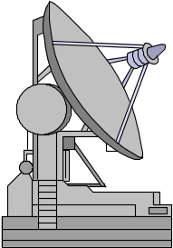
Data Mining
“The nontrivial extraction of implicit, previously unknown,
and potentially useful information from data” [Frawley et al., 92]
Increasing ability to generate data
Increasing ability to store data

Slide 3
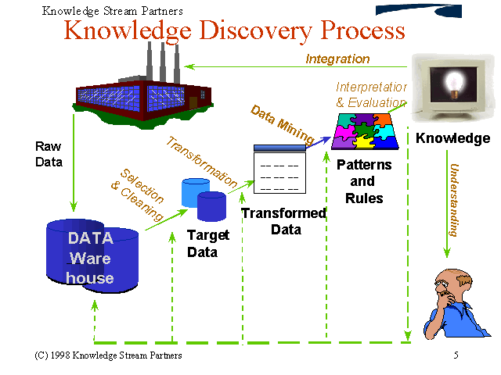
KDD Process
Notes:
Selection
Sampling
Remove redundancies
Remove noise
Transformation
Get to desired format
Heterogeneous distributed databases
Deal with missing data
feature selection
discretization
Data Mining
search for desired concept or pattern
Interpretation
Do diet drinks lead to obesity?

Slide 4
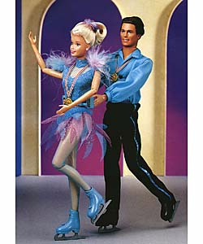
Approaches to Data Mining
Pattern extraction
Prediction / classification
Clustering
0.123
0.117
Debt
Loan
Debt<50
No
Loan
yes
no
Income
Income
Income
0.203
0.545
50-
100
50-
100
<50
>100
<50
>100
NO
YES
YES
NO
NO
YES

Slide 5
Substructure Discovery
Most data mining algorithms deal with linear attribute-value data
Need to represent and learn relationships between attributes

Slide 6

SUBDUE
Discovers repetitive substructure patterns in graph databases
Pattern extraction, classification, clustering
Serial and parallel / distributed versions
Applied to CAD circuits, telecom, DNA, and more
http://cygnus.uta.edu/subdue

Slide 7
Graph Representation
Input is a labeled graph
A substructure is connected subgraph
An instance of a substructure is a subgraph that is isomorphic to substructure definition
Input Database
Substructure S1
(graph form)
Compressed Database
T1
triangle
S1
C1
shape
S1
C1
R1
object
R1
on
square
S1
S1
S1
T2
T3
T4
shape
object
S2
S3
S4

Slide 8
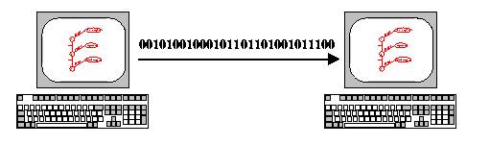
MDL Principle
Best theory minimizes description length of data
Evaluate substructure based ability to compress DL of graph
Description length = DL(S) + DL(G|S)

Slide 9
Algorithm
Create substructure for each unique vertex label
Substructures:
triangle (4), square (4),
circle (1), rectangle (1)
triangle
on
square
left
circle
on
rectangle
on
left
on
left
on
triangle
triangle
triangle
on
on
on
left
left
square
square
square

Slide 10
Algorithm
Expand best substructure by an edge or edge+neighboring vertex
Substructures:
triangle
triangle
on
on
square
left
circle
square
on
left
square
circle
rectangle
on
left
on
left
on
square
rectangle
triangle
triangle
triangle
on
on
on
on
on
triangle
left
left
rectangle
square
square
square

Slide 11
Algorithm
Keep only best substructures on queue (specified by beam width)
Terminate when queue is empty or #discovered substructures >= limit
Compress graph and repeat to generate hierarchical description
Note: polynomially constrained [IEEE Exp96]

Slide 12
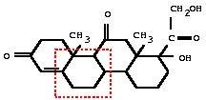
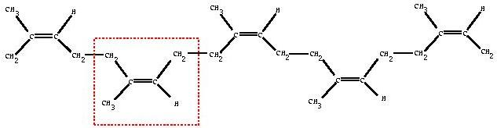
Examples [Jair94]

Slide 13
Inexact Graph Match [JIIS95]
Some variations may occur between instances
Want to abstract over minor differences
Difference = cost of transforming one graph to make it isomorphic to another
Match if cost/size < threshold

Slide 14
Inexact Graph Match
A
a
B
B
b
A
1
2
3
4
b
a
a
b
5
∅
B
(1,3) 1
(1,4) 0
(1,5) 1
(1,λ) 1
(2,4)
7
(2,5)
6
(2,λ)
10
(2,3)
3
(2,5)
6
(2,λ)
9
(2,3)
7
(2,4)
7
(2,λ)
10
(2,3)
9
(2,4)
10
(2,5)
9
(2,λ)
11
Least-cost match is {(1,4), (2,3)}

Slide 15
Background Knowledge [IEEE TKDE96]
Some substructures not relevant
Background knowledge can bias search
Two types
  Model knowledge
  Graph match rules

Slide 16
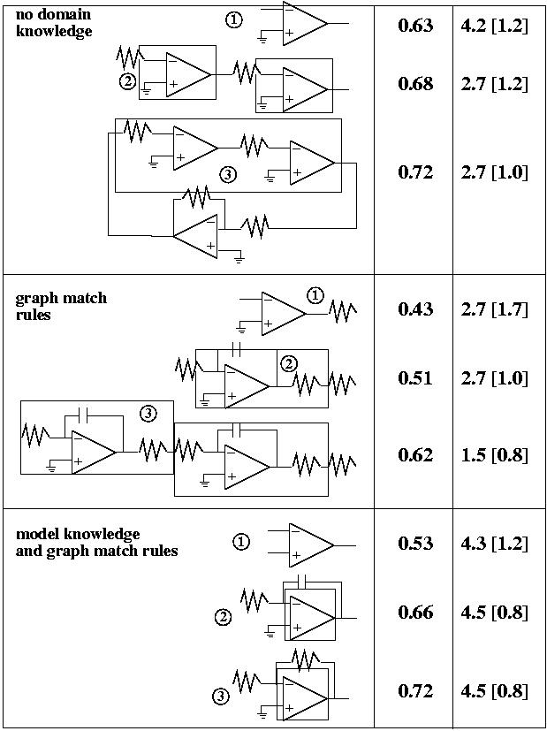
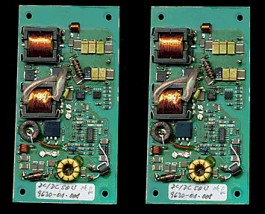

Slide 17
Parallel/distributed Subdue [JPDC00]
Scalability issues
Three approaches
  Dynamic partitioning
  Functional parallel
  Static partitioning

Slide 18
Dynamic Partitioning
Processor i stores ith vertex label
Each processor operates as in serial Subdue
Avoid replication by expanding to higher vertices
e1
v1
v2
e2
e2
v3
e2
v5
e3
e4
v4
v4

Slide 19
Dynamic Partitioning
Partitions are logical
Excessive processor idling and load balancing
Results very poor

Slide 20
Functional Parallel
Master processor controls search queue
Slaves evaluate and expand substructures
Synchronization after each step

Slide 21
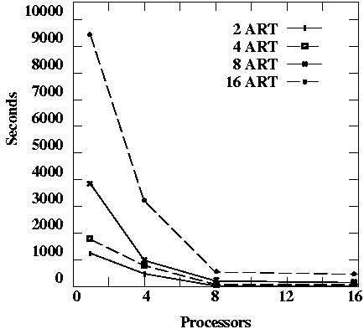
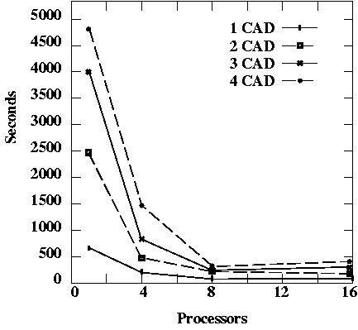
Functional Parallel Results
ART database: 1,000 vertices and 2,000 edges
CAD database: 8,441 vertices and 19,206 edges

Slide 22
Static Partitioning
Divide graph into P partitions, distribute to P processors
Each processor performs serial Subdue on local partition
Broadcast best substructures, evaluate on other processors
Master processor stores best global substructures

Slide 23
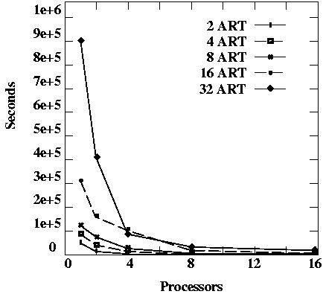
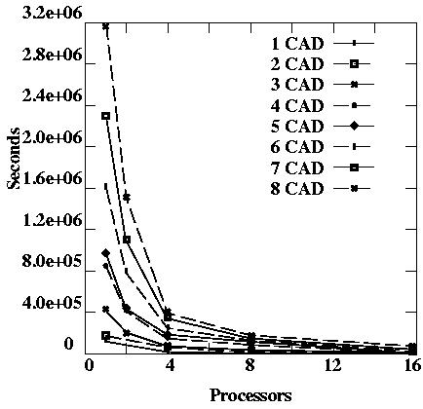
Static Partitioning Results
Close to linear speedup
Continue until #processors > #vertices

Slide 24
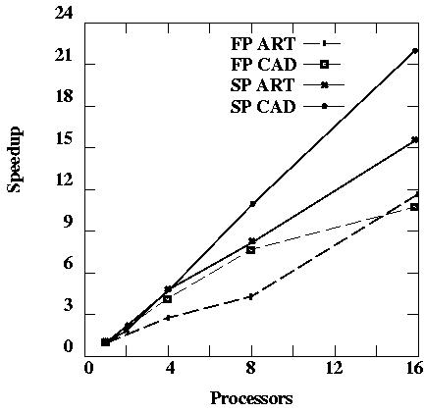
Speedup Comparison

Slide 25
Issues
When partition graph, lose information
Metis graph partitioning system
Quality of resulting substructures?
Recapture by overlap, multiple partitions
Evaluating more substructures globally

Slide 26
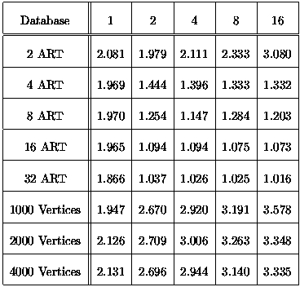
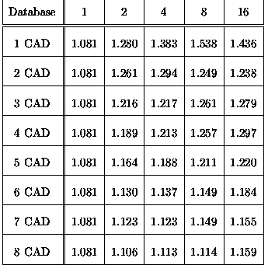
Compression Results

Slide 27
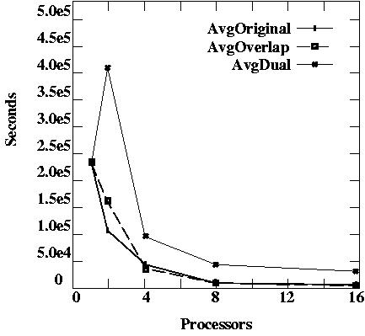
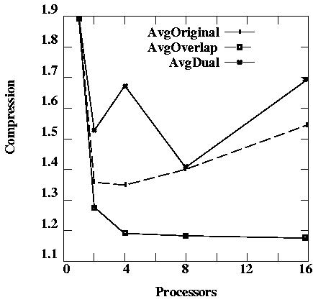
Recapture Lost Information
Allow overlap between partitions
Run twice with two partitions, max results

Slide 28
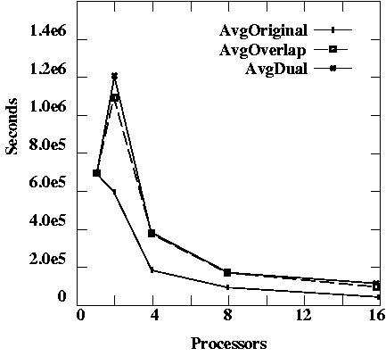
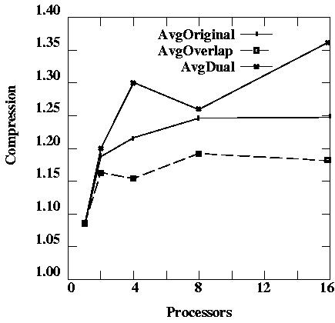
Recapture Lost Information

Slide 29
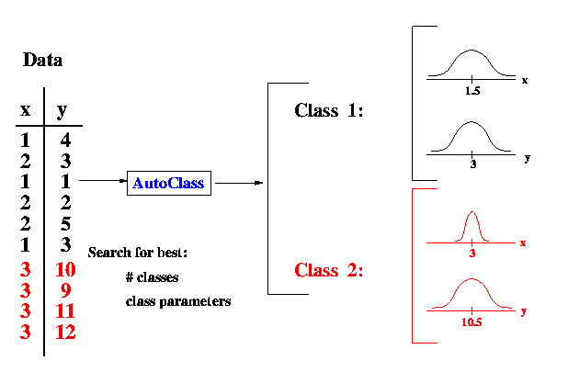
AutoClass
Linear representation
Fit possible probabilistic models to data
Satellite data, DNA data, Landsat data

Slide 30
SUBDUE/AutoClass Combined
linear features
Data
+
AutoClass
Classes
structural
features
structural
patterns
Subdue
+
= Combination of linear data or addition of linear features

Slide 31
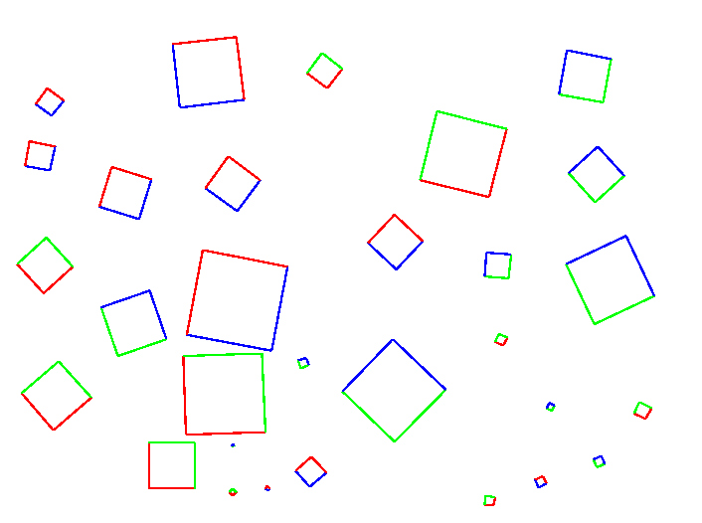
Example - 30 2-color squares
AutoClass Rep - tuple for each line (x1, y1, x2, y2, angle, length, color)
Add structure (neighboring edge information)
Subdue Rep - each line is node in graph, edges between connecting lines
Attributes from nodes

Slide 32
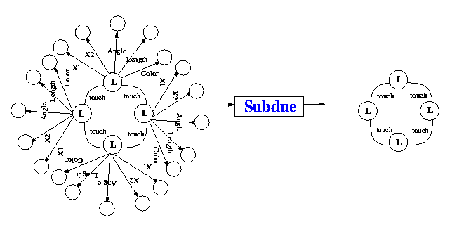
Results
AutoClass (12 classes)
Subdue (top substructure)
Class 0 (20): Color=green, LineNo=Line1=Line2=98 +/- 10
Class 1 (20): Color=red, LineNo=Line1=Line2=99 +/- 10
…
Class 11 (3): Line2=1 +/-13, Color=green

Slide 33
Combined Results
Combine 4 entries for each square into one
30 tuples (one for each square)
Discover
Class 0 (10): Color1=red, Color2=red,
Color3=green, Color4=green
Class 1 (10): Color1=green, Color2=green,
Color3=blue, Color4=blue
Class 2 (10): Color1=blue, Color2=blue,
Color3=red, Color4=red

Slide 34
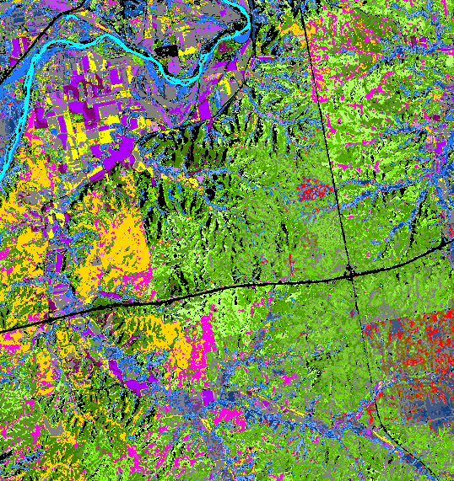
More Results

Slide 35
Supervised SUBDUE [IEEE IS00]
One graph stores positive examples
One graph stores negative examples
Find substructure that compresses positive graph but not negative graph

Slide 36
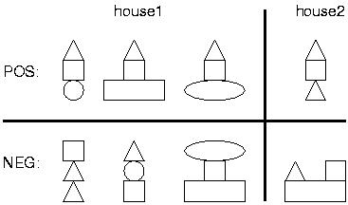
Example
object
shape
triangle
on
shape
object
square
on
object

Slide 37
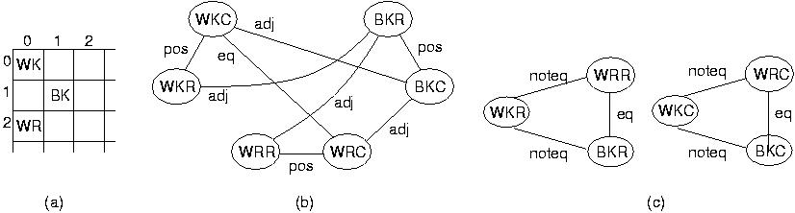
Results
Chess endgames (19,257 examples), BK is (+) or is not (-) in check
99.8% FOIL, 99.77% C4.5, 99.21% Subdue

Slide 38
More Results
Tic Tac Toe endgames
  + is win for X (958 examples)
  100% Subdue, 92.35% FOIL, 96.03% C4.5
Bach chorales
  Musical sequences (20 sequences)
  100% Subdue, 85.71% FOIL, 82.00% C4.5

Slide 39
Clustering Using SUBDUE
Iterate Subdue until single vertex
  Each cluster (substructure) inserted into a classification lattice
Early results similar to COBWEB [Fisher87]
Root

Slide 40
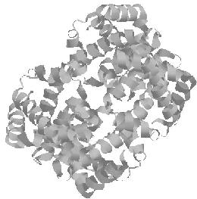
Discovery Application Domains
Biochemical domains
  Protein data [PSB99, IDA99]
  Human Genome DNA data
  Toxicology (cancer) data
Spatial-temporal domains
  Earthquake data
  Aircraft Safety and Reporting System
Telecommunications data
Program source code

Slide 41
Structured Web Search [AAAI-AIWS00]
Existing search engines use linear feature match
Subdue searches based on structure
Incorporation of WordNet allows for inexact feature match through synset path length
Technique
  Breadth-first search through domain to generate graph
  Nodes represent pages / documents
  Edges represent hyperlinks
  Additional nodes used to represent document keywords
  Pose query as graph
  Search for query match within domain graph

Slide 42
Sample Search
Instructor
Postscript
| PDF
http
http
Teaching
Robotics
Research
Robotics
Publication
Robotics

Slide 43
Query: Find all pages which link to a page containing term ‘subdue’
Subgraph vertices:
1 _page_
URL: http://cygnus.uta.edu
7 _page_
URL: http://cygnus.uta.edu/projects.html
Subdue
[1->7] hyperlink
[7->8] word
subdue
word
hyperlink
page
page
/* Vertex ID Label */
s
v 1 _page_
v 2 _page_
v 3 subdue
/* Edge Vertex 1 Vertex 2 Label */
d 1 2 _hyperlink_
d 2 3 _word_

Slide 44
Search for Presentation Pages
page
hyperlink
hyperlink
hyperlink
page
page
page
hyperlink
hyperlink
Subdue
  22 instances
AltaVista
  Query “host:www-cse.uta.edu AND image:next_motif.gif AND image:up_motif.gif AND image:previous_motif.gif.”
  12 instances

Slide 45
Search for Reference Pages
page
hyperlink
hyperlink
hyperlink
page
page
…
page
Search for page with at least 35 in links
  5 pages in www-cse
AltaVista cannot perform this type of search

Slide 46
Search for pages on ‘jobs in computer science’
Inexact match: allow one level of synonyms
Subdue found 33 matches
  Words include employment, work, job, problem, task
AltaVista found 2 matches
page
word
word
word
jobs
computer
science

Slide 47
Search for ‘authority’ hub and authority pages
page
page
page
HUBS
hyperlink
page
page
page
AUTHORITIES
word
word
word
algorithms
algorithms
algorithms
Subdue found 3 hub (and 3 authority) pages
AltaVista cannot perform this type of search
Inexact match applied with threshold = 0.2 (4.2 transformations allowed)
Subdue found 13 matches

Slide 48
Subdue Learning from Web Data
Distinguish professors’ and students’ web pages
  Learned concept (professors have “box” in address field)
Distinguish online stores and professors’ web pages
  Learned concept (stores have more levels in graph)
word
page
box
page
page
page
page
page
page
page

Slide 49
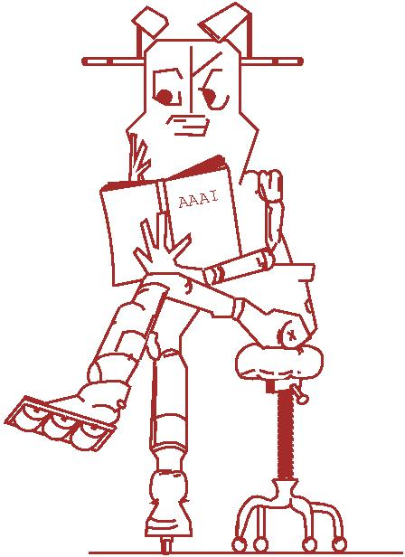
To Learn More
cygnus.uta.edu/subdue
cook@cse.uta.edu
http://www-cse.uta.edu/~cook

