Slide 1
Graph-Based Data Mining
Diane J. Cook
University of Texas at Arlington
cook@cse.uta.edu
http://www-cse.uta.edu/~cook

Slide 2
Substructure Discovery
Most data mining algorithms deal with linear attribute-value data
Need to represent and learn relationships between attributes

Slide 3

SUBDUE
Discovers repetitive substructure patterns in graph databases
Unsupervised or supervised data mining
Constrained to run in polynomial time
Serial and parallel / distributed versions
Applied to CAD circuits, chemical compounds, image analysis, Chinese characters, artificial databases, and more
Builds hierarchical model of structures
http://cygnus.uta.edu/subdue

Slide 4
SUBDUE KNOWLEDGE DISCOVERY SYSTEM
SUBDUE discovers patterns (substructures) in structural data sets
SUBDUE represents data as a labeled graph.
  Vertices represent objects or attributes
  Edges represent relationships between objects
  Input: Labeled graph
  Output: Discovered patterns and instances

Slide 5
Graph-Based Discovery
Finding “interesting” and repetitive substructures (connected subgraphs) in data represented as a graph
Input Database
Substructure S1
(graph form)
Compressed Database
T1
triangle
S1
C1
shape
S1
C1
R1
object
R1
on
square
S1
S1
S1
T2
T3
T4
shape
object
S2
S3
S4

Slide 6
Graph Representation
Input is a graph (labeled vertices and edges)
A substructure is connected subgraph
An instance of a substructure is a subgraph that is isomorphic to substructure definition
A graph can be compressed by replacing instances with a pointer to the substructure definition
Input Database
Substructure S1
(graph form)
Compressed Database
T1
triangle
S1
C1
shape
S1
C1
R1
object
R1
on
square
S1
S1
S1
T2
T3
T4
shape
object
S2
S3
S4

Slide 7
Overview of Subdue
Data mining in graph representations of structural databases
E
A
e
A
g
a
d
a
B
D
D
b
B
b
c
f
c
C
C
F

Slide 8
Overview of Subdue
Iteratively searching for best substructure by MDL heuristic
A
a
D
b
B
c
C

Slide 9
Overview of Subdue
Compress using best substructure
E
e
g
S
d
S
f
F

Slide 10
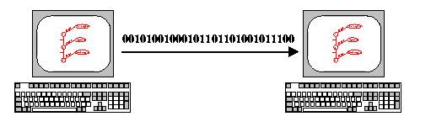
MDL Principle
Best theory minimizes description length of data
SUBDUE selects concepts that minimize graph MDL
Description length = DS(S) + DS(G|S)

Slide 11
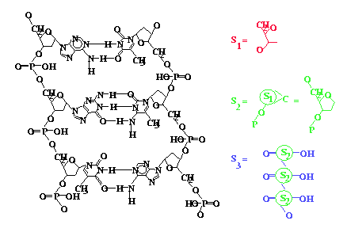
Hierarchical Description

Slide 12
Algorithm
Create substructure for each unique vertex label
Substructures:
triangle (4), square (4),
circle (1), rectangle (1)
triangle
on
square
left
circle
on
rectangle
on
left
on
left
on
triangle
triangle
triangle
on
on
on
left
left
square
square
square

Slide 13
Algorithm
Expand best substructure by an edge or edge+neighboring vertex
Substructures:
triangle
triangle
triangle
square
on
on
on
on
square
left
circle
square
on
square
left
square
left
circle
rectangle
on
left
on
left
on
square
rectangle
triangle
triangle
triangle
on
on
on
on
on
triangle
left
left
rectangle
square
square
square

Slide 14
Algorithm
Keep only best substructures on queue (specified by beam width)
Terminate when search queue is empty or when #discovered substructures >= limit
Compress graph and repeat to generate hierarchical description

Slide 15
Inexact Graph Match
Some variations may occur between instances
Noise, small differences
Want to abstract over minor differences
Difference = cost of transforming one graph to make it isomorphic to another
Vertex/edge addition, delete, label substitution
Match if cost/size < threshold

Slide 16
Inexact Graph Match
A
a
B
B
b
A
1
2
3
4
b
a
a
b
5
∅
B
(1,3) 1
(1,4) 0
(1,5) 1
(1,λ) 1
(2,4)
7
(2,5)
6
(2,λ)
10
(2,3)
3
(2,5)
6
(2,λ)
9
(2,3)
7
(2,4)
7
(2,λ)
10
(2,3)
9
(2,4)
10
(2,5)
9
(2,λ)
11
Least-cost match is {(1,4), (2,3)}

Slide 17
Background Knowledge
Some substructures not relevant
Background knowledge can direct search
Two types
  Model knowledge
  Graph match rules

Slide 18
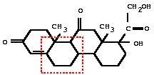
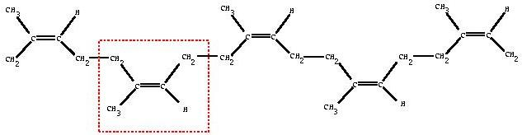
Early Results

Slide 19
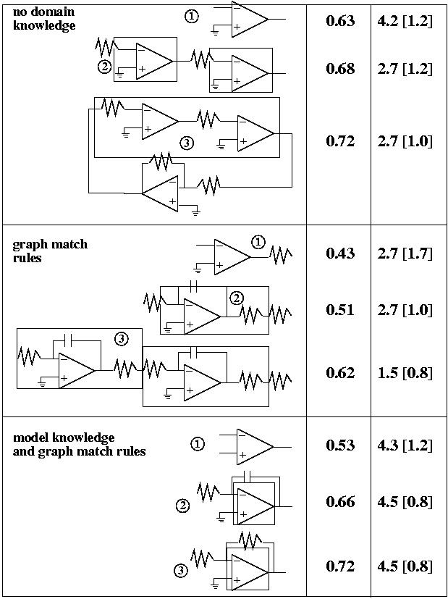

Slide 20
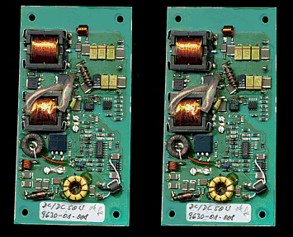
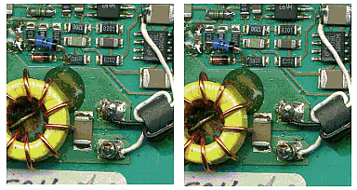
Early Results

Slide 21
Scalability
Serial Subdue not very scalable
Three approaches to parallel Subdue considered
  Dynamic Partitioning Approach
  Functional Parallel Approach
  Static Partitioning Approach
Subdue
Subdue
Subdue

Slide 22
Static Partitioning
Partition input graph into P partitions, distribute to P processors
Each processor performs serial Subdue on local partition
Share local results to compute global value
Master processor stores best global substructures

Slide 23
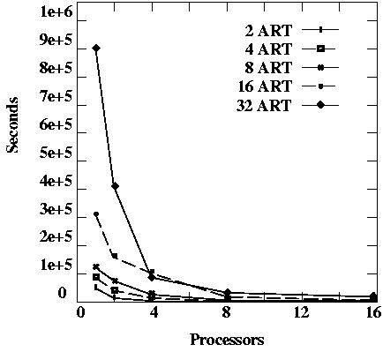
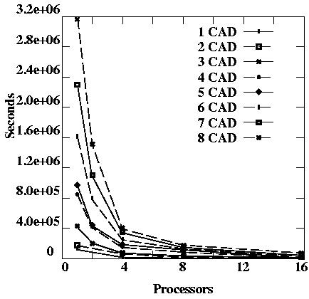
Static Partitioning Results
Close to linear speedup
Continue until #processors > #vertices

Slide 24
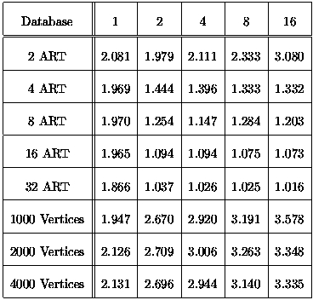
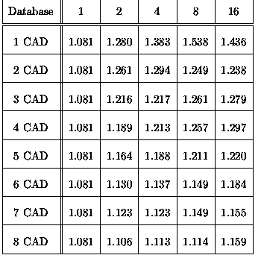
Compression Results

Slide 25
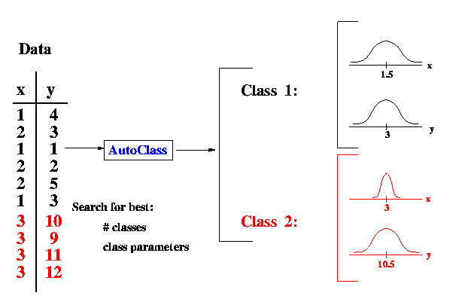
AutoClass
Linear representation
Fit possible probabilistic models to data
Satellite data, DNA data, Landsat data

Slide 26
SUBDUE/AutoClass Combined
linear features
Data
+
AutoClass
Classes
structural
features
structural
patterns
Subdue
+
= Combination of linear data or addition of linear features

Slide 27
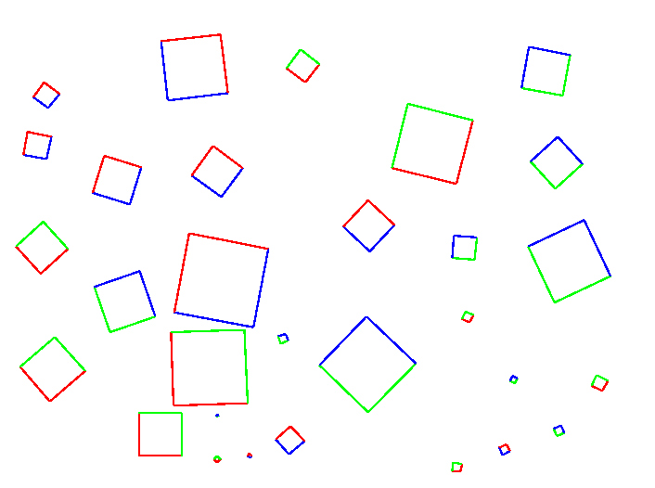
Example - 30 2-color squares
AutoClass Rep - tuple for each line (x1, y1, x2, y2, angle, length, color)
Add structure (neighboring edge information - lineto1, lineto2)
Subdue Rep - each line is node in graph, edges between connecting lines
Attributes hang from nodes

Slide 28
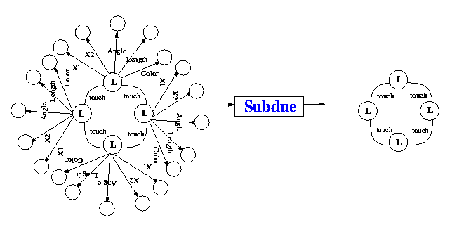
Results
AutoClass (12 classes)
Subdue (top substructure)
Class 0 (20): Color=green, LineNo=Line1=Line2=98 +/- 10
Class 1 (20): Color=red, LineNo=Line1=Line2=99 +/- 10
…
Class 11 (3): Line2=1 +/-13, Color=green

Slide 29
Combined Results
Combine 4 entries for each square into one
30 tuples (one for each square)
Discover
Class 0 (10): Color1=red, Color2=red,
Color3=green, Color4=green
Class 1 (10): Color1=green, Color2=green,
Color3=blue, Color4=blue
Class 2 (10): Color1=blue, Color2=blue,
Color3=red, Color4=red

Slide 30
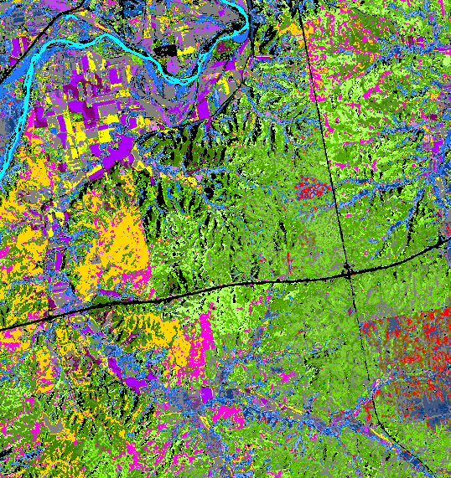
More Results

Slide 31
Supervised SUBDUE
One graph stores positive examples
One graph stores negative examples
Find substructure that compresses positive graph but not negative graph

Slide 32
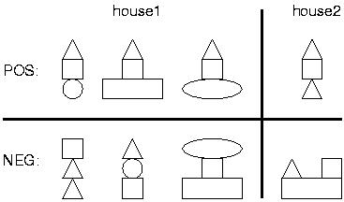
Example
object
shape
triangle
on
shape
object
square
on
object

Slide 33
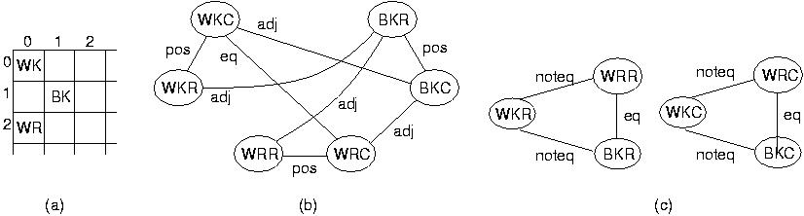
Results
Chess endgames (19,257 examples), BK is (+) or is not (-) in check
99.8% (0.19) FOIL, 99.77% (0.23) C4.5, 99.21% Subdue

Slide 34
More Results
Tic Tac Toe endgames
  End configurations (958 examples), + is win for X
  100% Subdue, 92.35% (0.21) FOIL, 96.03% (0.03) C4.5
Bach chorales
  Musical sequences (20 sequences)
  100% Subdue, 85.71% (0.06) FOIL, 82.00% (0.00) C4.5

Slide 35
Clustering Using SUBDUE
Iterate Subdue until single vertex
Each cluster (substructure) inserted into a classification lattice
Root

Slide 36
Structured Web Search
Existing search engines use linear feature match
Subdue searches based on structure
Incorporation of WordNet allows for inexact feature match
Instructor
Postscript
| PDF
http
http
Teaching
Robotics
Research
Robotics
Publication
Robotics

Slide 37
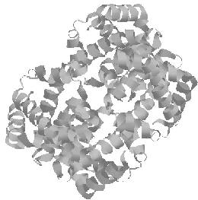
Ongoing Work
Biochemical domains
  Protein data [PSB99]
  Human Genome DNA data
  Toxicology (cancer) data
Spatial-temporal domains
  Earthquake data
  Aircraft Safety and Reporting System
Web link data
Telecommunications data
Program source code
Notes:
Primary structure from SEQRES (sequence of residues)
each amino acid in sequence is graph vertex
vertex numbers increase in sequence order, label is name of acid
edge labeled “bond” between adjacent amino acids
Secondary structure vertices for each helix and strand with
type, length, orientation in label
each amino acid alpha-carbon represented as vertex
if distance between two alpha-carbons < 4 angstroms, connected with
“very short” edge, 4-6, “short” edge, >6, no edge
Patterns identified unique to each class of protein
hemoglobin, myoglobin, and ribunuclease A
Brazma study of yeast gene start sites, clustered into groups
based on similar gene expression profiles
Each cluster likely to be involved in related cellular processes
Supervised Subdue, backbone representation, found possibly
undiscovered yeast transcription factor binding site

Slide 38

For More Information
http://cygnus.uta.edu
cook@cse.uta.edu
http://www-cse.uta.edu/~cook

