Slide 1

Mining Patterns in Source Code using
Tree Mining Algorithms
Hoang Son Pham, Siegfried Nijssen, Kim Mens,
Dario Di Nucci, Tim Molderez, Coen De Roover,
Johan Fabry, and Vadim Zaytsev
22nd International Conference on Discovery Science
SPLIT, CROATIA, OCTOBER 28-30, 2019

Slide 2
Outline
Introduction
Frequent tree mining
Constraint-based tree mining
Empirical Evaluation
Conclusion and future work

Slide 3
Introduction
Many design and code conventions get encoded in source code: coding idioms, usage protocols
Software engineers can obtain valuable information from these regularities
These regularities can be useful to build intelligent support systems to support maintain and develop big software projects

Slide 4
Examples of patterns in source code
Programming language structures, i.e., for-statement, if-statement
for (Figure figure : selectedFigures) {
…
}
protected void updateEnabledState() {
if (getView() != null) {
setEnabled(...);
} else {
setEnabled(false);
}
}

Slide 5
Usage protocols: A set of methods implemented on several classes
UndoableEdit edit = new AbstractUndoableEdit() {
@Override
public String getPresentationName() {
...
}
@Override
public void undo() {
super.undo();
...
}
@Override
public void redo() {
super.redo();
...
}
};

Slide 6
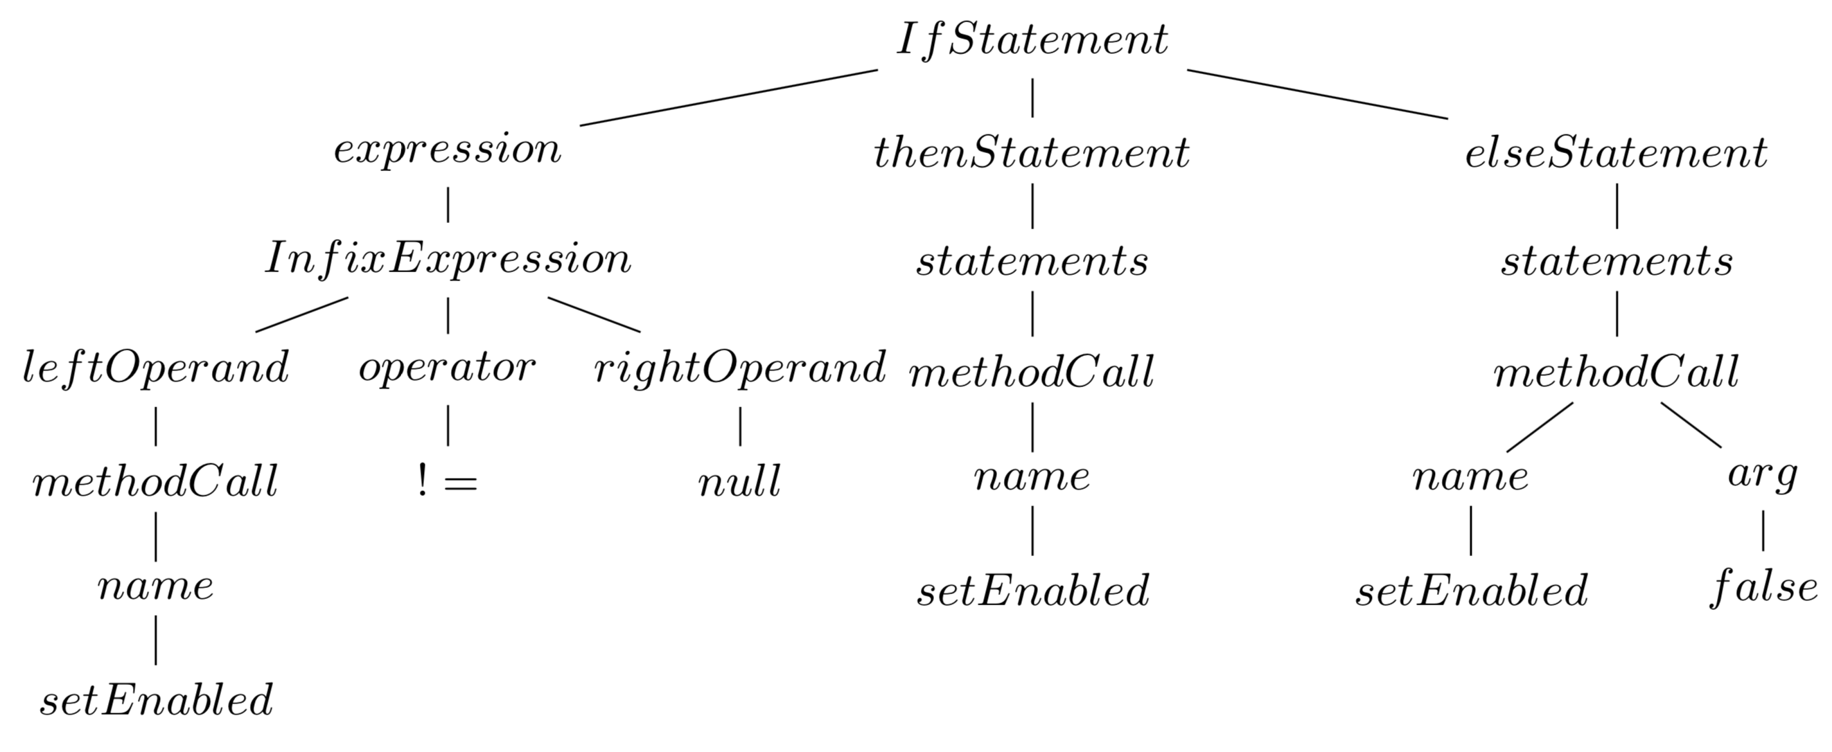
Source code patterns
Source code are represented by Abstract Syntax Trees (ASTs)
Source code patterns correspond to fragments of trees that occur frequently
Discover source code patterns by using frequent tree mining algorithms
Source code pattern
protected void updateEnabledState() {
if (getView() != null) {
setEnabled(...);
} else {
setEnabled(false);
}
}
Tree representation

Slide 7
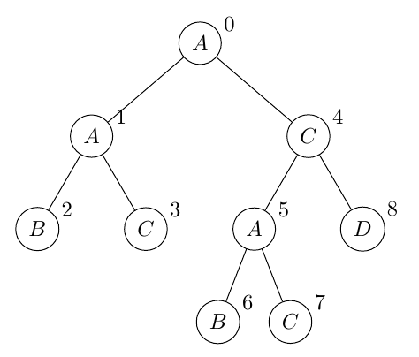
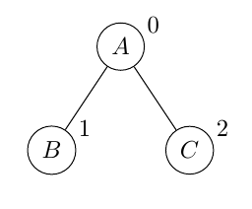
Frequent tree mining
Tree data: labeled, ordered, rooted trees
Matching ordered tree: induced subtree
Support of subtree: the number of trees in a database in which the subtree occurs
Frequent tree mining: discover all frequent subtrees in a given tree data.
Tree data
Induced subtree

Slide 8
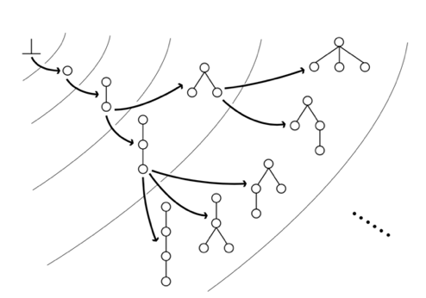
FREQT algorithm
Search patterns: depth-first search
Grow patterns: rightmost path extension
Prune: minimum support
Problem:
- does not scale for source code mining
- produces a large amount of useless patterns

Slide 9
Alternative tree mining approaches
Constraint-based pattern mining approaches
Condensed representations, e.g., closed, maximal frequent tree mining
Statistically motivated pattern set mining approaches
Notes:
Among these, constraint-based data mining approaches are of particular interest, as they allow developers to specify easy to interpret constraints on the patterns to include in the output of the algorithm, and are guaranteed to find all patterns satisfying the constraints, contrary to sampling based approaches
However, applying constraint-based data mining and condensed representations on the ASTs of software repositories is not straightforward. While frequent pattern mining has been studied extensively in the frequent tree mining literature, constraint-based tree mining algorithms did not receive a similar attention

Slide 10
Proposed approach
Novel constraint-based tree mining algorithm, specifically designed for the analysis of software repositories.
It combines two ideas:
(i) maximal frequent subtree mining to ensure that a condensed representation of only large patterns is found,
(ii) constraint-based data mining, in which additional constraints are imposed on the patterns to be found.
Notes:
In this paper, we therefore propose a novel constraint-based tree mining algorithm, specifically designed for the analysis of software repositories.
It combines two ideas:
(i) maximal frequent subtree mining to ensure that a condensed representation of only large patterns is found,
(ii) constraint-based data mining, in which additional constraints are imposed on the patterns to be found.
Our approach is based on the addition of a number of novel constraints to the FREQT algorithm, combined with a new approach to find maximal subtrees.

Slide 11
Interesting source code patterns
Reflect structure of programming language
The total number of nodes/leafs in a pattern is sufficiently large

Slide 12
Constraint-based tree mining
1: Constraints on size and minimum support
  C0: minimum support
  C1: maximum size of the pattern
  C2: minimum size of the pattern
2: Constraints on labels
  C3: limit the set of labels allowed to occur in the root of patterns
  C4: provide labels forbidden from occurring in the pattern
  C5: limit the number of siblings in a pattern that can have the same label

Slide 13
Constraint-based tree mining
3: Constraint on leafs
  C6: All leaf nodes in a pattern must have a label that is included in leafs of data
4: Obligatory children
  C7: do not allow to produce patterns that missing mandatory labels
  Mandatory labels: children’s labels of a node which are always presented in the ASTs.

Slide 14
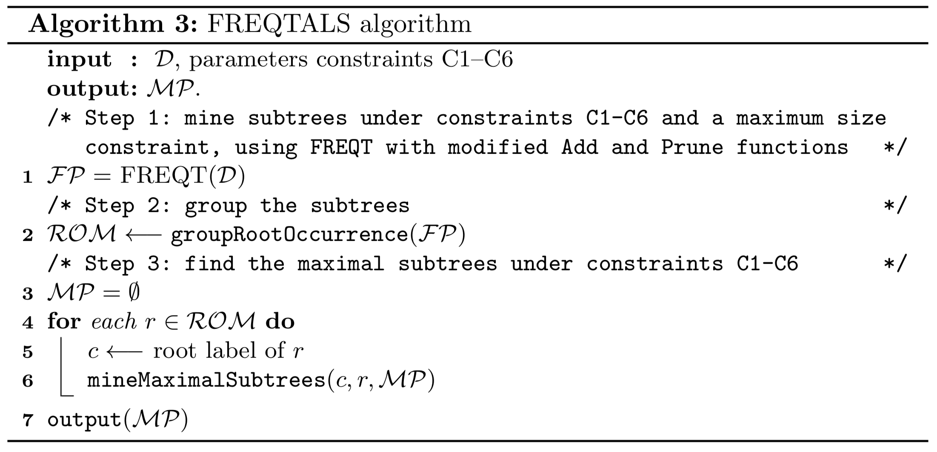
Constraint-based maximal tree mining algorithm

Slide 15
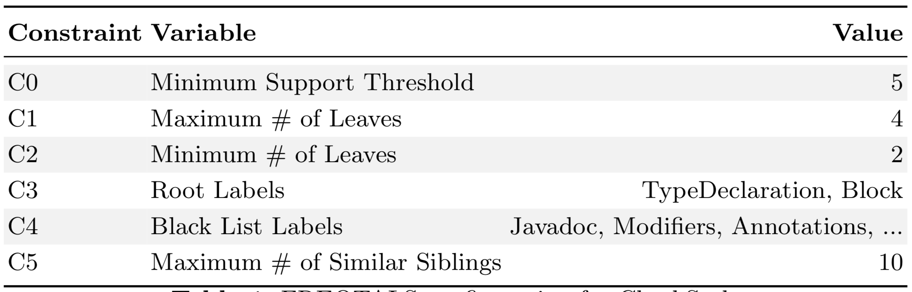
Empirical evaluation
Dataset: CheckStyle project, Java source code, includes 270 classes
Configurations:

Slide 16
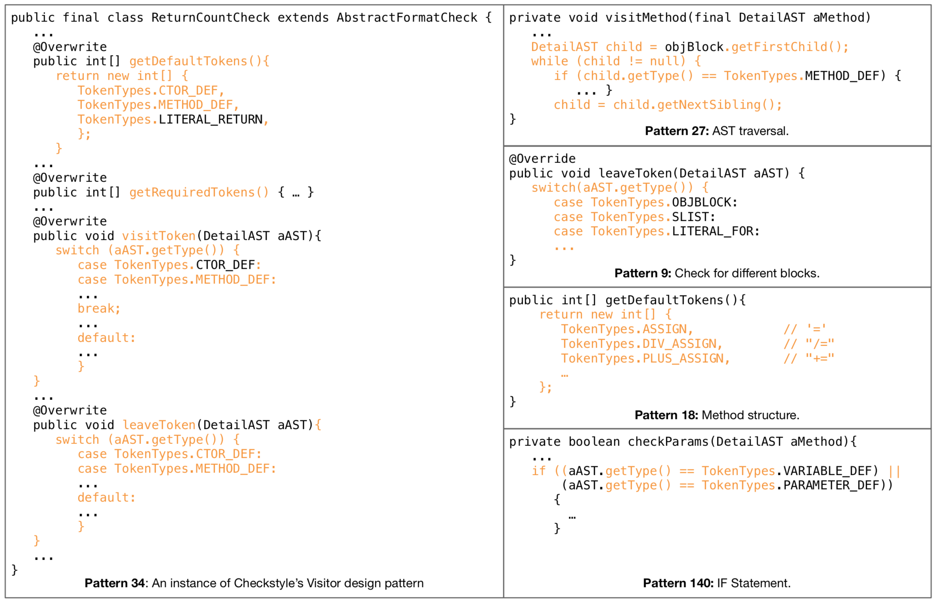
Qualitative Analysis

Slide 17
Quantitative Analysis

Slide 18
Compare to the original FREQT algorithm
Algorithm | Frequent Patterns | Running time
FREQTALS with extensions | 1,288 | 23 seconds
Original FREQT with minsup constraint | 717,859 | Timeout (60 minutes)
Note: due to the running time, the minsup (C0) is set to 8 which is higher than the minsup used in previous configuration

Slide 19
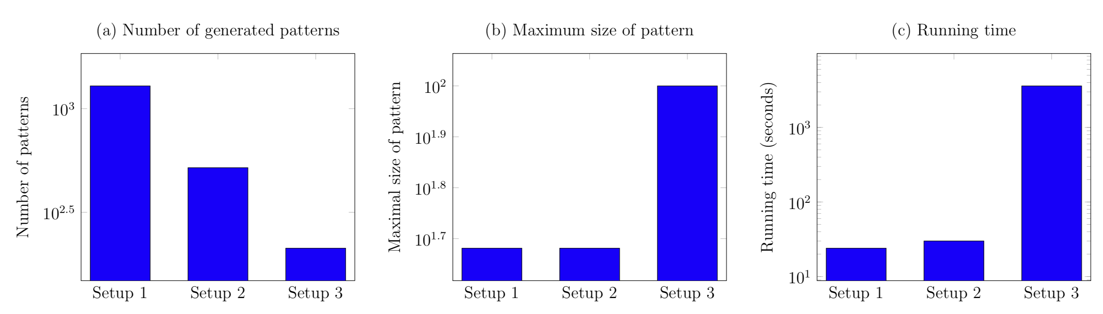
Evaluate the extensions of FREQTALS
Setup 1: applies only step 1, with a maximal size constraint
Setup 2: filters maximal patterns from result of step 1
Setup 3: applies all steps to find maximal patterns without maximal size constraint

Slide 20
Conclusion
Contributions of FREQTALS algorithm:
  the discovered patterns highlight relevant code regularities;
  the patterns found are significantly larger;
  amount of output patterns are significantly smaller for the same minSup;
  the configurations are easily adapted for other programming languages.

Slide 21
Future work
Employ FREQTALS on legacy programming languages, e.g., COBOL;
Explore more details of the quality of patterns;
Improve the scalability;
Define guidelines to setup configurations.

Slide 22
Thank for your attention!

