Slide 1

Mining Patterns in Source Code using
Tree Mining Algorithms
Hoang Son Pham, Siegfried Nijssen, Kim Mens,
Dario Di Nucci, Tim Molderez, Coen De Roover,
Johan Fabry, and Vadim Zaytsev
22nd International Conference on Discovery Science
SPLIT, CROATIA, OCTOBER 28-30, 2019

Slide 2
Outline
Introduction
Frequent tree mining
Constraint-based maximal tree mining
Empirical evaluation
Conclusion and future work

Slide 3
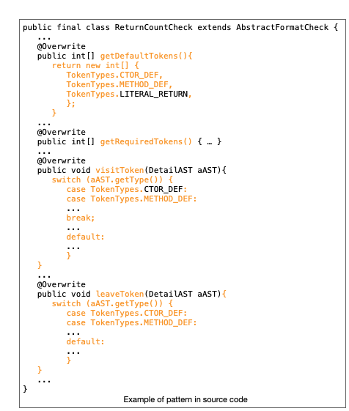
Introduction
Discovering source code patterns: coding idioms, usage protocols
Source code patterns can be used to build intelligent systems to support maintaining and developing big software projects

Slide 4
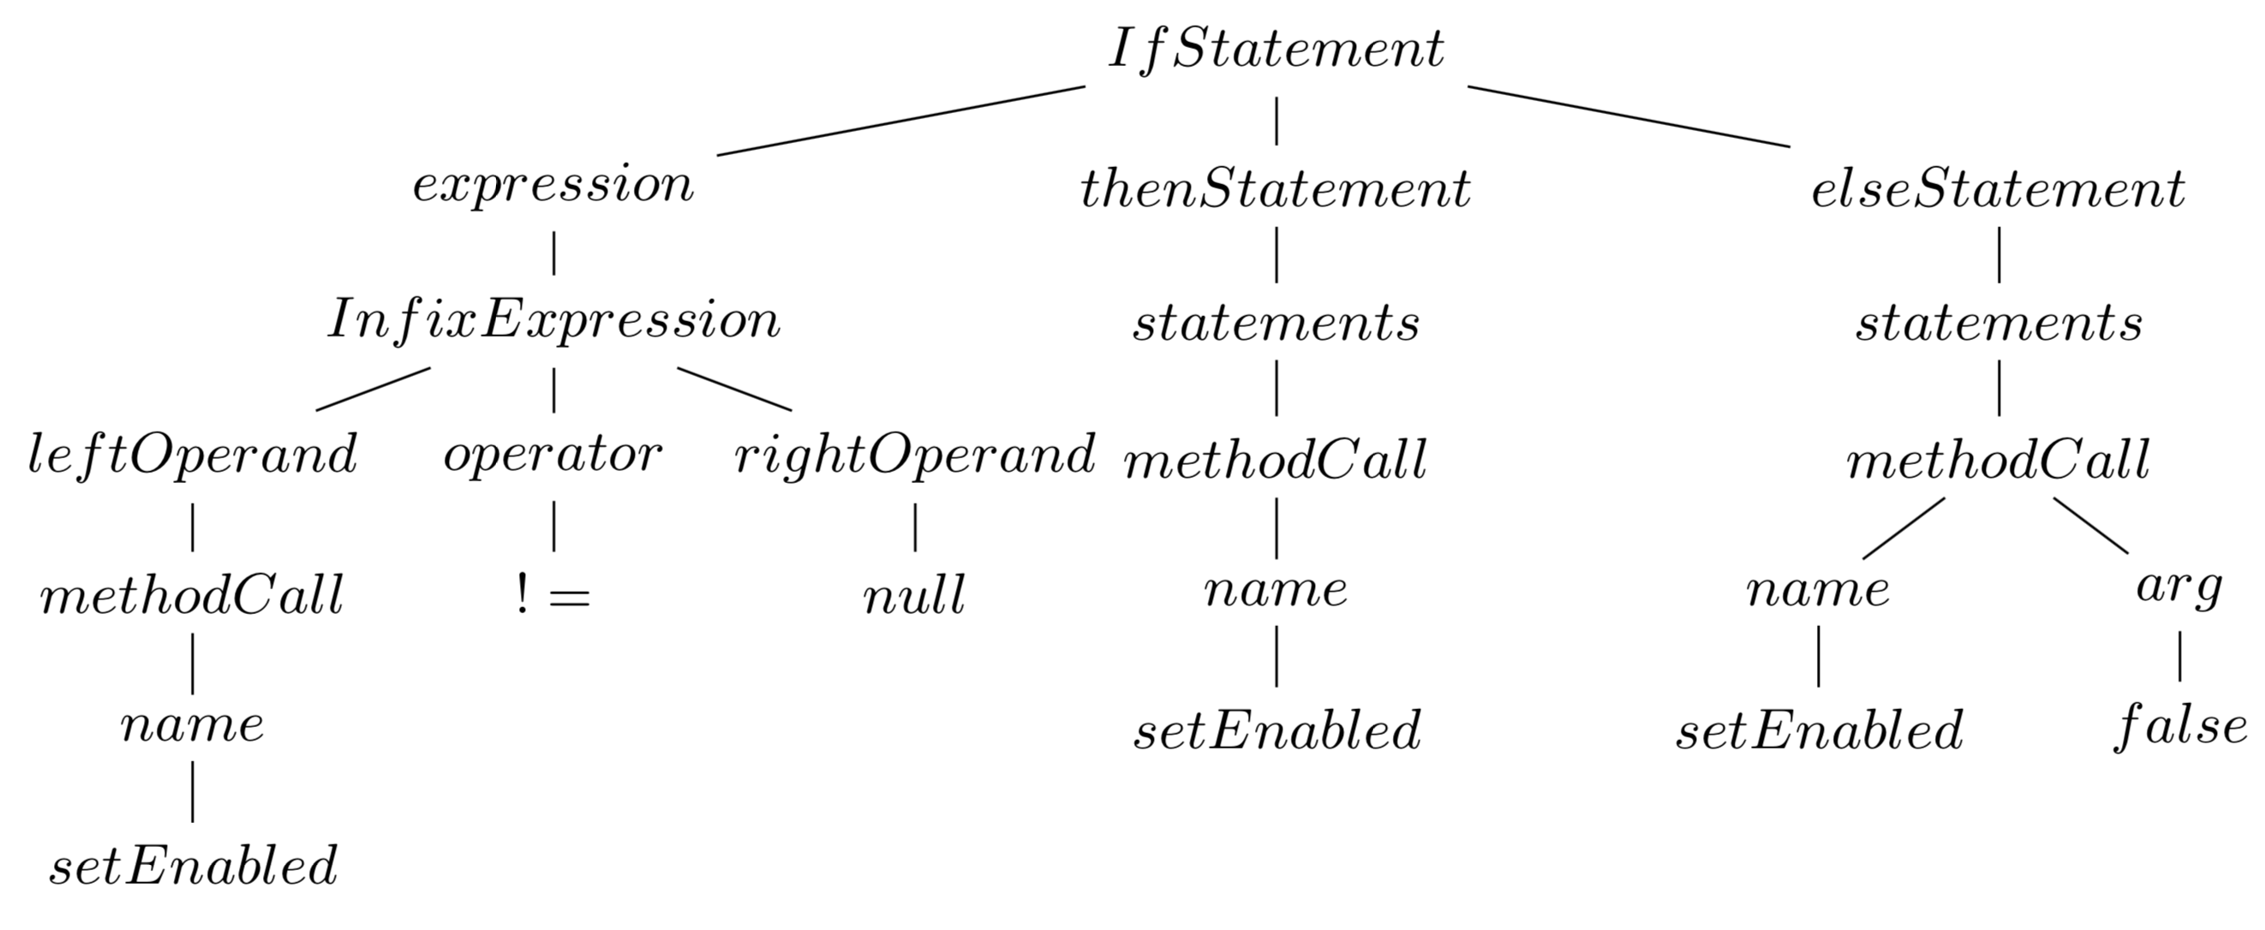
Source code patterns
Source code pattern
protected void updateEnabledState() {
if (getView() != null) {
setEnabled(...);
} else {
setEnabled(false);
}
}
Source code are represented by Abstract Syntax Trees (ASTs)
Source code patterns correspond to fragments that occur frequently
Discover source code patterns: frequent tree mining algorithms
Tree representation

Slide 5
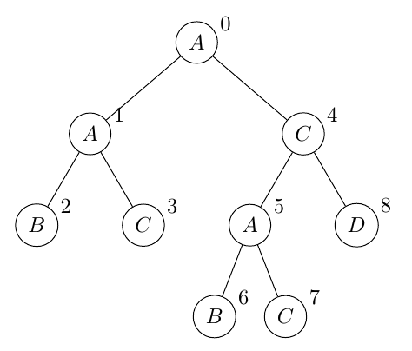
Frequent tree mining
Ordered, rooted tree mining
  FREQT, a depth-first search tree mining algorithm
  Limitation: finds large numbers of patterns
Other approaches:
  Constraint-based pattern mining
  Condensed representations, e.g., closed, maximal frequent tree mining
  Statistically motivated pattern set mining
  → not designed to work on ASTs
Example of ordered, rooted tree

Slide 6
Our proposal
Novel constraint-based tree mining algorithm, specifically designed for the analysis of code repositories
Our approach based on FREQT with these extensions:
(i) constraint-based data mining, in which additional constraints are imposed on the patterns to be found
(ii) maximal frequent subtree mining to ensure that a condensed representation of only large patterns is found

Slide 7
Interesting source code patterns
Reflect structure of programming language
Total number of nodes/leafs in a pattern sufficiently large
AST representation of if-statement

Slide 8
Proposed constraints
C0: minimum support
C1: maximum size of the pattern
C2: minimum size of the pattern
C3: limit the set of labels allowed to occur in the root of patterns
C4: provide labels forbidden from occurring in the pattern
C5: limit the number of siblings in a pattern that can have the same label
C6: all leaf nodes in a pattern must have a label that is included in leafs of data
C7: do not allow to produce patterns that missing mandatory labels

Slide 9
Constraint-based maximal tree mining algorithm
FREQTALS algorithm
input: tree data D, constraints C0-C5
output: a set of maximal patterns
Step 1: using modified FREQT to find frequent patterns under the given constraints
Step 2: growing the patterns found under constraint as large as possible, and return the maximal patterns among these large patterns

Slide 10
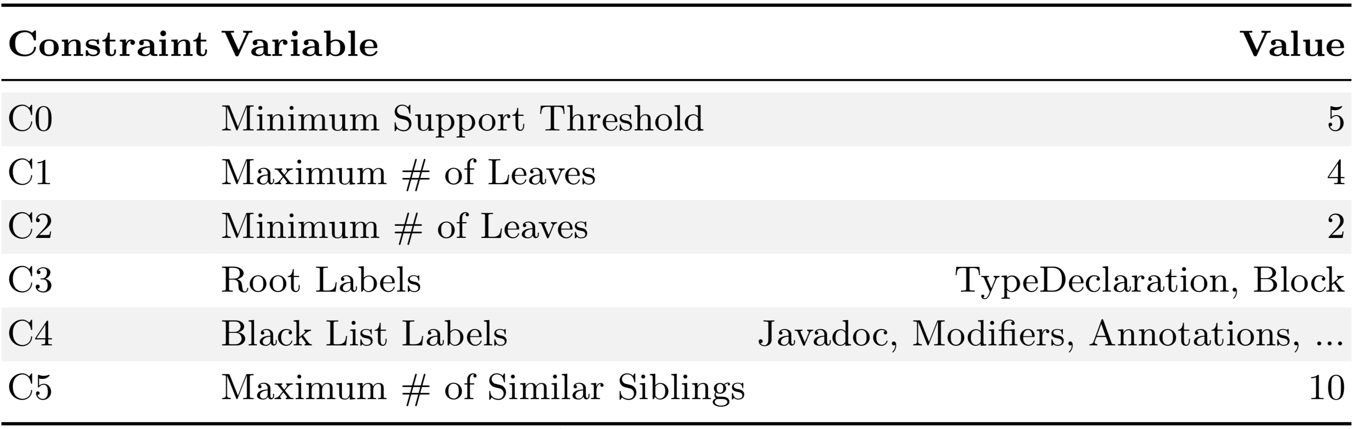
Empirical evaluation
Dataset:
Programming language: Java
Project: CheckStyle (including 270 classes)
Configurations:

Slide 11
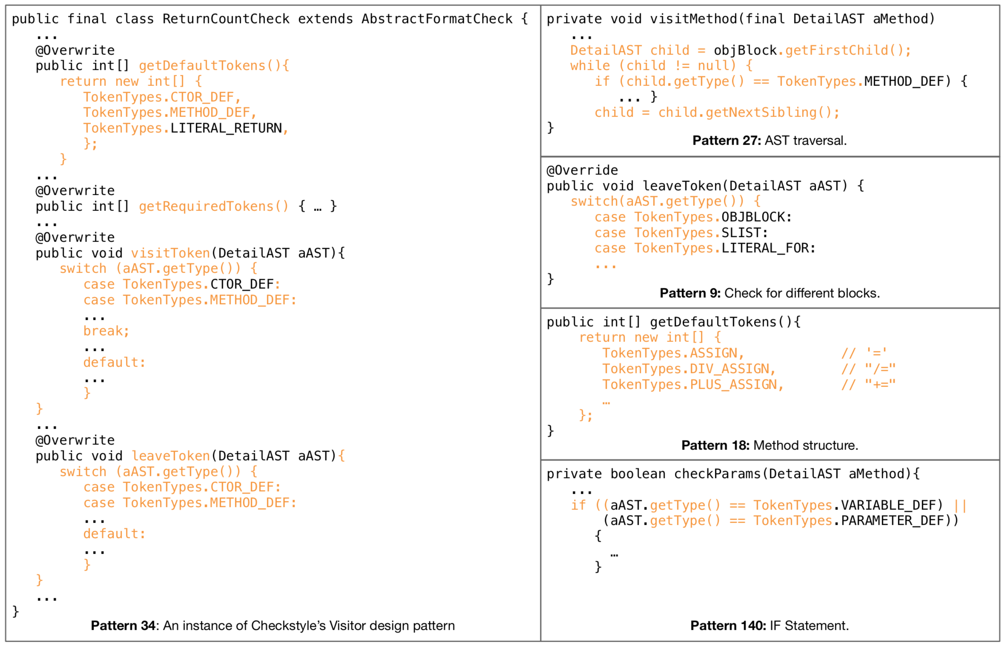
Qualitative Analysis

Slide 12
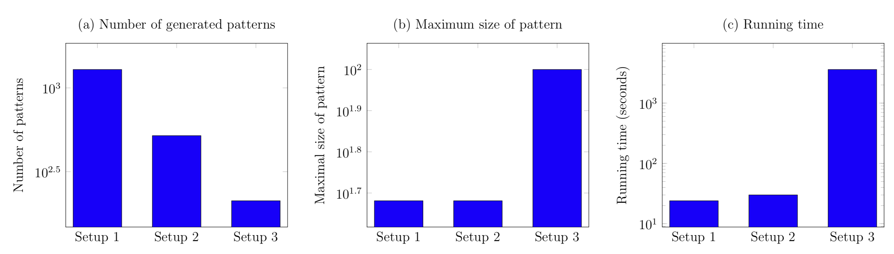
Quantitative analysis
1. Compare to the original FREQT algorithm
FREQTALS : 1,288 patterns in 23 seconds
Original FREQT : 717,859 patterns in 60 minutes
2. Evaluate the extensions of FREQTALS

Slide 13
Conclusion and Future work
Conclusion:
discovered patterns highlight relevant code regularities
patterns found are significantly larger
amount of output patterns is significantly smaller
configurations are easily adapted to other programming languages
Future work:
employ FREQTALS on legacy programming languages, e.g., COBOL
explore more details of the quality of patterns
improve the scalability
define guidelines to setup configurations

Slide 14
Thank for your attention!

